Slide 1

Intelligent Replay Sampling for Lifelong Object Recognition
Vidit Goel¹, Debdoot Sheet¹, Somesh Kumar²
Department of Electrical Engineering 2. Department of Mathematics
Indian Institute of Technology Kharagpur, India

Slide 2
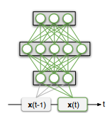
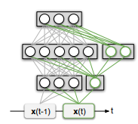
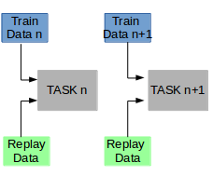
Different Approaches for CL
Regularization approaches
Dynamic Architectures
Replay Based methods
source

Slide 3
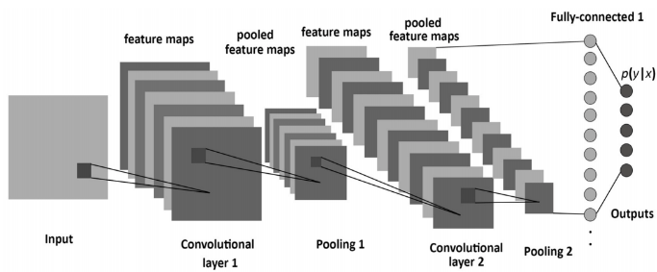
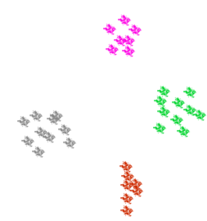
Intuition behind method
Different colors represent different classes

Slide 4
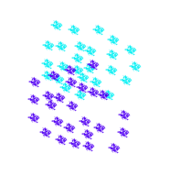
Intuition behind method
Task 1
Task 2
Representation of same class from two different tasks

Slide 5
Method
Train Task n-1
Train Task n
Train Task n+1
V_{n-2} ,BAcc _{n-2}
V_{n-1} , BAcc_{n-1}
V_{n}
BAcc_{n} is best accuracy for validation data of task n
V_{n} is validation data for task n
Architecture - MobileNetV2
Update BAcc_{n}
Flush replay data
Calculate acc on V_{i} i < n
Choose replay data from batches of V_{i} whose acc dropped most, where i < n.
Replay Data

Slide 6
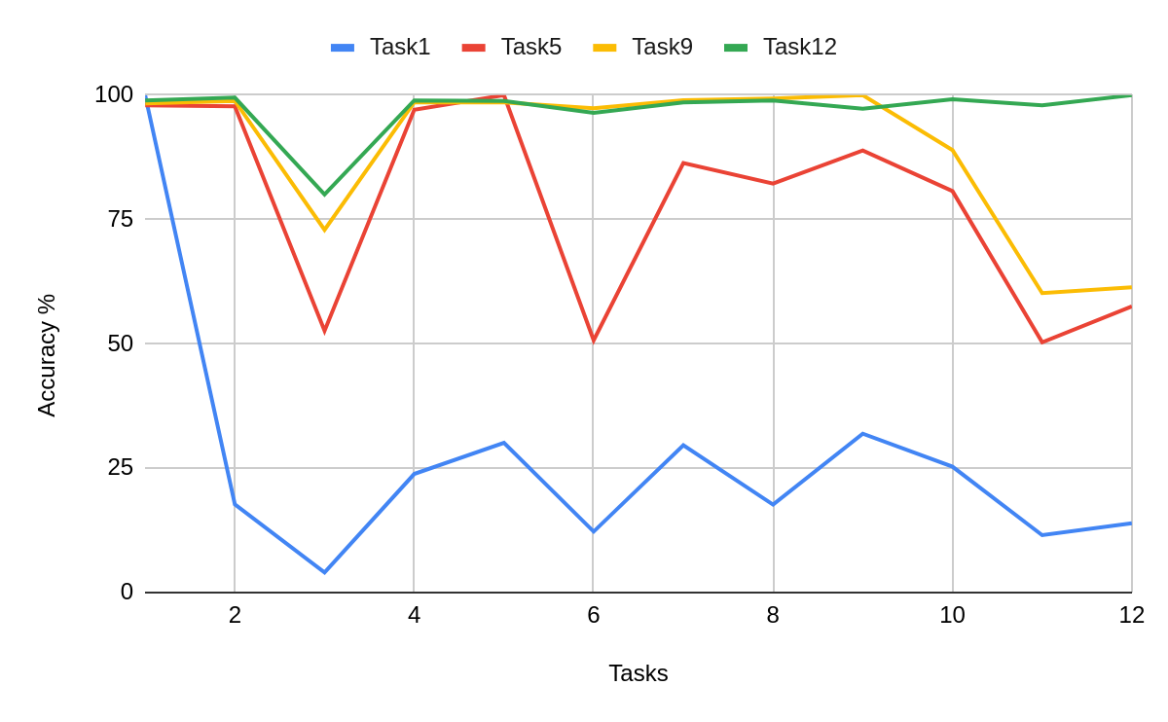
Result
Accuracy after task 12
1 | 98.942
2 | 99.527
3 | 80.04
4 | 98.94
5 | 98.85
6 | 96.44
7 | 98.56
8 | 98.94
9 | 97.26
10 | 99.16
11 | 97.95
12 | 100
Mean: 97.05%

Slide 7
Conclusion & Applications
Method is independent of architecture
Easy to implement
The proposed method can be used in autonomous driving vehicles.
With advances in computational power object detection is made available in cell phone cameras as well. The proposed algorithm can be of great use over there.
Useful in assistant robots at home which use object recognition.

Slide 8
Thank You

