Slide 1

Lifelong Object Recognition using Regularization and Data Augmentation
Duvindu Piyasena, Sathursan Kanagarajah, Siew-Kei Lam and Meiqing Wu

Slide 2
Outline
Problem Statement
Methodology
Training Configurations
Experimental Results
Conclusion

Slide 3
Problem Statement
Perform Lifelong Learning, when faced with difficulty-incremental learning scenario, with changing environmental conditions
Objectives
Efficiently retain previous knowledge
Leverage previous knowledge to generalize to new tasks when continuously learning under difficulty-incremental environmental conditions such as illumination, occlusion, clutter, pose, etc.
Challenges
Catastrophic interference
Data imbalance

Slide 4
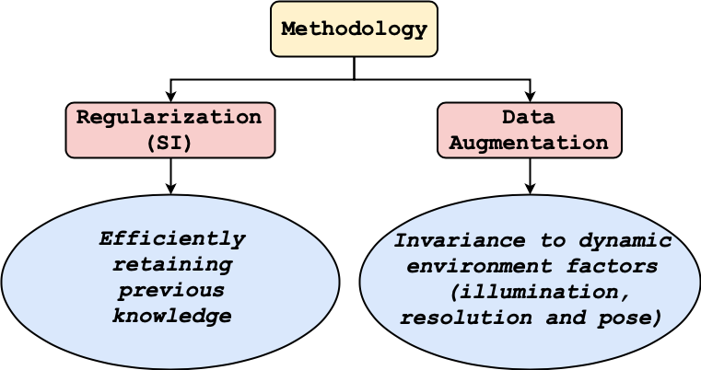
Methodology
The proposed method uses
Regularization based approach to efficiently retain previous knowledge
Data augmentation to tackle data imbalance and invariance to dynamic environment factors

Slide 5
Regularization based Lifelong Learning
Regularization based Lifelong Learning can be broadly categorized under
Protecting parameters important for old tasks
EwC (J. Kirkpatrick, et al. 2016)
SI (F. Zenke, et al., 2017)
Knowledge Distillation
LwF (Z. Li et al 2016)

Slide 6
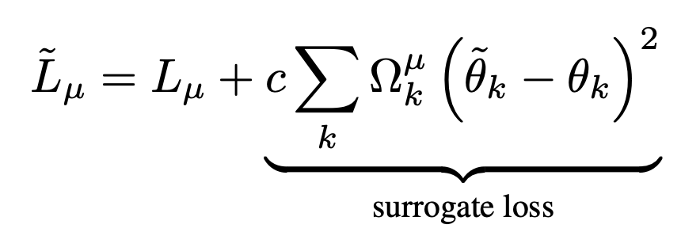
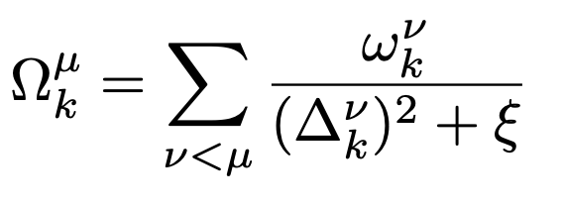
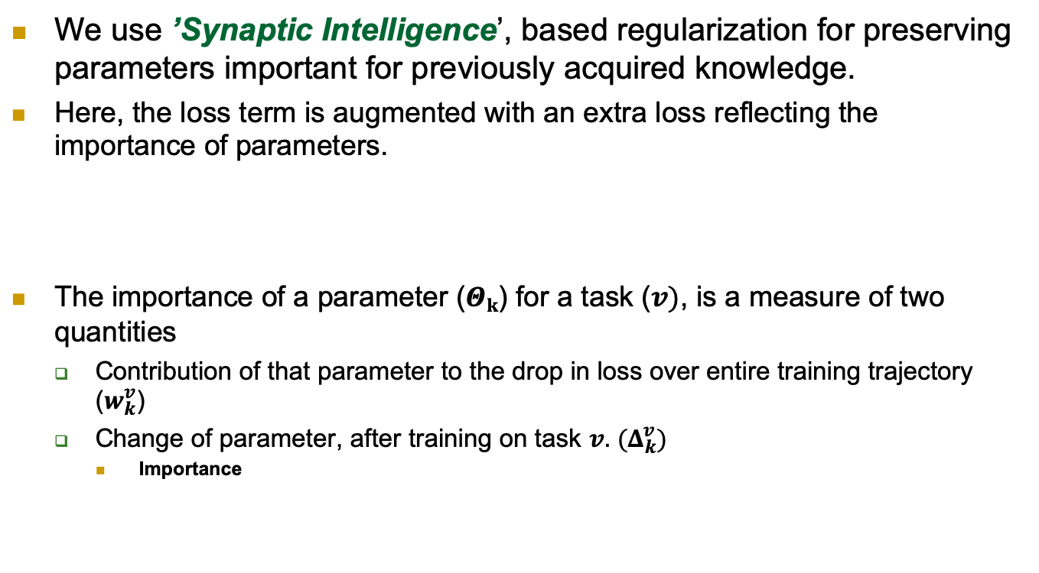
Regularization based Lifelong Learning (Continual Learning through Synaptic Intelligence (ICML 2017) F. Zenke, et al.)
We use ’Synaptic Intelligence’, based regularization for preserving parameters important for previously acquired knowledge.
Here, the loss term is augmented with an extra loss reflecting the importance of parameters.
The importance of a parameter ($Θk$) for a task ($v)$, is a measure of two quantities
Contribution of that parameter to the drop in loss over entire training trajectory ($w_{k}^{v}$)
Change of parameter, after training on task $v.$ $(Δ_{k}^{v})$
Importance

Slide 7
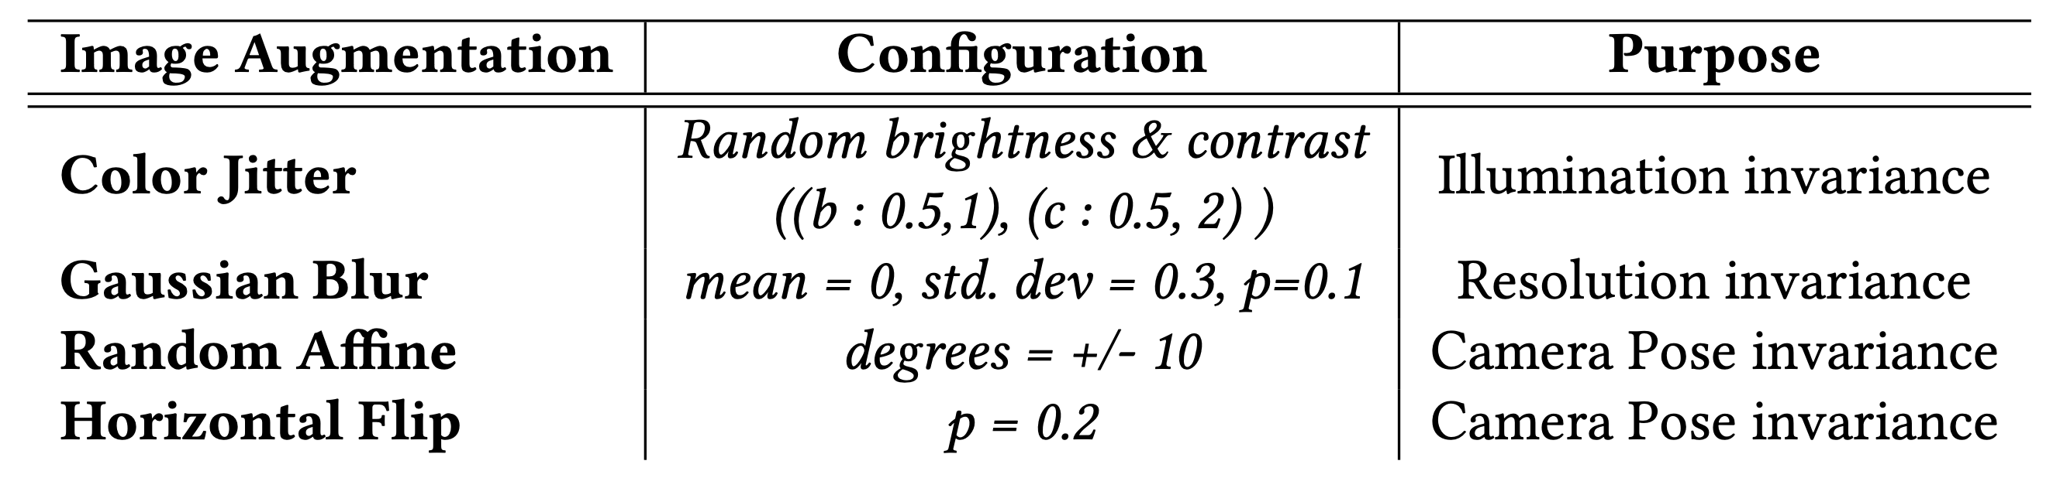
Data Augmentation
Data augmentation is used to tackle the data imbalance problem and improve generalization of the model, to prevent overfitting of the model.

Slide 8
Training Methods
Following training strategies were followed
Naïve: Incremental batch learning using SGD
Cumulative : Combined training of all tasks (to be used as upper bound accuracy)
SI : Incremental batch learning using SGD with Synaptic Intelligence based regularization
SI + Aug : Incremental batch learning using SGD with Synaptic Intelligence based regularization and data augmentation

Slide 9
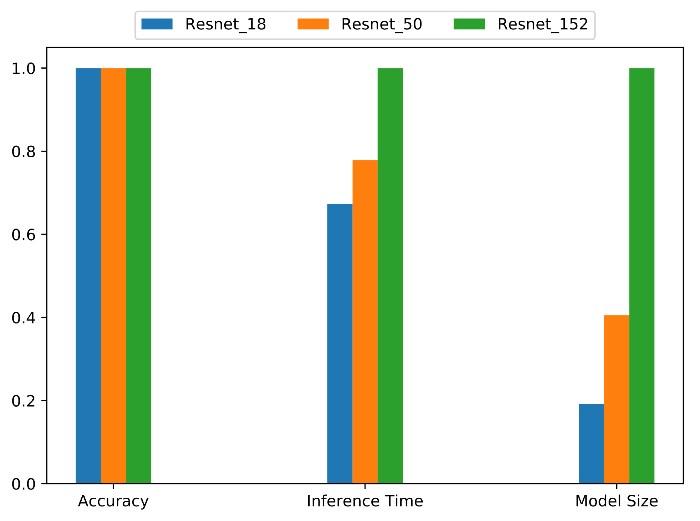
Model Selection
Evaluated Models
Resnet-18
Resnet-50
Resnet-152

Slide 10
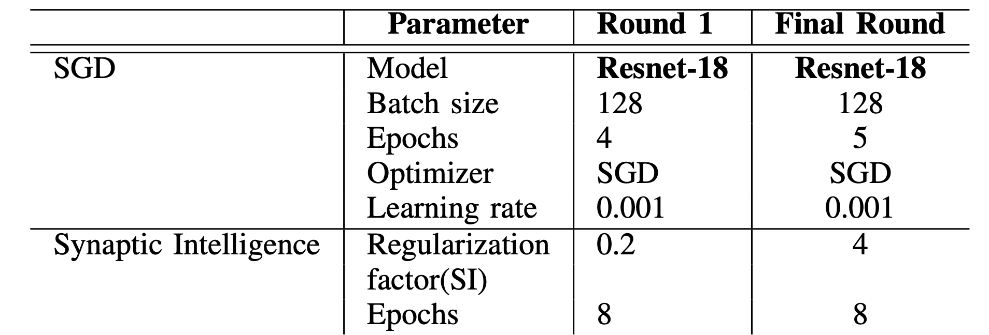
Training Parameters

Slide 11
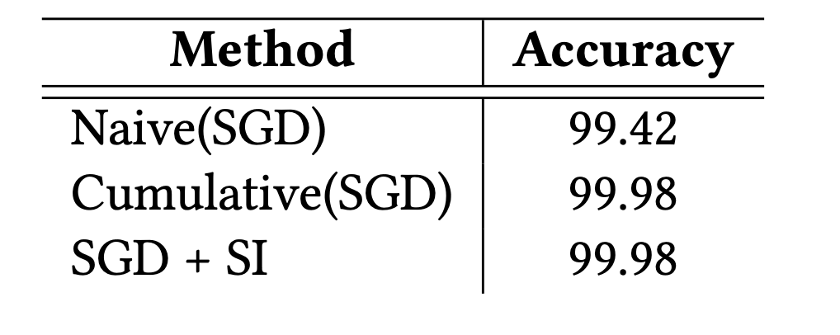
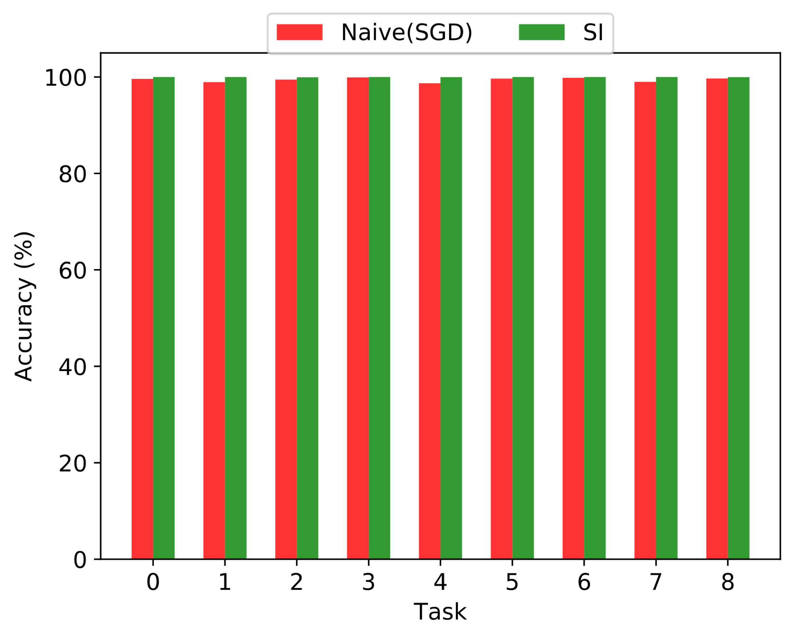
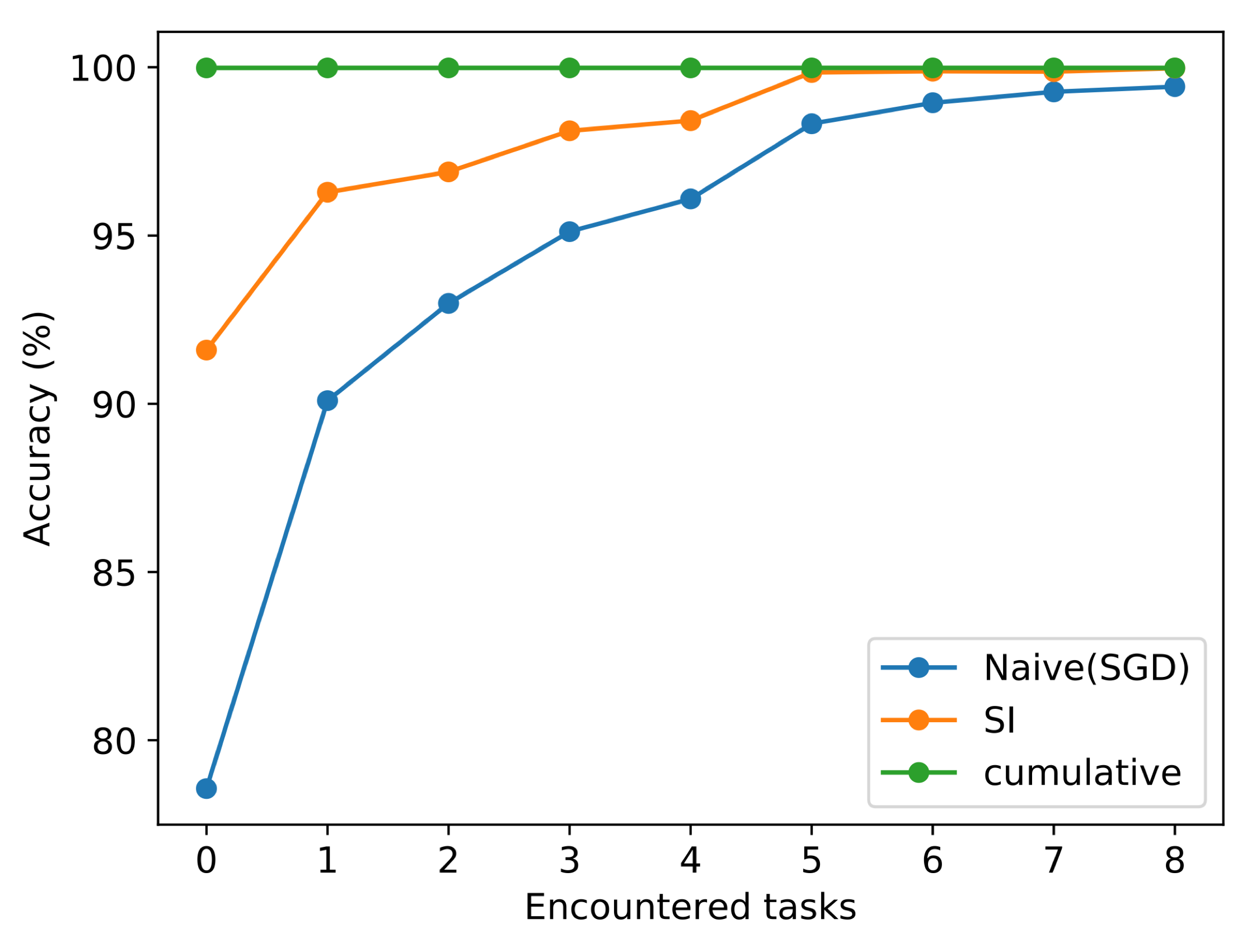
Experimental Results – First Round

Slide 12
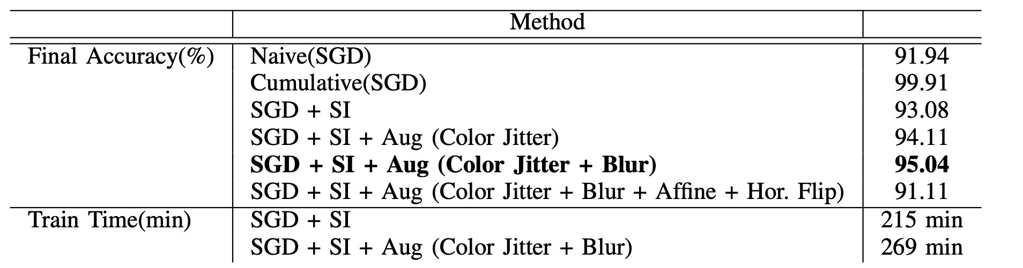
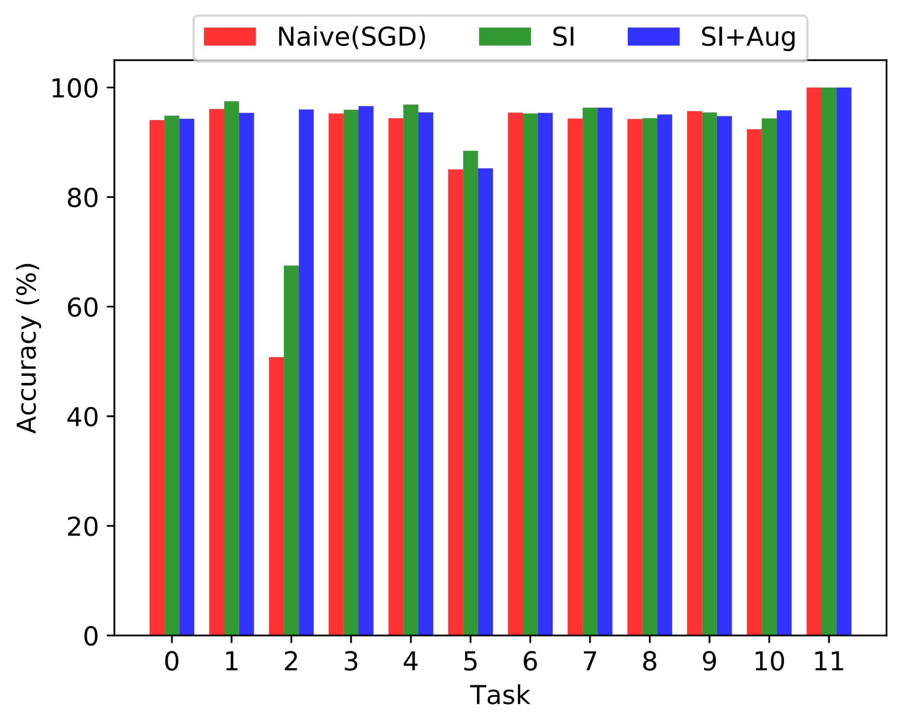
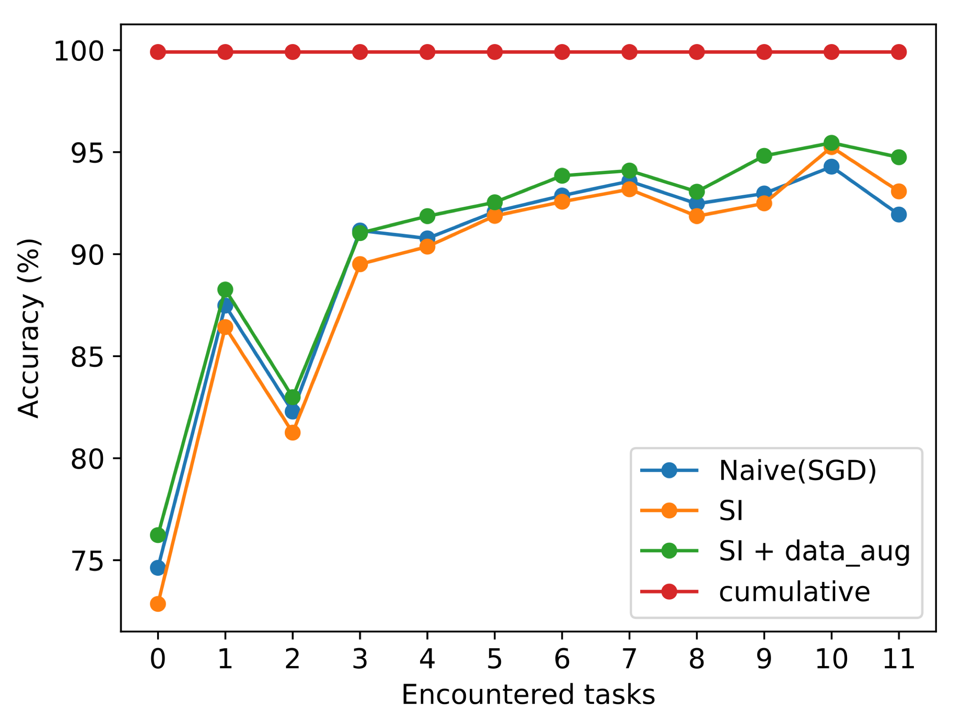
Experimental Results – Final Round

Slide 13
Engineering Applications
Robots navigating in dynamic environments
Self-driving cars
Video surveillance systems

Slide 14
Conclusion
Synaptic Intelligence based Regularization and data augmentation increases generalization of model and helps to reduce overfitting of model to particular environmental conditions

Slide 15

Q & A
Notes:
15

