Slide 1
Selective Feature Learning with Filtering Out Noisy Objects in Background Images
Soonyoung Song, Heechul Bae, Hyonyoung Han and Youngsung Son
Smart ICT Convergence Research Department, ETRI, Korea

Slide 2
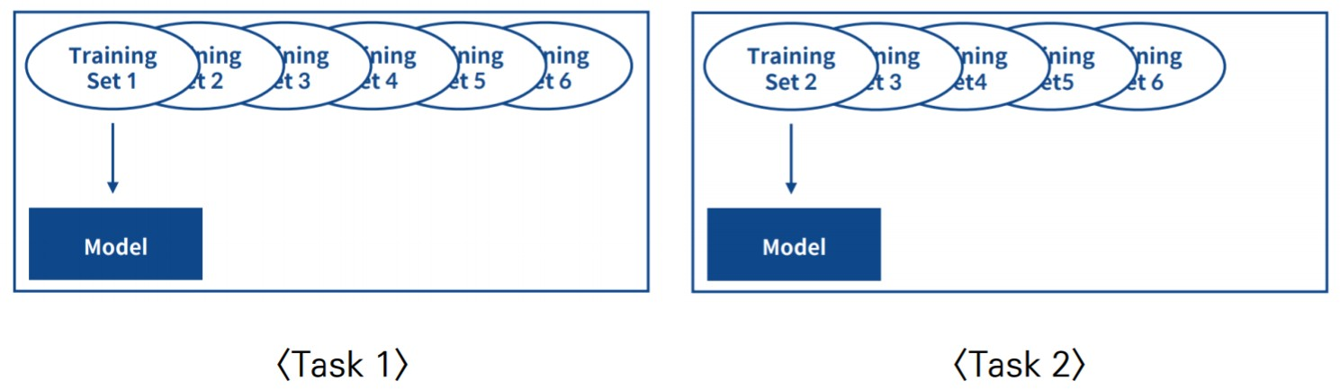

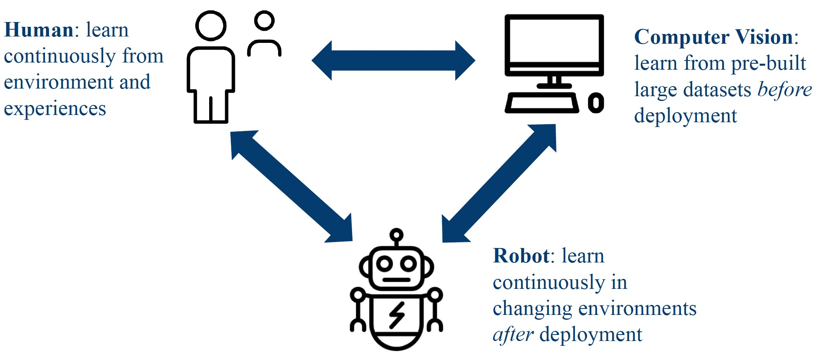
Introduction
Lifelong Robotic Vision Challenge
Online multi-task learning problem
Model training in situations where data is presented sequentially in subset form
Methodology for learning multiple tasks simultaneously
Overcoming catastrophic forgetting (semantic drift)
To keep old memory from the new training dataset
To transfer object features during continual learning
Memory replay
Weight regularization method
Self-expandable networks

Slide 3
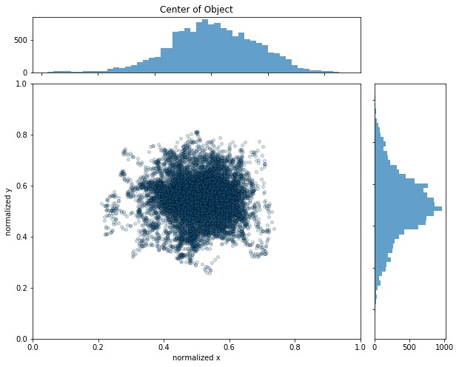
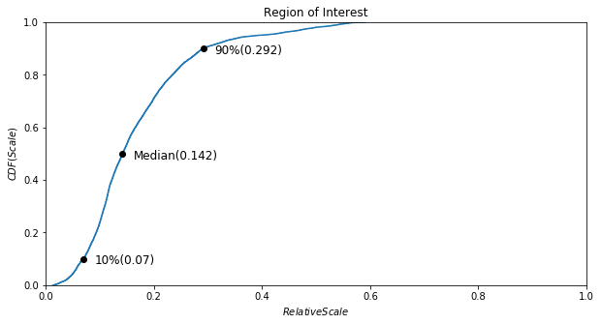





Dataset Analysis
Region of Objects (relative scale)
Median relative size = 0.142
Relative size difference: 4.14 = object@90% / object@10%
Position of Objects (relative scale)
0.2< center of object < 0.8
4X
_{Relative Scale =} sqrt(area(Object))
sqrt(area(Image))

Slide 4
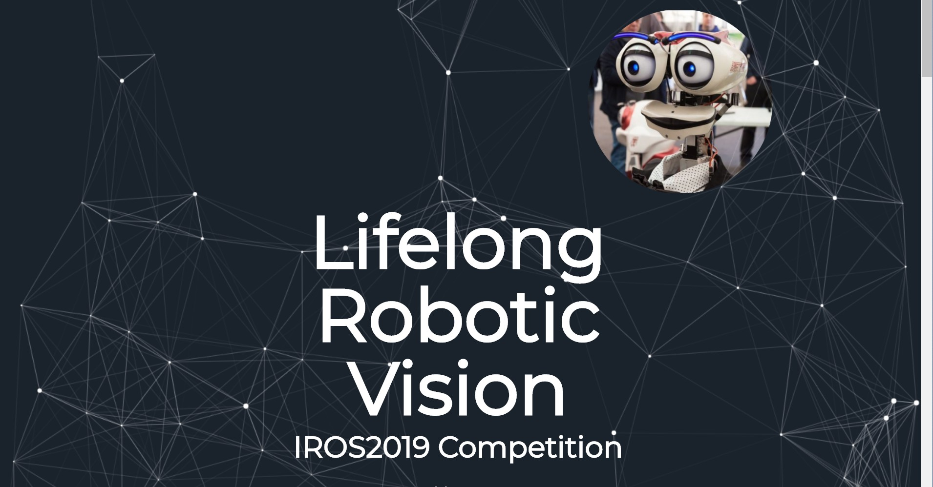

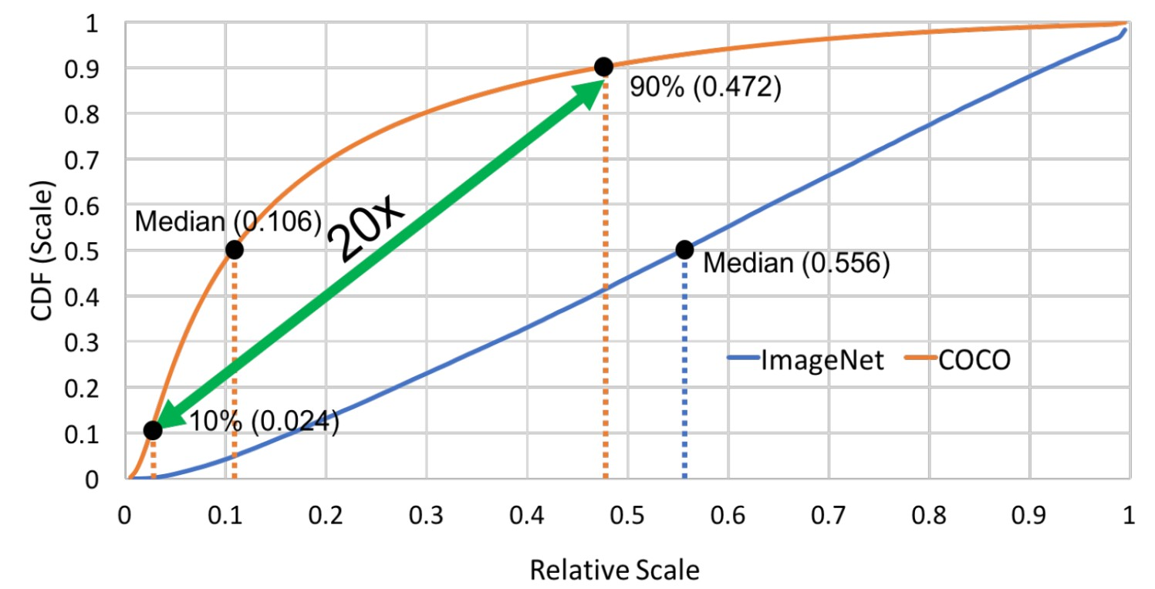

Dataset Analysis
What makes object detection harder than image classification?
Small scale variation(4x vs. 20x), but most small objects(90% vs. 80%)
Object data that collected under real-world challenges
# of classes in OpenLORIS = 19 # of instance = 69
# of view = 260
+ illumination, occlusion, object pixel size, clutter
4X
_{Relative Scale =} sqrt(area(Object))
sqrt(area(Image))
the mAP of the best performing detector on COCO is only 62%
– even at 50% overlap.
# of classes in COCO = 80
since AlexNet was proposed,
the top-5 error on ImageNet 15% to 2%
# of classes in COCO = 1000
An Analysis of Scale Invariance in Object Detection – SNIP (https://arxiv.org/abs/1711.08189)

Slide 5
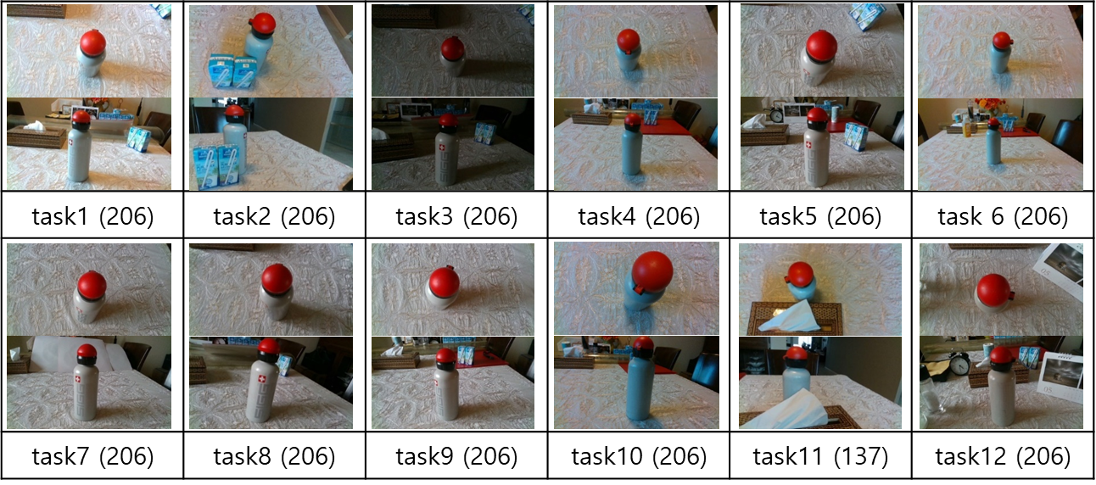








Software Design
Target objects located in the dataset coexist with unlabeled objects, such as bags, clocks, milk cartons and paper clips.
One of intuitive solutions of maintaining features is minimizing noise features implied in training sources
The selective future learning procedure is as follows:
– ① extracting target objects from training dataset by an object detection algorithm
Selective feature learning method
SSD for the convenience of flexible feature network design and proper detection performances
Trained the SSD model with human-annotated dataset in task 1
Converted the SSD model to a frozen graph to infer object location in feeding images
ⓛ SSD
to select
desired objects
② MobileNet classification network
The refined dataset was resized by 224x224 resolution
– ② feeding the refined dataset into a deep neural network to predict labels.
Classification network: traditional MobileNet
5

Slide 6
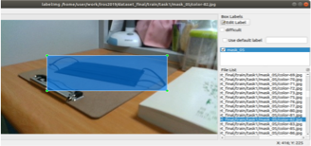
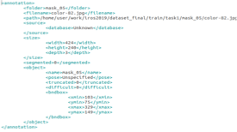


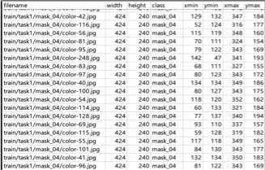
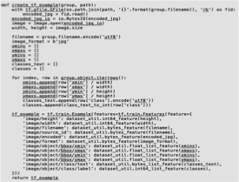


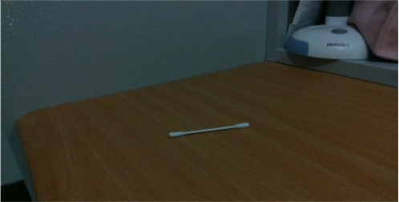
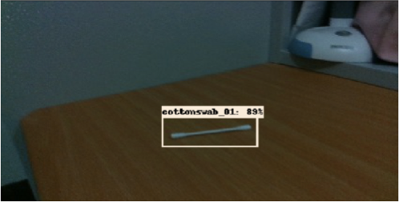




Software Design
Selective feature learning method
Task 1
SSD
SSD
Training
Model
ⓛ SSD
to select
desired objects
② MobileNet classification network
Object Selection (Inference with frozen graph)
The refined dataset was resized by 224x224 resolution
Training dataset Validation dataset
Task 1
Object Selection (SSD)
Training (MobileNet)
Trained Model
Task 2
Validation
Task 11
Task 1
result
Task 1
result
result
Task 1
result
Task 12
Task 1 result

Slide 7
Software Design
Reasons selecting the SSD algorithm are as follows.
Customizing feature extraction networks
Excellent object detection performance for its processing time
Single pipeline of deep neural network
The SSD algorithm was developed by modifying examples in tensorflow open source.
We applied MobileNet version 2 as a backbone network of the feature extraction network in SSD algorithm.
The backbone network model was pretrained with coco dataset.
We retrained the backbone network model using our handcrafted annotation data.
After finishing sequential training for task 12, trained model and weight were saved files with json and h5 extension respectively.
We programmed our software using python 3.6 interpreter with tensorflow version 2.0.x and keras version 2.3.x.
https://github.com/tensorflow/models/

Slide 8
Future Works
Lifelong learning of object selection inference graph
Currently, our software is implemented to infer object locations with frozen graph.
In the future, the software should be modified to adopt sequential training procedures to trace environment variations.
Lifelong learning of feature extraction network
Current SSD models use feature extraction networks with fixed size.
Therefore dynamic expanded networks should be devised to train SSD model sequentially.
Single pipeline for object recognition
The object detection and training block could be integrated to single pipeline.
8

Slide 9
Acknowledgement
This work was supported by Electronics and Telecommunications Research Institute (ETRI) grant funded by the Korean Government. [19ZH1100, Distributed Intelligence Core Technology of
Hyper-Connected Space]

