Slide 1
Dynamic Neural Network for Incremental Learning
Hikvision Research Institute
Liang Ma, Jianwen Wu, Qiaoyong Zhong, Di Xie, Shiiliang PuQiaoyong Zhong, Di Xie, Shiiliang Pu
Notes:
Goode morning Ladies and Gentleman
Today The topic of my report is Dynamic Neural Network for incremental learning

Slide 2
Content
What we ask for incremental learning
Main stream in the community
Our solution: Dynamic Neural Network
Notes:
The content is divided into three parts.

Slide 3
What we ask for incremental learning
Training without using previous data
data-incremental
class-incremental
data&class-incremental
Where
data&class-incremental
class-incremental
data-incremental
GOAL
Training fast
Less storage and memory costs
Good performance without forgetting
Notes:
Recently, artificial neural networks (ANNs) have been widely apply to machine learning application.
However, it sufferes from Catastrophic forgetting when learning incrementally over tasks.
Incremental learning can be divided into data incremental, class incremental, and the combination of both.
The goal of incremental learning is to maintain the performance of the previous tasks while learning new tasks.

Slide 4
Main stream in the community
Regularization
Network
Rehearsal
weight regularization: EWC/MAS/SI
feature regularization: KD/SLNI
Different networks for different tasks: PNN
coreset selection and replay: iCarl/GEM
generative replay
Notes:
At present, Incremental learning algorithm can be divided into the following three methods: Regularization, Network expand and data rehearsal.

Slide 5
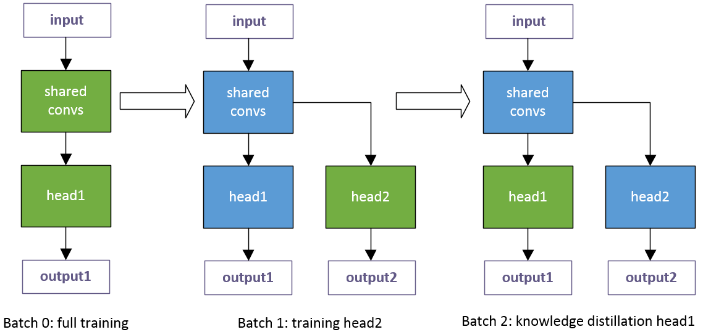
Our solution: Dynamic Neural Network
Dynamic network expansion for data across dissimilar domain
Knowledge distillation for data in similar domain
Features
Dynamic network expansion to alleviate domain gap
No need for previous data
Combined method of network expansion and feature regularization
Notes:
Next I will present our solution for data-incremental problem in openLORIS competition.
In this competition, we develop a combined method with knowledge distillation and network expansion. Without using previous data, our method still achieves good performance and low time latency
From the following diagram example, you can see, based on a trained model, if we faced with a new task, we can do two operations:
Dynamic network expansion for data across dissimilar domain
Knowledge distillation for data in similar domain
The main advantages of our approach are:
Combined method of network expansion and feature regularization
No need for previous data
Dynamic network expansion to alleviate domain gap

Slide 6
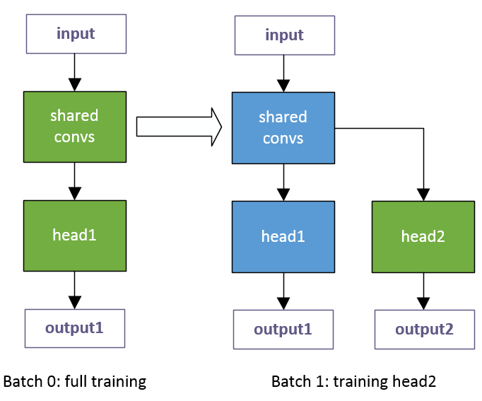
Dynamic network expansion
Freeze shared conv layers
Network expansion for severe domain gap (bad accuracy)
Tricks for generalization ability:
For shared convs, imagenet pre-trained model
For heads, more data augmentation and more batches to train head1
Notes:
Then, i will introduce Dynamic network expansion and knowledge distillation respectively。
First We will train a benchmark model with a good generalization performance on the first batch of the data.
And then We determine the domain gap by measuring the accuracy using previous model before training on current task.
If we get a severe domain gap, we will expand our network and freeze the backbone network, only train the new heads.
It‘s also worth noting that， In order to increase the generalization ability of trained model,
for shared convs, we fixed it by imagenet pre-trained model，
and use more data augmentation and more batches to train head1 for base model.

Slide 7
Knowledge distillation
Replace BatchNorm with GroupNorm
Mining known instances in new task and distill on best head
Notes:
In the part of Knowledge distillation:
We Replace the BatchNorm with GroupNorm in the backbone network.
Then as shown in the figure, we will discover known instances in current task by a single forward pass via previous model.
Those correctly classified are known samples and we will use these samples for knowledge distillation. Also we use total training data to get the classification loss.
In addition ,to perform knowledge distillation over muliple heads, we must choose a suitable head first.
Here, using best head for distillation is resonable and more stable verified by experiment results.

Slide 8
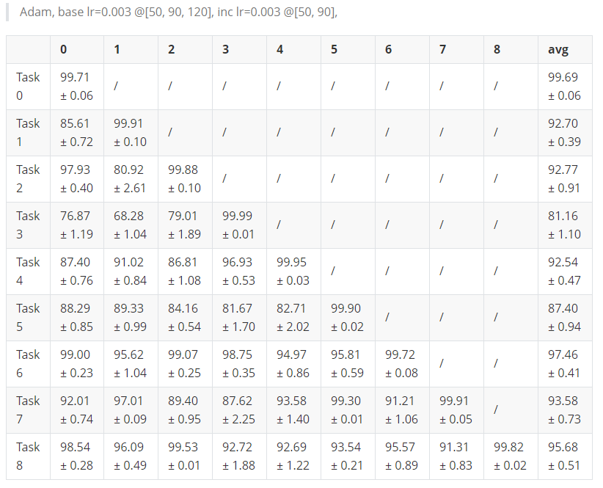
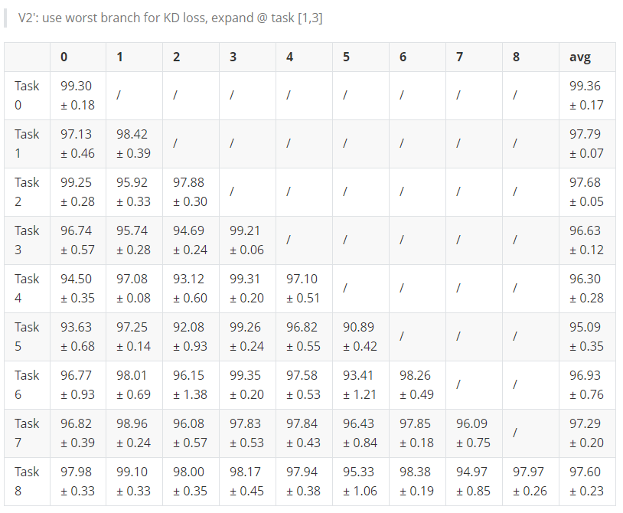
Experimental comparison
Finetune
DynamicNN
Notes:
This is our roun1 result, We can see that using the knowledge distillation and Dynamic expand method,
the performance is much better than finetune, and there is a significant reduction in catastrophic forgetting.

Slide 9
Experiment results in 1st round
Square performance on all tasks
Finetune | 93.84
DynamicNN(No expand) | 94.50
DynamicNN(expand@1) | 95.75
DynamicNN(No expand) + LR trick | 96.01
DynamicNN(expand@1) + LR trick | 96.83
LR trick: Incremental learning with small learning rate
Notes:
This is square performance on all tasks，
The square performance means when we finished a task traing, we will use all tasks to test.
For example, when we train the 1st batch of datasets, we also need to test over 1-9 batch test datasets.

Slide 10
Notes:
That's all for my presentation. Thank you.

