Slide 1
Stroke Prediction Project
Agnesa Percuku Gerxhaliu
Notes:
In my final project, I have decided to work with medical data. I think that technology and machine learning in specifics, can contribute a lot on improving our lives, including the medical field. So I decided to work on medical data, and tackle an important issue: Stroke.

Slide 2
Content
01
04
02
05
03
06
Stroke & Data
The Model Selection
Exploratory Data Analysis
Feature Importance
Data
Pre-processing
Conclusion
Notes:
In my presentation, I am going to talk about:
Stroke and Data
Data Analysis
Data Pre-processing
The model selection
Feature importance
And a quick conclusion

Slide 3
Stroke
01
“A stroke, sometimes called a brain attack, occurs when something blocks blood supply to part of the brain or when a blood vessel in the brain bursts”. (CDC)
“100,000 people have strokes each year”. (Stroke Association)
2nd leading cause of deaths (WHO).

Slide 4
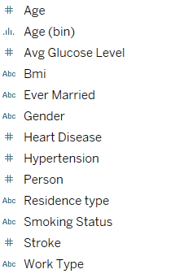
Stroke dataset
01
The dataset has in total 11 features, 5110 records. This dataset is an highly Imbalanced dataset.
Can we predict if a patient is likely to get a stroke by looking at health parameters?
Notes:
This dataset was found in Kaggle.

Slide 5
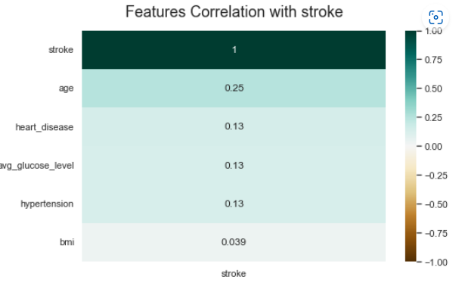
Feature Correlation
Notes:
Age seems to be the closest feature to stroke, followed by heart disease and glucose level.

Slide 6
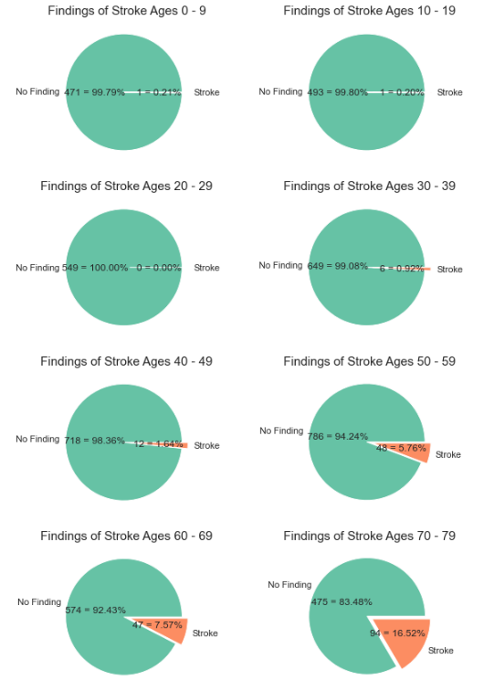
Stroke by Age

Slide 7
Which metric is important to us?
Precision — Out of all the cases that were predicted as positive, how many are positive?
Recall — Out of all the positive cases, how many were predicted as positive?
We do not want to miss people in risk for a stroke and falsely diagnose them as healthy. So we want a higher recall as possible so the persons in risk receive treatment soon.
There is usually a trade-off between recall and precision. Increasing precision might lower the recall, and vice-versa.
So maximizing recall over precision is important to find people at risk for a stroke.
Notes:
We need a good recall so we can find all relevant cases and be able to treat patients who are in risk. We don’t want to miss any risk cases.
Precision is acceptable to be low as we want as it’s still acceptable to misdiagnose someone as in risk for stroke, that medical analysis can confirm that. But we still want a good recall so we don’t miss a patient in risk.

Slide 8
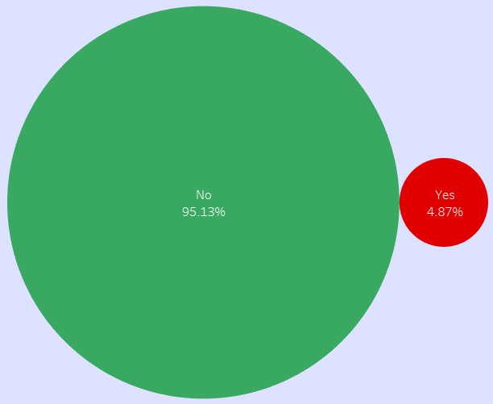
Imbalanced Data!
Patient Data was highly imbalanced
Only 4.87% positives: a challenge
Notes:
In our dataset, more than 95% of data was in 1 class: no stroke. This was a challenge for training the model.

Slide 9
Dealing with imbalance
Encoding categorical values
OneHotEncoder used for the encoding
Scale the data
StandardScaler giving the best results.
Class weighting
Giving more weight to entries with a stroke.
Notes:
To solve this challenge, I took 3 steps: Encode the categorical values, scale the data, and use weights. Weight was the most important for dealing with imbalance.

Slide 10
Model Performance
Model | Precision | Recall
Logistic Regression | 0.16 | 0.84
KNeighborsClassifier | 0.15 | 0.81
Decision Trees | 0.16 | 0.74
Techniques for Imbalance
ClassWeights
SMOTE
ClassWeights
Random Forest | 0.23 | 0.55
ClassWeights
Notes:
Logistic Regression is performing best so this is what we want.

Slide 11
Accuracy Score
0.70%
0.74%
0.93%
Logistic Regression
Decision Trees
KNeighborsClassifier
0.94%
Random Forest
Notes:
Accuracy Score turned out to be pretty high and the best was RandomForest in this number. But, this score is misleading here. The reason why is that we have a highly imbalanced dataset. The “No stroke” class is the majority and dominates the results. That’s why recall is much more relevant to us.

Slide 12
Chi-Squared Test
During data analysis, it was observed that some work types are more related to stroke than others.
Let’s perform a Chi-Squared Test!
P-Value:
Chi-Squared value:
5.74e-06
20.57
Low p-value and high chi-squared
Null Hypothesis rejected! No significant relationship between work type and stroke.

Slide 13
Conclusion
Patient health parameters and stroke risk was analyzed
Data imbalance challenge was solved
Good results were received
A trained model, a data exploration dashboard and a small web-app were built.
Further work, to collect more data and improve the models might contribute to the medical field on avoiding stroke.

Slide 14
Resources
Dataset: https://www.kaggle.com/datasets/fedesoriano/stroke-prediction-dataset (Kaggle)

