Slide 1


Coping with Covid
By: Reina, Sarah, and Agnes
11/6/2020
Website : https://reinaseustache.github.io/news

Slide 2
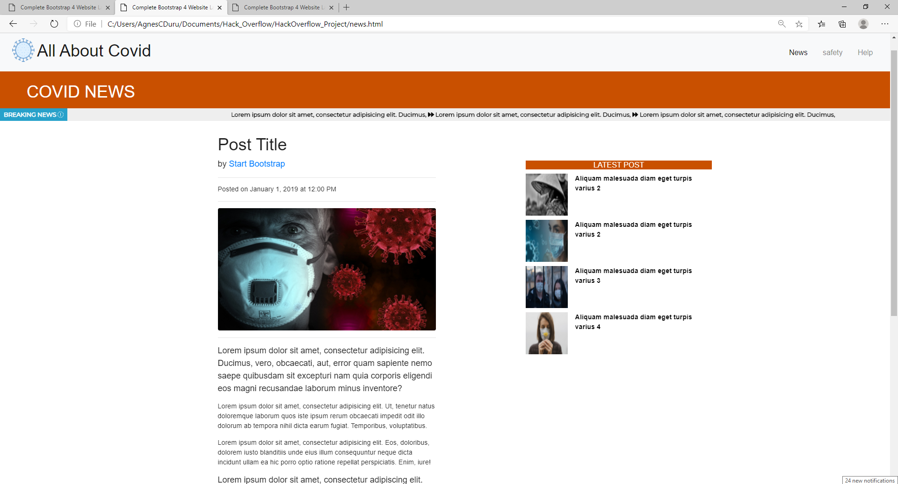

News
This news page utilizes news
APIs to deliver real time
articles related to Covid-19.
This page serves to be
informative, and unbiased.

Slide 3
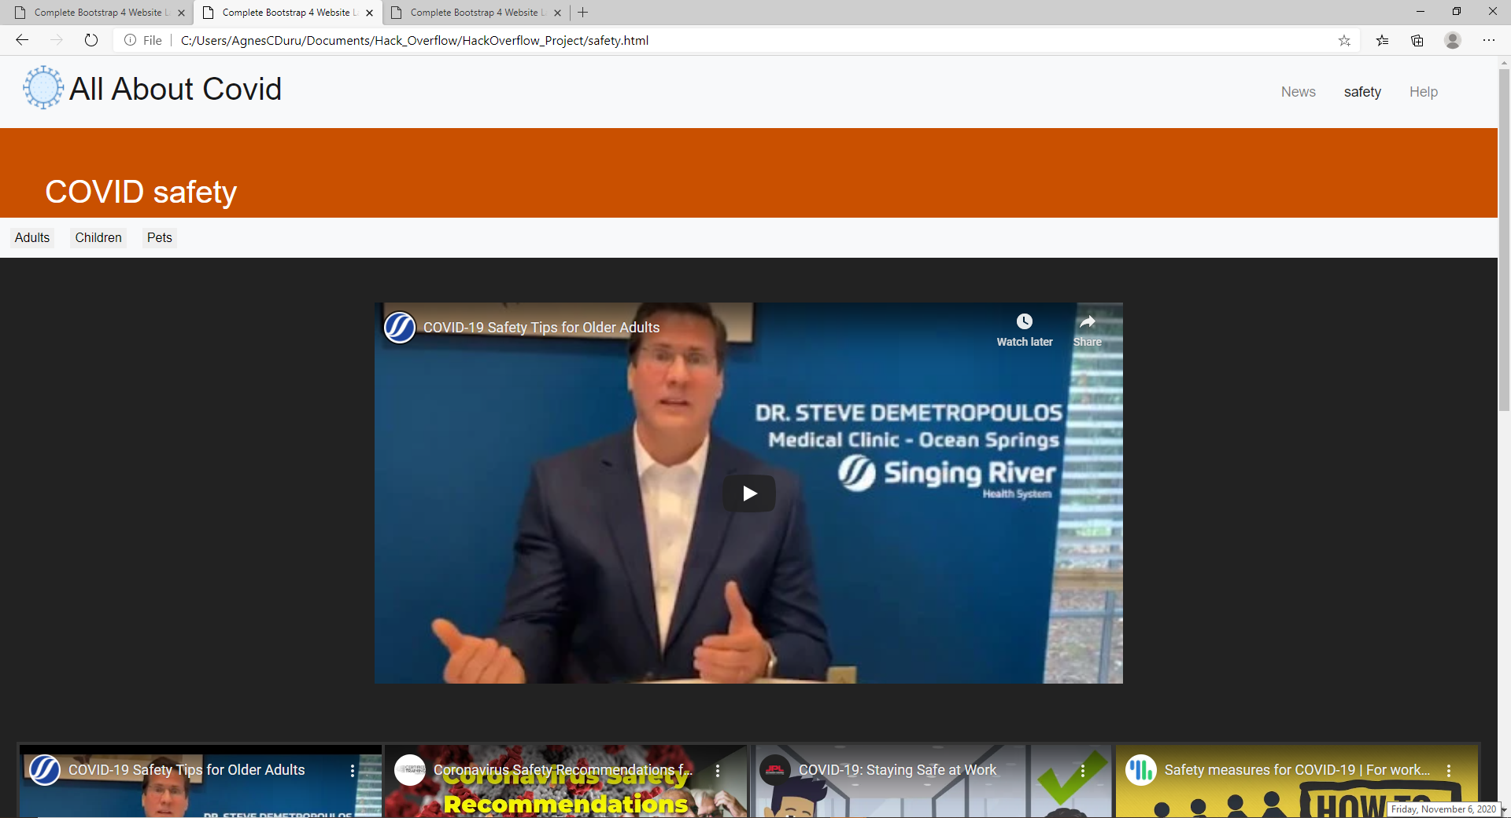

Safety
Safety - Adults
This page serves to educate adults, children, and pet owners on the importance of taking the necessary safety precautions during quarantine. This page also includes helpful videos to guide people on the best way they can care for their pets during this difficult time.

Slide 4
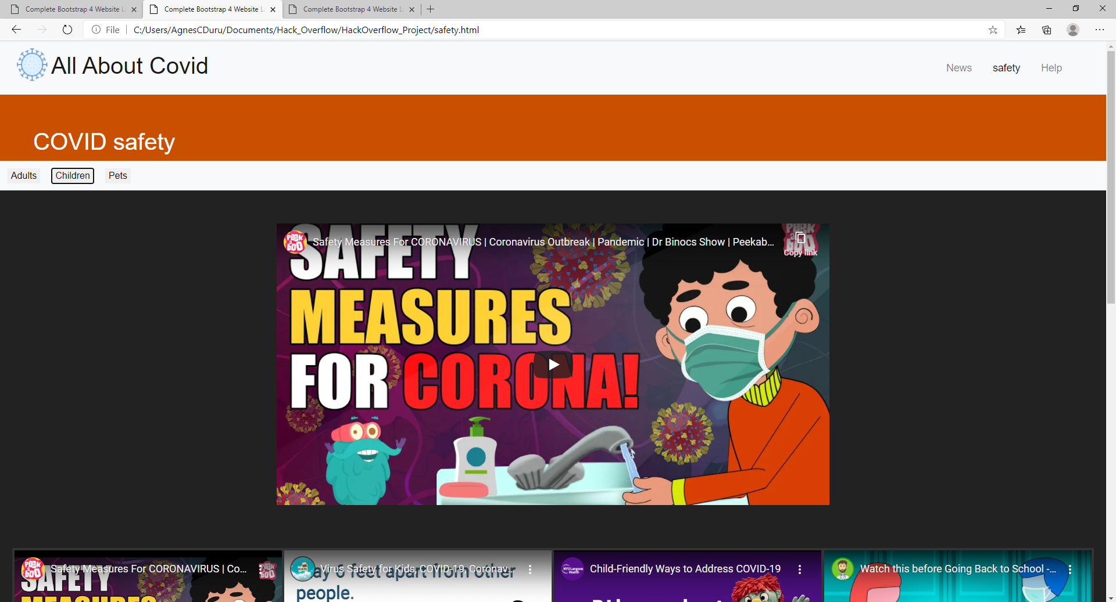
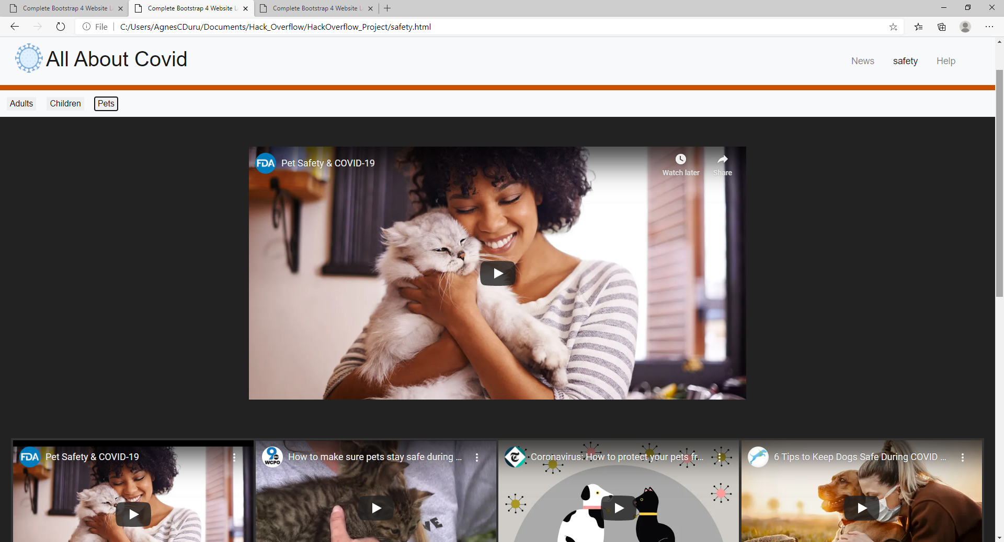
Safety-Children Safety-Pets
Logo here

Slide 5
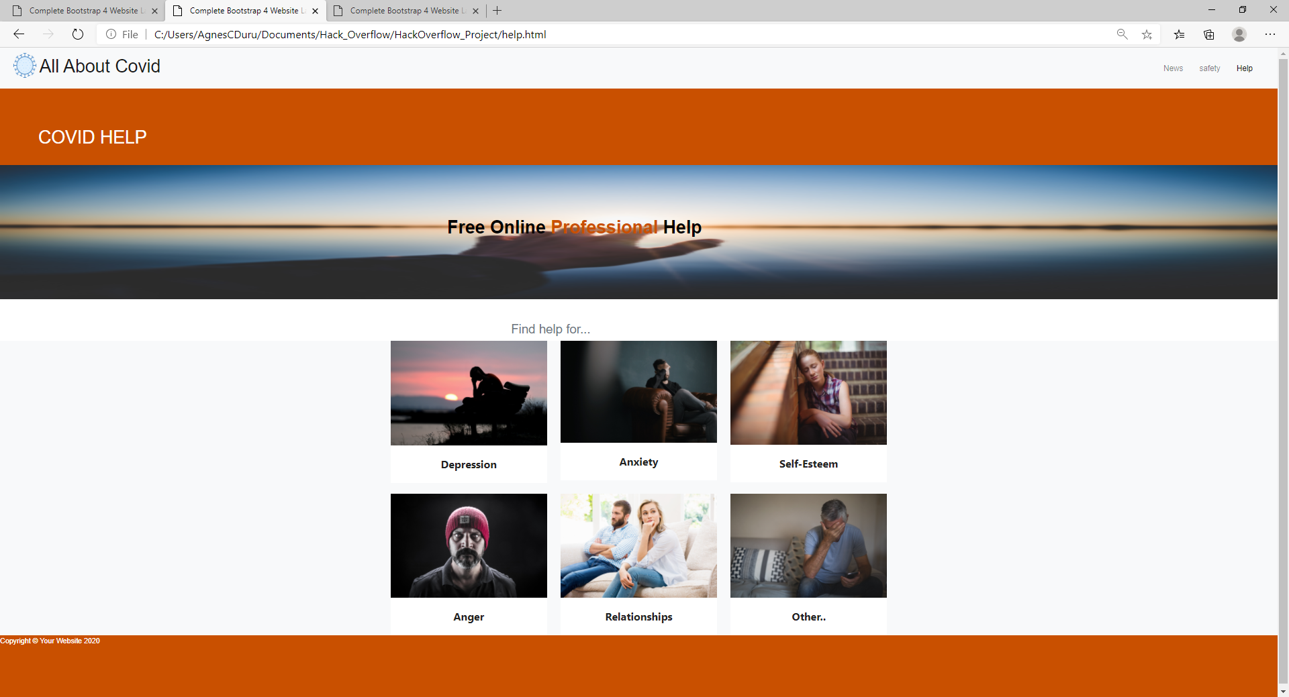
Help
This page provides people with relief from the mental stress that they have been facing during quarantine. The user can select from a number of different categories that best fit their situation. They will then be matched with a certified counselor free of charge. This counselor will chat with them and comfort them.

Slide 6
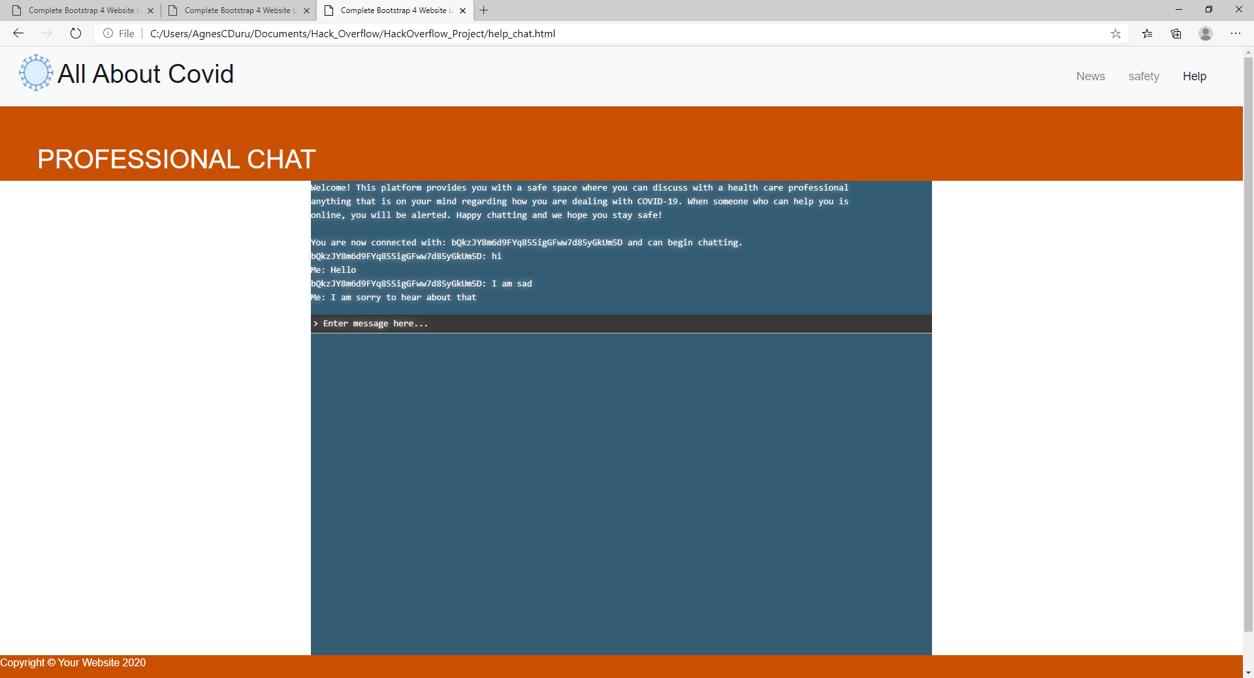
Help Chat
The user is not obligated to share their name or any other personal information. They simply can vent or share their feelings and feel heard. They also will receive the best advice to apply for their situation. The chat will be monitored for security reasons, but sensitive information would remain classified.

