Slide 1
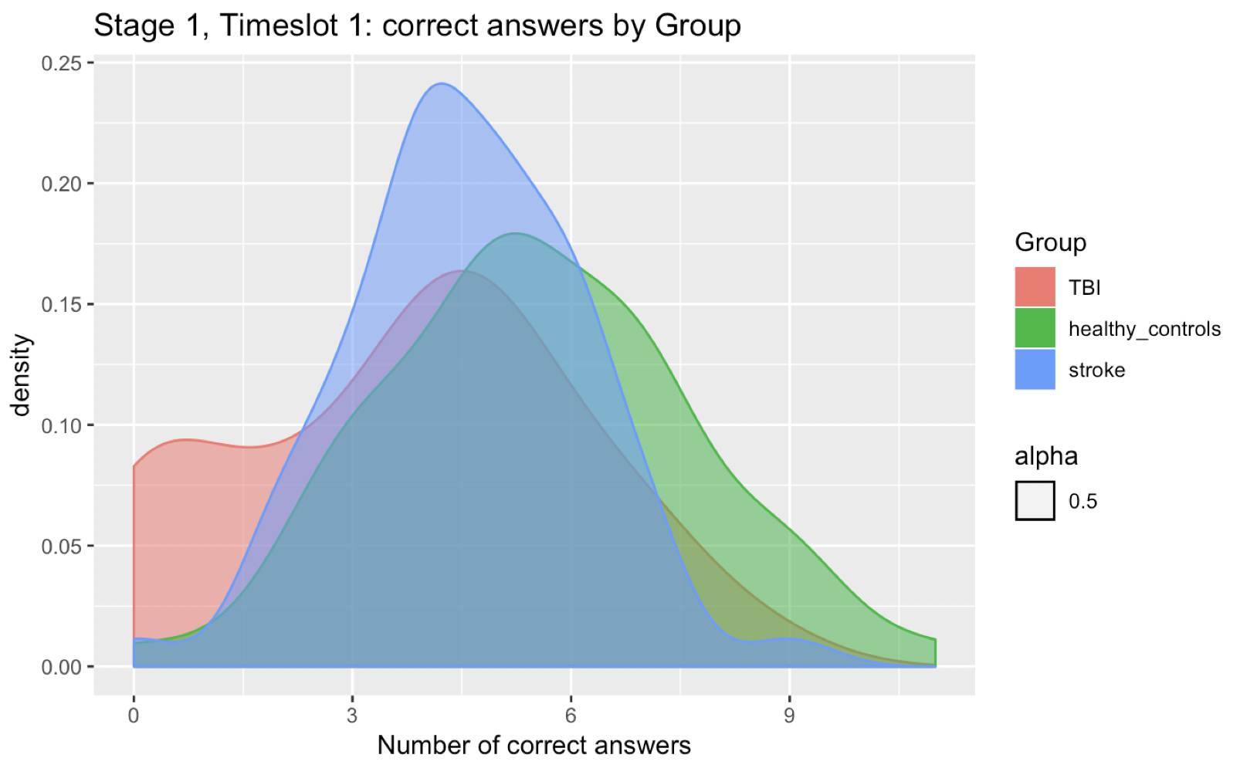
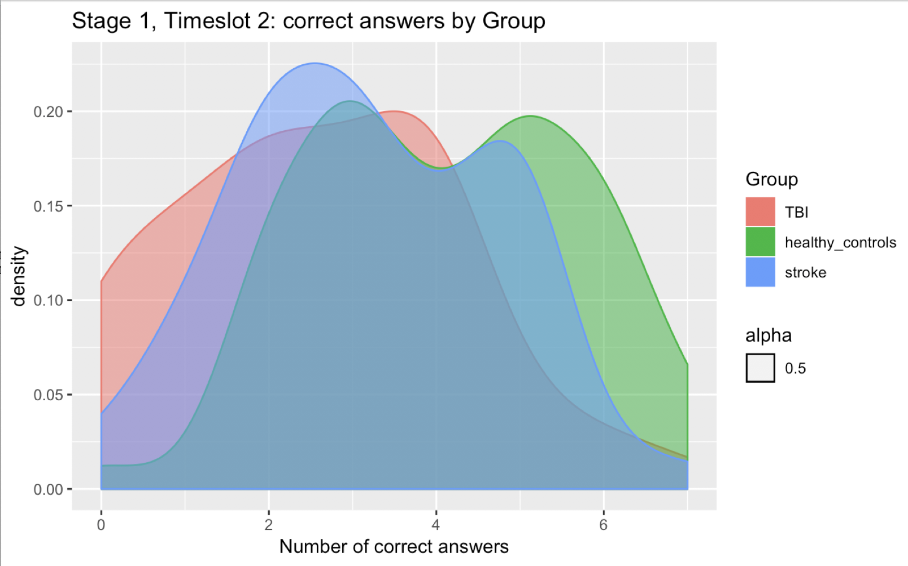
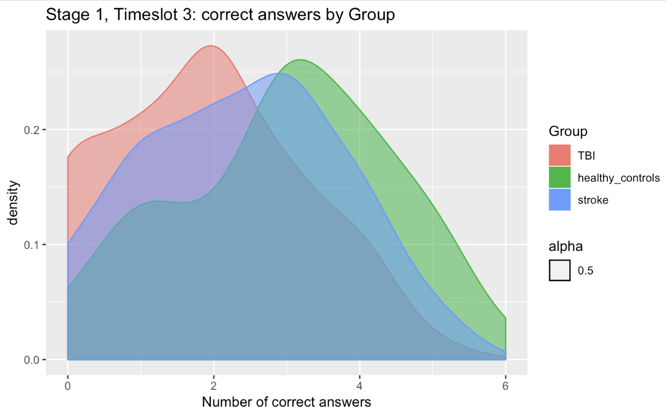
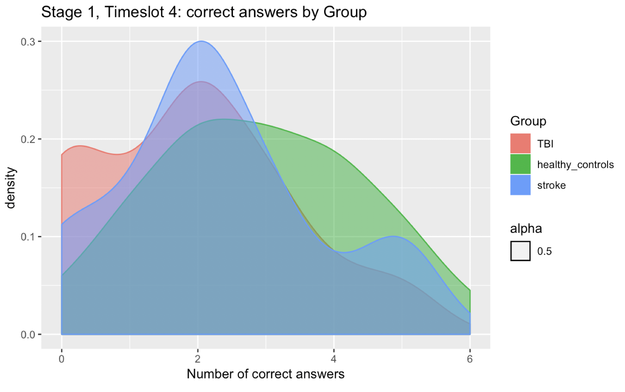
FLUENCY LETTER, Trial 1: Distribution of number of correct words per-group at each timeslots
Please note that the x range of each distribution is different.
E.g., at Timeslot 1 people said the highest number of words !!

Slide 2
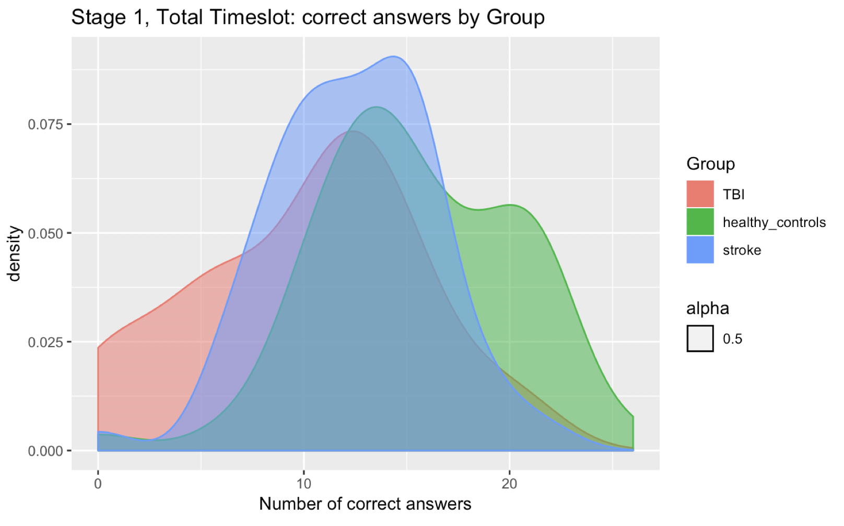
Final distribution
Although there is an overlap among the central values of the distribution, healthy controls show a definite thicker right tail, while patients with TBI show a tick left tail (--> lower number of correct words). Stroke patients have a very central, almost symmetrical, distribution. To test whether statistically significant differences are present, statistical tests need to be used.

