Slide 1

Note: The data and information in this document is reflective of a hypothetical situation and client. This document is to be used for KPMG Virtual Internship purposes only.
Sprocket Central Pty Ltd
Data analytics approach
Agniva Roy

Slide 2
Note: The data and information in this document is reflective of a hypothetical situation and client. This document is to be used for KPMG Virtual Internship purposes only.
Agenda
Introduction
Data Exploration
Model Development
Interpretation

Slide 3
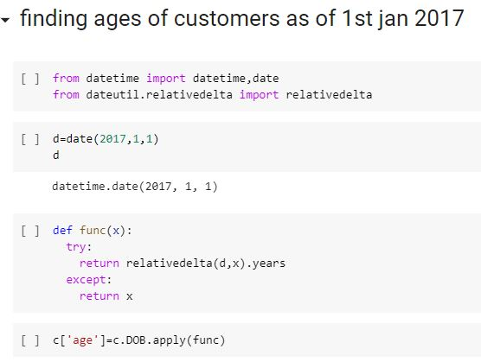
Note: The data and information in this document is reflective of a hypothetical situation and client. This document is to be used for KPMG Virtual Internship purposes only.
Introduction
Getting meaningful insights from the data
We followed a series of steps which consists of data exploration, model development and interpretation.
The tools that we have used here are Power Bi and Python.
We cleaned the data in Python and then used the resulting dataset to get some visualizations using Python as well as Power-Bi.
A snapshot of our work in Python has been shown here
Place any supporting images, graphs, data or extra text here.

Slide 4
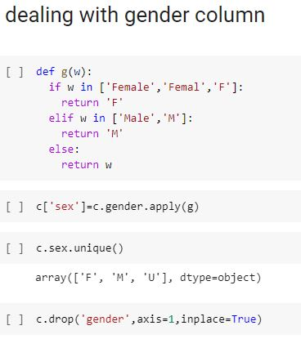
Note: The data and information in this document is reflective of a hypothetical situation and client. This document is to be used for KPMG Virtual Internship purposes only.
Data Exploration
We explored the datasets, cleaned some columns and created some new features which may help us to derive useful insights
For the calculation of revenue the list price has been considered. The potential profit is list price – standard cost.
The gender and state columns have been cleaned.
Some absurd DOB values have been made to null values.
The ages of the customers as of 1st Jan 2017 has been calculated.

Slide 5
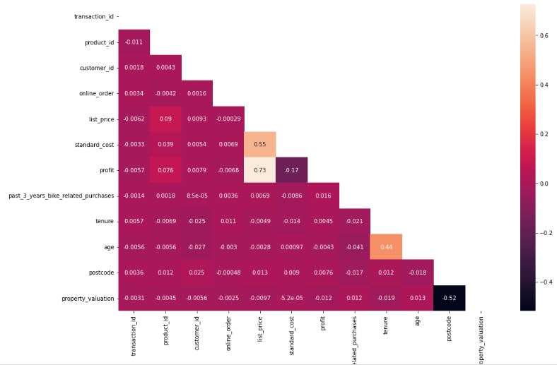
Note: The data and information in this document is reflective of a hypothetical situation and client. This document is to be used for KPMG Virtual Internship purposes only.
Model Development
EDA was done to get some meaningful insights
The tables were joined using the column customer_id.
Correlation matrix and few scatterplots were plotted using Python. Other analysis were done
Using Power-Bi time series plots, bar charts and pie charts were made

Slide 6
Note: The data and information in this document is reflective of a hypothetical situation and client. This document is to be used for KPMG Virtual Internship purposes only.
Interpretation
We can make some significant interpretations
Most of the customers are female.
The average transaction value and profit for the people with gender U is more than that of females and males
There does not seem to be any significant correlation between list price and age, tenure and no of transactions related to bikes in the last 3 years
There also does not seem to be any significant correlation between the number of transactions a customer has made and the no of transactions related to bikes in the last 3 years
The mean transaction value as well as the mean profit value is the most for affluent customers.
Most of the customers reside on NSW.

