Slide 1
Citation-Driven Improvements in Information Retrieval: A TREC COVID Exploration
ANJALI KUMARI AND AGNIDEEP MUKHERJEE
Supervisor: Prof. ALAN SMEATON

Slide 2


Introduction
Context: COVID-19 pandemic created a public health crisis and information challenge.
TREC-COVID Challenge: Addressed the need for reliable virus-related information through information retrieval systems.
Objective: Investigate enhancing information retrieval using citation analysis.
Approach: Replicate TREC COVID benchmark using Okapi BM25 system.
Research Question: Can enriching the corpus with citations improve BM25 retrieval score?
Evaluation: Utilizing TREC-Eval framework for comprehensive assessment.
Notes:
1) Before heading towards our first slide, I would like to give a brief idea about what is information retrieval?
So, Information retrieval (IR) refers to the process of retrieving relevant information from a collection of
documents or data based on a user's query. For instance-web search engine, e-commerce platforms, email search,
social media platforms all of them uses information retrieval.
2) Now let us move towards our first slide which is the introduction. The COVID-19 pandemic brought not only
a health crisis but also a significant challenge in managing and disseminating accurate and timely information.
3) To address and solve this information challenge, the TREC COVID Challenge was introduced.
(I will give the overview of this competition in the further slide.)
4) The primary objective of our research is to explore ways to enhance information retrieval systems using
citation analysis and that leads us to our central research question, driving this study that whether
augmenting the corpus with citations could lead to an improvement in the retrieval score obtained
through the BM25 system.
5) To evaluate our approach, we have used TREC-Eval framework and we will discuss
about the framework later in the slides.

Slide 3

A Brief Summary
Overview of TREC COVID information retrieval structure, finding, and exploration and the TREC COVID benchmarking task.
Utilize Okapi BM25 information retrieval system for extensive analysis.
Determine impact of adding citation information to corpus on baseline score.
Code has been implemented in Jupyter notebook, DCU’s desktop computer systems and written in Python.
Python libraries: json, nltk, math, pandas etc.
Notes:
This slide is about our project’s brief summary wherein we aimed to leverage citation analysis to enhance IR in the context of the TREC-COVID Challenge.
We have tried to achieved it by replicating the benchmark using the Okapi BM25 system and evaluating their results through the TREC-Eval framework,
we sought to determine if the inclusion of citations could positively impact retrieval scores.
Initially the code was implemented on Jupyter notebook.
Afterwards DCU’s computer systems, enabled us to conduct a
successful research and execute complex programs seamlessly.
So, let us move to our next slide which is about the literature review of the few papers among all have reviewed.

Slide 4

Literature Review
1. TREC-COVID Overview Paper:
Provides a comprehensive view of the TREC-COVID challenge.
Utilizes the COVID-19 Open Research Dataset (CORD-19) from Allen Institute for AI.
TREC-COVID competition organized into rounds.
Objective of Participants was to generate and submit effective "runs" for evaluation.
Independent development of Information Retrieval (IR) systems by participants.
2. Team unique-ptr:
Utilized an ensemble of systems for enhanced performance.
Obtained nDCG@20 score of 0.8496 and MAP score of 0.4718.
Notes:
So, let us move to our next slide which is about the literature review of the few papers among all have reviewed.
The very first paper is about a comprehensive view of the trec covid challenge.
The TREC-COVID Challenge, 5 months competition (April-August 20) is being organized by the Allen Institute for Artificial Intelligence (AI2), National Institute of Standards and Technology (NIST), the National Library of Medicine (NLM), Oregon Health and Science University (OHSU), and the University of Texas Health Science Center at Houston (UTHealth).
The competition utilizes the COVID-19 Open Research Dataset and I will be describing about the dataset in the data description slide
The aim of this challenge was to provide effective solutions for retrieving and organizing reliable information related to the pandemic for researchers, healthcare professionals, and the general public. By developing and evaluating information retrieval systems within the TREC framework, the challenge aimed to improve the accessibility and reliability of COVID-19 related information
Objective of Participants was to generate and submit effective "runs" for evaluation. A ranked list of documents per topic by decreasing order of relevance. now, there were 50 topic related to covid 19 in total. The performance of the systems was evaluated using standard metrics such as
ndcg@20 (Normalized Discounted Cumulative Gain) : It is a measure of the effectiveness of a ranking system, taking into account the position of relevant items in the ranked list.
· MAP (Mean Average Precision): is a measure of the precision of a ranking system, taking into account the number of relevant items in the ranked list.
· p@20 (Precision at 20)
· Bpref (Binary Preference): a measure of how many relevant documents are ranked before irrelevant documents
We will be explaining about the metrics in the further slides.
The 2nd, 3rd, 4th, and 5th paper is the paper of the top 4 performing teams in the competition, their approaches to generate the run and their score.
I will just give a quick review of their scores
Team unique-ptr Ranked as the best run among all submissions in round 5 of TREC-COVID benchmark.

Slide 5
Literature Review….(contd.)
3. Team Covidex:
Operational search engine developed using Python FastAPI framework.
Achieved nDCG@20 score of 0.8311 and MAP score of 0.3922.
4. Elhuyar-NLP-team:
Proposed 7 different techniques and models to improve the ranking of documents
The fusion of BERT, RoBERTa, and XLNet, achieved the highest nDCG@20 score of 0.7956 and MAP score of 0.3789.
5. Team xj4wang:
Demonstrated Continuous Active Learning approach.
Achieved nDCG@20 score of 0.6663 and MAP score of 0.2448.
Notes:
The 2nd, 3rd, 4th, and 5th paper is the paper of the top 4 performing teams in the competition, their approaches to generate the run and their score.
I will just give a quick review of their scores
And they aquired the third position in the competition

Slide 6

Data Description
COVID-19 Open Research Dataset (CORD-19):
Obtained from https://github.com/allenai/cord19.
Utilized metadata.csv, including unique identifiers, titles, abstracts, and PDF JSON files paths.
Incorporated a collection of 84,000 JSON files with full-text parses.
Notes:
Now, let us come to the slide of Data Description of cord-19:
As mentioned above earlier, the dataset was provided by allen institute of technology and we have obtained it from their github repository.
Initially, We have used the metadata.csv: which is the Metadata for all CORD-19 papers having 150,000 datapoints with 19 attributes, among them
particularly we have used the title, abstract, cord_uid wherein the unique identifiers of each document is there in an alphanumeric value and the path of the pdf files which is A collection of JSON files that contain full text parses of CORD-19 papers.
The next slide is about our data exploration.

Slide 7

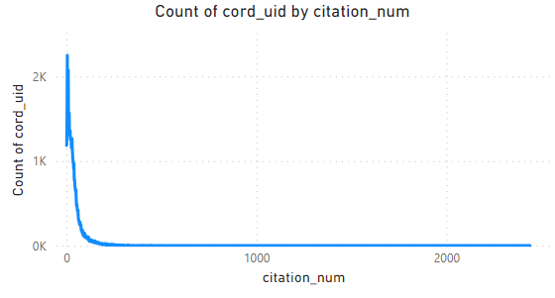
Data Exploration
Distribution in TREC Covid dataset based on citation count.
Spectrum ranges from 0 citations to an impressive 2,440 citations in a single document.
About 90% of data concentrated within 0 to 150 citations range.
Notes:
The graph on the slide is the distribution of the trec covid dataset based on the citation count, now Let us try to understand it.
The x axis is the number of citation of each document and y axis is the total number of document having n number of citation.
From the given graph we can clearly see that the spectrum spans of documents with no citations up to an impressive maximum of 2,440 citations in a single document. However, the majority of the dataset, approximately 90% of it, is concentrated within the range of 0 to 150 citations and from here we can conclude that the data is not normalised as there is a skewness in the graph. In order to use this data we have to perform normalisation and i will discuss about it in the next slide which is Data pre-processing

Slide 8
Data Pre-Processing
Duplicate Removal:
Initial cleaning by eliminating duplicate documents.
Focused on unique documents for subsequent analysis.
Stopwords and Special Characters Removal:
Eliminated stopwords and special characters from each document.
Enhanced data quality and relevancy.
Stemming Using nltk Library:
Employed nltk library in Python for stemming.
Reduced words to their root form for consistency.
Data Normalisation for Citations:
Addressed imbalanced citation counts in documents.
Performed data normalisation in citation titles.
Tokenization of Cleaned Data:
Concluded pre-processing by tokenising the cleaned data.
Prepared data for further analysis and modelling.
Notes:
Initially, for data preprocessing duplicate documents were identified and eliminated from the dataset.
The focus was then directed towards working with a collection of unique documents for subsequent analysis.
Stopwords (common words like "the," "is," "and," etc.) and special characters were removed from each document.
This process aimed to enhance the quality and relevance of the data by eliminating noise.
The NLTK (Natural Language Toolkit) library in Python was utilized for stemming.
Stemming involves reducing words to their root form, which promotes consistency and improves text analysis by treating related words as a single entity.
To address imbalanced citation counts in documents, a data normalisation process was carried out specifically on the citation titles.
This step likely involved adjusting the citation counts to achieve a more balanced representation. We have tried few combination of most frequent words in the titles like 50,100…300 which will be later elaborated by Agnideep
The preprocessing concluded with the tokenization of the cleaned data.
Tokenization involves breaking down text into individual tokens (words or phrases), creating a format suitable for further analysis and modeling.

Slide 9
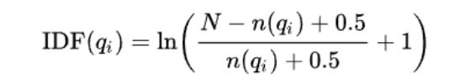
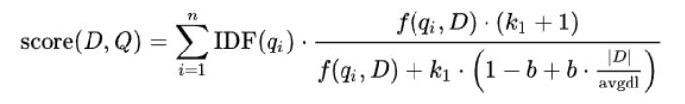
Implementation
Below formulas were used to determine the score of each document:
2. The best scores was achieved by the combination of k1= 1.5 and b= 0.5
Notes:
For generating the score of each document we have used the okapi bm25 algorithm which stands for "Best Matching 25," It is a ranking function commonly used in information retrieval. Documents with higher relevance scores are ranked higher in search results.
Term Frequency (TF): Similar to TF-IDF, BM25 takes into account the frequency of terms in a document. However, instead of using a simple term frequency, BM25 employs a logarithmic scaling to dampen the impact of very high term frequencies.
Inverse Document Frequency (IDF): Like TF-IDF, BM25 considers the importance of a term in the entire document collection. However, BM25 uses a more flexible and dynamic formula for IDF that adjusts based on the total number of documents and the number of documents containing the term.
Document Length Normalization: BM25 normalizes the document length to account for differences in document sizes. This is important because longer documents might have more occurrences of a term simply due to their length, not necessarily because they are more relevant.
Query Term Saturation: BM25 incorporates a parameter called "k1" that controls the saturation point of the term frequency. This means that as the term frequency increases, its impact on the relevance score diminishes after a certain point.
Query Term Weighting: BM25 introduces a parameter called "b" that adjusts the impact of document length normalization on the relevance score.
D is the document being evaluated
Q is the query
qi is the ith term in the quer Q
f(qi, D) is the inverse document frequency of term qi
|D| is the length in terms of document D
avgdl is the average length of the document length in the entire collection
k1 and b are the tuning parameters thats controls the term saturation and document length normalisation,respectively.
My project Agnideep will walk you all through the rest of the slides.

Slide 10

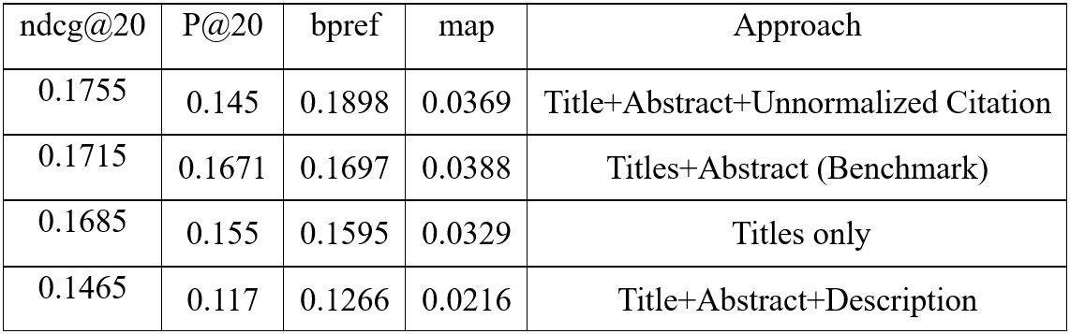
Results
Trec_Eval has been used as a tool to evaluate our system performance
The parameters used to compare the performance are
ndcg@20 (Normalized Discounted Cumulative Gain)
MAP (Mean Average Precision)
p@20 (Precision at 20)
Bpref (Binary Preference)
We indexed several types of corpus but selected the one with title and abstract as the benchmark:
Notes:
Greetings! I'm Agnideep, and I'm excited to guide you through the upcoming slides
After the implementation of the code, we get the result file, which is the ranked list of 1000 documents per topic, arranged in descending order of their ranking score. We can observe the results from the table shown.
We pass this result file to the evaluation tool called ‘Trec_eval’, which was used at the competition.
From this tool, we get the result parameters such as
· ndcg@20 (Normalized Discounted Cumulative Gain) : It is a measure of the effectiveness of a ranking system, taking into account the position of relevant items in the ranked list.
· MAP (Mean Average Precision): is a measure of the precision of a ranking system, taking into account the number of relevant items in the ranked list.
· p@20 (Precision at 20)
· Bpref (Binary Preference): a measure of how many relevant documents are ranked before irrelevant documents
We have indexed several types of corpus, considering Title, Abstract, Body and Citations and found the scores for several combinations. We identified the Title + Abs as our benchmark.

Slide 11

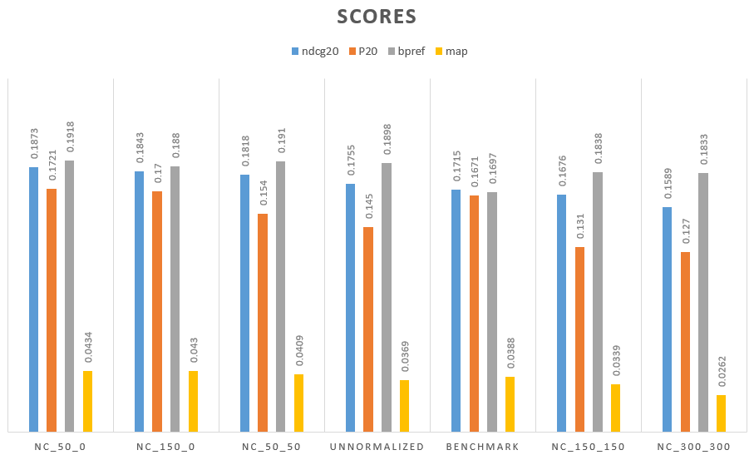
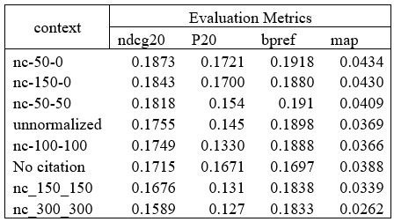
Scores after adding Citation information
* Notation : nc-x-y stands for Normalized citation with ‘x’ upper bound and ‘y’ lower bound
Notes:
Now let’s understand how we decided to normalize the data. As we have seen previously, that 90% of the total documents contains 0 to 150 numbers of citations, so there is a chance that enriching the corpus without normalizing it would introduce bias towards the data having higher citation counts.
So we have introduced the idea of higher and lower bounding. we adopted the notation “nc-x-y” where ‘nc’ stands for ‘normalized citations’, “x” denotes the upper bound and “y” signifies the lower bound.
For instance, consider “x=10”. In this scenario, if the total number of words in a citation exceeds 10, we would only consider the top 10 most frequent words present in the citations.
On the other hand, when “y=10” if the total number of words in a citation falls below 10, we replicate the citation words until the total count reaches 10.
As seen in the table, we have performed several combinations of normalizations.
The scores in the table have been arranged in descending order of the nDCG score. So is the graph, which shows, how the different result parameters have changed based on different corpus by adding citation information. The corpus with ‘no citations’ comes at 6th position at the table, so most of the corpus have outperformed the benchmark score.

Slide 12
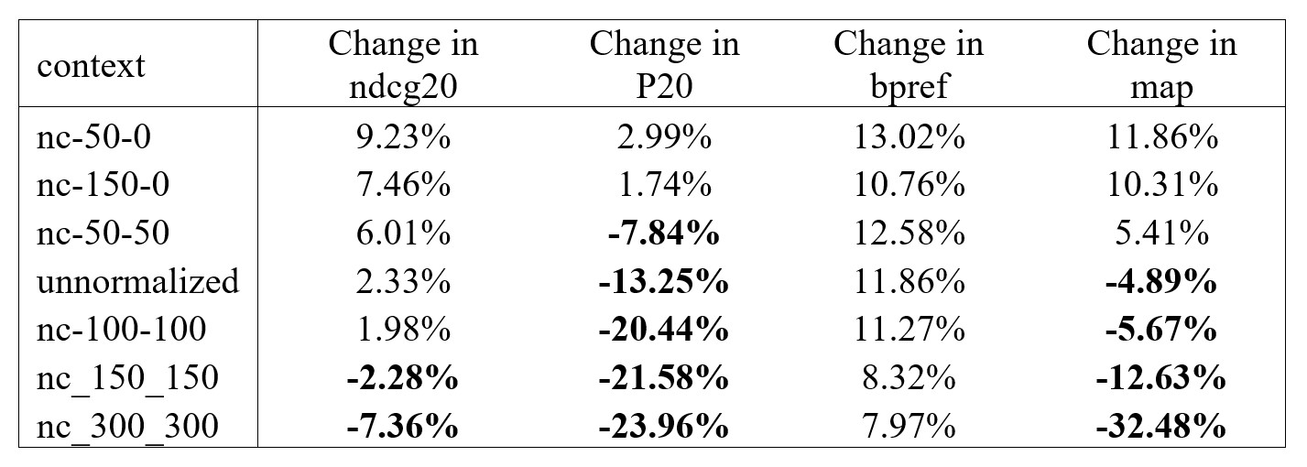
Evaluation
Formula for Change Calculation: Change = ((New Val - Benchmark) / Benchmark) * 100
Percentage Changes Table:
* Notation : nc-x-y stands for Normalized citation with ‘x’ upper bound and ‘y’ lower bound
Notes:
Now, let's look at our evaluation. For a better understanding, we have calculated the percentage change of parameters with respect to the benchmark score. We have arranged it in the descending order of the change in ndcg score. From here we can unfold interesting insights

Slide 13
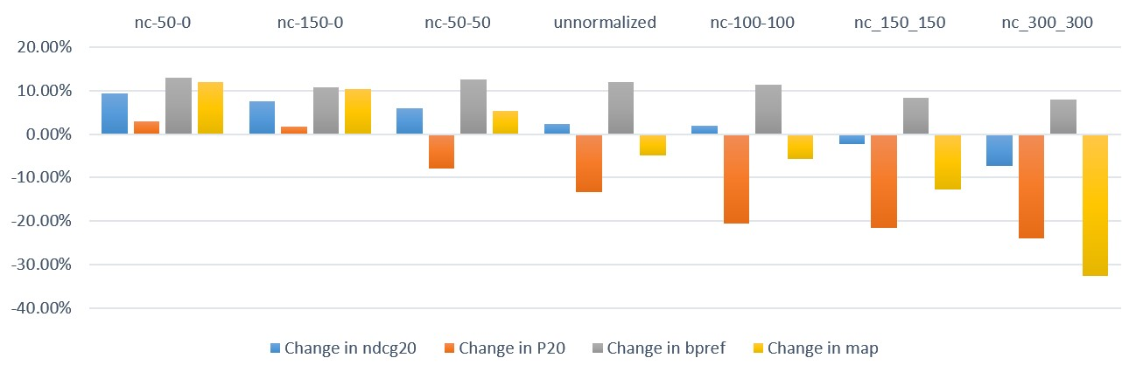
Evaluation (1)
Relative scores against benchmark:
Notes:
For a clearer picture, let’s look into the clustered bar chart and identify the findings.
1. One fascinating inference is, if we look at the grey bar representing bpref, It has always improved than the benchmark when citation information has been added. This means the relevant document is getting placed on top of the irrelevant ones.
2. To strengthen our inference on the position of the ranking of relevant document, we can also check the blue bar representing the NDCG score. It has done improvement till nc-100-100 but further that, the score has decreased maybe due to excess information.
3. However, if we look at precession measures like MAP and P@20, we unveil a tricky situation, We see that after adding citation information, it has improved for some and decreased for others. This suggests that larger citation contexts may pose challenges, potentially due to the complexities arising from an extensive number of citations. However, there is a sweet spot which can be used to push the benchmark performance in terms of precision.
4. CHANGE SLIDE

Slide 14
Inferences
Citations consistently enhance bpref, indicating added context improves retrieval systems identification and ranking.
MAP, p@20 scores vary across citation contexts. Some improve precision; broader contexts may challenge performance.
Adding lower boundary in normalization harms retrieval. Top-performing corpus lacks it. Duplicating citations compromises quality
Incorporating citations boosts system performance, particularly NDCG20, with optimal window size and normalization
Notes:
4. Notably, we observe that introducing a lower boundary while normalising the citation data adversely impacts the retrieval scores. The top-performing corpus reveals no implementation of lower boundaries. A striking comparison between nc-50-0 and nc-50-50 shows that nc-50-0 outperforms its counterpart in all aspects. This suggests that duplicating the citation information to enhance its weight backfires, as it may accumulate redundant data, consequently compromising the corpus's quality.

Slide 15
Conclusion and Future Work
Key Research Question: Can enriching the corpus with citations improve the baseline score?
Objective Accomplished: Enriched corpus showed notable baseline score improvement with certain limitations.
Future Work:
Fine tuning models
Exploring different normalization techniques
Improving Scalability and Efficiency
Incorporating advanced Machine Language techniques.
Notes:
Now, coming to the conclusion and the future scope of our project.
Through our practicum, we successfully pursued our research question: “Can we enhance the baseline score by enriching the corpus with added citation information?”
Our findings showcased promising outcomes, as we enriched the corpus with citation information, we yielded noticeable improvements in the baseline score. However, too much extra citation information can become counter-productive and hamper system performance. With optimum tuning we could attent 9% increase in ndcg and 12% increase in MAP score.
Coming to Future scope,
1. Can be used for fine-tuning models by boosting that extra mile, by optimally adding citation information.
2. Further research can be done on techniques used in normalization. Ex, instead of using just the frequency, tf-idf score can be explored.
3. We can explore methods to handle larger and more diverse citation datasets efficiently to ensure practical applicability in real-world information retrieval scenarios
4. We can use more advanced state-of-the-art technologies with the enriched corpus to yield even better results.

Slide 16

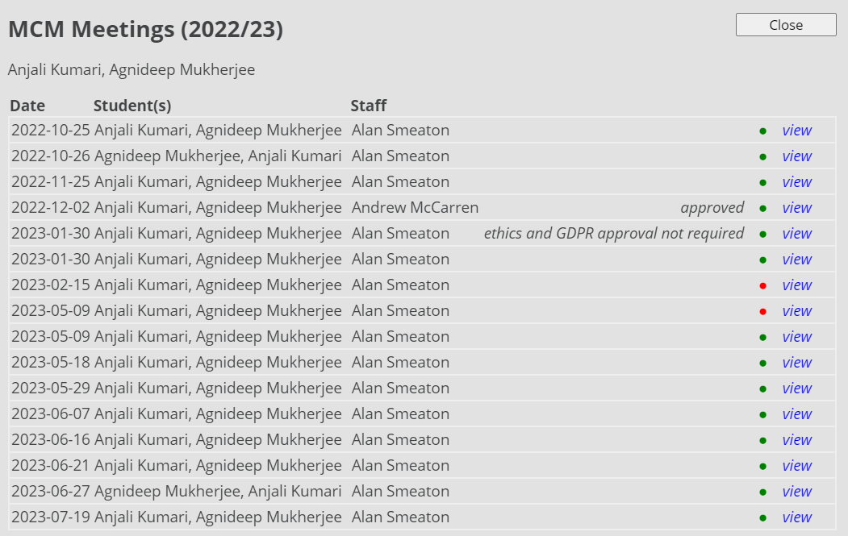
Project Dashboard
NOTE: The meeting on 2023-05-09 is marked ‘Unsatisfactory’ by mistake, it should be ‘Satisfactory’ instead
Notes:
NOTE: The meeting on 2023-05-09 is marked ‘Unsatisfactory’ by mistake,As suggested by our mentor, it should be ‘Satisfactory’ instead

Slide 17
Thank you.

