Slide 1
Fine-Tuning or Retrieval?
Comparing Knowledge Injection in LLMs
Agnidipto Sinha
UIN: 656951369
Pratyay Banerjee
UIN: 657166077

Slide 2
Paper Overview
Problem: Injecting new factual knowledge into LLMs
Approaches compared:
Unsupervised Fine-Tuning (FT)
Retrieval-Augmented Generation (RAG)

Slide 3
Knowledge Injection Framework
Define question set Q and knowledge base B
Seek transformation M′=F(M,B) such that accuracy L(M′,Q)>L(M,Q)
FT: = continue LM training on BBB
RAG: FFF = retrieve top-KKK chunks from BBB and prepend to query

Slide 4
Dataset Construction
MMLU Subsets: Anatomy, Astronomy, Biology, Chemistry, Prehistory
Knowledge Base: Wikipedia articles chunked (256 tokens) via wikiextractor
Current-Events MCQs:
GPT-4 generated 910 Qs from Wiki events (Aug–Nov 2023)
Human verification for correctness
Note: We use only Astronomy subset for our Mistral runs

Slide 5
Our Reproduction Scope
Model: Mistral-7B-Instruct-v0.2 (4-bit quantized + LoRA)
Methods evaluated:
1. FT only (LoRA adapters)
2. RAG only (K=3 retrieved chunks)
3. FT + RAG
Dataset: Astronomy validation & test sets from MMLU
Training Data: Scraped Wikipedia
Metric: MCQ accuracy via log-prob sum scoring

Slide 6
Training Data Collection
Gathered MMLU Validation and Test Dataset (JSON Format)
Identified key topics.
Scraped 47 Wikipedia pages based on topics.
Created 5 Multiple Choice Questions per subheading in each page. (JSON Format) via GPT-4.

Slide 7
Implementation Details
FT setup:
Learning rate 2e-5, per-device batch 4, grad-accum 8, epochs 3
LoRA adapters on all transformer layers
RAG setup:
– bge-large-en embeddings, FAISS index, K=3

Slide 8
Evaluation Method
For each question, form the prompt: “Q: <question text>\nA:”
For each answer choice:
– Append it to the prompt at the token level
– Run the concatenated tokens through the model
– Compute the sum of log-probabilities assigned to the answer tokens
Select the choice with the highest total log-probability as the model’s prediction
Compute accuracy = (number of correct predictions) / (total questions)

Slide 9
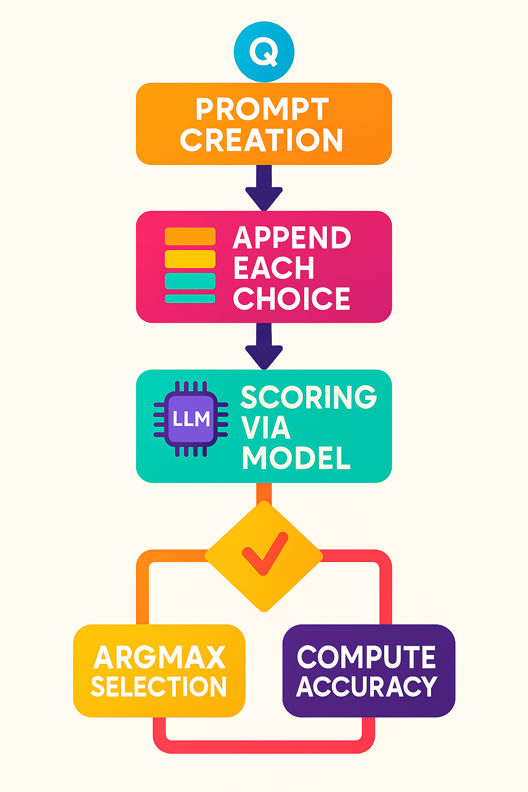

Slide 10
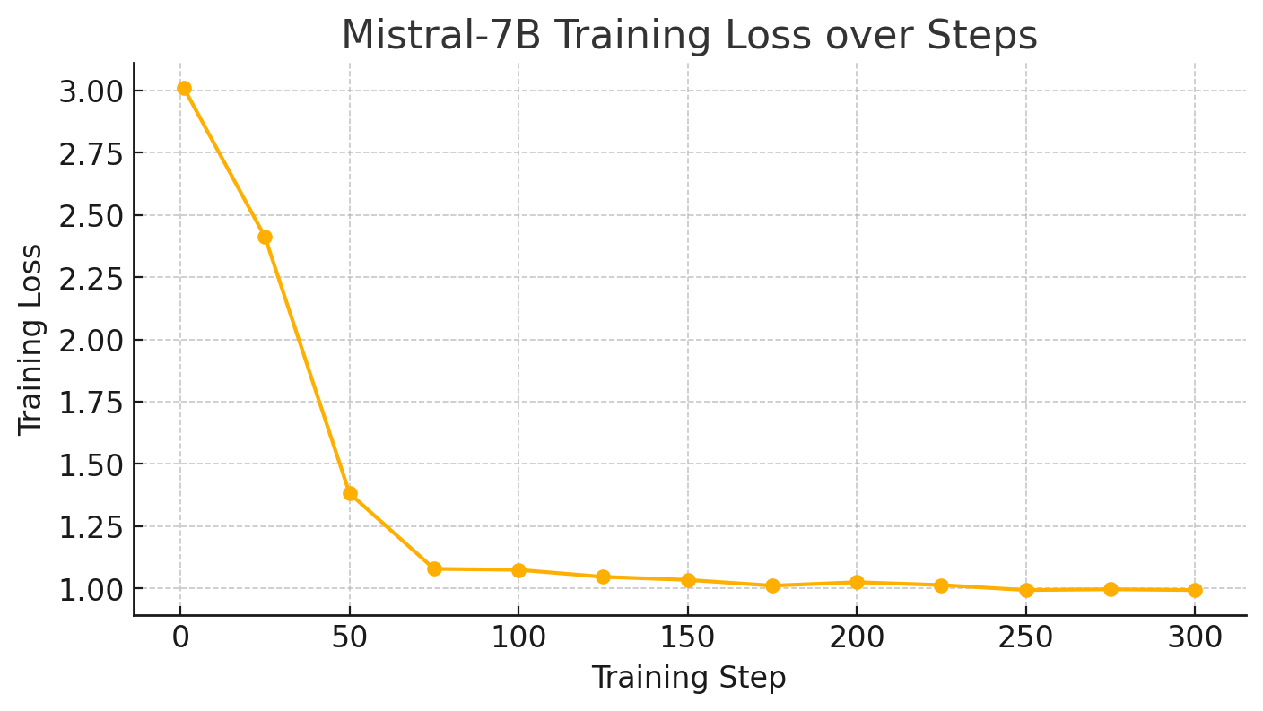
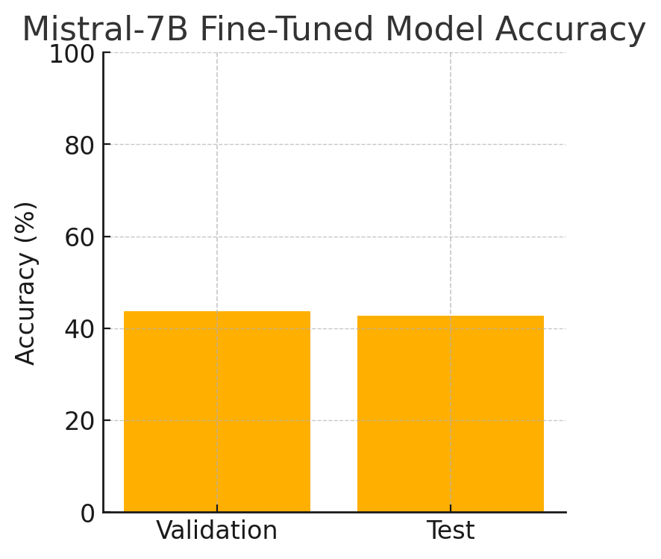
Finetuning Mistral

Slide 11
RAG
Retrieval method/algorithm: FAISS
Embeddings used: BAAI/bge-large-en
Number of documents to be retrieved: 3

Slide 12
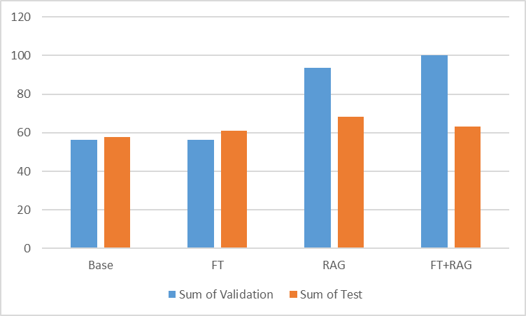

Slide 13
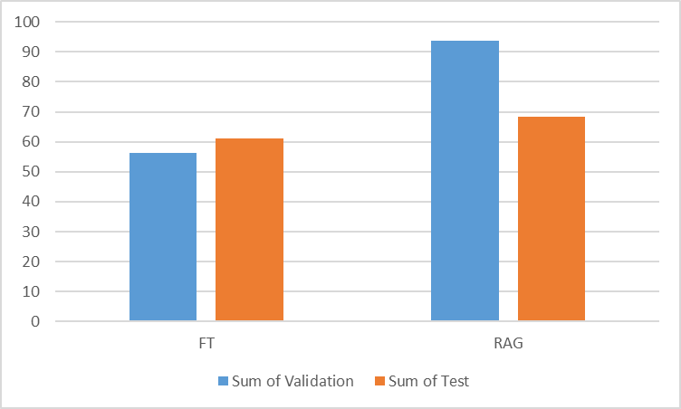
Fine-tune vs RAG

Slide 14
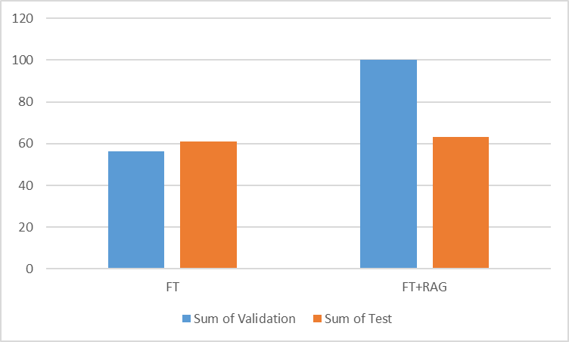
Fine-Tune vs FT+RAG

Slide 15
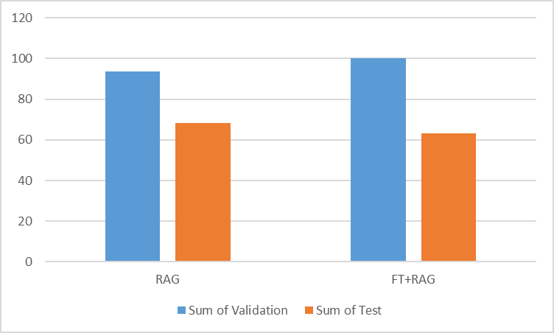
RAG vs FT+RAG

Slide 16
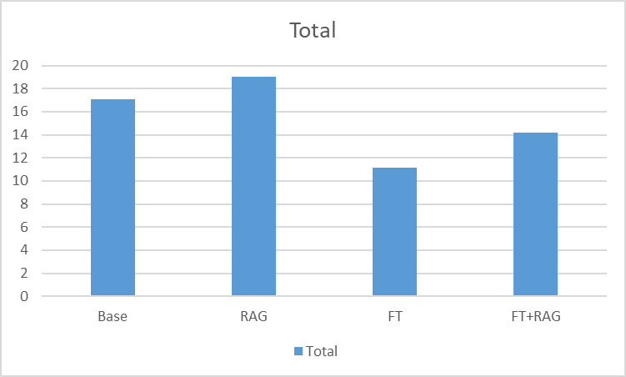
New Findings

Slide 17
New Findings
Fine-Tuned model took less time to predict output in every scenario.
FT+RAG model was faster than the Base Model under the same specs (T4 GPU).

Slide 18
Challenges
Providing Mistral with Context (RAG) made it give additional unnecessary details.
It generated new questions with choices, and provided answers to them as well.
Fine-Tuned model gave less unnecessary text output when it was paired with RAG compared to Base Model.

Slide 19
Conclusions
Base Model performs the poorest.
RAG is an improvement over the Base Model.
Fine-Tuning performs the same on Validation, but performs better during Testing.
RAG + Fine-Tuning is unpredictable and does not improve the Fine-Tuned model’s performance.
RAG is good for predicting known data, much more than unknown data.

Slide 20
Thank You!
THANK YOU!

