Slide 1

Introduction to probability, statistics and data handling
Agnieszka Obłąkowska-Mucha
Tomasz Szumlak
Faculty of Physics and Applied Computer Science
AGH University of Krakow

Slide 2
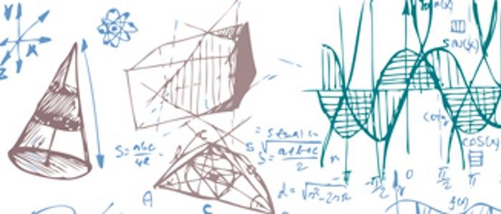
Intro
Lectures 30 hours
Tutorials 20 hours (compulsory!)
Computer Labs 10 hours (compulsory!)
Final grades – 0.2 lecture activity 0.4 tutorial + 0.4 labs
  Note, you may not fail neither tutorial nor labs
Please make sure in advance that you have computer account with the Uni!
Our contact details
  Agnieszka Obłąkowska-Mucha (lectures): amucha@agh.edu.pl
  Saliha Bashir (tutorials and labs): bashir@agh.edu.pl
  Building D11/110

Slide 3
Intro
Course web page: https://agnieszkamucha.github.io/Statistics/
Textbook: Introductory Statistics, OpenStax Access online
Lectures: slides with discussions
Computer Laboratory: follow the instructions, complete tasks
Tutorials:
    1. find assignments BEFORE the day of tutorial
    2. find and read matching lecture or chapter in textbook
    3. solve or think over the assignments

Slide 4
Data and Experiments
Our primary concern in Statistics is analysing data collected from an experiment – this is an essential notion and we should define it well
Just as in the lab, we define an experiment as a procedure to be followed – the outcome of this procedure constitutes the result which can be represented as a single quantity or a set of quantities or a distribution
These measured quantities can be discrete or continuous
Note: no matter how accurately all conditions of the experiment are maintained, its results will in general differ – the measurement has an intrinsic random component
This can be attributed to the very nature of the observed phenomenon or limited accuracy of the measurement
This is why we should always use statistics to process the results of an experiment and understand them
$$Result=Value ±Uncertainty [UNIT]$$

Slide 5


Where can you find statistics?
Everywhere…

Slide 6

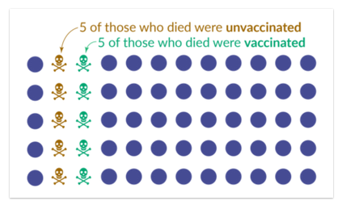
Data
Imagine we live in a place with a population of 60 people.
10 people died because of Covid-19. And we learn that 50% of them were vaccinated.
.
The newspaper may read, “Half of those who died from the virus were vaccinated.”
We need to know about those who did not die: how many people in this population were vaccinated? And how many were not vaccinated?
https://ourworldindata.org/covid-deaths-by-vaccination

Slide 7
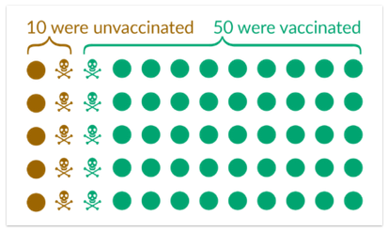
Data
Now we have all the information we need and can calculate the death rates:
Of 10 unvaccinated people, 5 died → the death rate among the unvaccinated is 50%.
Of 50 vaccinated people, 5 died → the death rate among the vaccinated is 10%.
We, therefore, see that the death rate among the vaccinated is 5 times lower than among the unvaccinated.

Slide 8
Probability vs statistics
Probability serves as the foundational framework for statistical analysis, providing the theoretical basis for understanding uncertainty and randomness in data.
Statistics utilizes probability theory to make inferences, draw conclusions, and quantify the likelihood of different outcomes within a given dataset.

Slide 9
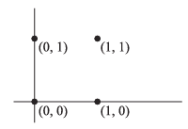
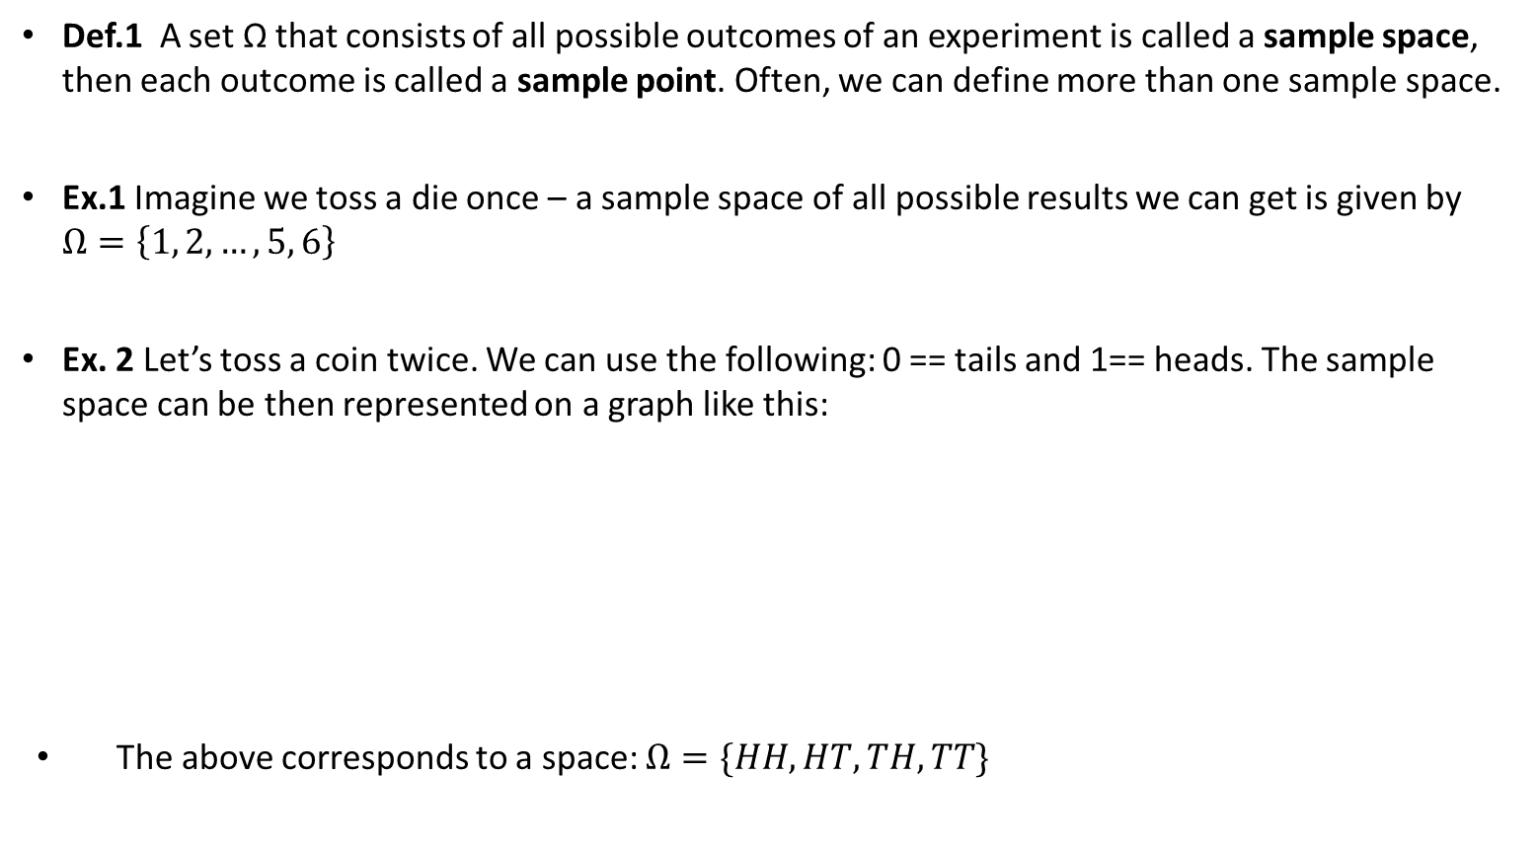
Sample space (I)
Def.1 A set Ω that consists of all possible outcomes of an experiment is called a sample space, then each outcome is called a sample point. Often, we can define more than one sample space.
Ex.1 Imagine we toss a die once – a sample space of all possible results we can get is given by $Ω=\left\{1, 2,…, 5, 6\right\}$
Ex. 2 Let’s toss a coin twice. We can use the following: 0 == tails and 1== heads. The sample space can be then represented on a graph like this:
The above corresponds to a space: $Ω=\{HH, HT, TH, TT\}$

Slide 10
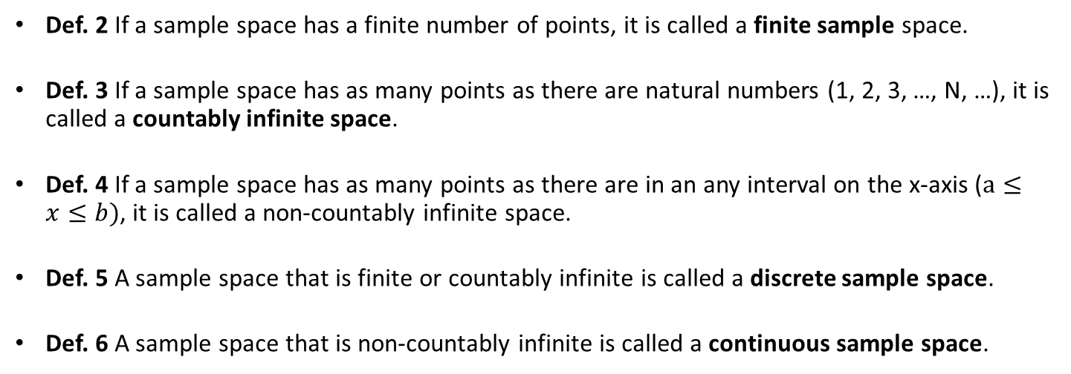
Sample space (II)
Def. 2 If a sample space has a finite number of points, it is called a finite sample space.
Def. 3 If a sample space has as many points as there are natural numbers (1, 2, 3, …, N, …), it is called a countably infinite space.
Def. 4 If a sample space has as many points as there are in an any interval on the x-axis ($a≤x≤b)$, it is called a non-countably infinite space.
Def. 5 A sample space that is finite or countably infinite is called a discrete sample space.
Def. 6 A sample space that is non-countably infinite is called a continuous sample space.

Slide 11
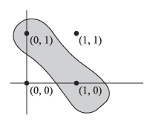

Events (I)
Def. 7 An event is a subset $𝔸$ of the sample space $Ω$, i.e., it is a set of possible outcomes that we are interested in.
Def. 8 If the outcome of an experiment is an element of $𝔸$ we say that the event $𝔸$ has occurred. An event consisting of a single point, belonging to sample space, is called an elementary event.
Ex. 3 We can use the sample space from ex. 2 to define an event $𝔸$: ‚only one head comes up’.

Slide 12
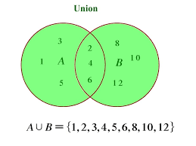
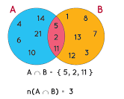
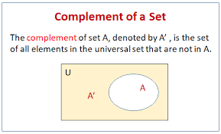
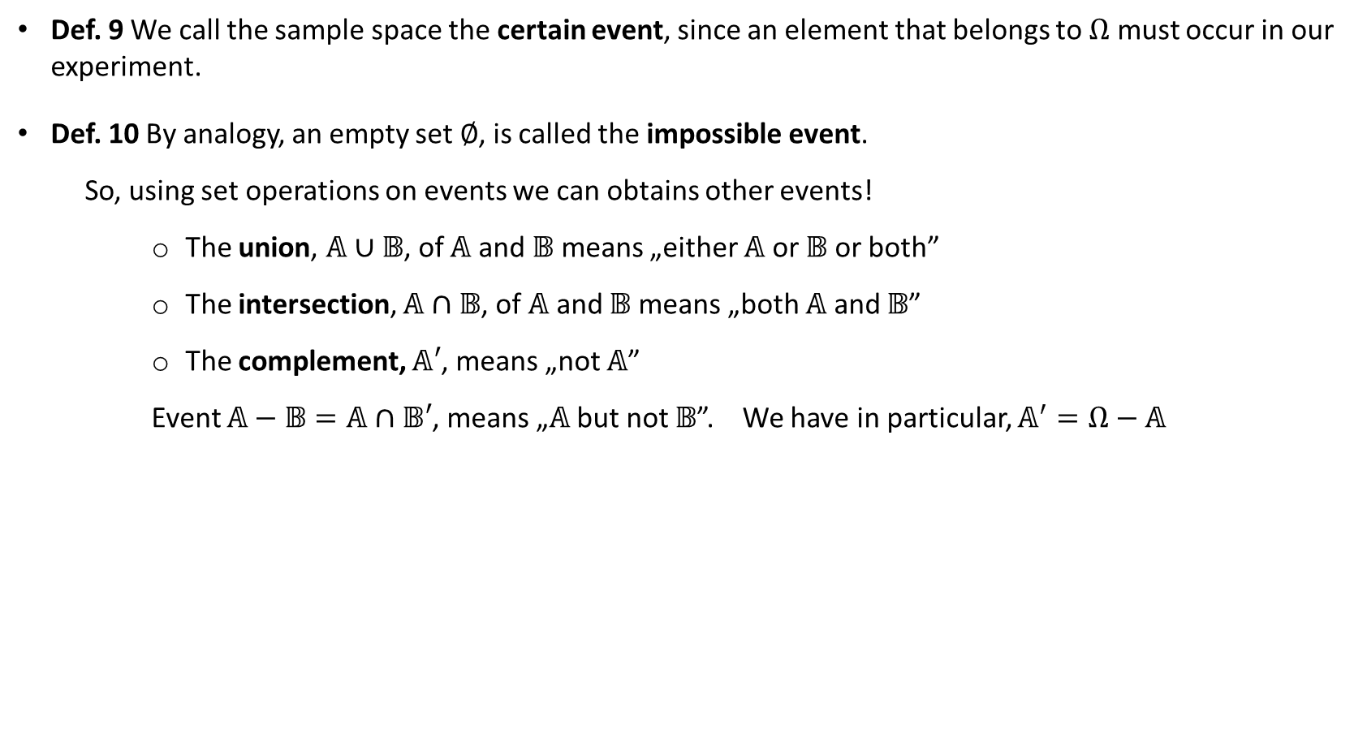
Events (II)
Def. 9 We call the sample space the certain event, since an element that belongs to $Ω$ must occur in our experiment.
Def. 10 By analogy, an empty set $∅$, is called the impossible event.
  So, using set operations on events we can obtains other events!
    The union, $𝔸∪𝔹$, of $𝔸$ and $𝔹$ means „either $𝔸$ or $𝔹$ or both”
    The intersection, $𝔸∩𝔹$, of $𝔸$ and $𝔹$ means „both $𝔸$ and $𝔹$”
    The complement, $𝔸′$, means „not $𝔸$”
    Event $𝔸−𝔹=𝔸∩𝔹′$, means „$𝔸$ but not $𝔹$”. We have in particular, $𝔸^{′}=Ω−𝔸$

Slide 13
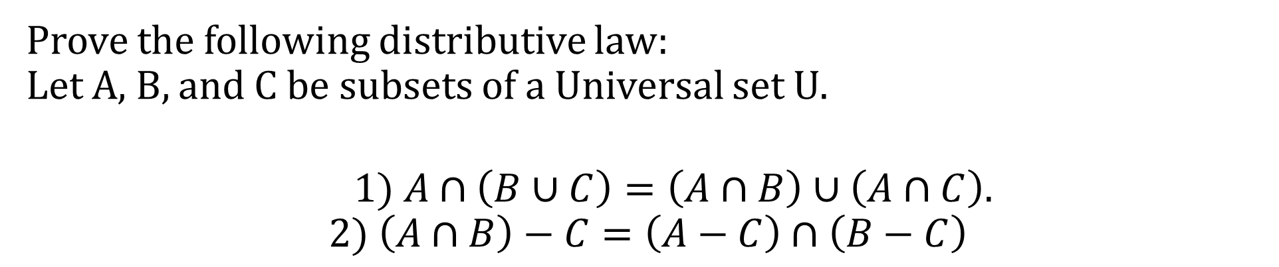
Sets and examples
Prove the following distributive law:
Let A, B, and C be subsets of a Universal set U.
$$\begin{matrix} & 1) A∩\left(B∪C\right)=\left(A∩B\right)∪\left(A∩C\right).\end{matrix}$$
$$2) \left(A∩B\right)−C=\left(A−C\right)∩\left(B−C\right)$$
U = {1,2,3,4,5}
A = {1,2}
B = {2,3}
C = {1,2,5}

Slide 14
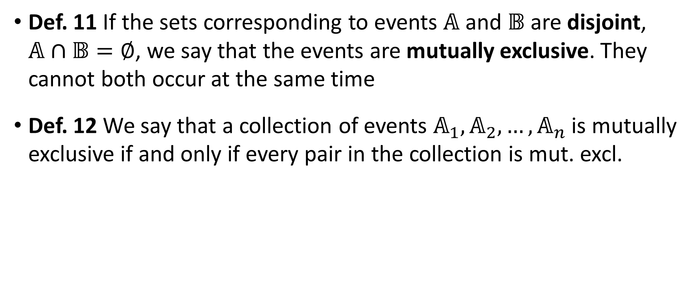
Events (III)
Def. 11 If the sets corresponding to events $𝔸$ and $𝔹$ are disjoint, $𝔸∩𝔹=∅$, we say that the events are mutually exclusive. They cannot both occur at the same time
Def. 12 We say that a collection of events $𝔸_{1}, 𝔸_{2},…,𝔸_{n}$ is mutually exclusive if and only if every pair in the collection is mut. excl.

Slide 15

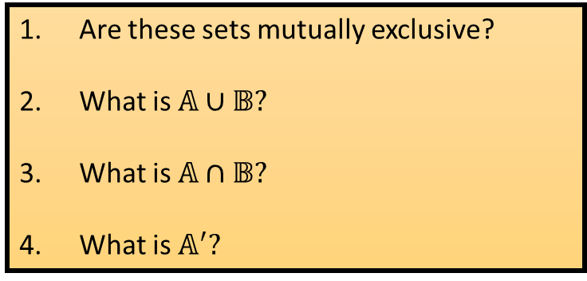
Events (IV)
Ex. 4 Using further ex. 2, let’s use the set operations on the following events: „at least one head occurs” and „the second toss result is a tail”. Determine the outcome of all the operations listed.
Are these sets mutually exclusive?
What is $𝔸∪𝔹?$
What is $𝔸∩𝔹?$
What is $𝔸^{′}?$

Slide 16
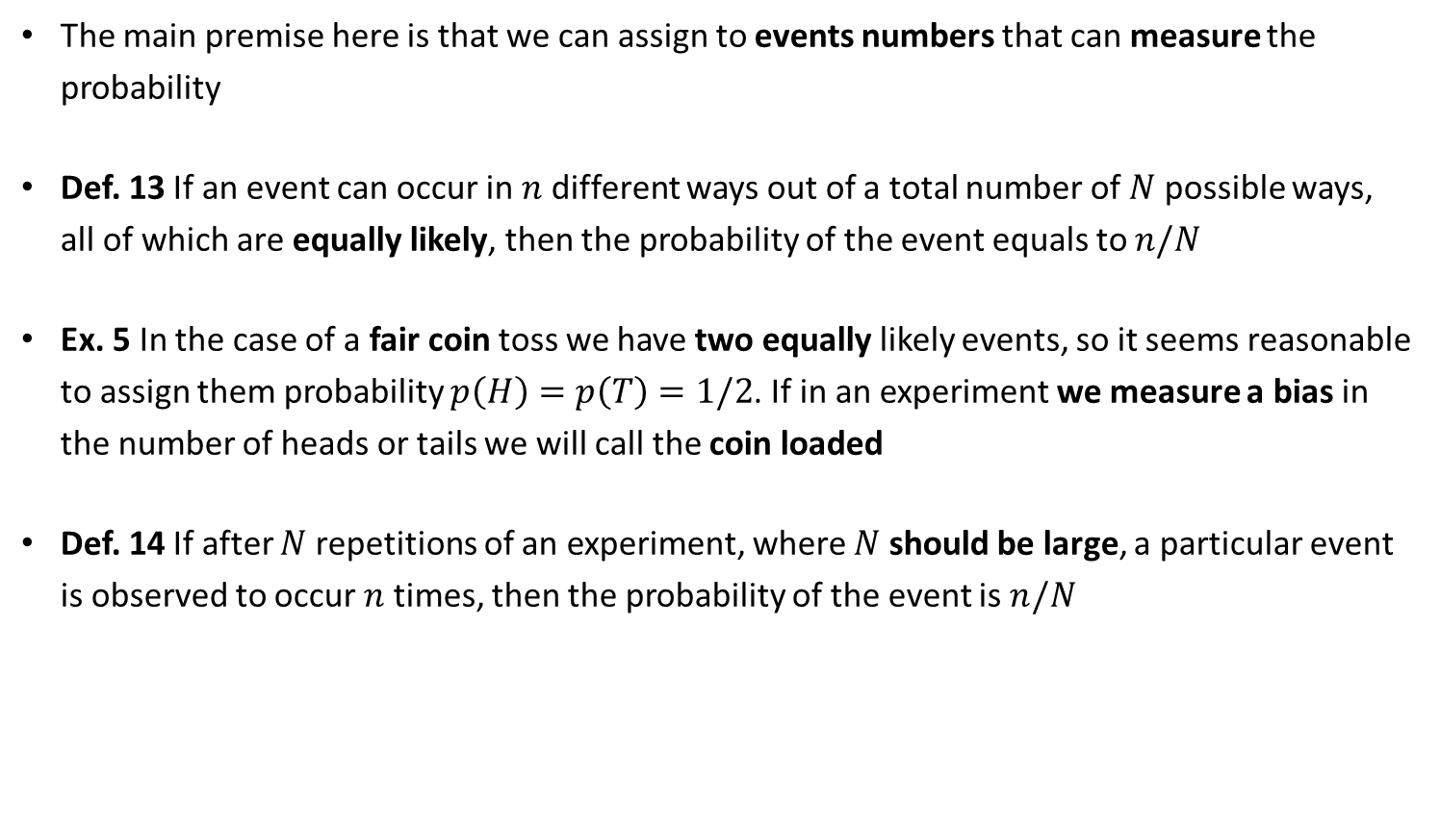
Probability (I)
The main premise here is that we can assign to events numbers that can measure the probability
Def. 13 If an event can occur in $n$ different ways out of a total number of $N$ possible ways, all of which are equally likely, then the probability of the event equals to $n/N$
Ex. 5 In the case of a fair coin toss we have two equally likely events, so it seems reasonable to assign them probability $p\left(H\right)=p\left(T\right)=1/2$. If in an experiment we measure a bias in the number of heads or tails we will call the coin loaded
Def. 14 If after $N$ repetitions of an experiment, where $N$ should be large, a particular event is observed to occur $n$ times, then the probability of the event is $n/N$

Slide 17

Probability (II)
There are some serious troubles with both definitions given in the previous slide…
  How can we tell if events are equally likely?
  What does it mean that a sample should be large?
These issues are „cured” by the axiomatic approach to the probability. The core element in the axiomatic definition is a notion of a probability function $p\left(𝔸\right)$, which gives a number related with each event.
  Axiom 1 For every event: $p\left(𝔸\right)≥0$
  Axiom 2 For the certain event $p\left(Ω\right)=1$
  Axiom 3 For any number of mutually exclusive events $𝔸_{1}, 𝔸_{2},…,𝔸_{n}$ $p\left(𝔸_{1}{∪𝔸}_{2}∪…∪𝔸_{n}\right)=p\left(𝔸_{1}\right)+p\left(𝔸_{2}\right)+…+p\left(𝔸_{n}\right)$

Slide 18
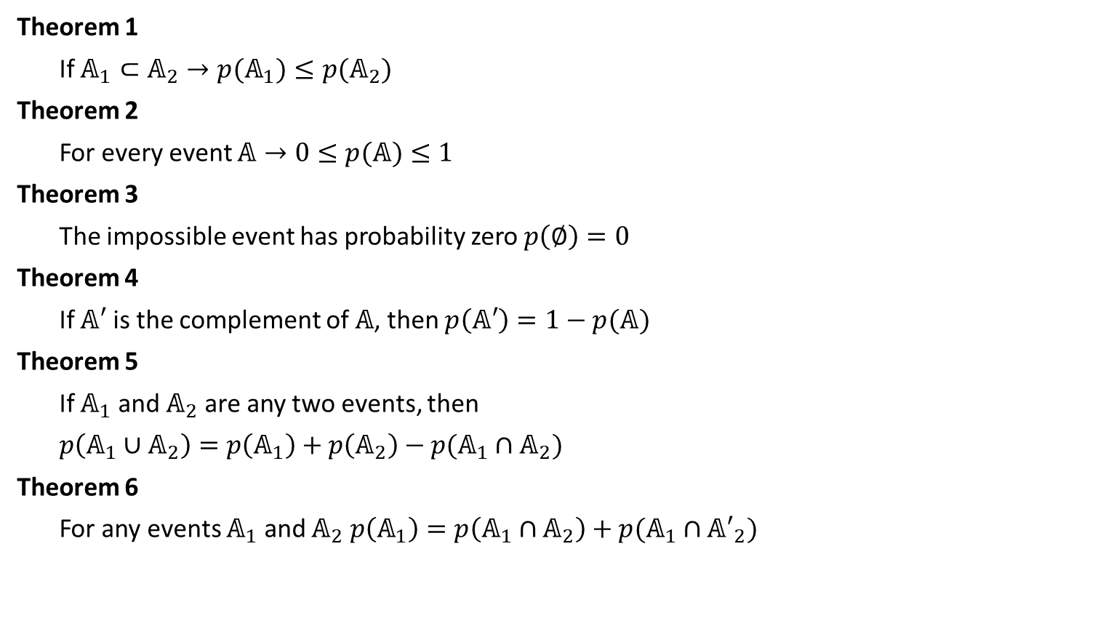
Probability (III)
Theorem 1
If $𝔸_{1}⊂𝔸_{2}→p(𝔸_{1})≤p(𝔸_{2})$
Theorem 2
For every event $𝔸→0≤p(𝔸)≤1$
Theorem 3
The impossible event has probability zero $p\left(∅\right)=0$
Theorem 4
If $𝔸′$ is the complement of $𝔸$, then $p\left(𝔸′\right)=1−p(𝔸)$
Theorem 5
If $𝔸_{1}$ and $𝔸_{2}$ are any two events, then
$p\left(𝔸_{1}{∪𝔸}_{2}\right)=p\left(𝔸_{1}\right)+p\left(𝔸_{2}\right)−p(𝔸_{1}∩𝔸_{2})$
Theorem 6
For any events $𝔸_{1}$ and $𝔸_{2} p\left(𝔸_{1}\right)=p\left(𝔸_{1}∩𝔸_{2}\right)+p(𝔸_{1}∩{𝔸′}_{2})$

Slide 19
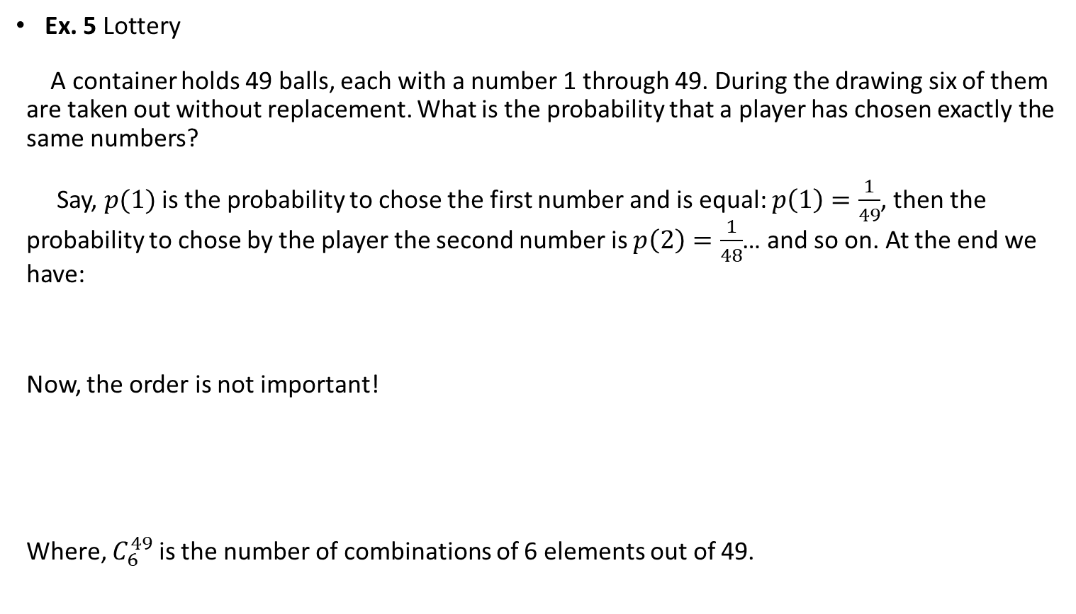
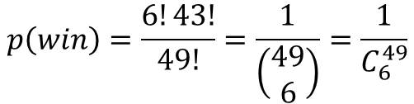

Examples
Ex. 5 Lottery
A container holds 49 balls, each with a number 1 through 49. During the drawing six of them are taken out without replacement. What is the probability that a player has chosen exactly the same numbers?
Say, $p(1)$ is the probability to chose the first number and is equal: $p\left(1\right)=\frac{1}{49}$, then the probability to chose by the player the second number is $p\left(2\right)=\frac{1}{48}$… and so on. At the end we have:
Now, the order is not important!
Where, $C_{6}^{49}$ is the number of combinations of 6 elements out of 49.
$$p\left(1,..,6\right)=\frac{1}{49∙48∙47∙46∙45∙44}=\frac{43!}{49!}$$
$$p\left(win\right)=\frac{6!43!}{49!}=\frac{1}{\left(\begin{aligned}49 \\ 6\end{aligned}\right)}=\frac{1}{C_{6}^{49}}$$

Slide 20
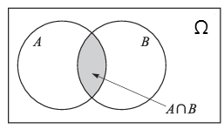
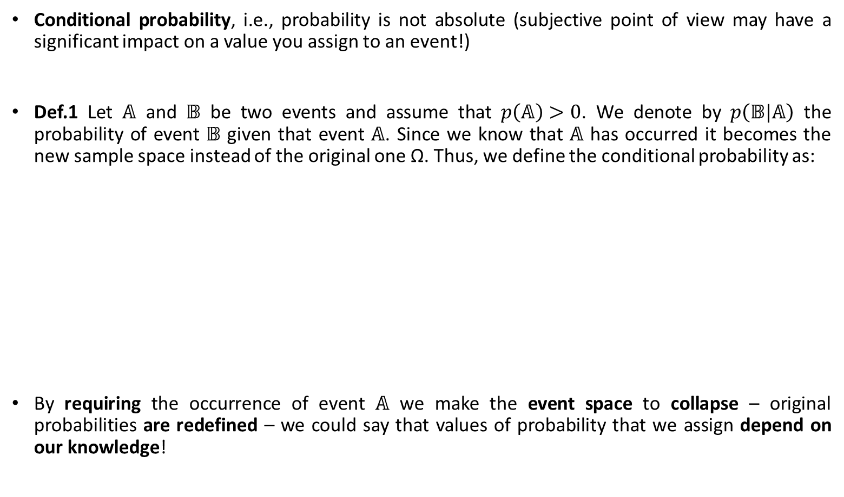


Conditional probability
Conditional probability, i.e., probability is not absolute (subjective point of view may have a significant impact on a value you assign to an event!)
Def.1 Let $𝔸$ and $𝔹$ be two events and assume that $p\left(𝔸\right)>0$. We denote by $p\left(𝔹|𝔸\right)$ the probability of event $𝔹$ given that event $𝔸$. Since we know that $𝔸$ has occurred it becomes the new sample space instead of the original one Ω. Thus, we define the conditional probability as:
By requiring the occurrence of event $𝔸$ we make the event space to collapse – original probabilities are redefined – we could say that values of probability that we assign depend on our knowledge!
$$p\left(𝔹|𝔸\right)=\frac{p\left(𝔸∩𝔹\right)}{p\left(𝔸\right)}$$
$$p\left(𝔸∩𝔹\right)=p\left(𝔹|𝔸\right)p\left(𝔸\right)$$

Slide 21

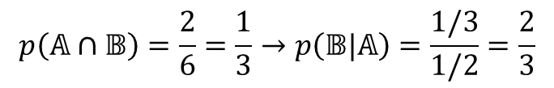

Conditional probability
Ex. 1 We have a fair die which is tossed once. Calculate the probability that a single toss of a die will result in a number less than 4. Repeat the math if it is given that the toss resulted in an odd number.
  If no additional information is available we estimate the probability of turning 4 as a union of fundamental events 1, 2, 3:
  Now, we know that an event „an odd number turned” has occurred, we have:
  In this case we „added knowledge” to our calculations! We knew that an odd number turned.
  So, the values of probabilities we are going to assign to events depends on the extent of our knowledge about this event. In time it can change!
$$p\left(𝔹\right)=p\left(1\right)+p\left(2\right)+p\left(3\right)=1/2$$
$$p\left(𝔸\right)=\frac{3}{6}=\frac{1}{2}$$
$$p\left(𝔸∩𝔹\right)=\frac{2}{6}=\frac{1}{3}→p\left(𝔹|𝔸\right)=\frac{1/3}{1/2}=\frac{2}{3}$$

Slide 22
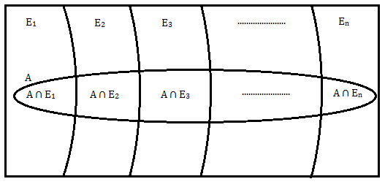

Some theorems on CP
Theorem.1 Let say we have three events $𝔸_{1},𝔸_{2},𝔸_{3}$. The probability that they all occur can be calculated as follow (can easily be generalised to any number of events):
Theorem.2 Imagine that we have an event $𝔸$that can be represented by n mutually exclusive events $𝔼_{i}$ (Ω $=𝔼_{1}$ $∪𝔼_{2}$ $∪$ … $∪𝔼_{n}$), then
$$p\left(𝔸_{1}∩𝔸_{2}∩𝔸_{3}\right)=p\left(𝔸_{1}\right)p\left(𝔸_{2}|𝔸_{1}\right)p\left(𝔸_{3}|𝔸_{1}∩𝔸_{2}\right)$$
$$p\left(𝔸\right)=\sum_{i/0}^{i/n}{p\left(𝔸∩𝔼_{i}\right)}=p\left(𝔼_{1}\right)p\left(𝔸|𝔼_{1}\right)+…+p\left(𝔼_{n}\right)p\left(𝔸|𝔼_{n}\right)$$

Slide 23
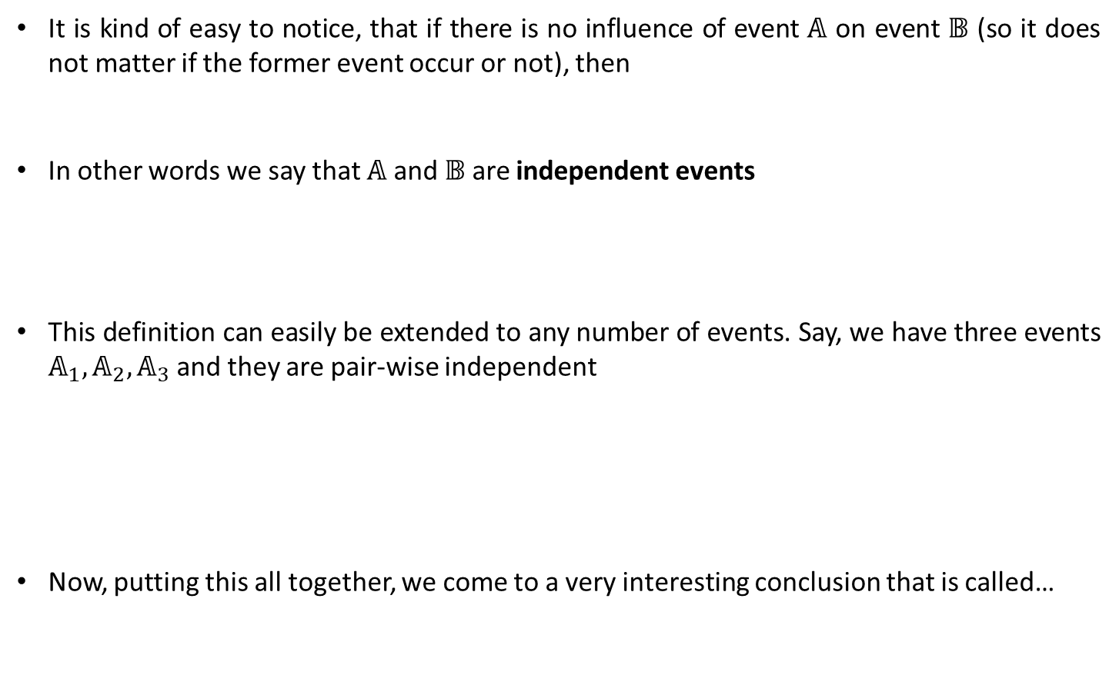


Independent events
It is kind of easy to notice, that if there is no influence of event $𝔸$ on event $𝔹$ (so it does not matter if the former event occur or not), then
In other words we say that $𝔸$ and $𝔹$ are independent events
This definition can easily be extended to any number of events. Say, we have three events $𝔸_{1},𝔸_{2},𝔸_{3}$ and they are pair-wise independent
Now, putting this all together, we come to a very interesting conclusion that is called…
$$p\left(𝔹|𝔸\right)=p\left(𝔹\right)$$
$$p\left(𝔸∩𝔹\right)=p\left(𝔹|𝔸\right)p\left(𝔸\right)=p\left(𝔹\right)p\left(𝔸\right)$$
$$p\left(𝔸_{i}∩𝔸_{j}\right)=p\left(𝔸_{i}\right)p\left(𝔸_{j}\right), i≠j, i,j=1,2,3$$
$$p\left(𝔸_{1}∩𝔸_{2}∩𝔸_{3}\right)=p\left(𝔸_{1}\right)p\left(𝔸_{2}\right)p\left(𝔸_{3}\right)$$

Slide 24
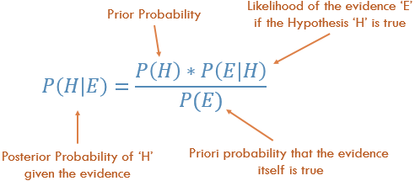
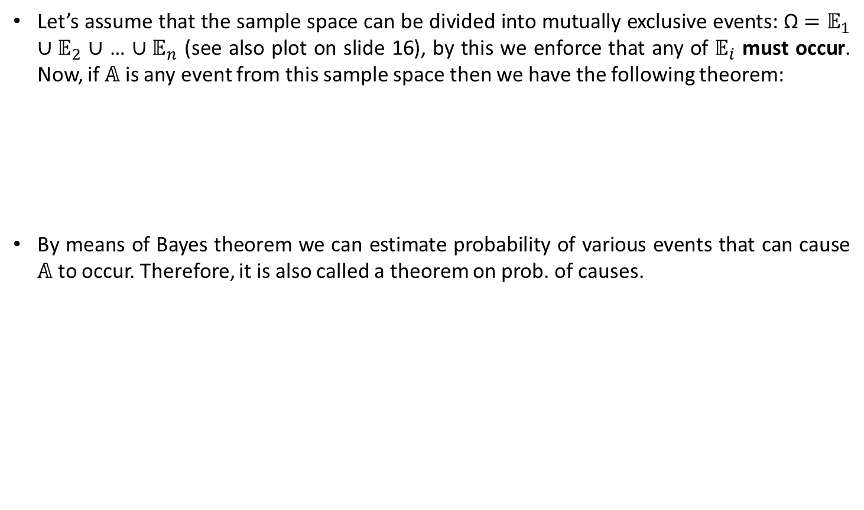
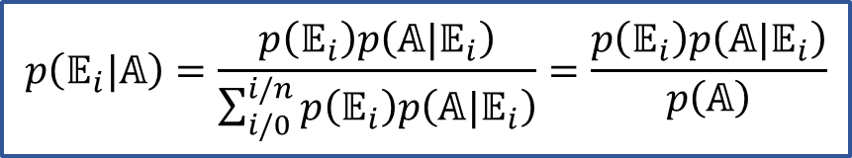
Bayes’ Theorem (I)
Let’s assume that the sample space can be divided into mutually exclusive events: Ω $=𝔼_{1}$ $∪𝔼_{2}$ $∪$ … $∪𝔼_{n}$ (see also plot on slide 16), by this we enforce that any of $𝔼_{i}$ must occur. Now, if $𝔸$ is any event from this sample space then we have the following theorem:
By means of Bayes theorem we can estimate probability of various events that can cause $𝔸$ to occur. Therefore, it is also called a theorem on prob. of causes.
$$p\left(𝔼_{i}|𝔸\right)=\frac{p\left(𝔼_{i}\right)p\left(𝔸|𝔼_{i}\right)}{\sum_{i/0}^{i/n}{p\left(𝔼_{i}\right)p\left(𝔸|𝔼_{i}\right)}}=\frac{p\left(𝔼_{i}\right)p\left(𝔸|𝔼_{i}\right)}{p\left(𝔸\right)}$$

Slide 25
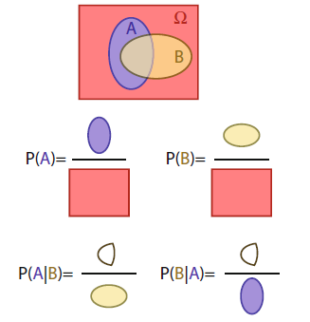

Bayes’ Theorem (II)
Pictures are nice, so…
$p\left(𝔸\right)$ - prob. of A, we have no knowledge of B
$$p\left(𝔸|𝔹\right)=\frac{p\left(𝔸\right)p\left(𝔹|𝔸\right)}{p\left(𝔹\right)}$$
$p\left(𝔸|𝔹\right)$- here, we are smarter, we know B has occurred

Slide 26
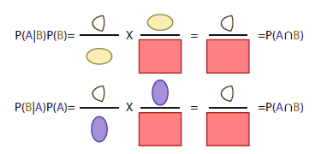
Bayes’ Theorem (III)
One amazing thing about Bayes approach is capability of working out probabilities of events that cannot be even considered by frequentists (which deal with repeatable cases)
A critical difference (that is very useful for experimentalists) between frequentist and Bayesian methods is that the latter can give a probability that a value of unknown parameter (something that came from theory for instance) lies within a certain interval
  Note, since a parameter is just a number and cannot be considered a random variable, this procedure would not be possible in a classical probability

Slide 27
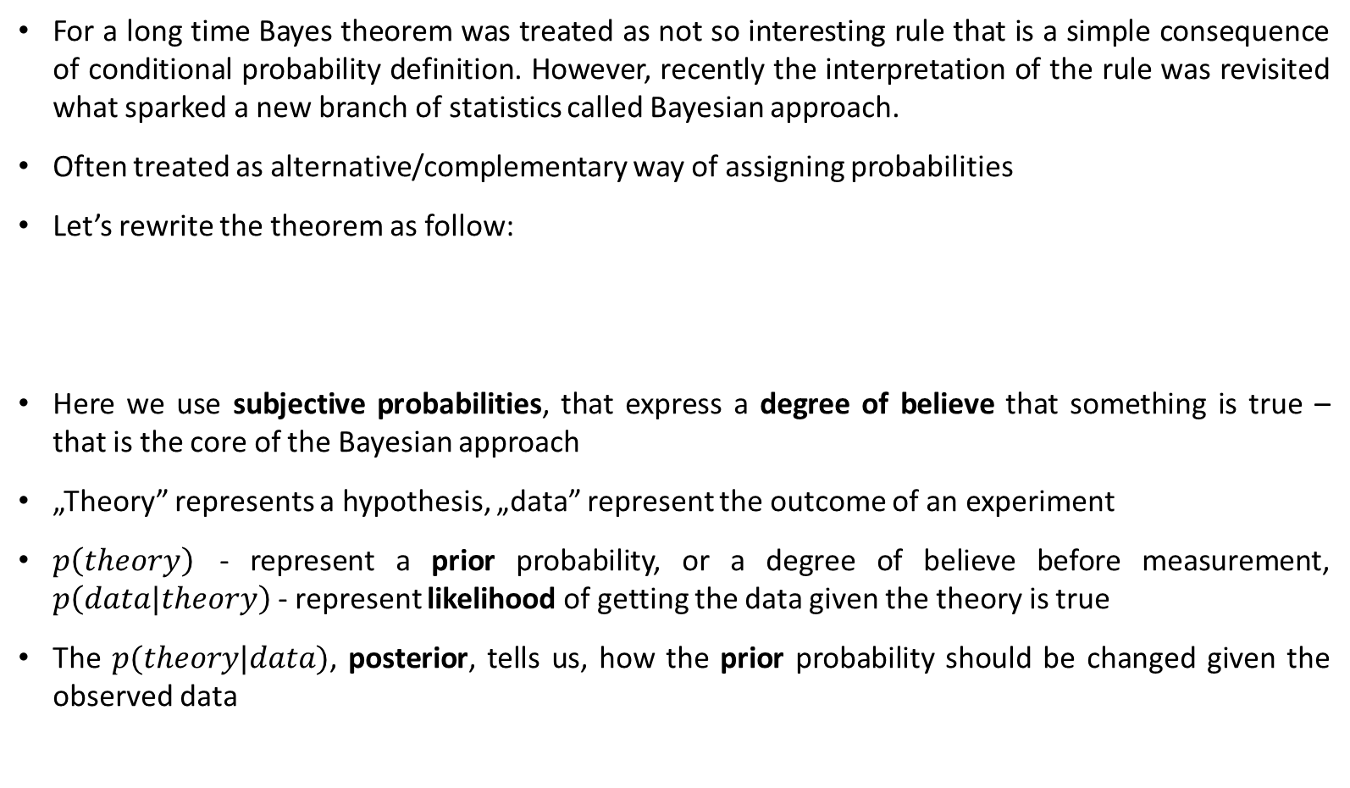
Bayes’ Theorem (IV)
For a long time Bayes theorem was treated as not so interesting rule that is a simple consequence of conditional probability definition. However, recently the interpretation of the rule was revisited what sparked a new branch of statistics called Bayesian approach.
Often treated as alternative/complementary way of assigning probabilities
Let’s rewrite the theorem as follow:
Here we use subjective probabilities, that express a degree of believe that something is true – that is the core of the Bayesian approach
„Theory” represents a hypothesis, „data” represent the outcome of an experiment
$p\left(theory\right)$ - represent a prior probability, or a degree of believe before measurement, $p\left(data|theory\right)$ - represent likelihood of getting the data given the theory is true
The $p(theory|data)$, posterior, tells us, how the prior probability should be changed given the observed data
$$p(theory|data)∝p\left(data|theory\right)p\left(theory\right)$$

Slide 28
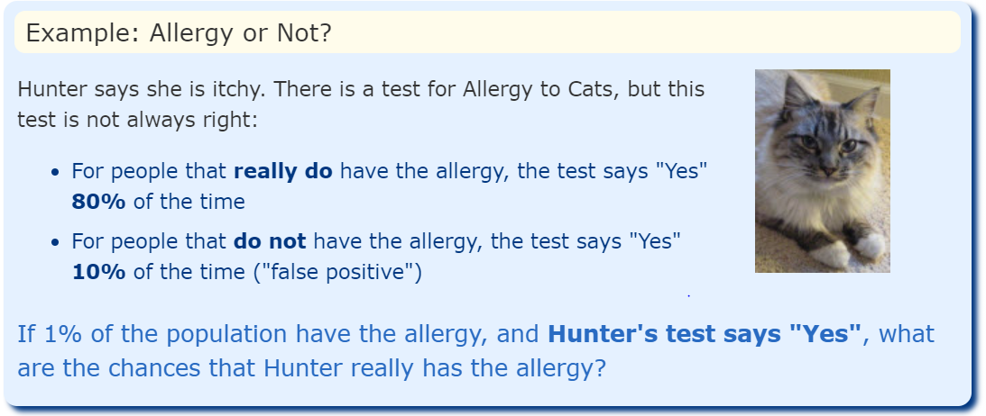
Bayes’ Theorem Example
https://www.mathsisfun.com/data/bayes-theorem.html

Slide 29
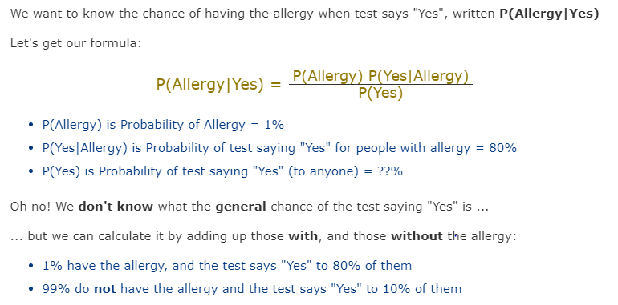

Bayes’ Theorem Example

Slide 30


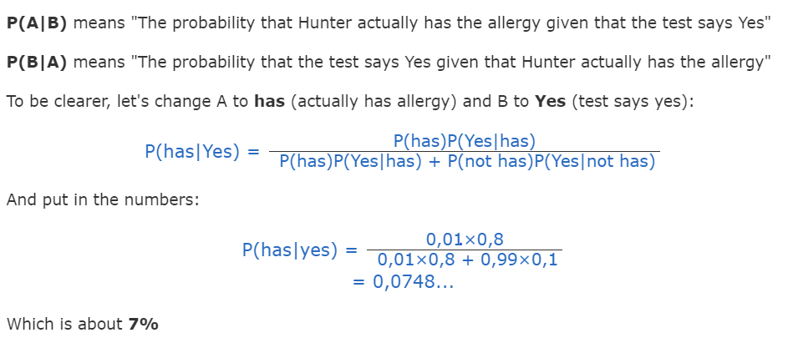
Bayes’ Theorem Example

Slide 31

Another example
Answer is 0.125…

Slide 32
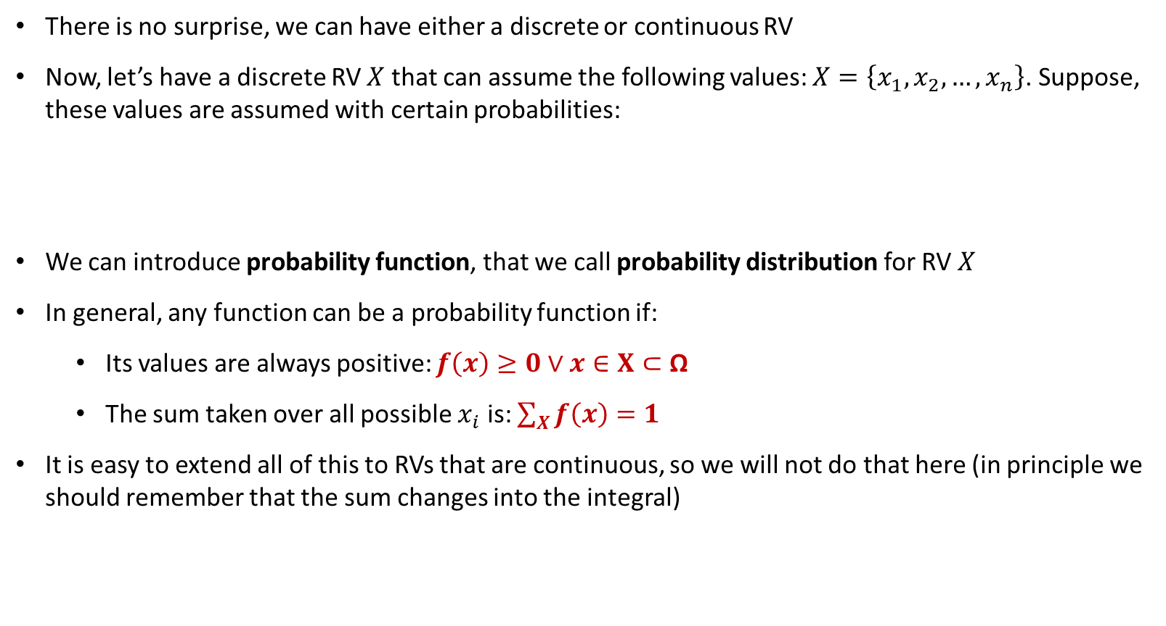

Random variables (I)
There is no surprise, we can have either a discrete or continuous RV
Now, let’s have a discrete RV $X$ that can assume the following values: $X=\left\{x_{1},x_{2}, …,x_{n}\right\}$. Suppose, these values are assumed with certain probabilities:
We can introduce probability function, that we call probability distribution for RV $X$
In general, any function can be a probability function if:
  Its values are always positive: $f\left(x\right)≥0∨x∈X⊂\text{Ω}$
  The sum taken over all possible $x_{i}$ is: $\sum_{X}{f\left(x\right)=1}$
It is easy to extend all of this to RVs that are continuous, so we will not do that here (in principle we should remember that the sum changes into the integral)
$$p\left(X=x_{i}\right)=f\left(x_{i}\right), i=1, 2, …, n$$

Slide 33





Random variables (II)
Ex. 2 Again, let’s look at the double coin toss. How do we define the probability distribution function (P.D.F.)?
  The sample space Ω$=\left\{HH, HT, TH, TT\right\}$, each of these events has the same probability $p\left(HH\right)=p\left(HT\right)=…=1/4$
  Using the Ex. 1 we can write:
$$p\left(X=0\right)=p\left(TT\right)=1/4$$
$$p\left(X=1\right)=p\left(HT∩TH\right)=1/2$$
$$p\left(X=2\right)=p\left(HH\right)=1/4$$

Slide 34





Distribution function (I)
Closely related to P.D.F. is the cumulative distribution function or just distribution function (DF)
We define it as follow:
The DF has the following properties:
  $F\left(x\right)$ must be non-decreasing
  Asymptotic behaviour
  DF is continuous from the right
$$F\left(x\right)=p\left(X≤x\right)$$
$$F\left(x_{i}\right)≤F\left(x_{j}\right)→ x_{i}≤x_{j}$$
$$\lim_{x→−∞}{F\left(x\right)=0},\lim_{x→∞}{F\left(x\right)=1}$$
$$\lim_{h→0^{+}}{F\left(x+h\right)=F\left(x\right), }∨x∈X$$

Slide 35
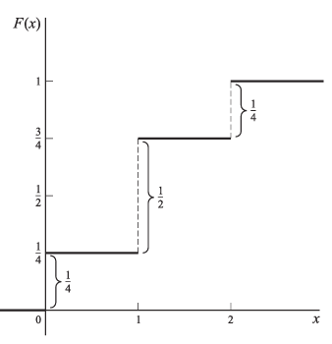

Distribution function (II)
Ex. 4 Again, taking the two tosses example, we can work out the distribution function.
$$F\left(x\right)=\left\{\begin{aligned}0 −∞<x<0 \\ \frac{1}{4} 0≤x<1 \\ \frac{3}{4} 1≤x<2 \\ 1 2≤x<∞\end{aligned}\right.$$

Slide 36
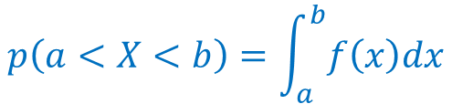
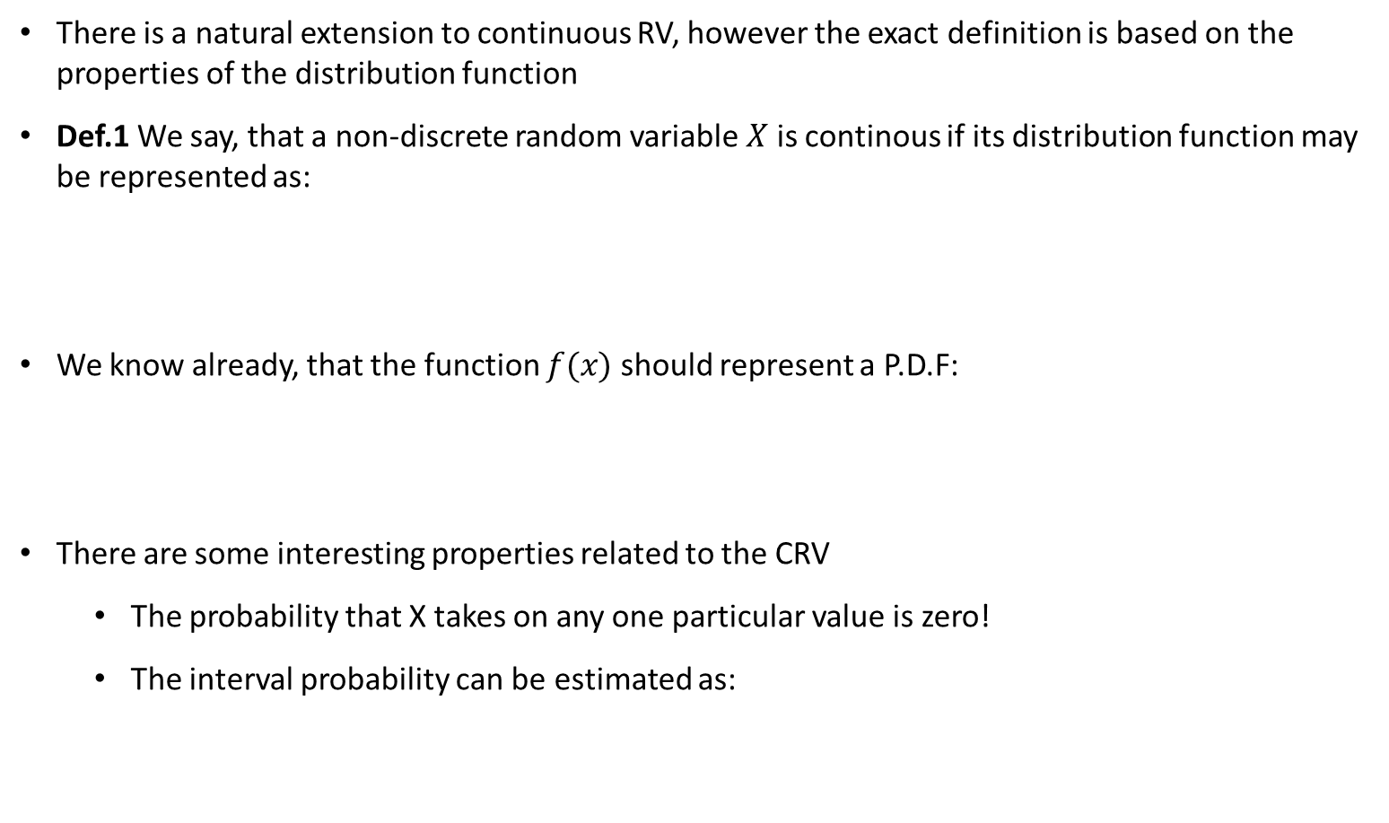


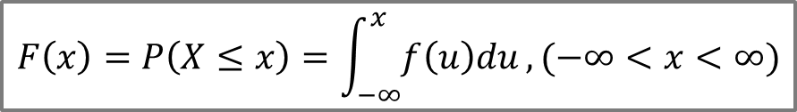
Continuous RV
There is a natural extension to continuous RV, however the exact definition is based on the properties of the distribution function
Def.1 We say, that a non-discrete random variable $X$ is continous if its distribution function may be represented as:
We know already, that the function $f(x)$ should represent a P.D.F:
There are some interesting properties related to the CRV
  The probability that X takes on any one particular value is zero!
  The interval probability can be estimated as:
$$F\left(x\right)=P\left(X≤x\right)=\int_{−∞}^{x}{f\left(u\right)du}, (−∞<x<∞)$$
$$\int_{−∞}^{∞}{f\left(x\right)dx=1}$$
$$f(x)≥0$$
$$p\left(a<X<b\right)=\int_{a}^{b}{f\left(x\right)dx}$$

Slide 37
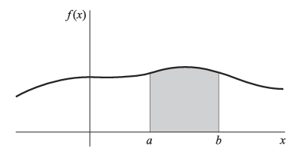
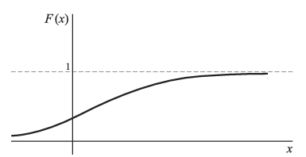

Graphical interpretation
Let f(x) be the density function for a random variable X. This function can be represented as a graph by some curve
The distribution function is, in turn, a monotonically increasing function which value goes from 0 to 1
$$p\left(a<X<b\right)$$

Slide 38

Random variables (II)
There is no surprise, we can have either discrete or continuous RV
Now, let’s have a discrete RV $X$ that can assume the following values: $X=\left\{x_{1},x_{2}, …,x_{n}\right\}$. Suppose, these values are assumed with certain probabilities:
We can introduce probability function, that we call probability distribution for RV $X$
In general, any function can be a probability function if:
  Its values are always positive: $f\left(x\right)≥0∨x∈X⊂\text{Ω}$
  The sum taken over all possible $x_{i}$ is: $\sum_{X}{f\left(x\right)=1}$
It is easy to extend all of this to RVs that are continuous, so we will not do that here (in principle we should remember that the sum changes into the integral)
$$p\left(X=x_{i}\right)=f\left(x_{i}\right), i=1, 2, …, n$$

Slide 39
Random variables (III)
Ex. 2 Again, let’s look at the double coin toss. How do we define the probability distribution function (P.D.F.)?
  The sample space Ω$=\left\{HH, HT, TH, TT\right\}$, each of these events has the same probability $p\left(HH\right)=p\left(HT\right)=…=1/4$
  Using the Ex. 1 we can write:
$$p\left(X=0\right)=p\left(TT\right)=1/4$$
$$p\left(X=1\right)=p\left(HT∩TH\right)=1/2$$
$$p\left(X=2\right)=p\left(HH\right)=1/4$$

Slide 40
Distribution function (I)
Closely related to P.D.F. is the cumulative distribution function or just distribution function (DF)
We define it as follow:
The DF has the following properties:
  $F\left(x\right)$ must be non-decreasing
  Asymptotic behaviour
  DF is continuous from the right
$$F\left(x\right)=p\left(X≤x\right)$$
$$F\left(x_{i}\right)≤F\left(x_{j}\right)→ x_{i}≤x_{j}$$
$$\lim_{x→−∞}{F\left(x\right)=0},\lim_{x→∞}{F\left(x\right)=1}$$
$$\lim_{h→0^{+}}{F\left(x+h\right)=F\left(x\right), }∨x∈X$$

Slide 41
Distribution function (II)
Ex. 4 Again, taking the two tosses example, we can work out the distribution function.
$$F\left(x\right)=\left\{\begin{aligned}0 −∞<x<0 \\ \frac{1}{4} 0≤x<1 \\ \frac{3}{4} 1≤x<2 \\ 1 2≤x<∞\end{aligned}\right.$$

Slide 42
Continuous RV
There is a natural extension to continuous RV, however the exact definition is based on the properties of the distribution function
Def.1 We say, that a non-discrete random variable $X$ is continous if its distribution function may be represented as:
We know already, that the function $f(x)$ should represent a P.D.F:
There are some interesting properties related to the CRV
  The probability that X takes on any one particular value is zero!
  The interval probability can be estimated as:
$$F\left(x\right)=P\left(X≤x\right)=\int_{−∞}^{x}{f\left(u\right)du}, (−∞<x<∞)$$
$$\int_{−∞}^{∞}{f\left(x\right)dx=1}$$
$$f(x)≥0$$
$$p\left(a<X<b\right)=\int_{a}^{b}{f\left(x\right)dx}$$

Slide 43
Graphical interpretation
Let f(x) be the density function for a random variable X. This function can be represented as a graph by some curve
The distribution function is, in turn, a monotonically increasing function which value goes from 0 to 1
$$p\left(a<X<b\right)$$

Slide 44







Joint distributions (I)
If X and Y are two discrete RVs, we can define P.D.F. of X and Y as follow:
If we assume that: $X=\left\{x_{1},x_{2},…,x_{m}\right\}$ and $Y=\left\{y_{1},y_{2},…,y_{n}\right\}$, then the probability of the event that $X=x_{i}$ and $Y=y_{j}$ is given by:
Respective probabilities for $X=x_{i}$ and $Y=y_{j}$ are given by:
$$p\left(X=x,Y=y\right)=f(x,y)$$
$$f(x,y)≥0$$
$$\sum_{x}{\sum_{y}{f(x,y)}=1}$$
$$p\left(X=x_{i}, Y=y_{j}\right)=f(x_{i}, y_{j})$$
$$p\left(X=x_{i}\right)=f_{1}\left(x_{i}\right)=f_{x}\left(x_{i}\right)=\sum_{k}{f\left(x_{i},y_{k}\right)}$$
$$p\left(Y=y_{j}\right)=f_{2}\left(y_{j}\right)=f_{y}\left(y_{j}\right)=\sum_{l}{f\left(x_{l},y_{j}\right)}$$

Slide 45
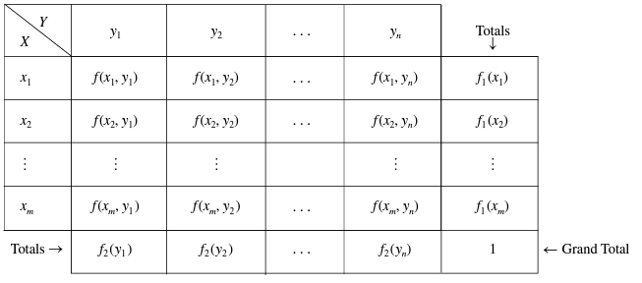
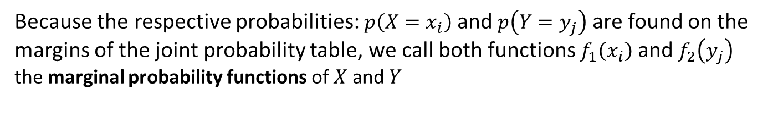
Joint distributions (II)
Right Margin
Bottom Margin
Because the respective probabilities: $p\left(X=x_{i}\right)$ and $p\left(Y=y_{j}\right)$ are found on the margins of the joint probability table, we call both functions $f_{1}\left(x_{i}\right)$ and $f_{2}\left(y_{j}\right)$ the marginal probability functions of $X$ and $Y$

Slide 46




Joint distributions (III)
It is essential to note that for both marginal density functions we have:
The two above are equivalent of:
Since all of these functions represent P.D.F. they must be normalised, or in other words the probability of all entries is 1
The joint distribution function of RVs $X$ and $Y$ is given by
So, to get a value of $F(x,y)$ for a given pair $\left(x,y\right)$ we need to sum-up all the entries for which $x_{i}≤x$ and $y_{j}≤y$
$$\sum_{i}{f_{1}\left(x_{i}\right)}=1,\sum_{j}{f_{2}\left(y_{j}\right)}=1$$
$$\sum_{i}{\sum_{j}{f\left(x_{i},y_{j}\right)}}=1$$
$$F\left(x,y\right)=p\left(X≤x,Y≤y\right)=\sum_{u≤x}{\sum_{v≤y}{f(u,v)}}$$

Slide 47




Joint distributions (IV)
Again, by analogy we can easily obtain the joint probability function for continuous RVs $X$ and $Y$:
The probability can be estimated using the joint P.D.F. as follow:
$$f\left(x,y\right)≥0,\int_{−∞}^{∞}{\int_{−∞}^{∞}{f\left(x,y\right)dxdy}}=1$$
$$p\left(a<X<b, c<Y<d\right)=\int_{a}^{b}{\int_{c}^{d}{f\left(x,y\right)dxdy}}$$

Slide 48






Joint distributions (V)
Now, we can define the joint distribution function:
We also have the following:
By analogy, the respective marginal functions can be defined for both density, $f(x,y)$, and distribution, $F(x,y)$ functions
$$F\left(x,y\right)=p\left(X≤x,Y≤y\right)=\int_{−∞}^{x}{\int_{−∞}^{y}{f\left(u,v\right)dudv}}$$
$$\frac{∂^{2}F(x,y)}{∂x∂y}=f(x,y)$$
$$f_{1}\left(x\right)=\int_{−∞}^{∞}{f\left(x,v\right)dv}, f_{2}\left(y\right)=\int_{−∞}^{∞}{f\left(u,y\right)du}$$
$$F_{1}\left(x\right)=p\left(X≤x\right)=\int_{−∞}^{x}{\int_{−∞}^{∞}{f\left(u,v\right)dudv}}$$
$$F_{2}\left(y\right)=p\left(Y≤y\right)=\int_{−∞}^{∞}{\int_{−∞}^{y}{f\left(u,v\right)dudv}}$$

Slide 49

Joint distributions (VI)
Example: Students in a class of 100 were classified according to gender (G) and smoking (S) as follows:
s: “now smokes”,
q: “did smoke but quit”
n: “never smoked”.
Identify:
joint distribution function
marginal distributions
Find the probability that a randomly selected student
  1. is a male;
  2. is a male smoker;
  3. is either a smoker or did smoke but quit;
  4. is a female who is a smoker or did smoke but quit.

Slide 50




Independent RVs
We learned how to calculate probability of independent events:
This definition can also be used for probability functions. Say, $X$ and $Y$ are RVs. If the events $X=x$ and $Y=y$ are independent for all $x$ and $y$, then we say that $X$ and $Y$ are independent RVs. We also have:
Similarly, we say that $X$ and $Y$ are independent RVs if the events $X≤x$ and $Y≤y$ are independent for all $x$ and $y$. We can write:
$$p\left(𝔸∩𝔹\right)=p\left(𝔹|𝔸\right)p\left(𝔸\right)=p\left(𝔹\right)p\left(𝔸\right)$$
$$p\left(X=x, Y=y\right)=p(X=x)∙p(Y=y)$$
$$f\left(x,y\right)=f_{1}(x)f_{2}(y)$$
$$p\left(X≤x,Y≤y\right)=p\left(X≤x\right)p(Y≤y)→$$
$$F\left(x,y\right)=F_{1}(x)F_{2}(y)$$

