Slide 1


The PostDocs
team
CHALLENGE
Agnieszka
Anna
Elena

Slide 2

The problem
Yes, I’ve just transfered 20000 CHF to Afganistan ☺
Improve “money laundry”
detection system.

Slide 3
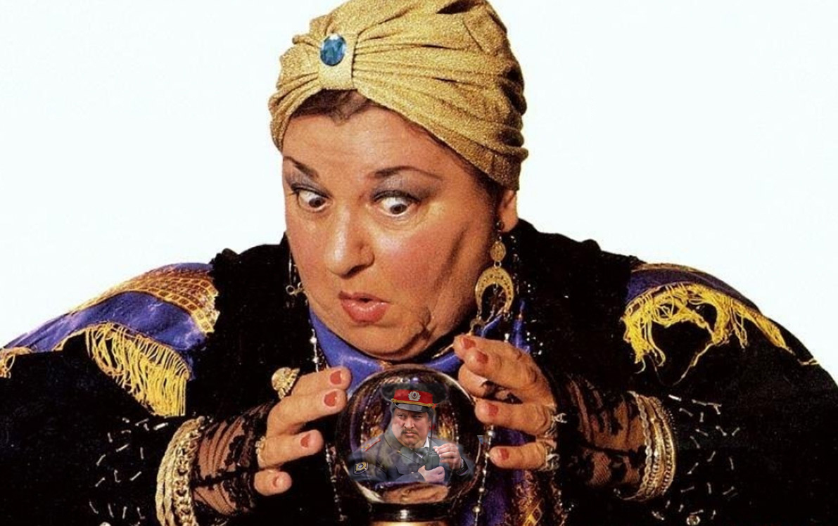


Our approach
Let your data speak:
ML approach
Improve the prediction with human expert knowledge
But what about the future?

Slide 4
ML approach
UnSupervised:
Insights from data
supervised:
Maximize Prediction accuracy
Frequency analysis of the features: the datasets are imbalanced (!)
Clustering
Embeddings and visualization
Balance the data (oversampling and undersampling)
Choose the best classifier (Gradient boosting decision trees)
Analyze feature importance (permutation feature index)

Slide 5
Insights from ML approach
UnSupervised:
Insights from data
supervised:
Most IMPORTAN Features
To detect fraudulent individuals we can use feature “individual/company” as labels.
If the individual predicted as a company, he/she performs suspicious activity.
Turnover
Atm_deposit
Atm_withdrawal
Transaction_count
Io_ratio
Age
Inactive_days_average

Slide 6
IS THE data enough?
Name of the country/city where transactions with ATM take place
Name of the destination places of money transfer (terrorism, war)
Mobile data (locations and movements)
Date of the money tranfer (elections, conflicts, natural disasters)
Social networks

Slide 7
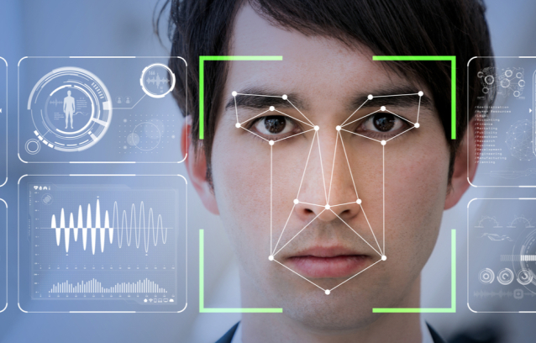
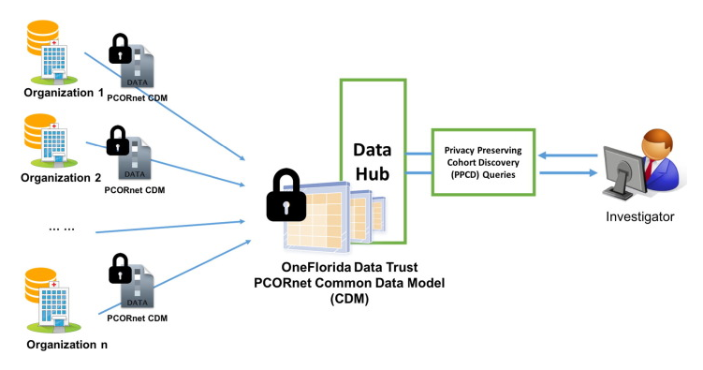
Money laundry detection in the future
More international legal control on bitcoins’ operations
ATM face/fingerprint detection
Distributed Privacy Preserving Information sharing with blockchain
Improve ML detection algorithms:
Advanced balancing algorithms
Deep Reinforcement Learning

Slide 8
Take home message
Be careful with algorithms and unbalanced data. Chose wisely!
Think beyond the data, e.g. follow political situation, technology, etc.
Think of the future, be one step ahead. Follow the technology advances.

