Slide 1
Publication of my preliminary results.

Slide 2
In my project, I use the data provided by your company, i.e. the collection of measurements based on 10 sensors
The aim of this project was to shorten the process of measuring the characteristics of the sensor in three different substances.

Slide 3
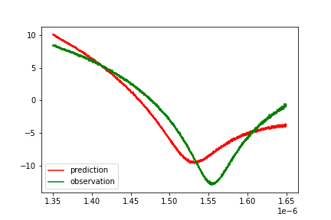
Prediction of characteristics of a working sensor in water based on measured characteristics in air.
Using the model the agreement of predictions with observations is 89%

Slide 4
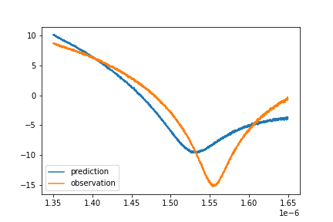
Prediction of characteristics of a working sensor in isopropanol based on measured characteristics in air.
Using the model the agreement of predictions with observations is 89%

Slide 5
Application
This project will be complemented by an application based on the previously presented prediction models.
This application will help to simplify the process of verifying the characteristics of each sensor.
Instead of collecting three signals, you will only need to collect data from one - the application will generate the rest of the characteristics.

Slide 6
Your main benefits!
increases the speed of the process
makes the process simpler
human resources will be more efficient
increase syour competitive advantage
minimal costs
reduces resources usage
boosts performance
continuous performance improvement

