Slide 1
Webinar Analysis & Lead Conversion Insights
Total Leads: 1013
Attendance Rate: 221 out of 1013
Top 3 Events:
1. Future Of Work - 198
2. Transformimg HR - 154
3. Application with ML - 139

Slide 2
Key Insights from Sales Comments
Top Reasons for Non-Conversion:
1. Other - 731
2. Incorrect Contact - 182
3. Lack of Interest - 66

Slide 3
Recommendations for Improvement
1. Address Price Concerns with Flexible Pricing
2. Improve Product Demo to Highlight Fit
3. Enhance Follow-up Strategies for Better Engagement

Slide 4
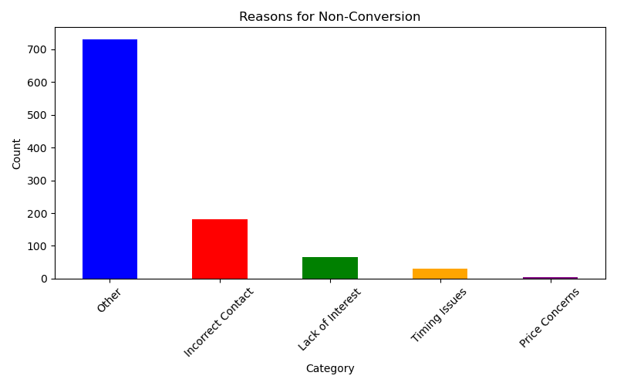
Reasons for Non-Conversion

