Slide 1
Orangee Cloud Player Description
orangee.tv

Slide 2
Revision History
Version | Date | Description | Author
1.0.0 | 2015.02.01 | First release | OrangeeTV
1.0.1 | 2015.02.24 | Fix all bugs found during Samsung app store’s review process | OrangeeTV
1.0.2 | 2015.03.11 | Fix all bugs found during Samsung app store’s review process | OrangeeTV

Slide 3
Contents
UI Structure
Usage Scenario
Menu & function description
Key policy
How to change languages

Slide 4
UI Structure
There are three types of screens in this app:
Link Screen: user is required to enter an code seen on this screen to our website via their computer. This needs to be done only once
Program Selection Screen: this is a grid of programs, user uses up/down/left/right/enter to select a program. This screen may have multiple levels (nested), and user can use return to go back to previous level.
Video Screen: fullscreen video player. And user can use return key to go back to Program Selection Screen, play key to pause/resume video

Slide 5
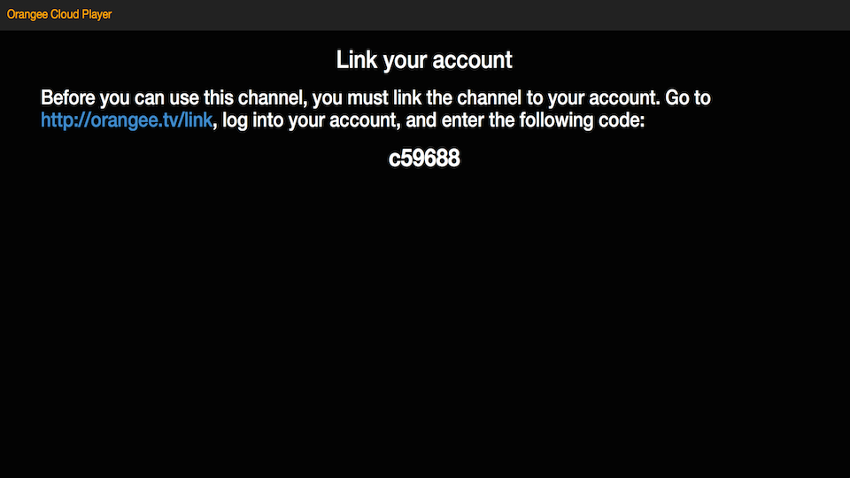
Link Screen Screenshot

Slide 6
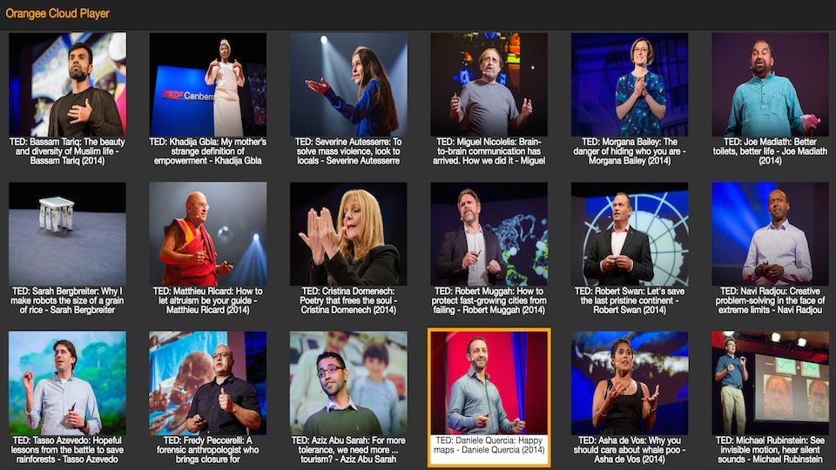
Program Selection Screen Screenshot

Slide 7

Video Screen Screenshot

Slide 8
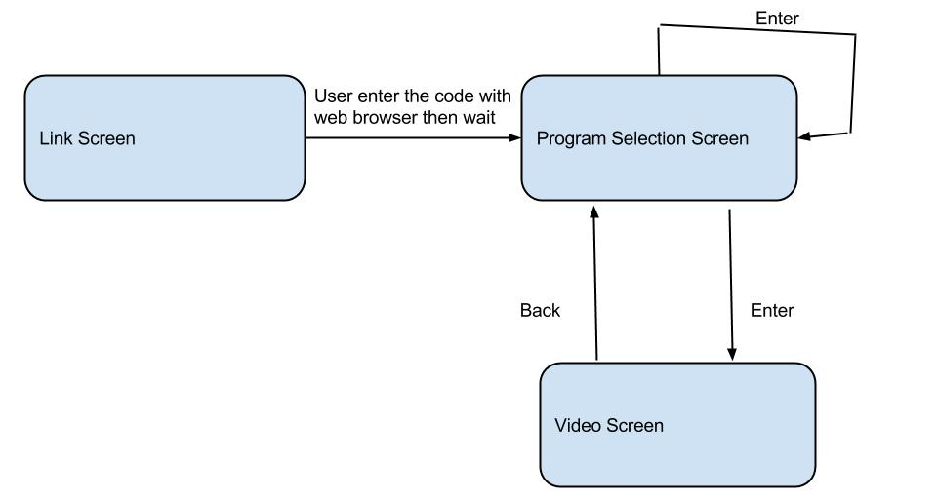
UI structure – (flow graph)

Slide 9
Usage Scenario
The app needs to be linked with an user's account on a computer before the first usage (Link Screen)
After that, just use up/down/left/right to navigate and enter/return to select (Program Selection Screen)
Once an video is selected and playing, user can use paly button to pause/resume (Video Screen)

Slide 10
Usage Scenario – Link Screen
The following are steps to link user’s account:
* Open the app on the tv, wait for the link screen.
* Visit this website on your computer: http://orangee.tv/link
* Click "Login" from top right
* It will redirect you to Facebook (we use third party authentication)
* Enter username/password on Facebook page
* It will redirect you back to orangee.tv's website
* Click "Link" from orangee.tv's website
* Enter the code seen on tv screen, click 'Save’
* Wait for about 15 seconds for tv app to refresh.
* If nothing happens after 15 seconds, Click to the 'Link' again on orangee.tv's website, make sure the code is spelled correctly (for example, letter o and number 0 looks similar but different).
:

Slide 11
Menu & function description
Menu& function description with screen shot
This screen is a multiple-level grid, just use up/down/left/right to navigate, enter to select, and return to return to previous
screen.

Slide 12
Key Policy - sample
If you have your own key policy on your app, please describe it.
Button | Action | Remarks
ENTER | Go to the next screen based on user’s selection.
UP/DOWN | Move highlight to up or down
LEFT/RIGHT | Move highlight to left or right
Play | Pause/resume video
RETURN | Move to previous screen | Samsung Mandatory
EXIT | Close the app and show broadcasting channel | Samsung Mandatory

Slide 13
How to change languages
Items | Contents
How to change languages | Not supported

