Slide 1
IRIS CLASSIFICATION using MLP AND CLUSTERING using SOM

Slide 2
Data Set Information
This is perhaps the best known database to be found in the pattern recognition literature. Fisher's paper is a classic in the field and is referenced frequently to this day. The data set contains 3 classes of 50 instances each, where each class refers to a type of iris plant. One class is linearly separable from the other 2; the latter are NOT linearly separable from each other. Predicted attribute: class of iris plant.

Slide 3
Attribute Information
sepal length in cm
sepal width in cm
petal length in cm
petal width in cm
class: -- Iris Setosa -- Iris Versicolour -- Iris Virginica

Slide 4
Classification using Multi Layer Perceptron Algorithm

Slide 5
The Model
An input layer with 4 nodes for the 4 features in the input is used.
A hidden layer with 4 nodes is used.
An output layer with 2 nodes is used as the classification requires 3 types to be clasified into. So, two bits were used. (00 – Iris setosa, 01 – Iris Versicolor, 10 – Iris Virginica.
The network is trained with 50 datas and tested with 101 datas.

Slide 6
Results
96 out of 101 datas were classified correctly.

Slide 7
Clustering using Self Organizing Maps

Slide 8
The Model
40 X 40 nodes where used.
The weight biasses for each node was initialised to a value between 0 to 10.
Each data trained the model for 2000 times.
The square of the norm of the weights of each nodes was set as r, g, b values and each node represented by 10 X 10 pixels.

Slide 9
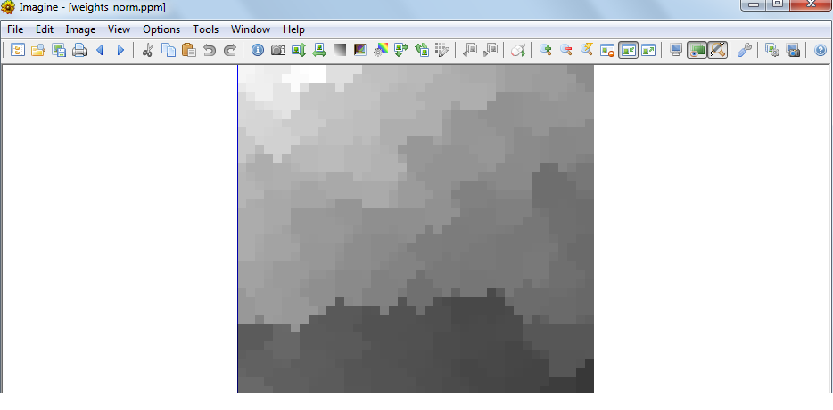
Results

Slide 10
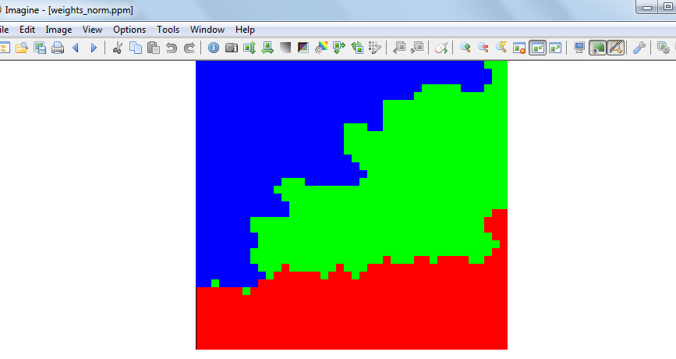
Segmented Output

Slide 11
THANK YOU

