Slide 1
HANGMAN GAME
(GUESS THE IMAGE)

Slide 2
WHAT IS A HANGMAN GAME ?
A hangman is a game in which we have to guess the image.
We have only three turns.
After game is over you have to press retry or cancel.

Slide 3
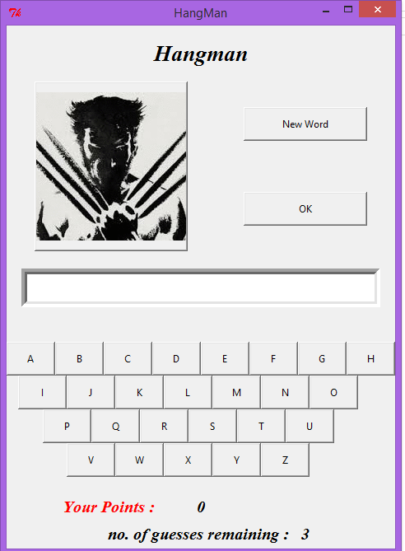

Slide 4
MODULES
LAYOUT(GUI)
KEYBOARD
PICTURES
START

Slide 5
LAYOUT
In layout we have the GUI part, that is how the data on the window of tkinter will appear.
Also layout specifies about the placing of every button whether it is raised and it’s length and breadth.
There also message boxes included in GUI part of this project

Slide 6
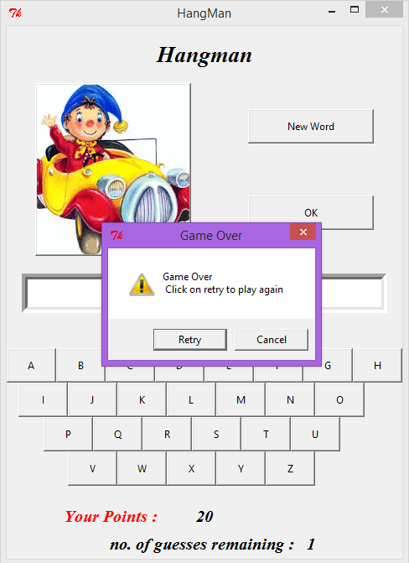

Slide 7
KEYBOARD
In keyboard we have 26 alphabets.
For 26 characters 26 functions are made to call them when the button is pressed.
Also in every function there is a condition to overcome the overwriting of entered data.

Slide 8
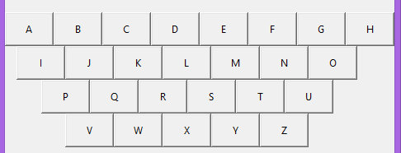

Slide 9
PICTURES
In picture module we have creted a folder of images localy which are of .gif format.
This pictures are the fetched from pc and given to variable.
That variable is then given to a list in list and also provided with image name.
In game every image is chosen randomly for that random function is used.

Slide 10
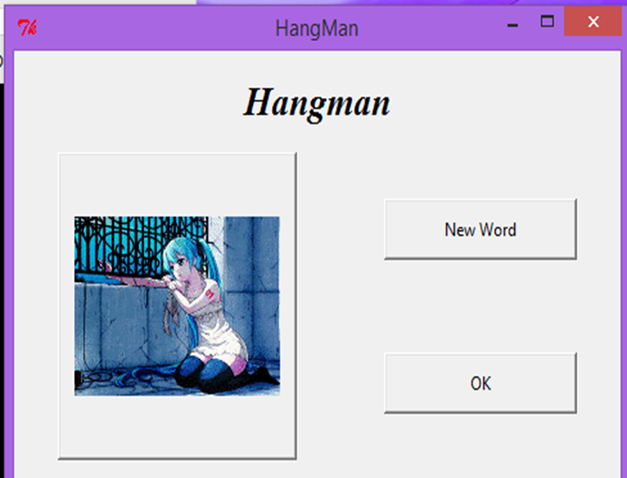
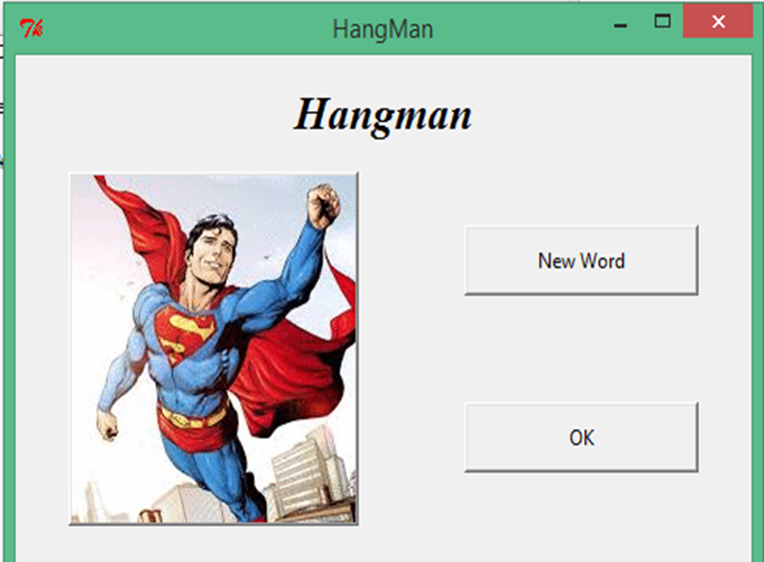
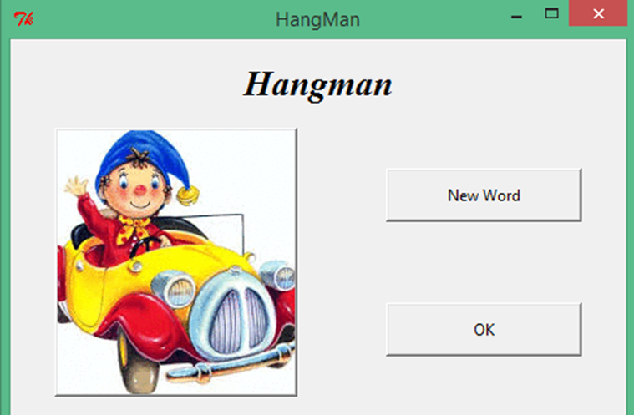
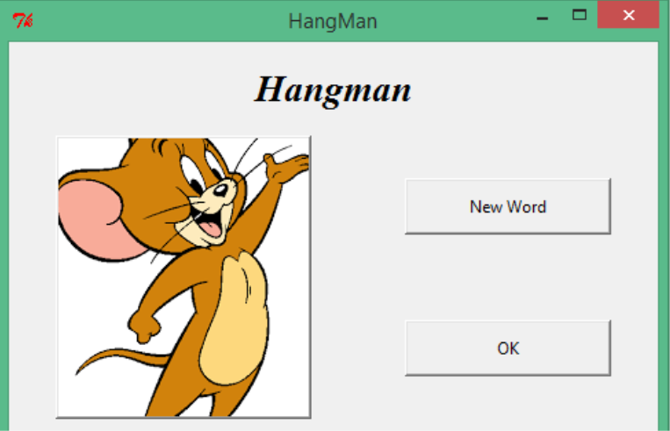

Slide 11
START
Start is another python file which is imported in the hangman game.
It is just asking the username and displaying message “Let’s Play Game Username”.
It has also a little gui part to place a button for submit and ok to go to game.

Slide 13
THANK YOU

