Slide 1
Evidence Change
Sentinel
Trace a changed assessment to the evidence behind it
Francisco Angulo de Lafuente · Solo · Track 02
Verified local sponsor workflow · Synthetic data · 23 October 2026
Notes:
Actual controlled synthetic fixture, not real-world accuracy. Sources: public repository https://github.com/Agnuxo1/evidence-change-sentinel ; evidence/live-feature-20261023.json (02:21 UTC, four fresh local replies, signed envelopes); evidence/nvidia-local-20261023.json; evidence/signature-verification-20261023.json. CI commit c5c573200daf3e1cf7a0819d1edfc81eac8438e0: https://github.com/Agnuxo1/evidence-change-sentinel/actions/runs/39889886408. H-MEM reference at 1742dec56a66e58eef9dda2d2b865823758ca8cd is pre-existing Apache-2.0 code, not original work. Team concept predates the build window; application code created during the window. Rules amendment: official Isreal Hosana announcement, 22 October 2026 14:30 Europe/Madrid, https://hackathon.genai.works/messages?c=01a01e1c-8ff8-7c95-8191-618849846e28 ; Cursor is optional, any AI coding tool permitted, one operational Meterless Engine still required. Source authored with Codex. No Nemotron prize claim or completed HackOS submission claim.

Slide 2
The review problem
For funding-call advisers and research reviewers
A changed call can invalidate an earlier assessment. Reviewing everything again wastes time; missing one amended criterion leaves stale advice.
Example: a staff limit changes from 50 to 20.
A fictional applicant has 35 employees.
The date and eligible regions remain unchanged.
Notes:
Actual controlled synthetic fixture, not real-world accuracy. Sources: public repository https://github.com/Agnuxo1/evidence-change-sentinel ; evidence/live-feature-20261023.json (02:21 UTC, four fresh local replies, signed envelopes); evidence/nvidia-local-20261023.json; evidence/signature-verification-20261023.json. CI commit c5c573200daf3e1cf7a0819d1edfc81eac8438e0: https://github.com/Agnuxo1/evidence-change-sentinel/actions/runs/39889886408. H-MEM reference at 1742dec56a66e58eef9dda2d2b865823758ca8cd is pre-existing Apache-2.0 code, not original work. Team concept predates the build window; application code created during the window. Rules amendment: official Isreal Hosana announcement, 22 October 2026 14:30 Europe/Madrid, https://hackathon.genai.works/messages?c=01a01e1c-8ff8-7c95-8191-618849846e28 ; Cursor is optional, any AI coding tool permitted, one operational Meterless Engine still required. Source authored with Codex. No Nemotron prize claim or completed HackOS submission claim.

Slide 3
Agent workflow
1 Retrieve both source versions from the Zetaris view
2 Find affected requirements and preserve unchanged work
3 Ask Nightshift for a typed rule and exact source quote
4 Validate independently; allow one repair, then abstain
5 Store provenance and supersession links in H-MEM
Notes:
Actual controlled synthetic fixture, not real-world accuracy. Sources: public repository https://github.com/Agnuxo1/evidence-change-sentinel ; evidence/live-feature-20261023.json (02:21 UTC, four fresh local replies, signed envelopes); evidence/nvidia-local-20261023.json; evidence/signature-verification-20261023.json. CI commit c5c573200daf3e1cf7a0819d1edfc81eac8438e0: https://github.com/Agnuxo1/evidence-change-sentinel/actions/runs/39889886408. H-MEM reference at 1742dec56a66e58eef9dda2d2b865823758ca8cd is pre-existing Apache-2.0 code, not original work. Team concept predates the build window; application code created during the window. Rules amendment: official Isreal Hosana announcement, 22 October 2026 14:30 Europe/Madrid, https://hackathon.genai.works/messages?c=01a01e1c-8ff8-7c95-8191-618849846e28 ; Cursor is optional, any AI coding tool permitted, one operational Meterless Engine still required. Source authored with Codex. No Nemotron prize claim or completed HackOS submission claim.

Slide 4
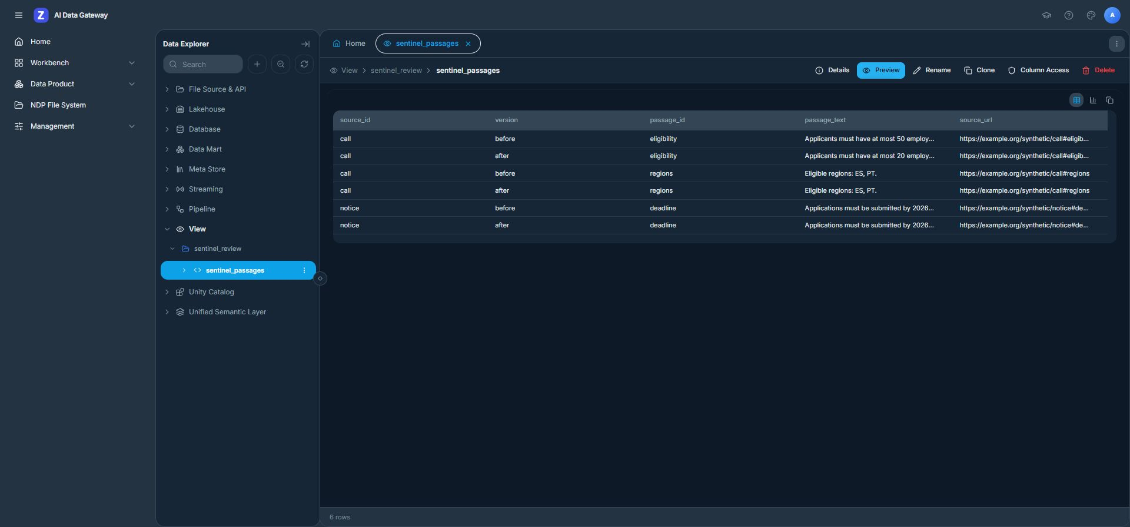
Versioned evidence in Zetaris
Two registered CSV sources → one view → six versioned rows
Notes:
Actual controlled synthetic fixture, not real-world accuracy. Sources: public repository https://github.com/Agnuxo1/evidence-change-sentinel ; evidence/live-feature-20261023.json (02:21 UTC, four fresh local replies, signed envelopes); evidence/nvidia-local-20261023.json; evidence/signature-verification-20261023.json. CI commit c5c573200daf3e1cf7a0819d1edfc81eac8438e0: https://github.com/Agnuxo1/evidence-change-sentinel/actions/runs/39889886408. H-MEM reference at 1742dec56a66e58eef9dda2d2b865823758ca8cd is pre-existing Apache-2.0 code, not original work. Team concept predates the build window; application code created during the window. Rules amendment: official Isreal Hosana announcement, 22 October 2026 14:30 Europe/Madrid, https://hackathon.genai.works/messages?c=01a01e1c-8ff8-7c95-8191-618849846e28 ; Cursor is optional, any AI coding tool permitted, one operational Meterless Engine still required. Source authored with Codex. No Nemotron prize claim or completed HackOS submission claim. Actual authenticated local UI, captured 22 October; the same view was queried by the verified live run on 23 October. All source URLs and clauses are explicitly synthetic.

Slide 5
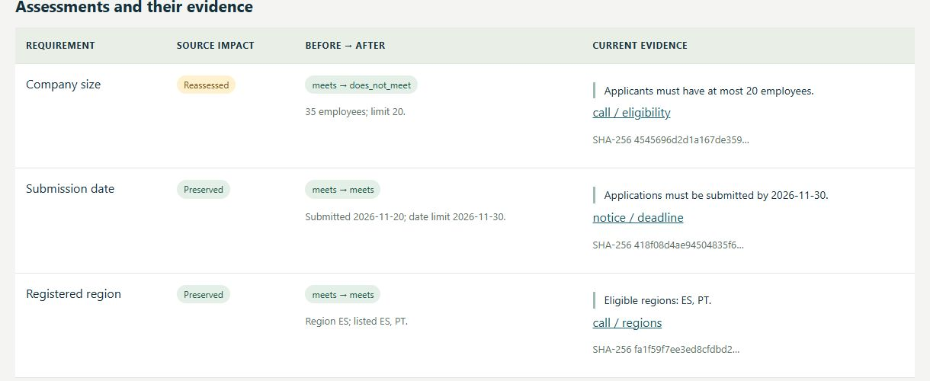
One changed assessment; two preserved
Staff: meets → does not meet · Date and region: preserved
Notes:
Actual controlled synthetic fixture, not real-world accuracy. Sources: public repository https://github.com/Agnuxo1/evidence-change-sentinel ; evidence/live-feature-20261023.json (02:21 UTC, four fresh local replies, signed envelopes); evidence/nvidia-local-20261023.json; evidence/signature-verification-20261023.json. CI commit c5c573200daf3e1cf7a0819d1edfc81eac8438e0: https://github.com/Agnuxo1/evidence-change-sentinel/actions/runs/39889886408. H-MEM reference at 1742dec56a66e58eef9dda2d2b865823758ca8cd is pre-existing Apache-2.0 code, not original work. Team concept predates the build window; application code created during the window. Rules amendment: official Isreal Hosana announcement, 22 October 2026 14:30 Europe/Madrid, https://hackathon.genai.works/messages?c=01a01e1c-8ff8-7c95-8191-618849846e28 ; Cursor is optional, any AI coding tool permitted, one operational Meterless Engine still required. Source authored with Codex. No Nemotron prize claim or completed HackOS submission claim. Actual browser UI execution on 23 October in live mode against Zetaris and Nightshift. Result: one affected requirement, two preserved, one changed decision, zero human-review items; four H-MEM records and twelve ledger events.

Slide 6
Validation and operating limits
29 application tests · 13 H-MEM checks · 55 synthetic cases
Real feature: 4 fresh local model replies, 3 validated criteria,
4 H-MEM records, 0 abstentions; local compute cost $0.
All 4 receipt signatures verify against the daemon’s public key.
Limits: three explicit English rule grammars and a controlled synthetic fixture. Unsupported wording enters human review. These checks do not measure real-world grant eligibility accuracy.
Notes:
Actual controlled synthetic fixture, not real-world accuracy. Sources: public repository https://github.com/Agnuxo1/evidence-change-sentinel ; evidence/live-feature-20261023.json (02:21 UTC, four fresh local replies, signed envelopes); evidence/nvidia-local-20261023.json; evidence/signature-verification-20261023.json. CI commit c5c573200daf3e1cf7a0819d1edfc81eac8438e0: https://github.com/Agnuxo1/evidence-change-sentinel/actions/runs/39889886408. H-MEM reference at 1742dec56a66e58eef9dda2d2b865823758ca8cd is pre-existing Apache-2.0 code, not original work. Team concept predates the build window; application code created during the window. Rules amendment: official Isreal Hosana announcement, 22 October 2026 14:30 Europe/Madrid, https://hackathon.genai.works/messages?c=01a01e1c-8ff8-7c95-8191-618849846e28 ; Cursor is optional, any AI coding tool permitted, one operational Meterless Engine still required. Source authored with Codex. No Nemotron prize claim or completed HackOS submission claim.

Slide 7
Technical stack and sponsor contribution
Zetaris
Unions separate call and notice sources with stable versions.
Meterless H-MEM
Provenance, exact-fingerprint reuse and a mutation ledger.
Meterless Nightshift
Local Llama 3.2 1B proposals with structured output and receipts.
NVIDIA CUDA
RTX 3090 runs the model; no Nemotron award is claimed.
Node.js + tsx + Codex
Application, bounded validator loop, UI, tests and CI.
Notes:
Actual controlled synthetic fixture, not real-world accuracy. Sources: public repository https://github.com/Agnuxo1/evidence-change-sentinel ; evidence/live-feature-20261023.json (02:21 UTC, four fresh local replies, signed envelopes); evidence/nvidia-local-20261023.json; evidence/signature-verification-20261023.json. CI commit c5c573200daf3e1cf7a0819d1edfc81eac8438e0: https://github.com/Agnuxo1/evidence-change-sentinel/actions/runs/39889886408. H-MEM reference at 1742dec56a66e58eef9dda2d2b865823758ca8cd is pre-existing Apache-2.0 code, not original work. Team concept predates the build window; application code created during the window. Rules amendment: official Isreal Hosana announcement, 22 October 2026 14:30 Europe/Madrid, https://hackathon.genai.works/messages?c=01a01e1c-8ff8-7c95-8191-618849846e28 ; Cursor is optional, any AI coding tool permitted, one operational Meterless Engine still required. Source authored with Codex. No Nemotron prize claim or completed HackOS submission claim.

Slide 8
Next steps and reproduction
Next: licensed real call datasets, multilingual rule coverage,
measured reviewer feedback and durable multi-user storage.
Run the sample: npm ci → npm test → npm run demo
Run privately: configure services → preflight → live:accept
github.com/Agnuxo1/evidence-change-sentinel
Research review tool. A person makes any official eligibility decision.
Notes:
Actual controlled synthetic fixture, not real-world accuracy. Sources: public repository https://github.com/Agnuxo1/evidence-change-sentinel ; evidence/live-feature-20261023.json (02:21 UTC, four fresh local replies, signed envelopes); evidence/nvidia-local-20261023.json; evidence/signature-verification-20261023.json. CI commit c5c573200daf3e1cf7a0819d1edfc81eac8438e0: https://github.com/Agnuxo1/evidence-change-sentinel/actions/runs/39889886408. H-MEM reference at 1742dec56a66e58eef9dda2d2b865823758ca8cd is pre-existing Apache-2.0 code, not original work. Team concept predates the build window; application code created during the window. Rules amendment: official Isreal Hosana announcement, 22 October 2026 14:30 Europe/Madrid, https://hackathon.genai.works/messages?c=01a01e1c-8ff8-7c95-8191-618849846e28 ; Cursor is optional, any AI coding tool permitted, one operational Meterless Engine still required. Source authored with Codex. No Nemotron prize claim or completed HackOS submission claim.

