Slide 1
Evidence Change
Sentinel
Review funding-call changes with evidence you can inspect
Offline prototype • synthetic data • 22 October 2026
Notes:
Sources: project app/core.mjs, app/adapters.mjs, tests/, evidence/evaluation.json and evidence/preflight.json. Snapshot 22 October 2026. Official event: https://hackathon.genai.works/event/open-agent-hackathon-2026. Sponsor engine: https://github.com/Meterless/Meterless commit 1742dec56a66e58eef9dda2d2b865823758ca8cd. No live integrations or prize eligibility claimed.

Slide 2
A changed call can invalidate an old assessment
Intended user
A funding-call reviewer who must revisit decisions after a call or notice changes.
The review task
Find the changed requirement, inspect its source, keep the unaffected work and identify what needs a person’s judgment.
Notes:
Sources: project app/core.mjs, app/adapters.mjs, tests/, evidence/evaluation.json and evidence/preflight.json. Snapshot 22 October 2026. Official event: https://hackathon.genai.works/event/open-agent-hackathon-2026. Sponsor engine: https://github.com/Meterless/Meterless commit 1742dec56a66e58eef9dda2d2b865823758ca8cd. No live integrations or prize eligibility claimed.

Slide 3
Evidence and review workflow
1 Read versioned passages from the call and notices
2 Find changed evidence and applicant dependencies
3 Propose a rule, then validate its quote and value
4 Request one repair; abstain if it remains unsupported
5 Preserve unaffected results and record provenance in H-MEM
Notes:
Sources: project app/core.mjs, app/adapters.mjs, tests/, evidence/evaluation.json and evidence/preflight.json. Snapshot 22 October 2026. Official event: https://hackathon.genai.works/event/open-agent-hackathon-2026. Sponsor engine: https://github.com/Meterless/Meterless commit 1742dec56a66e58eef9dda2d2b865823758ca8cd. No live integrations or prize eligibility claimed.

Slide 4
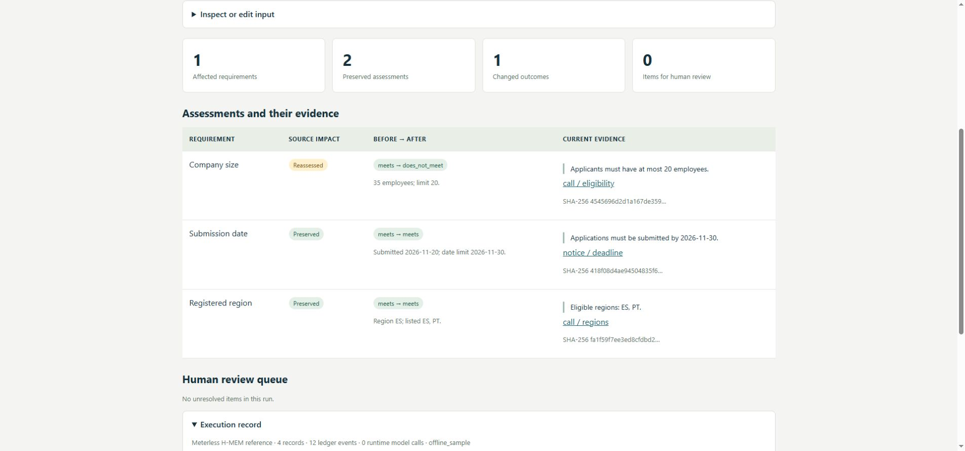
One changed criterion; two assessments preserved
Staff limit: 50 → 20. Fictional applicant: 35 employees.
Notes:
Sources: project app/core.mjs, app/adapters.mjs, tests/, evidence/evaluation.json and evidence/preflight.json. Snapshot 22 October 2026. Official event: https://hackathon.genai.works/event/open-agent-hackathon-2026. Sponsor engine: https://github.com/Meterless/Meterless commit 1742dec56a66e58eef9dda2d2b865823758ca8cd. No live integrations or prize eligibility claimed. Product image is an actual local browser run with synthetic example_1.json.

Slide 5
Local evidence, with a narrow scope
24 application tests
Invalid quotations, missing/new clauses, changed facts, repair limits, deadlines and memory reuse.
13 H-MEM conformance checks · 55 synthetic cases
All pass locally. The synthetic grid checks the explicit grammar and invalidation only; it is not real-world or model-quality accuracy.
Notes:
Sources: project app/core.mjs, app/adapters.mjs, tests/, evidence/evaluation.json and evidence/preflight.json. Snapshot 22 October 2026. Official event: https://hackathon.genai.works/event/open-agent-hackathon-2026. Sponsor engine: https://github.com/Meterless/Meterless commit 1742dec56a66e58eef9dda2d2b865823758ca8cd. No live integrations or prize eligibility claimed.

Slide 6
Sponsor technologies: implemented and pending
Meterless H-MEM
Working reference integration: provenance, recall, ledger
Zetaris
SQL adapter written; instance and live data view pending
Meterless Nightshift
Provider and revision loop written; live Runtime pending
Cursor
Interactive development verification pending; Codex assisted
NVIDIA
Optional Nemotron route; no actual model run claimed
Notes:
Sources: project app/core.mjs, app/adapters.mjs, tests/, evidence/evaluation.json and evidence/preflight.json. Snapshot 22 October 2026. Official event: https://hackathon.genai.works/event/open-agent-hackathon-2026. Sponsor engine: https://github.com/Meterless/Meterless commit 1742dec56a66e58eef9dda2d2b865823758ca8cd. No live integrations or prize eligibility claimed. Meterless provider contract: https://meterless.ai/engines.html; Zetaris REST shape from official Participant Setup Guide, updated 21 October 2026.

Slide 7
Technical contribution and operating limits
Contribution
Exact evidence fingerprints control reuse. A source change invalidates only its mapped assessments. Unsupported additions and missing clauses enter a review queue.
Limits
Three explicit English rule grammars. Supplied source URLs. Synthetic examples. No automatic funding decision, arbitrary-PDF extraction or certified legal interpretation.
Notes:
Sources: project app/core.mjs, app/adapters.mjs, tests/, evidence/evaluation.json and evidence/preflight.json. Snapshot 22 October 2026. Official event: https://hackathon.genai.works/event/open-agent-hackathon-2026. Sponsor engine: https://github.com/Meterless/Meterless commit 1742dec56a66e58eef9dda2d2b865823758ca8cd. No live integrations or prize eligibility claimed.

Slide 8
Work needed before the final submission
• Configure Zetaris and Nightshift with private credentials
• Build the live evidence view and run the complete feature
• Verify the required Cursor workflow and actual provider routing
• Replace interim materials with an authenticated 1–4 minute demo
• Submit repository, video, deck and truthful sponsor explanation
Notes:
Sources: project app/core.mjs, app/adapters.mjs, tests/, evidence/evaluation.json and evidence/preflight.json. Snapshot 22 October 2026. Official event: https://hackathon.genai.works/event/open-agent-hackathon-2026. Sponsor engine: https://github.com/Meterless/Meterless commit 1742dec56a66e58eef9dda2d2b865823758ca8cd. No live integrations or prize eligibility claimed.

