Slide 1

Air Quality Analysis
Akshita Goel
Morenzo MinarWidjaja
Savan Patel

Slide 2
Introduction
Air Pollution is a significant environment challenge, with PM2.5 (Particulate Matter) being a critical pollutant linked to health risks
PM2.5 levels can be modelled and analyzed with numerical methods
Regression Analysis: Model relationship between PM2.5 and CO (Carbon Monoxide) by leveraging exponential and polynomial regression techniques (linear, quadratic, cubic)
Simpson's Method: Compute cumulative exposure to pollutants over time, focusing on those strongly correlated with PM2.5

Slide 3
Problem Statement
Air pollution poses a significant threat to public health with particulate matter < 2.5 micrometers in size (PM2.5) being a critical pollutant linked to severe health issues such as respiratory and cardiovascular diseases. Effective air quality management requires understanding the factors affecting PM2.5 levels and developing predictive tools to aid in decision-making

Slide 4
Challenges
Identifying which pollutants have the strongest influence on PM2.5 levels
Modeling relationships between PM2.5 and other pollutants for better predictions on its behavior to meet WHO standards (PM2.5 < 15 µg/m³)
Quantifying cumulative exposure to pollutants over time to assess long-term health risks
Evaluate effectiveness of numerical algorithms in practical environmental applications

Slide 5
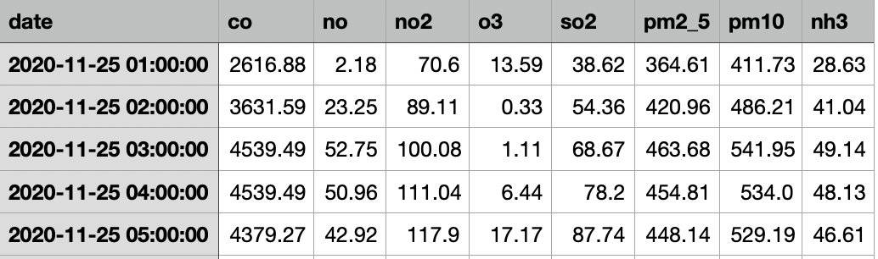
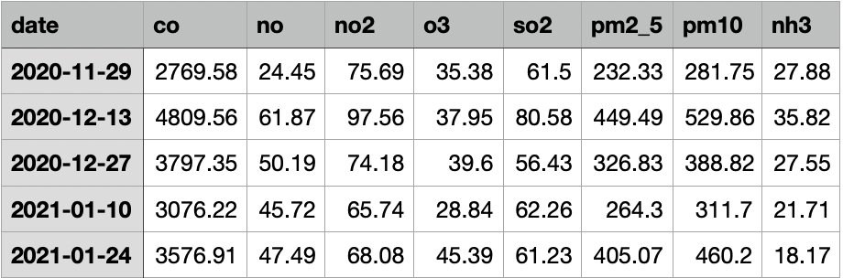
Dataset
Hourly air quality data from Delhi, India.
Collected between Nov, 2020 and Jan, 2023.
Dataset consists of Particulate Matter (PM2.5 and PM10) levels, Carbon Monoxide (CO), Nitrogen Monoxide (NO), Nitrogen dioxide (NO2), sulfur dioxide (SO2), ozone (O3), and Ammonia (NH3).
Data processed into bi-weekly averages to reduce size.
Daily Hourly
Biweekly

Slide 6
Rationale
Initial consideration: PM2.5 vs. Time
Violates regression assumption
("The independent variables are independent of each other")
Limited turning points
(e.g., Cubic polynomial has at most 2 turning points and then it diverges)
Switched to PM2.5 vs. other pollutants
(Pollutant values are independent of each other, fulfilling polynomial regression assumptions)

Slide 7
Exponential Regression
Model
Exponential Regression: Captures nonlinear growth/decay patterns.
PM2.5=a⋅e^{b⋅CO}
Applied MinMaxScaler to normalize pollutants to a range of [0, 1].
Added a small constant (1e-6) to PM2.5 where needed to handle logarithmic transformations.
Metrics
R² score: Measures fit accuracy (proportion of variation explained)
Mean Squared Error (MSE): Quantifies prediction error

Slide 8
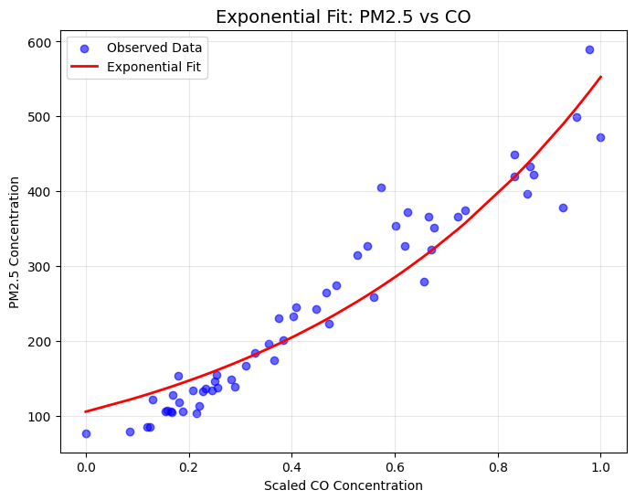
Results
Graph includes best fit line for PM2.5 vs all other pollutants
Predicted PM2.5 levels for future CO concentrations:
CO: 4195.83 µg/m³,
Predicted PM2.5: 338.09 µg/m³
CO: 4372.26 µg/m³,
Predicted PM2.5: 359.51 µg/m³

Slide 9
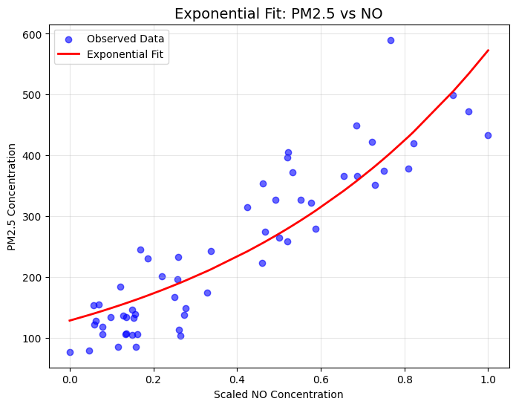
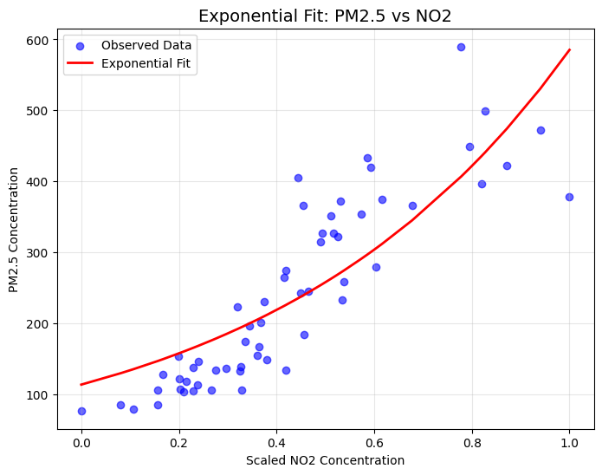
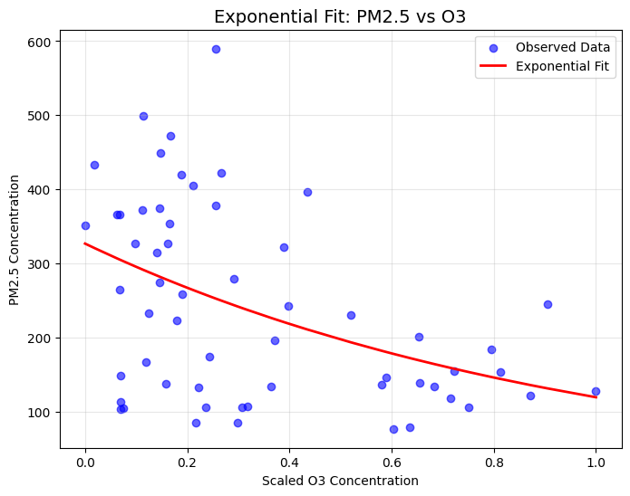
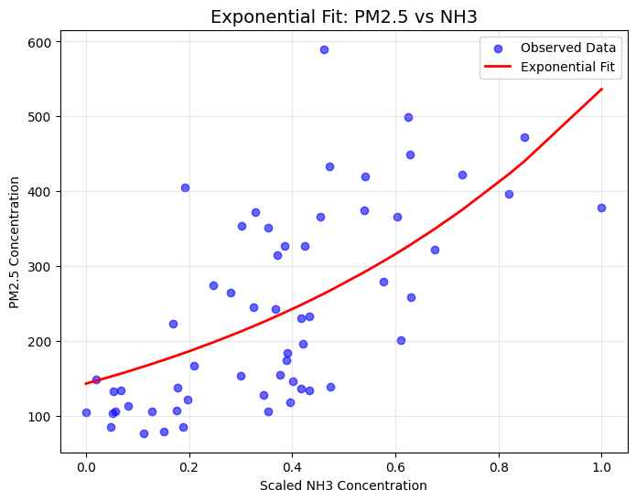
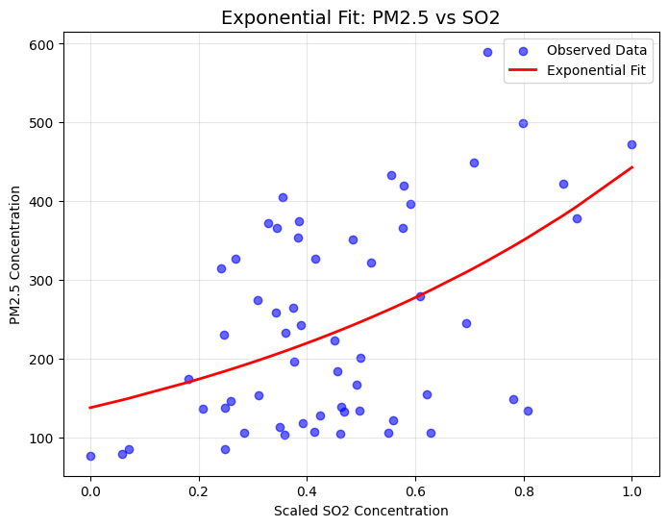

Slide 10
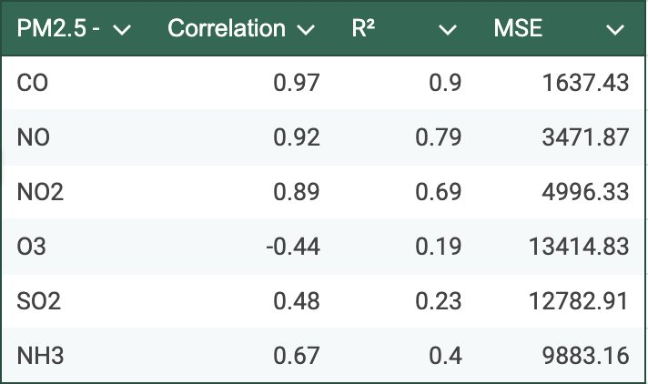
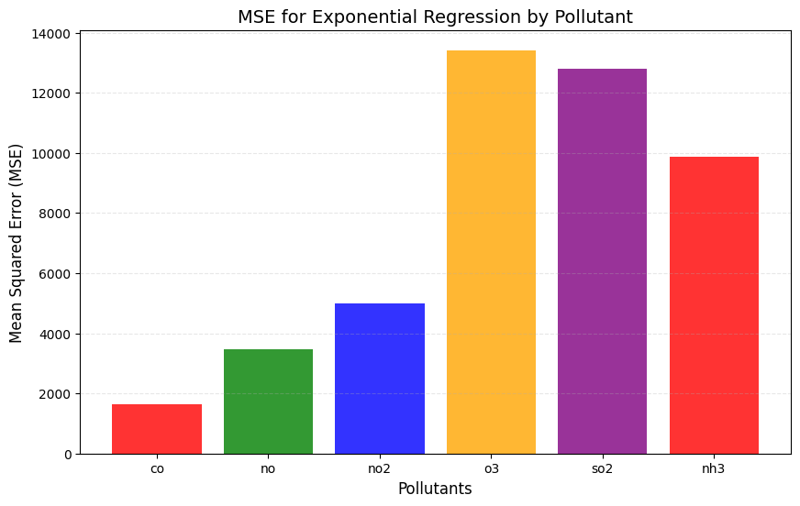
Analysis
Insight: The model performed best for CO, with the highest R² and lowest MSE.
Advantages: Suitable for modeling exponential growth or decay trends.
Limitation: It cannot capture non-monotonic relationships.
Computational Complexity: Fitting requires iterative optimization but remains efficient for small datasets.

Slide 11
Polynomial Regression
Models
Linear Regression: Fitting a straight line
Quadratic Regression: Includes squared term to capture curvature
Cubic regression : Includes cubic term to capture complex patterns
Metrics
R² score: Measures model accuracy (proportion of variation)
Prediction: Utilize model to estimate CO level required to achieve safe PM 2.5 threshold
Software: Implemented in Python using the "Normal Equation"

Slide 12
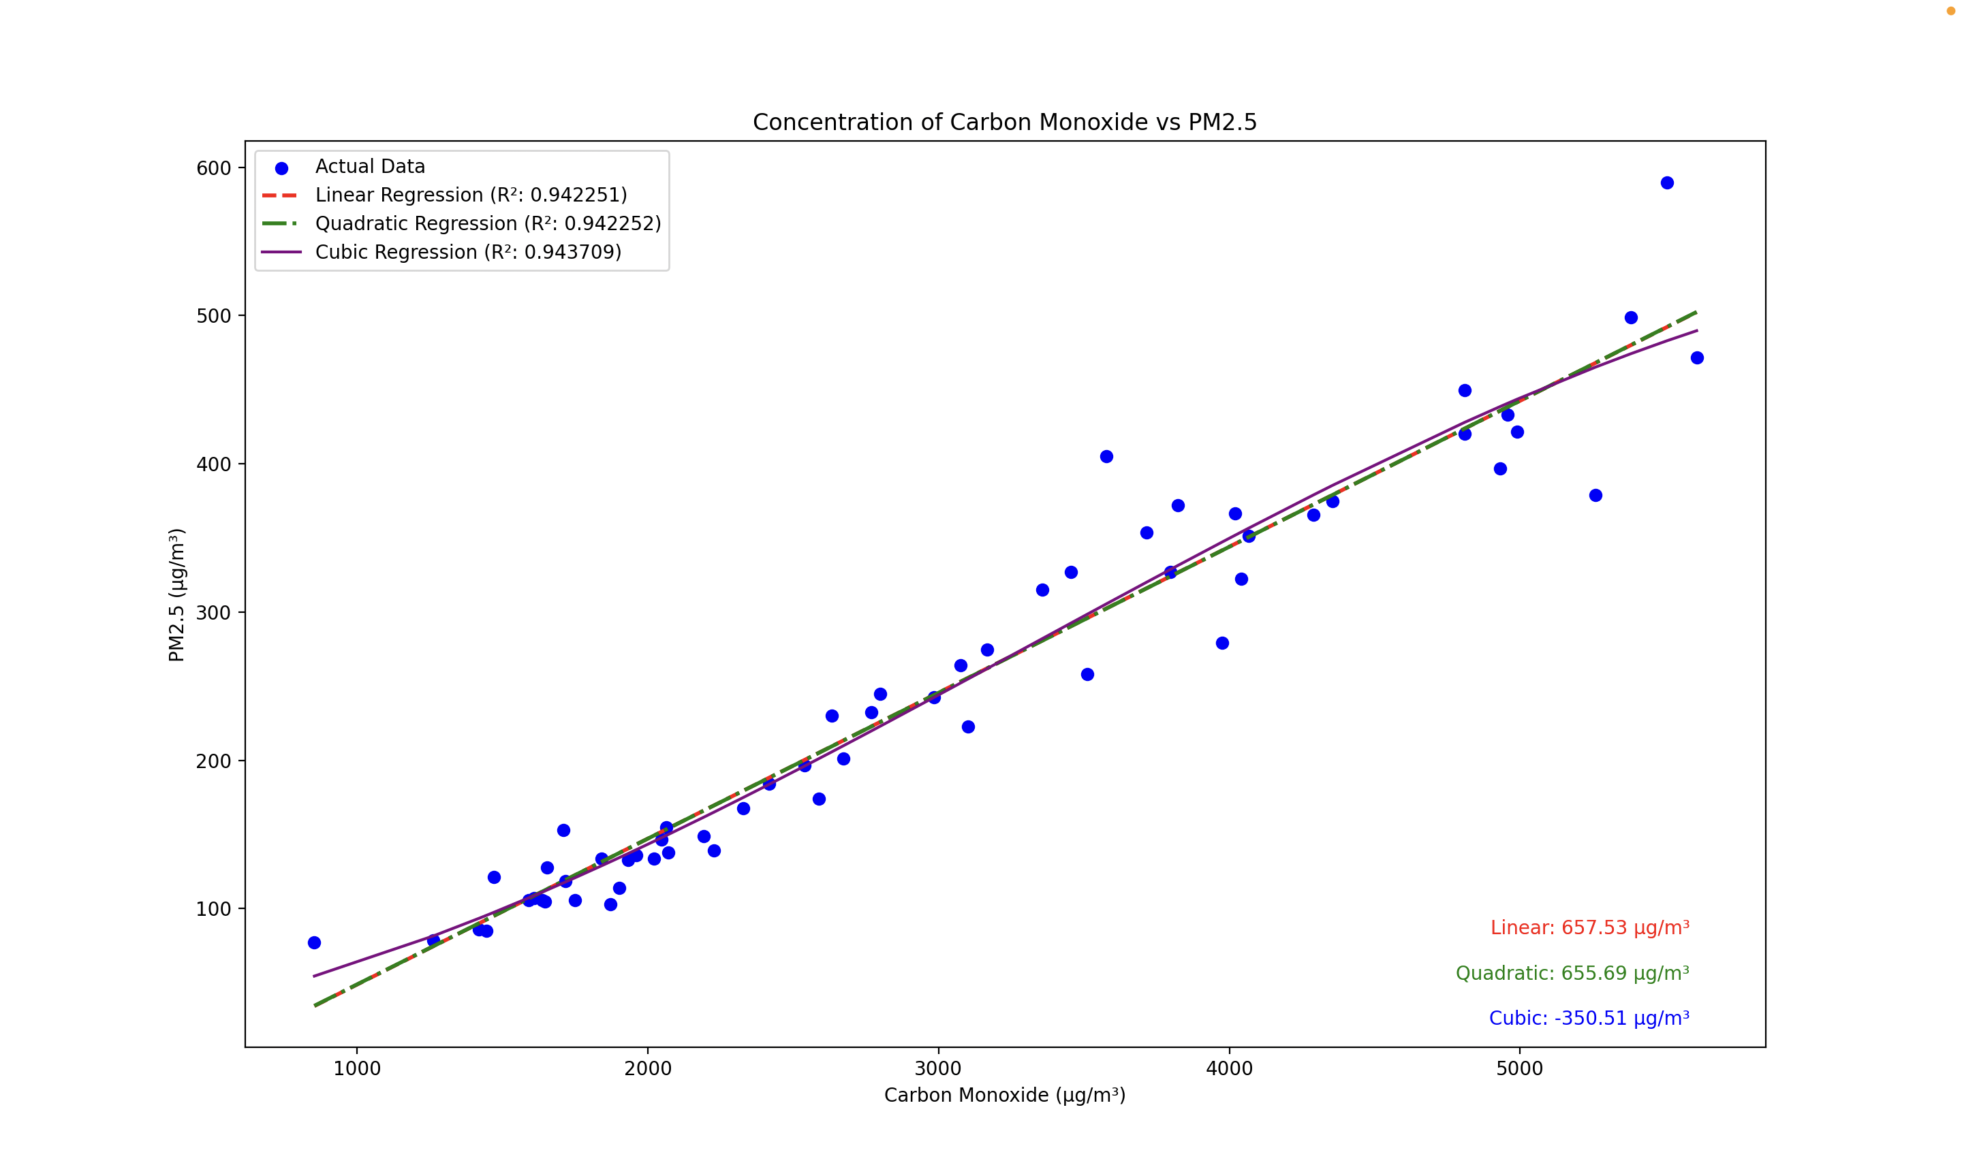
Results
Similar performance in terms of R² score
Linear: 0.942251
Quadratic: 0.942252
Cubic: 0.943709
Predicted CO levels to achieve PM 2.5 Threshold (15 µg/m³)
Linear : 657.53 µg/m³
Quadratic : 655.69 µg/m³
Cubic : -350.51 µg/m³ (Invalid)

Slide 13
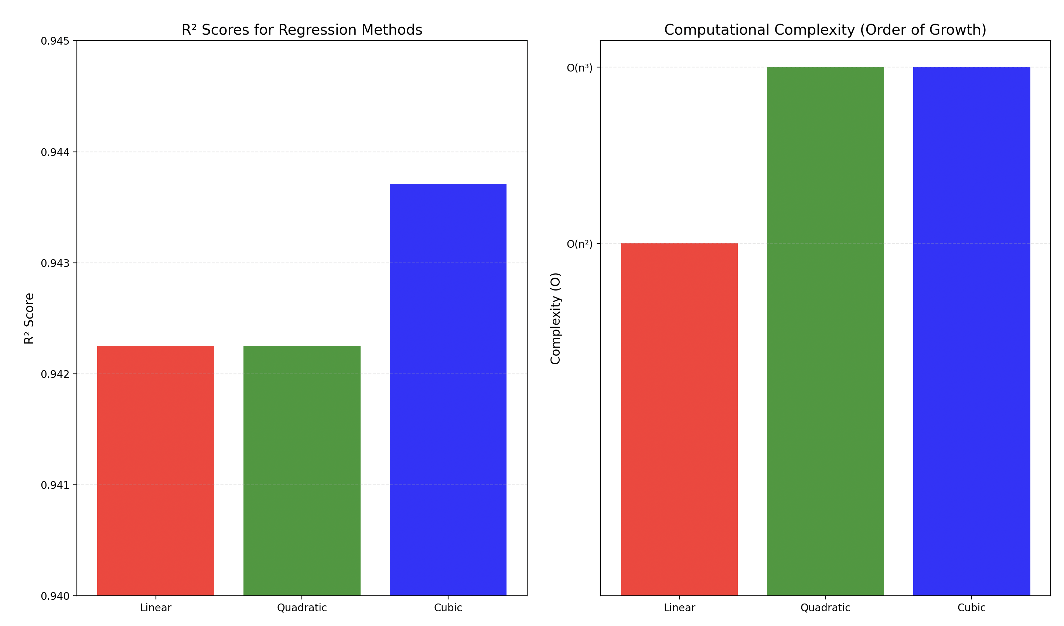
Analysis
Linear Regression: simple, efficient, interpretable results, accurate prediction
Quadratic Regression: more flexibility with quadratic term, but the added complexity had no significant impact on the R² score
Cubic Regression: overfitting and unrealistic predictions (e.g., negative CO levels), not suitable for this dataset
Computational Complexity: Linear regression is the simplest to compute (2x2 system), while quadratic and cubic regression involve larger matrices and takes longer to computer

Slide 14
Simpson's Method
Purpose
To calculate cumulative pollutant exposure over time, focusing on pollutants with strong correlations to PM2.5.

Slide 15
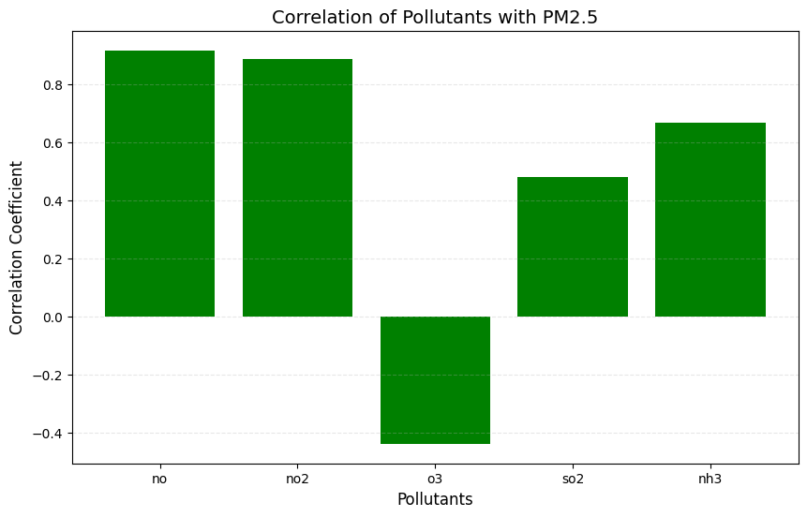
Steps
Selected top three pollutants (NO, NO2, and SO2)
excluded CO due to its overwhelming dominance.

Slide 16
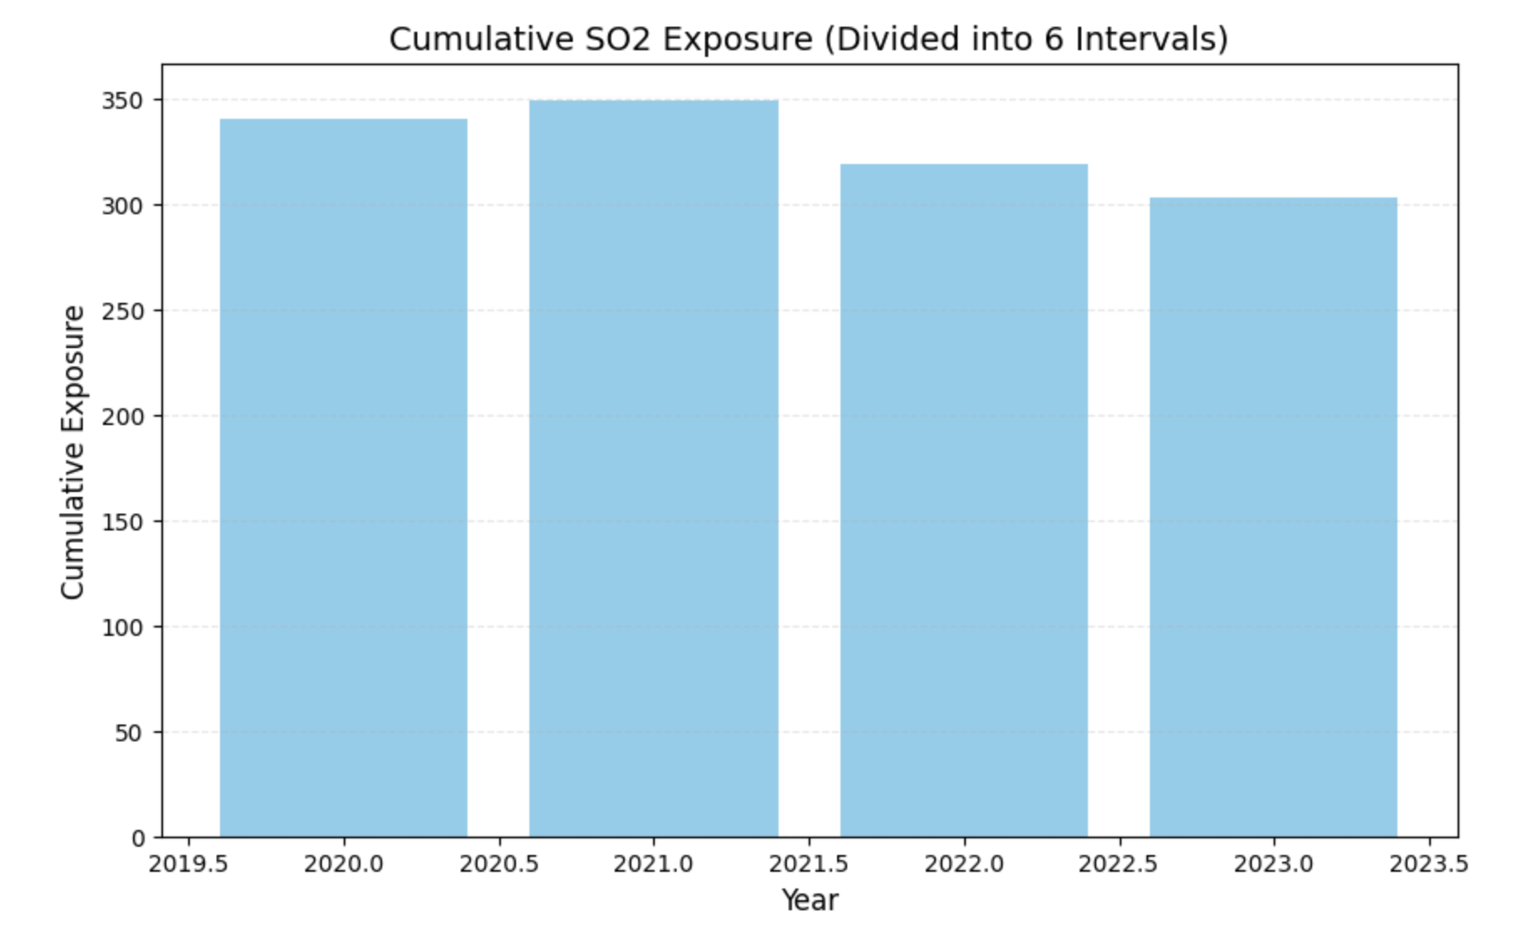
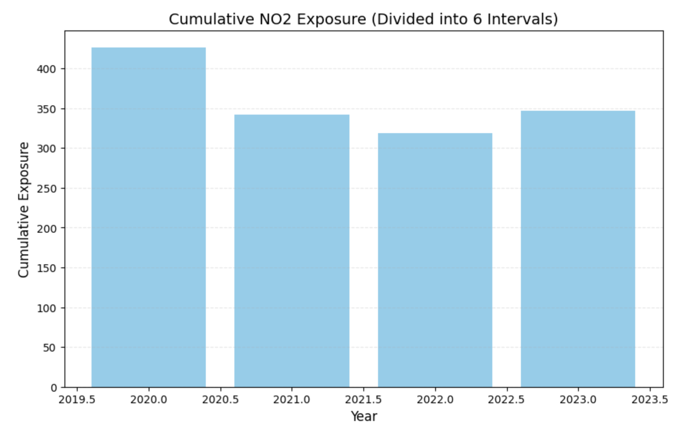
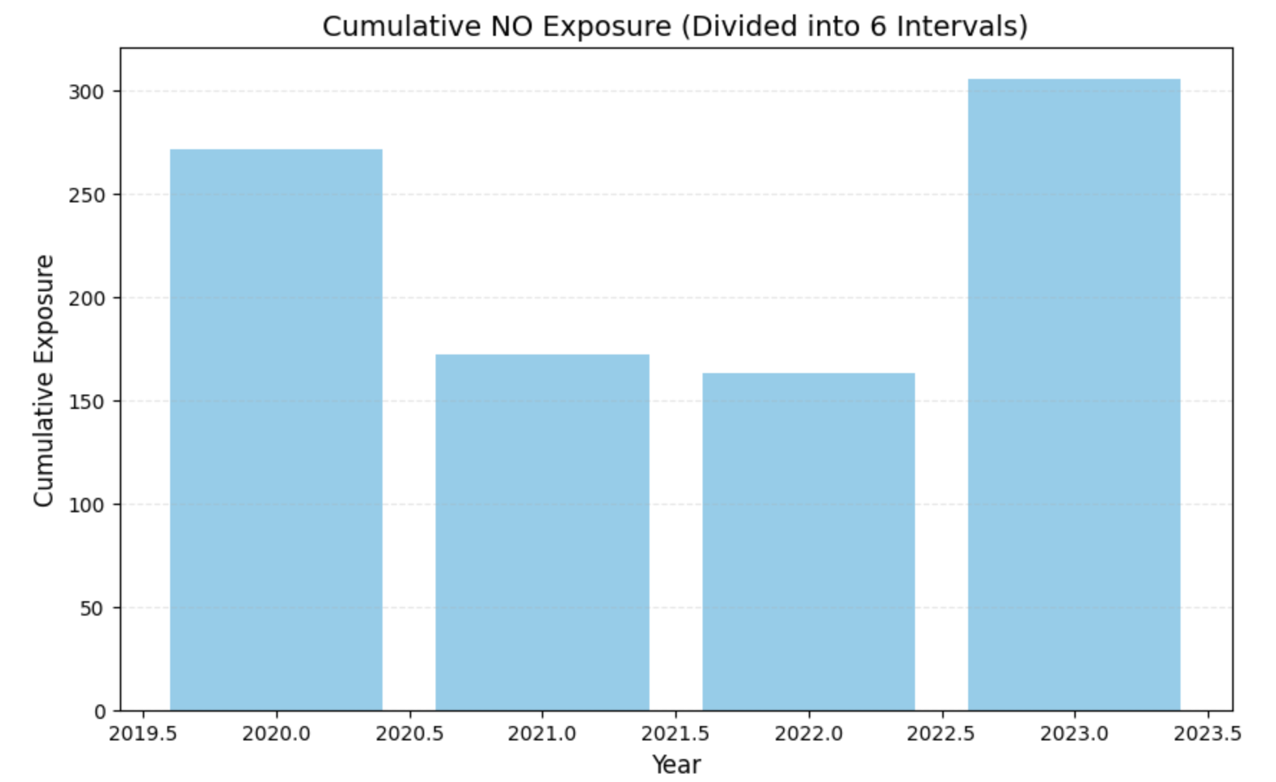
Implementation
Calculated cumulative exposure over equal time intervals (sixths of the year).
Exposure levels aligned with the correlation to PM2.5.

Slide 17
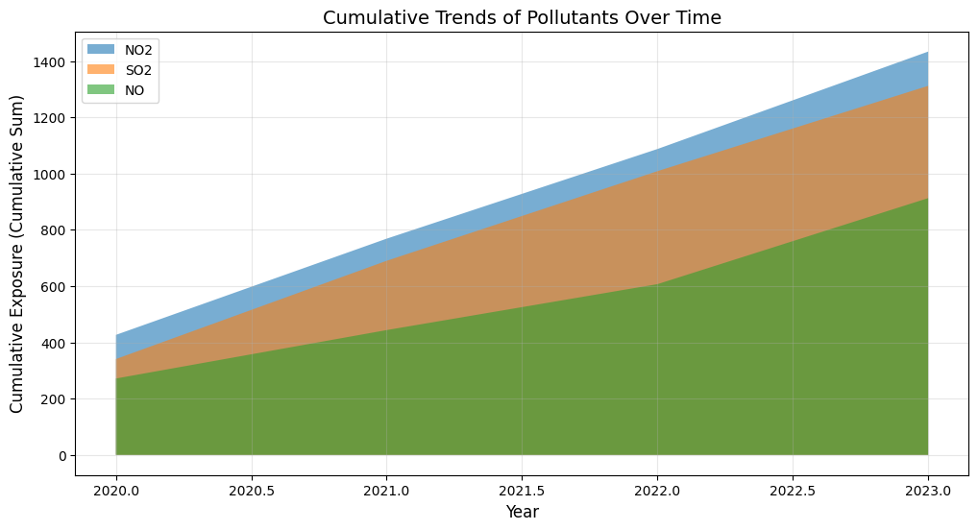
Results
Highest cumulative exposure for NO₂, followed by SO₂ and NO.
Cumulative exposure for NO2
2020: 426.52 µg/m³
2021: 342.10 µg/m³
2022: 318.70 µg/m³
2023: 346.42 µg/m³
.

Slide 18
Analysis
Insight: SO2 and NO had lower cumulative exposure but showed consistent trends.
Effectively quantifies cumulative exposure, capturing pollutant trends over time.
Advantage: Handles irregular data by dividing into equal intervals.
Limitation: Requires evenly spaced data points.

Slide 19
Conclusion
High R² score for both Exponential and Polynomial Regression suggests that CO levels can be a reliable predictor for PM2.5 levels in this region
Exponential Regresion Captured nonlinear relationships between PM2.5 and other pollutants but assumes monotonic relationships
Linear Regression is the most suitable for this dataset:
Interpretable and accurate result
Avoids issue of overfitting and unrealistic outputs
Computationally efficient and easy to implement
Simpson's Method quantified cumulative pollutant exposure (e.g., NO, NO2, SO2) over time.

Slide 20
References
Data- https://www.kaggle.com/datasets/deepaksirohiwal/delhi-air-quality

