Slide 1
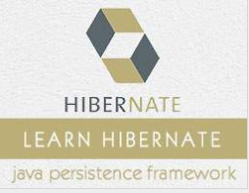
Hibernate Java ORM

Slide 2
Hibernate - ORM
Hibernate is an Object-Relational Mapping(ORM) solution for JAVA.
JPA – Java persistence API
Hibernate implements the JPA specification

Slide 3
Entity manages vs Session
Session is a hibernate-specific API, EntityManager is a standardized API for JPA.
You can think of the EntityManager as an adapter class that wraps Session
The EntityManager invokes the hibernate session under the hood.
And if you need some specific features that are not available in the EntityManager, you can obtain the session by calling: Session session = entityManager.unwrap(Session.class);

Slide 4
Persistent Class
The entire concept of Hibernate is to take the values from Java class attributes and persist them to a database table. A mapping document helps Hibernate in determining how to pull the values from the classes and map them with table and associated fields.
Java classes whose objects or instances will be stored in database tables are called persistent classes in Hibernate.
Hibernate works best if these classes follow some simple rules, also known as the Plain Old Java Object (POJO) programming model.

Slide 5
Persistent Class
All Java classes that will be persisted need a default constructor.
All classes should contain an ID in order to allow easy identification of your objects within Hibernate and the database. This property maps to the primary key column of a database table.
All attributes that will be persisted should be declared private and have getXXX and setXXX methods defined in the JavaBean style.

Slide 6
States Of Object
Instances may exist in one of the following three states at a given point in time −
transient − A new instance of a persistent class, which is not associated with a Session and has no representation in the database and no identifier value is considered transient by Hibernate.
persistent − You can make a transient instance persistent by associating it with a Session. A persistent instance has a representation in the database, an identifier value and is associated with a Session.
detached − Once we close the Hibernate Session, the persistent instance will become a detached instance. (lazy exception, no directly update in DB)

Slide 7
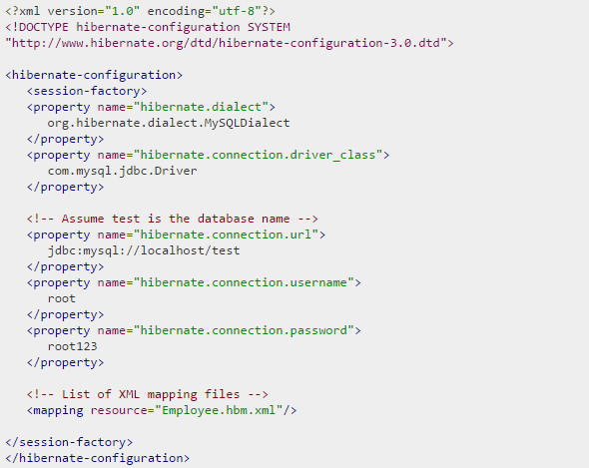
Configuration
Hibernate.cfg.xml

Slide 8
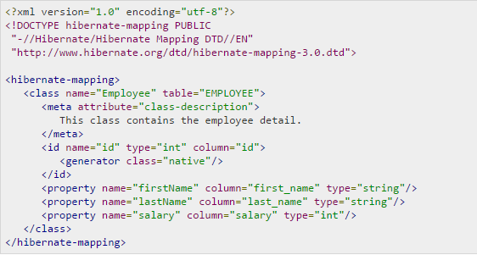
Mapping
The convention is: <Entity>.hbm.xml

Slide 9
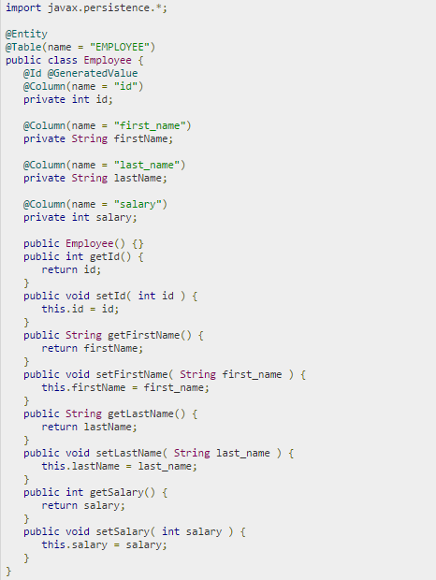
Mapping
Using Annotation:

Slide 10
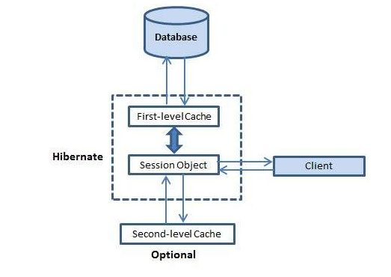
Caching
First-level Cache – Performance
The first-level cache is the Session cache and is a mandatory cache through which all requests must pass. The Session object keeps an object under its own power before committing it to the database.
If you issue multiple updates to an object, Hibernate tries to delay doing the update as long as possible to reduce the number of update SQL statements issued.
If you close the session, all the objects being cached are lost and either persisted or updated in the database.

Slide 11
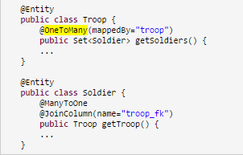
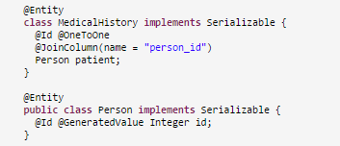
Relationship
@ManyToOne
@OneToMany
@OneToOne

Slide 12
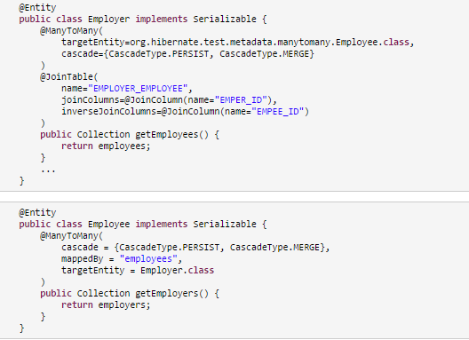
Relationship
@ManyToMany

Slide 13
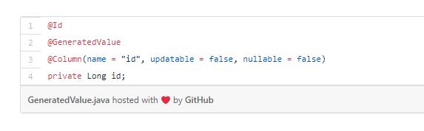
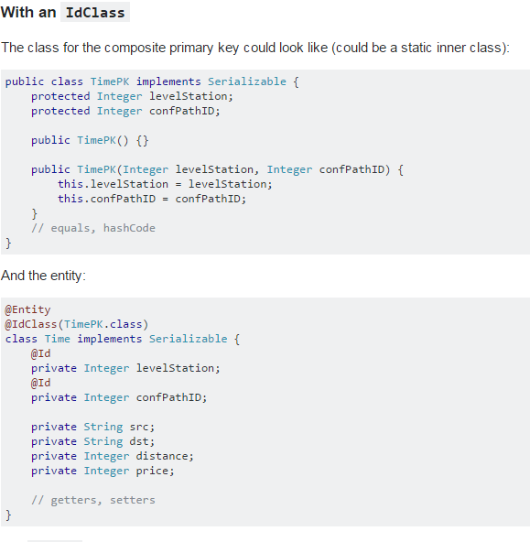
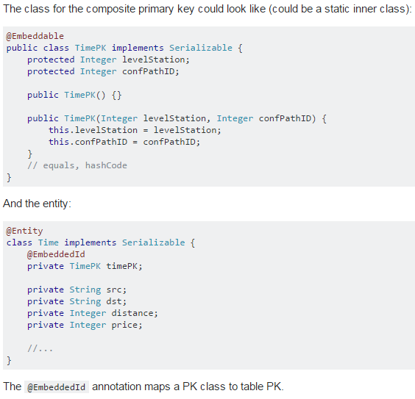
Primary Key
Two ways to manage composite primary key
@Id & @GeneratedValue
@IdClass
@EmbaddedId

Slide 14

Query Language - HQL
Hibernate Query Language (HQL) is an object-oriented query language, similar to SQL, but instead of operating on tables and columns, HQL works with persistent objects and their properties. HQL queries are translated by Hibernate into conventional SQL queries, which in turns perform action on database.

Slide 15
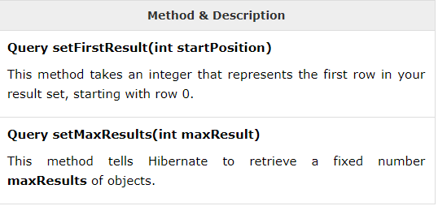
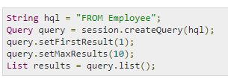
Query Language-HQL
Pagination using Query

Slide 16
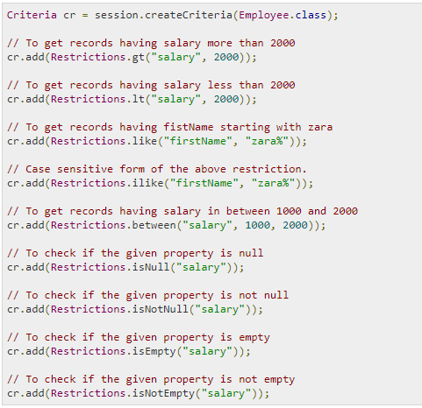

Criteria Queries

Slide 17
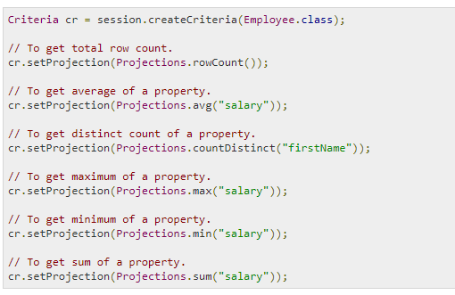
Criteria Queries -Projections & Aggregations

Slide 18
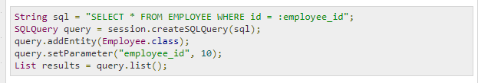
Native SQL

Slide 19
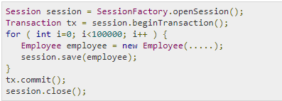
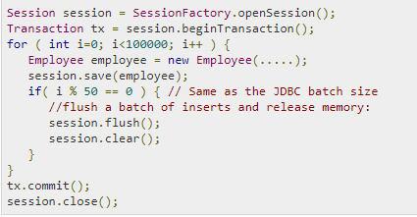
Batch Processing
Before
After : hibernate.jdbc.batch_size
JDBC batch updates allow sending multiple update queries in a single batch to the database. It reduces the number of network calls.

Slide 20
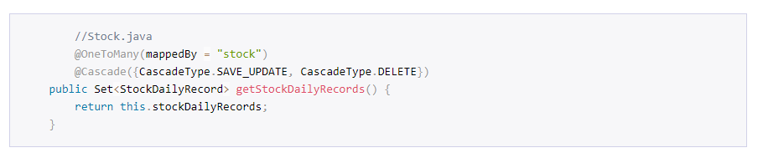

Cascade Type
Fetch Type

Slide 21
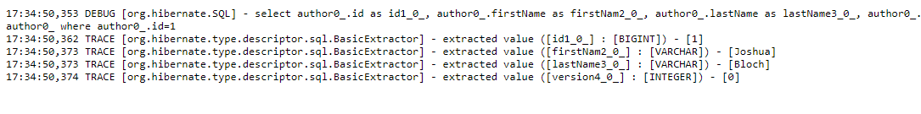
How to debug the query , Behind the Scenes..
The SQL statements are written as DEBUG messages to the category org.hibernate.SQL.
The bind parameters are logged to the org.hibernate.type.descriptor.sql category with log level TRACE.

Slide 22
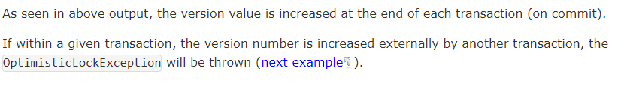

Version management
The @version element is optional and indicates that the table contains versioned data. This is particularly useful if you plan to use long transactions, Version tag may help you to avoid concurrent updating for a row.

Slide 23
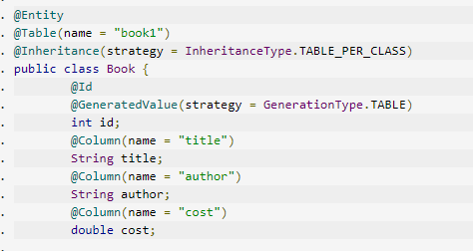
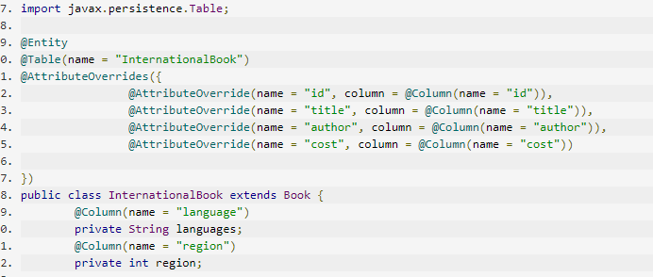
Inheritance mapping Table per class

Slide 24
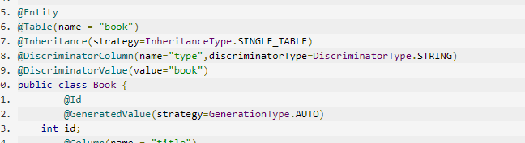
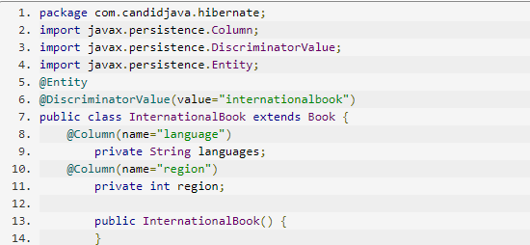
Inheritance mapping Single table per class hierarchy

Slide 25
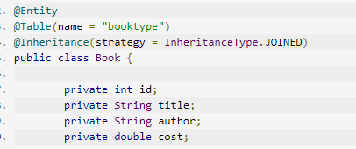
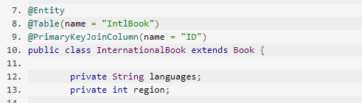
Inheritance Joined subclasses

Slide 26
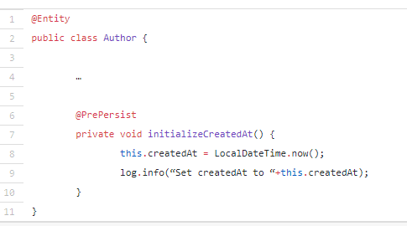
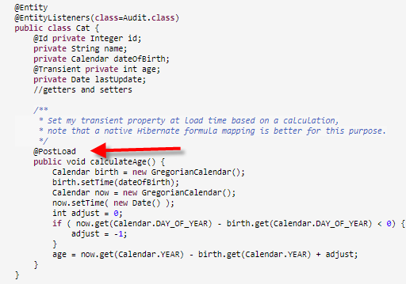
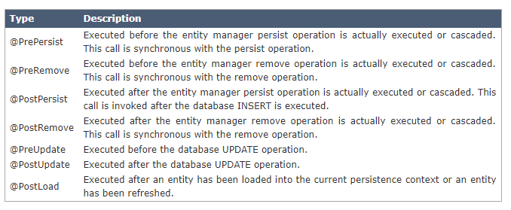
Entity listeners and Callback methods

Slide 27
Using DTO projections - Data Transfer Object
TypedQuery<BookWithAuthorNames> q = em.createQuery(
"SELECT new org.thoughts.on.java.model.BookWithAuthorNames(b.id, b.title, b.price, concat(a.firstName, ' ', a.lastName))
FROM Book b JOIN b.author a WHERE b.title LIKE :title",
BookWithAuthorNames.class);
q.setParameter("title", "%Hibernate Tips%");
List<BookWithAuthorNames> books = q.getResultList();
for (BookWithAuthorNames b : books) {
log.info(b);
}

Slide 28


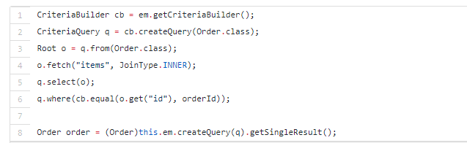
3 ways to initialize lazy associations
1. Call a method on the mapped relation
2. Fetch Join
3. Fetch Join in Criteria API

Slide 29
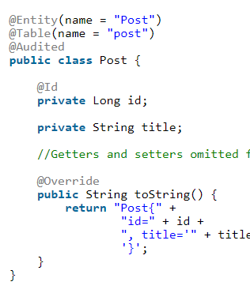
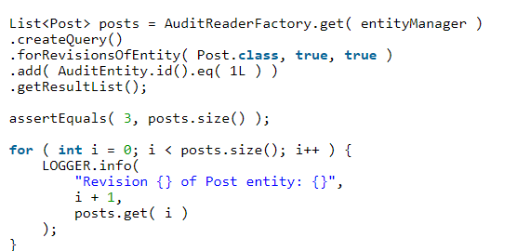
Entity Auditing
Add @Audited to entity
Creating Audit Log Tables
Querying the entity snapshots

Slide 30
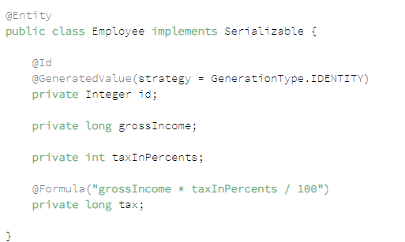
Dynamic Mapping
Calculated Columns with @Formula
the value is calculated when the entity
is fetched from the database.

Slide 31
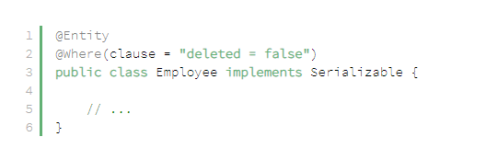
Dynamic Mapping
Filtering Entities with @Where
The @Where annotation on a method contains an SQL clause that will be added to any query or subquery to this entity:

