Slide 1
Chinook Music Sales Analysis
Nwokike Chiagozie Precious
chiagozienwokike@gmail.com
Date: 07-05-2025
Tool Stack: SQL, Python, Power BI

Slide 2
Project Overview
Objective: Analyze music sales data from the Chinook database to uncover sales trends, customer behavior, and lifetime value.
Tools Used:
- SQL: For querying and extracting insights.
- Python: For business and predictive analysis (CLTV modeling).
- Power BI: For interactive dashboard visualizations.

Slide 3
Key Business Questions
Who are the top-selling artists and how do their sales vary over time?
What customer segments exist based on purchase behavior?
Which genres are most popular?
How can we predict customer lifetime value?
Are there patterns in product purchases?

Slide 4
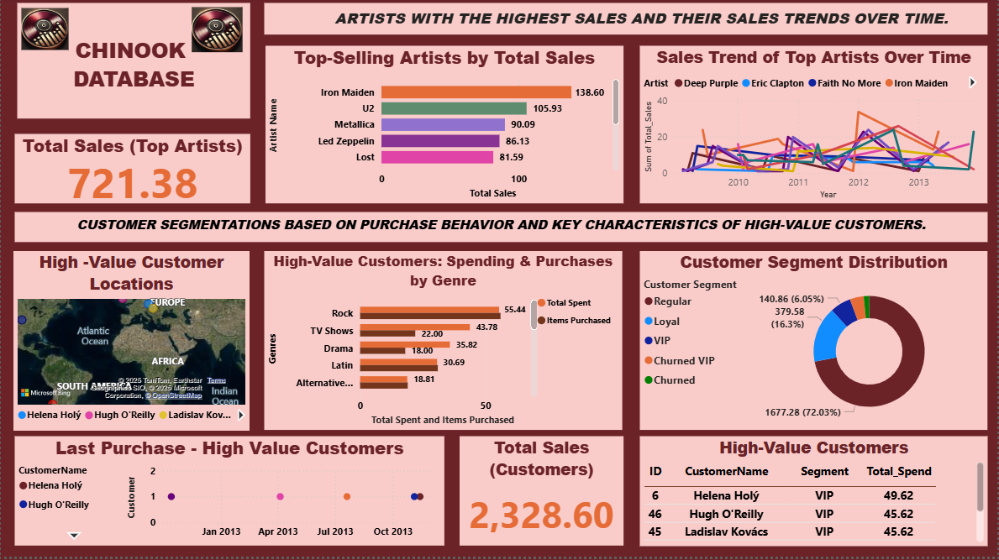
Dashboard 1 – Sales & Customer Segmentation
- Iron Maiden tops artist sales. - Clear segmentation of customer types (VIP, Loyal, Churned). - High-value customers mapped globally.

Slide 5
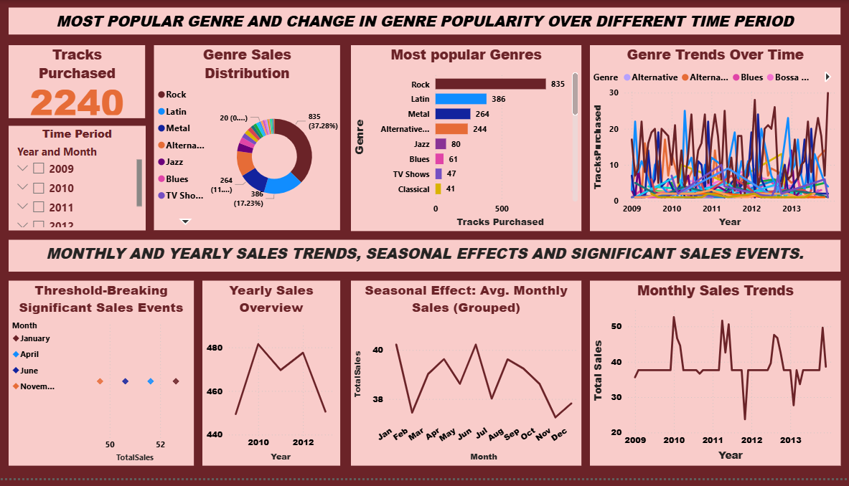
Dashboard 2 – Genre & Time-Based Sales Analysis
- Rock dominates genre sales. - Seasonal trends suggest peak sales periods. - Genre popularity shifts over time.

Slide 6
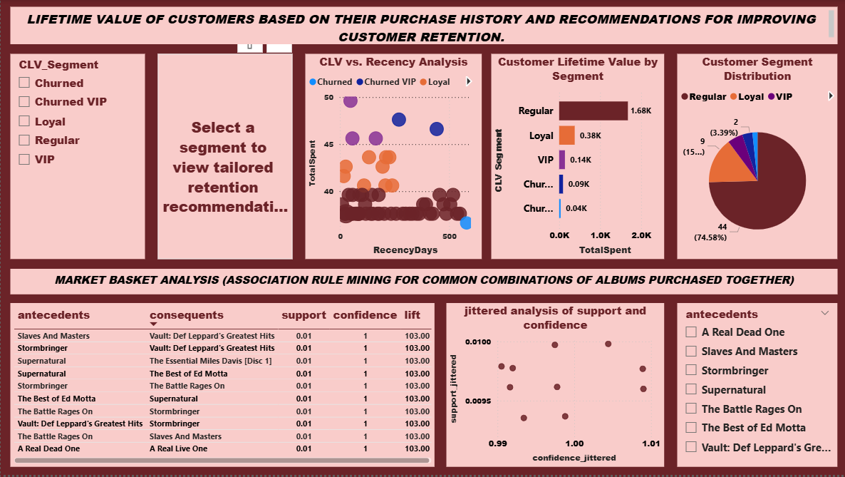
Dashboard 3 – CLTV & Market Basket Insights
- CLTV segments show most value in "Regular" and "Loyal" customers. - Market Basket Analysis reveals commonly paired albums. - Retention strategies can target high CLTV segments.

Slide 7
Machine Learning Objective and Approach
Predicting Customer Lifetime Value with Machine Learning
• Objective: Predict customer lifetime value (CLV) to identify high-value customers and inform targeted marketing strategies for the Chinook Media Store. • Data Source: Extracted features from Chinook database tables, including total spend, purchase frequency, genre preferences, etc. • Approach: Developed machine learning models in Jupyter Notebook using Python to predict CLV based on historical customer purchase data. • Models Evaluated: Linear regression, random forest, and gradient boosting, selected for their ability to model customer behaviour patterns.

Slide 8
Model Development and Results
Model Performance: Linear Regression Leads
• Model Development: Trained three models in Jupyter Notebook:
Linear regression: Baseline model assuming linear relationships.
Random forest: Ensemble model capturing non-linear patterns.
Gradient boosting: Advanced ensemble for complex relationships.
Features Used: Country, Total spend, Recency, and TopGenre, EmailDomain, engineered from Chinook data.
Performance Results: Linear regression outperformed others with [Model Metric, e.g., R² =0.31], the only positive R² among the three models, indicating strong predictive accuracy for CLV.

Slide 9
Conclusion
• Analysis of the Chinook database uncovers actionable insights into customer behavior, sales trends, and market opportunities. • The dominance of the Rock genre, coupled with the high lifetime value of Regular and Loyal customers, underscores their critical role in revenue growth. • Seasonal sales fluctuations highlight the need for strategic promotions, while top artists and album associations offer avenues for enhanced marketing. • By leveraging these findings through targeted campaigns, optimized promotions, and data-driven bundling, the Chinook Media Store can strengthen customer loyalty, stabilize revenue, and drive sustainable growth.
• Power of CLV Predictions: Linear regression outperforms random forest and gradient boosting in predicting CLV.

Slide 10
Recommendations
• Target High-Value Customer Segments: Implement personalized retention strategies, such as loyalty programs and exclusive offers, to boost repeat purchases and minimize churn. • Optimize Genre-Based Marketing: Capitalize on the popularity of Rock, Latin, and Metal genres by prioritizing these categories in marketing campaigns to maximize customer engagement and sales. • Address Seasonal Sales Trends: Counter low-sales periods (e.g., November, December, February) with targeted promotions, events, or discounts to stabilize revenue throughout the year. • Leverage Artist Partnerships: Strengthen relationships with top-performing artists like Iron Maiden and U2 to sustain consistent sales and enhance brand appeal. • Enhance Cross-Selling with Market Basket Insights: Use album association rules (e.g., Stormbringer → Def Leppard’s Greatest Hits) to create bundled offers and personalized product recommendations, driving incremental sales.
• Use linear regression’s CLV predictions to prioritize high-value customers for loyalty programs.

Slide 11
Thank You
Questions?
Contact: chiagozienwokike@gmail.com

