Slide 1

Introduction to CNNs

Slide 2
Deep Learning
Welcome to the section on Convolutional Neural Networks!
CNNs are a specific architecture of Neural Networks that are extremely effective at dealing with image data.
Let’s review what we will learn in this section!

Slide 3
Deep Learning
CNN Section
Understanding CNNs
Image Kernels and Filters
Convolutions
Pooling Layers
MNIST Dataset (Grayscale Images)
CIFAR-10 Dataset (Color Images)

Slide 4
Deep Learning
CNN Section
Working with image files (jpg,png,etc…) with CNNs.
CNNs for malaria blood cell classification.
CNN exercise on Fashion Image Dataset.

Slide 5
MNIST Data

Slide 6
Deep Learning
A classic data set in Deep Learning is the MNIST data set.
Let’s quickly cover some basics about it since we’ll be using it quite frequently during this section of the course!

Slide 7
Deep Learning
Fortunately this data is easy to access with PyTorch Vision. We will download:
60,000 training images
10,000 test images

Slide 8
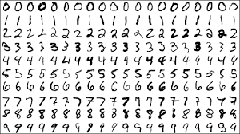
Deep Learning
The MNIST data set contains handwritten single digits from 0 to 9

Slide 9
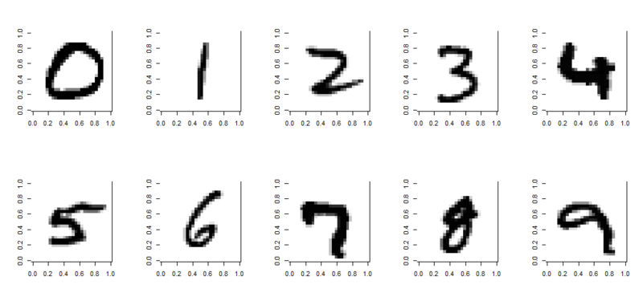
Deep Learning
A single digit image can be represented as an array

Slide 10
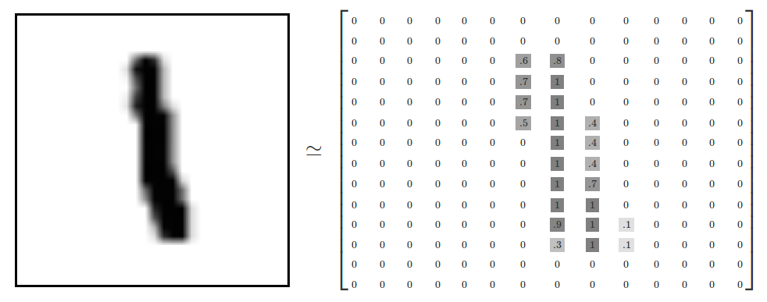
Deep Learning
Specifically, 28 by 28 pixels

Slide 11
Deep Learning
The values represent the grayscale image

Slide 12
Deep Learning
We will first explore how we could approach this data set with a standard ANN.
In this case, to feed it into our network we will need to flatten the 28 by 28 array to 784

Slide 13
Deep Learning

Slide 14
Deep Learning
...

Slide 15
Deep Learning
...
784 inputs

Slide 16
Deep Learning
...

Slide 17
Deep Learning
...
...
784 neurons

Slide 18
Deep Learning
...
...
784 neurons
Hidden Layers
10 output neurons

Slide 19
Deep Learning
Flattening out the image ends up removing some of the 2-D information, such as the relationship of a pixel to its neighboring pixels.
For now, we’ll ignore this, but come back to it later when we discuss CNN in depth!

Slide 20
MNIST ANN
PART ONE: DATA

Slide 21
MNIST ANN
PART TWO: NEURAL NETWORK

Slide 22
MNIST ANN
PART THREE: TRAINING AND EVALUATION

Slide 23
MNIST ANN
PART FOUR: EVALUATION

Slide 24
Image Filters

Slide 25
Deep Learning
Before we dive into CNNs, let’s first discuss a few key ideas in computer vision.
Computer vision is a general term of using computer programs to process image data.

Slide 26

Deep Learning
If you’ve ever used photo editing software, you have probably seen filters, such as a blur filter. But how do these work?

Slide 27
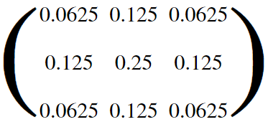
Deep Learning
Filters are essentially an image kernel, which is a small matrix applied to an entire image.
Certain popular filters are well known, for example a blur filter:

Slide 28
Deep Learning
Let’s explore how these image kernel/filters actually get applied to an image.

Slide 29
Deep Learning
Filters allow us to transform images
0 | 0 | 0 | 0 | 0 | 0
0 | 1 | 1 | 1 | 1 | 0
0 | 1 | -1 | -1 | 1 | 0
0 | 1 | -1 | -1 | 1 | 0
0 | 1 | 1 | 1 | 1 | 0
0 | 0 | 0 | 0 | 0 | 0

Slide 30
Deep Learning
Here we have an grayscale image
0 | 0 | 0 | 0 | 0 | 0
0 | 1 | 1 | 1 | 1 | 0
0 | 1 | -1 | -1 | 1 | 0
0 | 1 | -1 | -1 | 1 | 0
0 | 1 | 1 | 1 | 1 | 0
0 | 0 | 0 | 0 | 0 | 0

Slide 31
Deep Learning
Values scaled between -1 and 1
0 | 0 | 0 | 0 | 0 | 0
0 | 1 | 1 | 1 | 1 | 0
0 | 1 | -1 | -1 | 1 | 0
0 | 1 | -1 | -1 | 1 | 0
0 | 1 | 1 | 1 | 1 | 0
0 | 0 | 0 | 0 | 0 | 0

Slide 32
Deep Learning
Filters allow us to transform images
0 | 0 | 0 | 0 | 0 | 0
0 | 1 | 1 | 1 | 1 | 0
0 | 1 | -1 | -1 | 1 | 0
0 | 1 | -1 | -1 | 1 | 0
0 | 1 | 1 | 1 | 1 | 0
0 | 0 | 0 | 0 | 0 | 0
0 | 0 | 0
0 | -1 | 1
0 | 1 | -1
3 by 3 Filter

Slide 33
Deep Learning
Filters allow us to transform images
0 | 0 | 0 | 0 | 0 | 0
0 | 1 | 1 | 1 | 1 | 0
0 | 1 | -1 | -1 | 1 | 0
0 | 1 | -1 | -1 | 1 | 0
0 | 1 | 1 | 1 | 1 | 0
0 | 0 | 0 | 0 | 0 | 0
0 | 0 | 0
0 | -1 | 1
0 | 1 | -1
3 by 3 Filter

Slide 34
Deep Learning
Filters are essentially a matrix
0 | 0 | 0 | 0 | 0 | 0
0 | 1 | 1 | 1 | 1 | 0
0 | 1 | -1 | -1 | 1 | 0
0 | 1 | -1 | -1 | 1 | 0
0 | 1 | 1 | 1 | 1 | 0
0 | 0 | 0 | 0 | 0 | 0
0 | 0 | 0
0 | -1 | 1
0 | 1 | -1
0×0 | 0×0 | 0×0
0×0 | 1×-1 | 1×1
0×0 | 1×1 | -1×-1
3 by 3 Filter
Multiply by filter weights

Slide 35
Deep Learning
Notice how the resolution will decrease
0 | 0 | 0 | 0 | 0 | 0
0 | 1 | 1 | 1 | 1 | 0
0 | 1 | -1 | -1 | 1 | 0
0 | 1 | -1 | -1 | 1 | 0
0 | 1 | 1 | 1 | 1 | 0
0 | 0 | 0 | 0 | 0 | 0
0 | 0 | 0
0 | -1 | 1
0 | 1 | -1
0×0 | 0×0 | 0×0
0×0 | 1×-1 | 1×1
0×0 | 1×1 | -1×-1
0 | 0 | 0
0 | -1 | 1
0 | 1 | 1
2
3 by 3 Filter
Multiply by filter weights
Sum the Result

Slide 36
Deep Learning
We can also edit our stride distance
0 | 0 | 0 | 0 | 0 | 0
0 | 1 | 1 | 1 | 1 | 0
0 | 1 | -1 | -1 | 1 | 0
0 | 1 | -1 | -1 | 1 | 0
0 | 1 | 1 | 1 | 1 | 0
0 | 0 | 0 | 0 | 0 | 0
0 | 0 | 0
0 | -1 | 1
0 | 1 | -1
3 by 3 Filter

Slide 37
Deep Learning
Stride Distance of 2 Example
0 | 0 | 0 | 0 | 0 | 0
0 | 1 | 1 | 1 | 1 | 0
0 | 1 | -1 | -1 | 1 | 0
0 | 1 | -1 | -1 | 1 | 0
0 | 1 | 1 | 1 | 1 | 0
0 | 0 | 0 | 0 | 0 | 0
0 | 0 | 0
0 | -1 | 1
0 | 1 | -1
3 by 3 Filter

Slide 38
Deep Learning
Let’s explore an interactive example!
setosa.io/ev/image-kernels/

Slide 39
Deep Learning
In the context of CNNs, these “filters” are referred to as convolution kernels.
The process of passing them over an image is known as convolution.
Let’s go over a few more important factors!

Slide 40
Deep Learning
During convolution, we would lose borders
1 | 1 | 1 | 1
1 | -1 | -1 | 1
1 | -1 | -1 | 1
1 | 1 | 1 | 1
0 | 0 | 0
0 | -1 | 1
0 | 1 | -1
3 by 3 Filter

Slide 41
Deep Learning
During convolution, we would lose borders
1 | 1 | 1 | 1
1 | -1 | -1 | 1
1 | -1 | -1 | 1
1 | 1 | 1 | 1
0 | 0 | 0
0 | -1 | 1
0 | 1 | -1
3 by 3 Filter

Slide 42
Deep Learning
We can pad the image with more values
0 | 0 | 0 | 0 | 0 | 0
0 | 1 | 1 | 1 | 1 | 0
0 | 1 | -1 | -1 | 1 | 0
0 | 1 | -1 | -1 | 1 | 0
0 | 1 | 1 | 1 | 1 | 0
0 | 0 | 0 | 0 | 0 | 0
0 | 0 | 0
0 | -1 | 1
0 | 1 | -1
3 by 3 Filter

Slide 43
Deep Learning
This allows us to preserve the image size
0 | 0 | 0 | 0 | 0 | 0
0 | 1 | 1 | 1 | 1 | 0
0 | 1 | -1 | -1 | 1 | 0
0 | 1 | -1 | -1 | 1 | 0
0 | 1 | 1 | 1 | 1 | 0
0 | 0 | 0 | 0 | 0 | 0
0 | 0 | 0
0 | -1 | 1
0 | 1 | -1
3 by 3 Filter

Slide 44
Deep Learning
Now that we understand image filters, let’s explore the architecture of a CNN that allows the network to come up with the best weights for a filter in the convolutional layer.

Slide 45
Convolutional Layers

Slide 46
Deep Learning
Recall that running an ANN for the MNIST data set resulted in a network with relatively good accuracy.
However, there are some issues with always using ANN models for image data.

Slide 47
Deep Learning
ANNs
Large amount of parameters (over 100,000 for tiny 28 by 28 images)
We lose all 2D information by flattening out the image
Will only work on very similar, well centered images.

Slide 48
Deep Learning
A CNN can use convolutional layers to help alleviate these issues.
A convolutional layer is created when we apply multiple image filters to the input images.
The layer will then be trained to figure out the best filter weight values.

Slide 49
Deep Learning
A CNN also helps reduce parameters by focusing on local connectivity.
Not all neurons will be fully connected.
Instead, neurons are only connected to a subset of local neurons in the next layer (these end up being the filters!)

Slide 50
Deep Learning
Let’s understand this local connectivity and its connection to filters by beginning with a simplified 1-D example.
We will later expand this to 2-D inputs for a grayscale image and then later on to 3-D tensor inputs for color images.

Slide 51
Deep Learning
ANN

Slide 52
Deep Learning
Fully Connected, lots of parameters!

Slide 53
Deep Learning
CNN - Convolutional Layer

Slide 54
Deep Learning
CNN - Localized Connections

Slide 55
Deep Learning
CNN - Here we have 1 filter

Slide 56
Deep Learning
CNN - Here we have 2 filters

Slide 57
Deep Learning
We just saw a 1-D example of convolution, but recall, grayscale images are 2-D!
Plus we want to preserve that 2-D relational information in the convolutional layer.

Slide 58
Deep Learning
Input Image

Slide 59
Deep Learning
0
1
1
0
1
0
0
1
1
0
0
1
Input Image

Slide 60
Deep Learning
Input Image

Slide 61
Deep Learning
Input Image

Slide 62
Deep Learning
Input Image

Slide 63
Deep Learning
Stride = 2
Input Image

Slide 64
Deep Learning
Input Image

Slide 65
Deep Learning
Input Image

Slide 66
Deep Learning
Input Image

Slide 67
Deep Learning
Input Image

Slide 68
Deep Learning
Convolutional
Layer
Input Image

Slide 69
Deep Learning
But this was just in 2D for grayscale images.
What about color images?
Color Images can be thought of as 3D Tensors consisting of Red, Green, and Blue color channels.

Slide 70
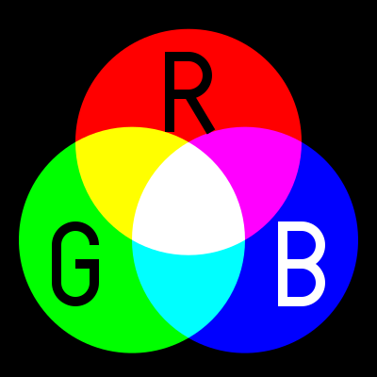
Deep Learning
Additive color mixing allows us to represent a wide variety of colors by simply combining different amounts or R, G, B.

Slide 71
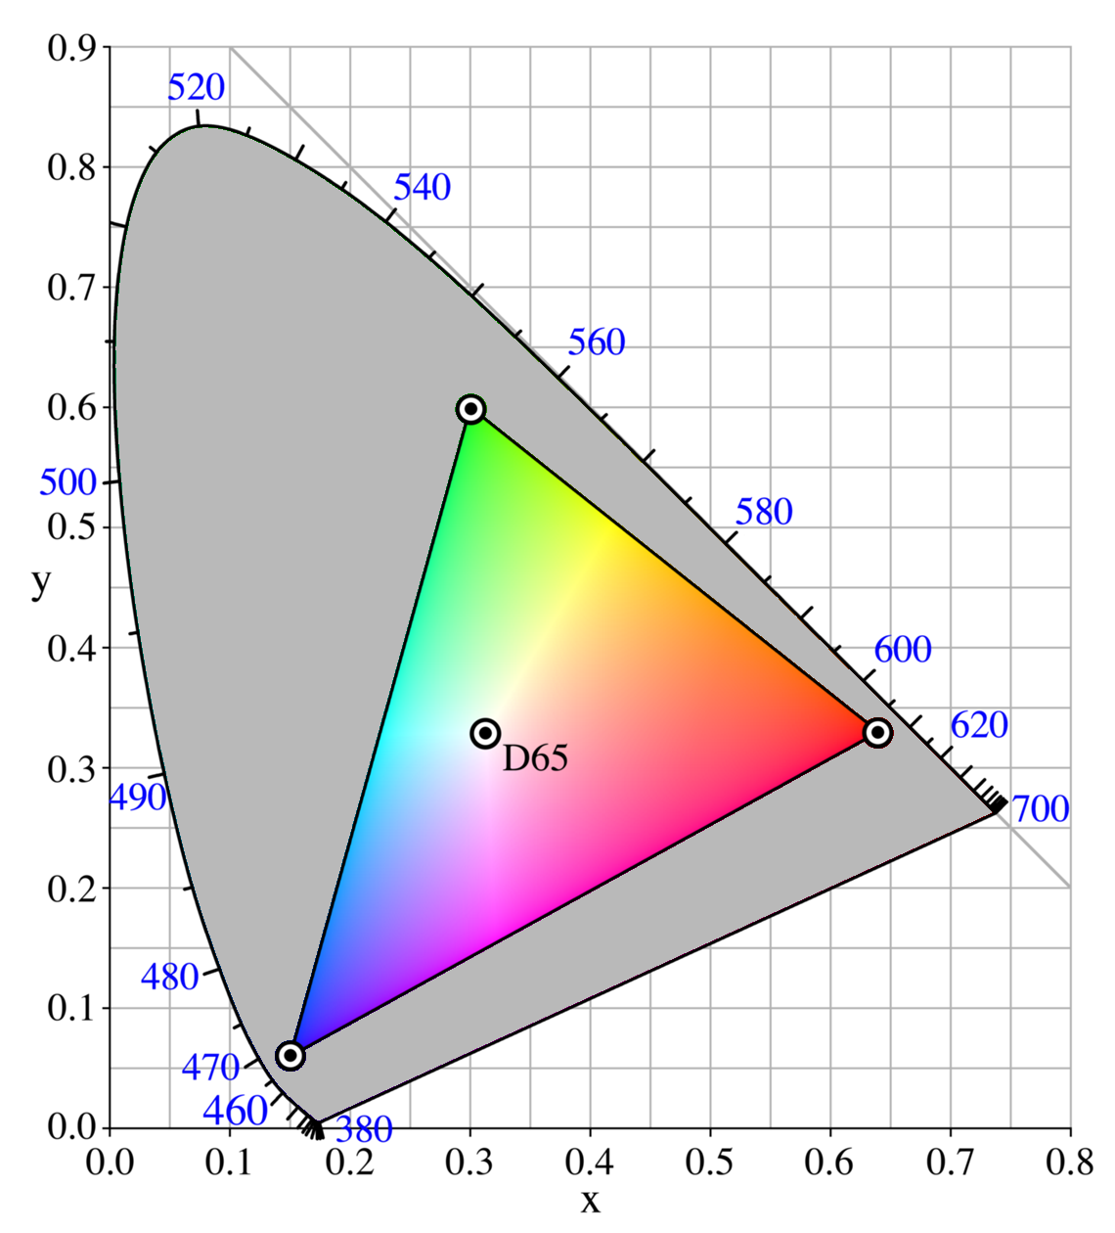
Deep Learning
RGB allows to produce a range of colors

Slide 72

Deep Learning
Each color channel will have intensity values.
You may have already seen this sort of representation in other software with RGB sliders.

Slide 73
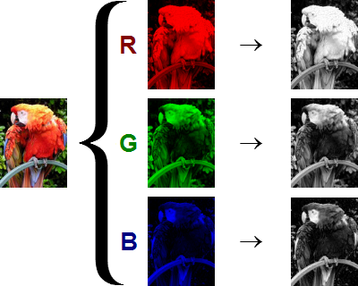
Deep Learning
The shape of the color array then has 3 dimensions.
Height
Width
Color Channels

Slide 74
Deep Learning
This means when you read in an image and check its shape, it will look something like:
(1280,720,3)
1280 pixel width
720 pixel height
3 color channels

Slide 75
Deep Learning
This means when you read in an image and check its shape, it will look something like:
(720,1280,3)
720 pixel height
1280 pixel width
3 color channels
1st
3rd
2nd

Slide 76
Deep Learning
Keep in mind the computer won’t “know” a channel is Red, it just knows that there are now 3 intensity channels.

Slide 77
Deep Learning
How do we then perform a convolution on a color image?
We end up with a 3D filter, with values for each color channel.

Slide 78
Deep Learning
Input Layer
Filter

Slide 79
Deep Learning
Input Layer
Filter 1
Filter 2 ...

Slide 80
Deep Learning
Often convolutional layers are fed into another convolutional layer.
This allows the networks to discover patterns within patterns, usually with more complexity for later convolutional layers.

Slide 81
Deep Learning
We’ve learned a lot so far and we have one final theory topic to cover before coding our own CNNs, and that is the Pooling Layer! (also known as a downsampling layer)

Slide 82
Deep Learning
ANN

Slide 83
Pooling Layers

Slide 84
Deep Learning
Even with local connectivity, when dealing with color images and possibly 10s or 100s of filters we will have a large amount of parameters.
We can use pooling layers to reduce this.

Slide 85
Deep Learning
Pooling layers accept convolutional layers as input:
Input
Conv
Pool

Slide 86
Deep Learning
Our convolutional layers will often have many filters

Slide 87
Deep Learning
Our convolutional layers will often have many filters

Slide 88
Deep Learning
Our convolutional layers will often have many filters

Slide 89
Deep Learning
Let’s imagine a filter
1
3
6
8
4
2
9
7
8
7
3
2
7
9
1
1

Slide 90
Deep Learning
We can reduce the size with subsampling
1
3
6
8
4
2
9
7
8
7
3
2
7
9
1
1

Slide 91
Deep Learning
We can reduce the size with subsampling
1
3
6
8
4
2
9
7
8
7
3
2
7
9
1
1

Slide 92
Deep Learning
Max Pooling: Window 2x2 , Stride: 2
1
3
6
8
4
2
9
7
4
8
7
3
2
7
9
1
1

Slide 93
Deep Learning
Max Pooling: Window 2x2 , Stride: 2
1
3
6
8
4
2
9
7
4
9
8
7
3
2
7
9
1
1

Slide 94
Deep Learning
Max Pooling: Window 2x2 , Stride: 2
1
3
6
8
4
2
9
7
4
9
8
7
3
2
7
9
1
1

Slide 95
Deep Learning
Max Pooling: Window 2x2 , Stride: 2
1
3
6
8
4
2
9
7
4
9
8
7
3
2
9
7
9
1
1

Slide 96
Deep Learning
Max Pooling: Window 2x2 , Stride: 2
1
3
6
8
4
2
9
7
4
9
8
7
3
2
9
3
7
9
1
1

Slide 97
Deep Learning
Max Pooling: Window 2x2 , Stride: 2
1
3
6
8
4
2
9
7
4
9
8
7
3
2
9
3
7
9
1
1

Slide 98
Deep Learning
Average Pooling: Window 2x2 , Stride: 2
1
3
6
8
4
2
9
7
2.5
7.5
8
7
3
2
7.75
1.75
7
9
1
1

Slide 99
Deep Learning
This greatly reduces our number of parameters!

Slide 100
Deep Learning
This pooling layer will end up removing a lot of information, even a small pooling “kernel” of 2 by 2 with a stride of 2 will remove 75% of the input data.

Slide 101
Deep Learning
Another common technique deployed with CNN is called “Dropout”
Dropout can be thought of as a form of regularization to help prevent overfitting.
During training, units are randomly dropped, along with their connections.

Slide 102
Deep Learning
This helps prevent units from “co-adapting” too much.
Let’s also quickly point out some famous CNN architectures!

Slide 103
Deep Learning
LeNet-5 by Yann LeCun
AlexNet by Alex Krizhevsky et al.
GoogLeNet by Szegedy at Google Research
ResNet by Kaiming He et al.
Check out the resource links to the papers discussing these architectures!

Slide 104
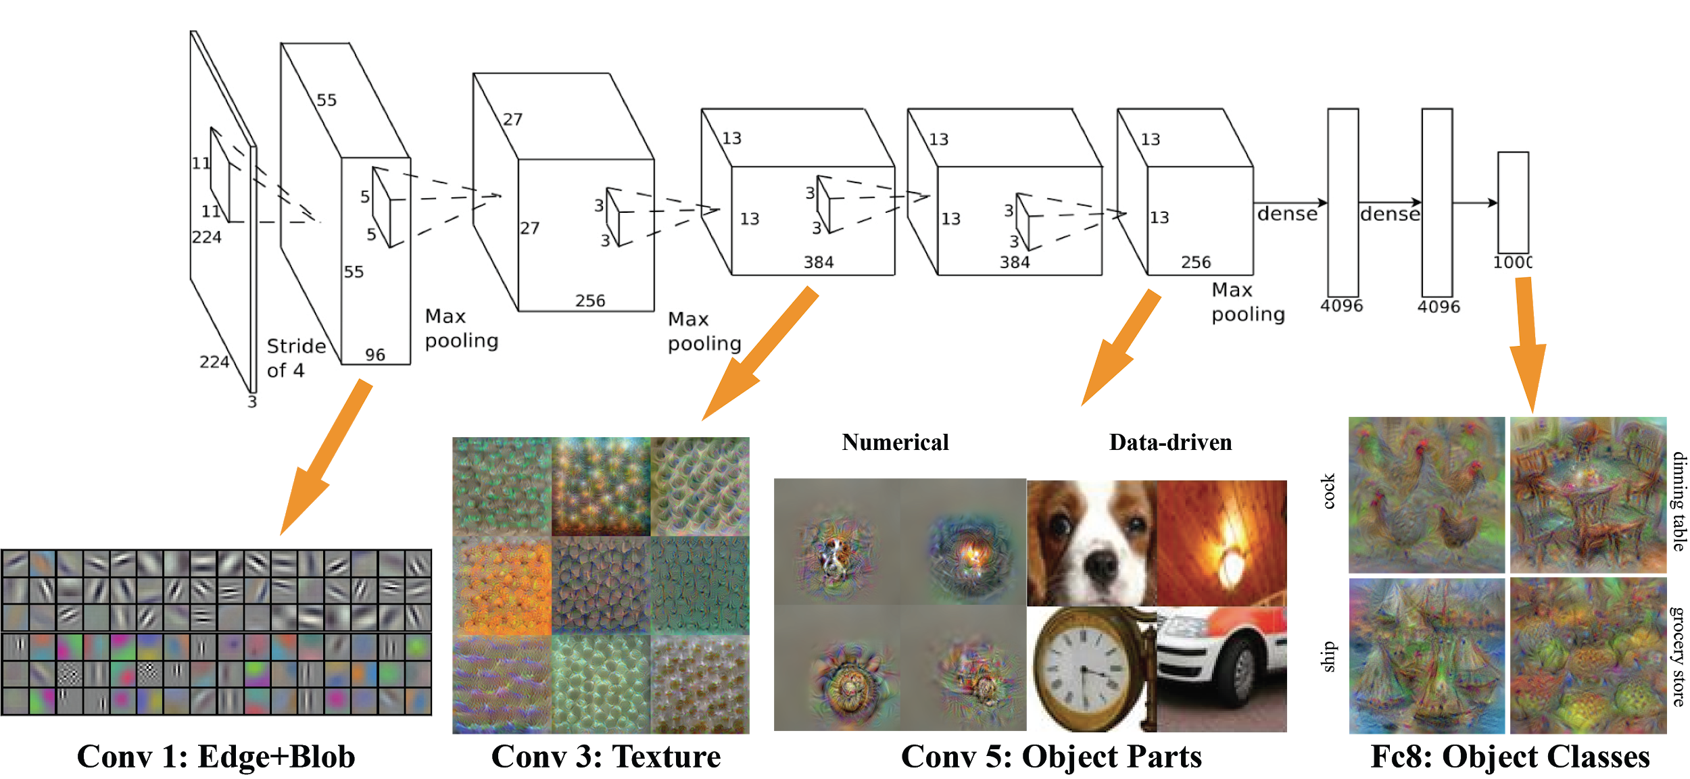
Deep Learning
AlexNet

Slide 105
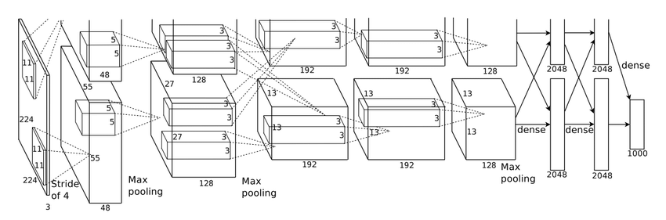
Deep Learning
AlexNet

Slide 106
Deep Learning
CNNs can have all types of architectures!
Input
Conv
Pool

Slide 107
Deep Learning
CNNs can have all types of architectures!
Input
Conv
Pool
Conv
Conv

Slide 108
Deep Learning
CNNs can have all types of architectures!
Input
Conv
Pool
Conv
Pool

Slide 109
Deep Learning
CNNs can have all types of architectures!
Input
Conv
Pool
FC
Out

Slide 110
MNIST Data Revisited

Slide 111
Deep Learning
Recall that flattening out the MNIST data caused us to lose 2D information.
With CNNs, we can feed in the data as an array of 2D images.

Slide 112
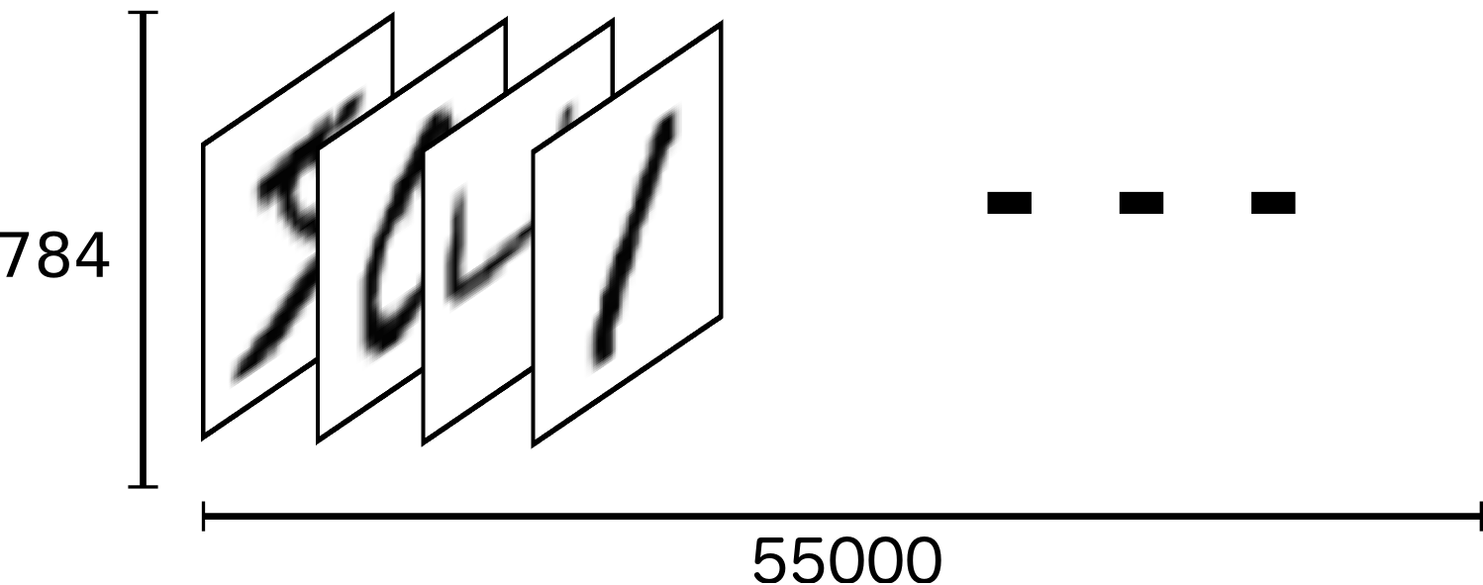
Deep Learning
We can think of the entire group of the 60,000 images as a tensor (an n-dimensional array)
60000

Slide 113
Deep Learning
For the labels we’ll use One-Hot Encoding.
This means that instead of having labels such as “One”, “Two”, etc… we’ll have a single array for each image.

Slide 114
Deep Learning
The label is represented based off the index position in the label array.
The corresponding label will be a 1 at the index location and zero everywhere else.
For example, 4 would have this label array:
[0,0,0,0,1,0,0,0,0,0]

Slide 115
Deep Learning
Keep in mind that when dealing with tensors of image data, we actually end up with 4 dimensions:
Number of Images
Height
Width
Color Channels

Slide 116
MNIST with CNN
PART ONE - The Data

Slide 117
MNIST with CNN
PART TWO - Model and Training

Slide 118
MNIST with CNN
PART THREE - Model Evaluation

Slide 119
CIFAR-10 with CNN
PART ONE - Data

Slide 120
Deep Learning
CIFAR-10 dataset are 32by32 images of 10 different objects:
Airplane,Car,Bird,Cat,Deer,Dog,Frog, Horse,Ship,Truck
These are color images!

Slide 121
Deep Learning
In this series of lectures we will be reusing a lot of the previous CNN code, so we will only focus on new additions due to the introduction of 3 color channels (RGB).

Slide 122
CIFAR-10 with CNN
PART TWO - Model Evaluation

Slide 123
Downloading
Image Data

Slide 124
Deep Learning
So far we’ve only dealt with pre-packaged data sets such as MNIST and CIFAR-10.
But what about working with real image files? Like .jpg or .png?

Slide 125
Deep Learning
Let’s learn about TensorFlow’s built in tools for generating image data batches from directories with real files.
First we need to download a large zip file of data.

Slide 126
Deep Learning
This dataset is available as a zip file called cell_images.zip
The link is a supplemental resource in this lecture, it is also within the same Google Drive resource as the slides.
Let’s explore getting the data!

Slide 127
CNN on Custom Images Part 1 - The Data

Slide 128
CNN on Custom Images Part 2 ImageDataGenerator

Slide 129
CNN on Custom Images Part 3
Creating the Model

Slide 130
CNN on Custom Images Part 4
Model Evaluation

Slide 131
Let’s get started!

Slide 132
CNN Exercises

Slide 133
CNN Exercises
Solutions

