Slide 1

NLP with Deep Learning

Slide 2
Deep Learning
Let’s explore how to work with text data in conjunction with deep learning!
This is a natural extension of the time series and recurrent neural network topics we just discussed.

Slide 3
Deep Learning
We will create a neural network that will generate new text based on a corpus of text data.
Check out “The Unreasonable Effectiveness of RNNs” by Andrej Karpathy
So how will this work?

Slide 4
Deep Learning
Given an input string sequence, predict the sequence shifted forward 1 character.
[“h” , ”e” , ”l” , ”l” ]
[“e” , ”l” , ”l” , ”o”]

Slide 5
Deep Learning
The character based RNN will actually learn the structure of the text.
In our example we will use the works of William Shakespeare.
We will see the network clearly learn play writing structure and spacing, just from a character level!

Slide 6
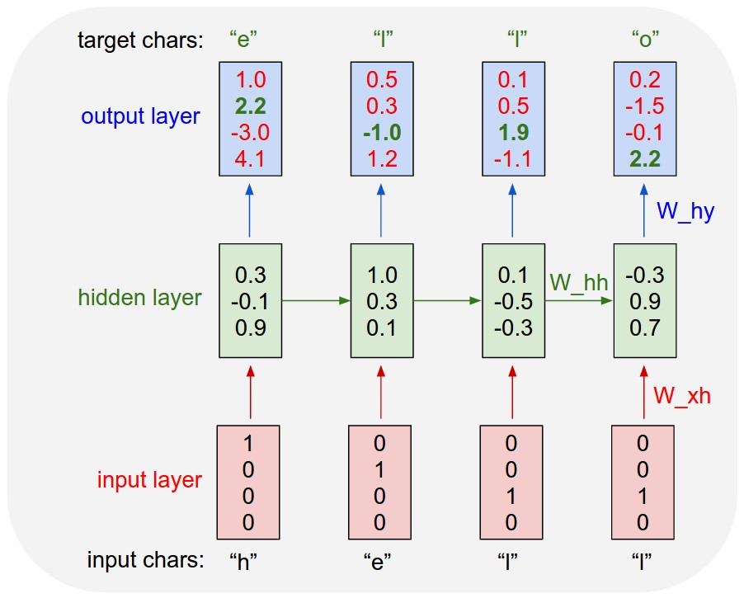
Deep Learning

Slide 7
Deep Learning
Step 1: Read in Text Data
We can use basic built in python commands to read in a corpus of text as string data.
Note, you should have a large data set for this, at least 1 million characters for realistic results.

Slide 8
Deep Learning
Step 2: Text Processing and Vectorization
The neural network can’t take in raw strings, so we will encode them each to an integer.
A : 1
B : 2
C : 3
? : 55

Slide 9
Deep Learning
Step 3: Creating Batches
We’ll use Tensorflow’s dataset object to easily create batches of text sequences.
[“h”, “e” , “l” , “l” , “o” , “ “, “m”]
[,“e” , “l” , “l” , “o” , “ “, “m”, “y”]

Slide 10
Deep Learning
Step 3: Creating Batches
We’ll want to use sequence lengths that are long enough to capture structure and previous words.
But not so long that the sequence is just historical noise.

Slide 11
Deep Learning
Step 4: Creating the Model
We’ll use 3 layers
Embedding
GRU
Dense

Slide 12
Deep Learning
Step 4: Creating the Model
Embedding Layer turns positive integers (indexes) into dense vectors of fixed size. eg. [[4], [20]] -> [[0.25, 0.1,0.3], [0.6, -0.2,0.9]]
Its up to the user to choose the number of embedding dimensions.

Slide 13
Deep Learning
Step 4: Creating the Model
GRU
Gated Recurrent Unit is a special type of recurrent neuron unit.
The GRU is like a long short-term memory (LSTM) with forget gate but has fewer parameters than LSTM, as it lacks an output gate.

Slide 14
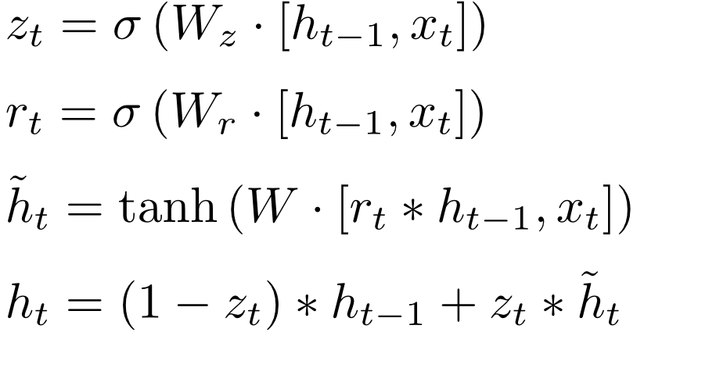
Gated Recurrent Unit (GRU)
h_{t}
h_{t-1}
C_{t}
X
+
X
r_{t}
1-
z_{t}
X
σ
σ
tanh
x_{t}

Slide 15
Deep Learning
Step 4: Creating the Model
Dense Layer
One neuron per character.
Character labels will be one hot encoded so the final dense layer produces a probability per character.

Slide 16
Deep Learning
Step 4: Creating the Model
Dense Layer
Probability per character means we can play around with “temperature”:
Choosing less probable characters more/less often

Slide 17
Deep Learning
Step 5: Training the Model
We’ll set up our batches and make sure to one-hot encode our character labels.

Slide 18
Deep Learning
Step 6: Generating new text
We’ll save our models weights and show you how to reload a model’s weights with a different batch size in order to pass in single examples.

Slide 19
Let’s get started!

Slide 20
Text Generation
With Python and Keras
Part One

Slide 21
Deep Learning
Part 1: The Data
Import main libraries
Importing Text
Understanding Characters

Slide 22
Text Generation
With Python and Keras
Part Two

Slide 23
Deep Learning
Part 2: Text Processing
Vectorize the text
Create encoding dictionary

Slide 24
Text Generation
With Python and Keras
Part Three

Slide 25
Deep Learning
Step 3: Creating Batches
Understand text sequences
Use Tensorflow datasets to generate batches
Shuffle batches

Slide 26
Text Generation
With Python and Keras
Part Four

Slide 27
Deep Learning
Step 4: Creating the Model
Set up loss function
Create Model
Embedding
GRU
Dense

Slide 28
Text Generation
With Python and Keras
Part Five

Slide 29
Deep Learning
Step 5: Training the Model
We’ll quickly show an example of how to train the model.
We’ll also show you how to load our provided saved model file.

Slide 30
Text Generation
With Python and Keras
Part Six

Slide 31
Deep Learning
Step 6: Generating Text
We’ll load our model
Adjust batch size to 1
Run a loop that generates new text

