Slide 1


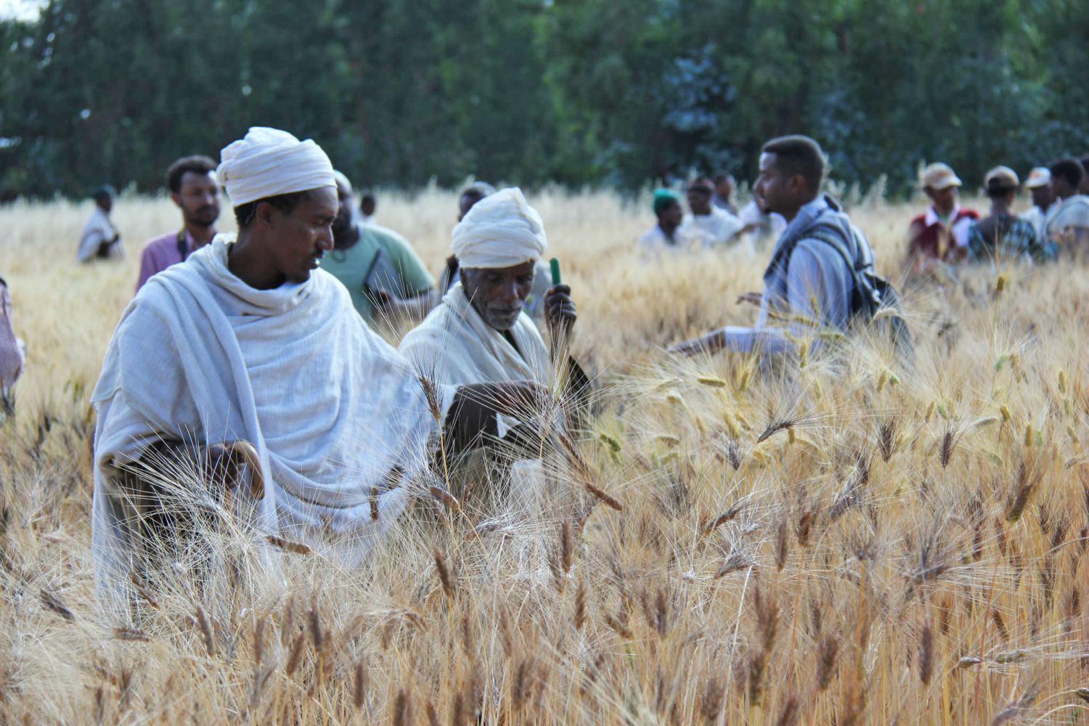
Farmers’ generated data for climate adaptation: experiences from three continents
Bioversity International, Information Services and Seed Supplies

Slide 2
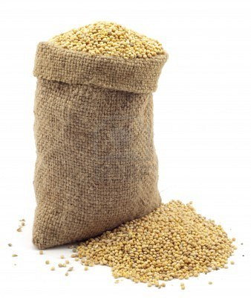
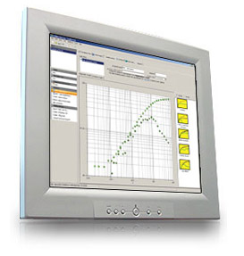
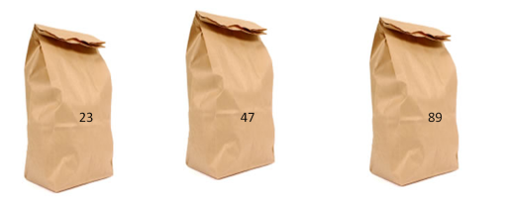
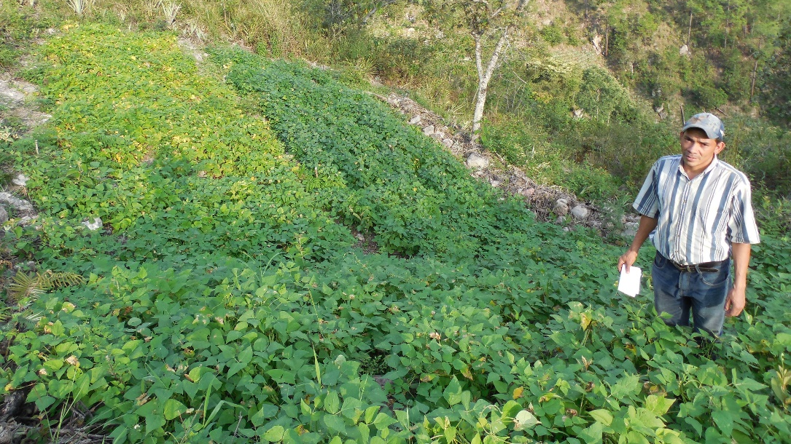

The cycle of tricot research
1. A broad set of varieties (10-25) is evaluated
5. Data are used to evaluate varieties and to detect demand for new varieties and traits
A > C > D
C > D > G
A > D > G
A>C>D>G
6. Farmers receive variety recommendations and can order seeds
2. Each farmer gets a combination of 3 varieties
3. Farmer plants a trial and makes observations
4. Project managers collect farmers’ observations by phone
van Etten et al. (2016) Expl. Agric.
Beza et al. (2017) PloS ONE 12(5):e0175700
Notes:
The ultimate aim is that the whole seed system becomes more responsive. Information goes around to keep constantly adapting to change, matching seeds to emerging needs.

Slide 3



> 22k
on-farm trails
> 170
varieties
3
continents

Slide 4
What we learned

Slide 5
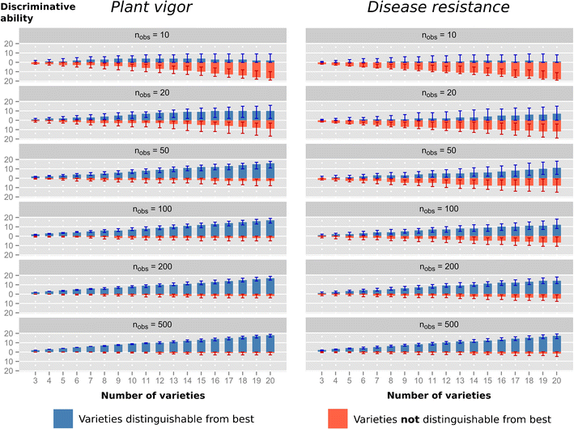
Farmers’ generated data are reliable
Steinke et al. (2017) Agron. Sustain. Dev. (2017)37:32

Slide 6
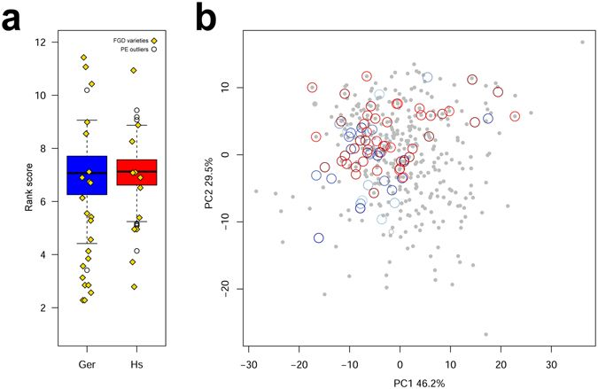
Farmers supports plant breeding initiatives
Mancini et al. (2017) Sci. Rep. 7: 9120

Slide 7
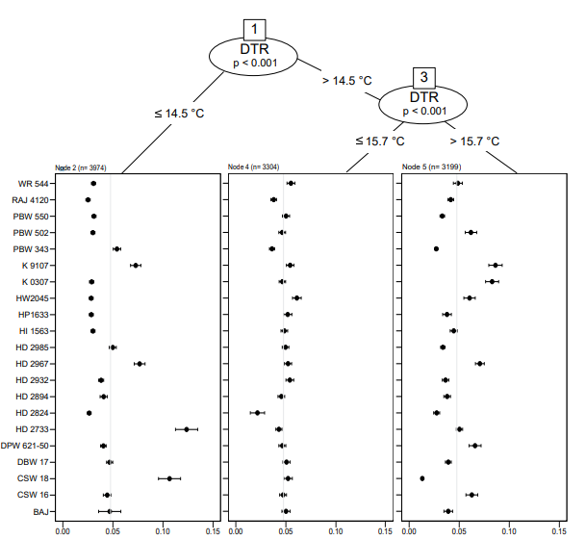
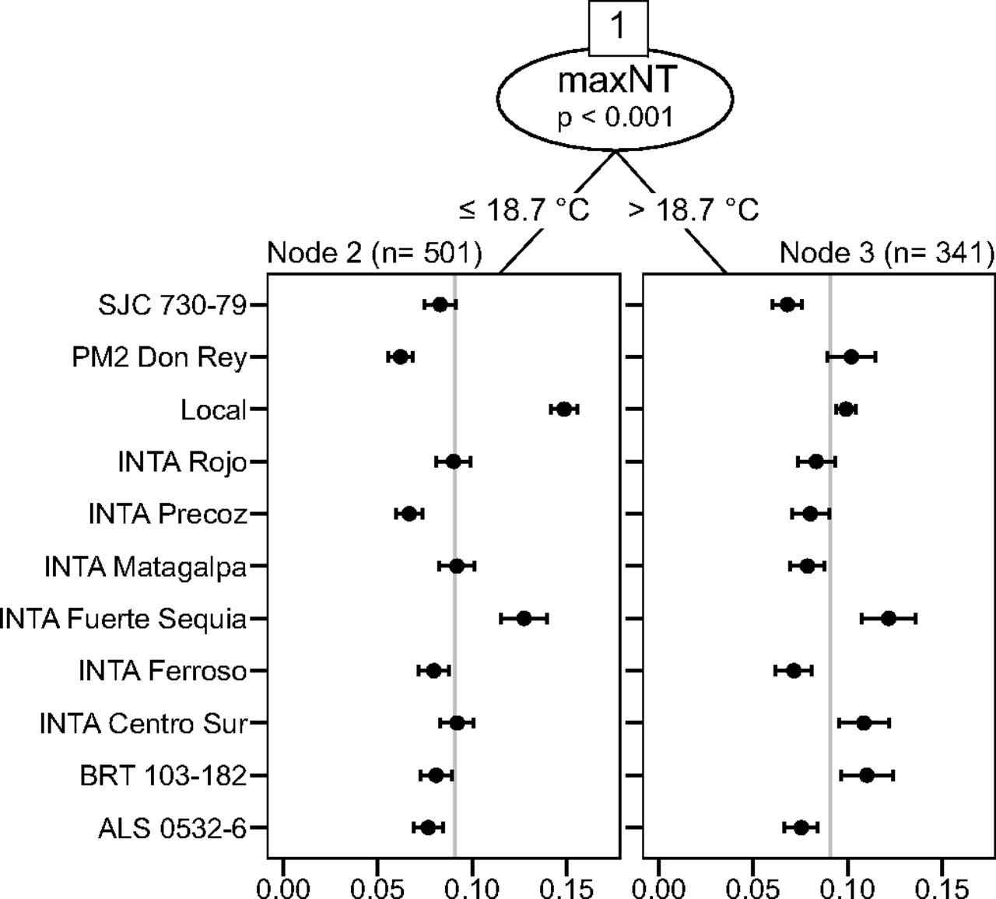
Register the effects of climate on crop performance
van Etten et al. (2019) PNAS 116(10):4194-4199

Slide 8
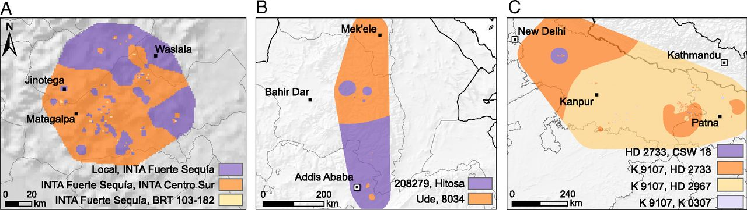
Variety replacement for climate adaptation
van Etten et al. (2019) PNAS 116(10):4194-4199

Slide 9
Farmers keep crop diversity

Slide 10
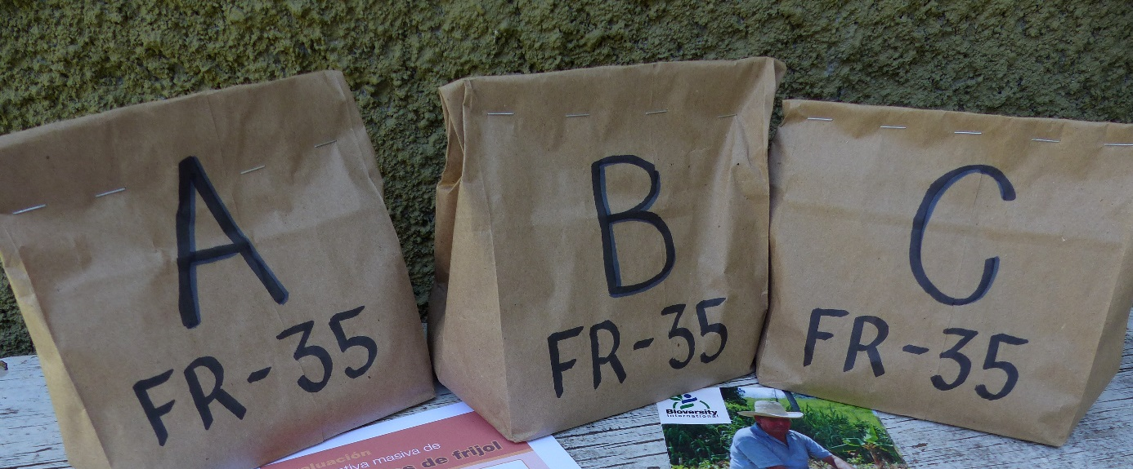
Effects: Up-scaled diverse seed production in Honduras
Many more farmers want to participate in crowdsourcing
Local NGO sells tricot packages as “diversity test kits”
“Local farmer research committees” now produce seed of many varieties commercially
National seed law recently changed – CIAL-produced seed can be sold
First official release of common bean variety after multiple seasons of tricot trialling
Notes:
Tricot has created local demand for diversified seed businesses

Slide 11
Is a cost-effective approach
41.01 USD
33.43 USD

Slide 12

Thank you!

Slide 13
This is a compilation of several presentations of the members of Bioversity International’s “Information Services and Seed Supplies” Team. If you intend to cite it please do it as:
de Sousa, K; Steinke, J.; van Etten, J. (2019) Farmers’ generated data for climate adaptation: experiences from three continents
Other materials used in this training course are available at:
https://github.com/kauedesousa/ClimMobTools

