Slide 1
The Alliance of Bioversity International and CIAT
Author
Position
Email
Place & Date

Slide 2
Why the Alliance?
CREATE significant synergies to achieve more impact
BE more competitive
INCREASE presence on the ground
MEET the demands for research-for-development solutions at scale
INCREASE capacity to address emerging issues – size matters
Notes:
STAFF ONLY

Slide 3



Bioversity International and CIAT Memorandum of Understanding
One Board of Trustees & one Chief Executive Officer based in Rome
Hubs in Africa, Asia, Europe and Latin America & common research programs
Harmonized support services

Slide 4
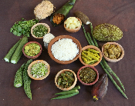
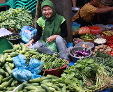
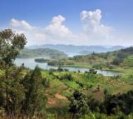

Vision
Mission
Food systems and landscapes that sustain the planet, drive prosperity, and nourish people.
We deliver research-based solutions that harness agricultural biodiversity and sustainably transform food systems to improve people’s lives.
Strategic objectives
People consume diverse, nutritious and safe foods.
People participate in and benefit from inclusive, innovative and diversified agri-food markets.
People sustainably manage farms, forests and landscapes that are productive and resilient to climate change.
Communities and institutions sustainably use and safeguard agricultural biodiversity.
*Vision, mission and strategic objectives were agreed in the 2018 Memorandum of Understanding but subject to change as strategy and results framework, operational & board discussions advance during 2019

Slide 5
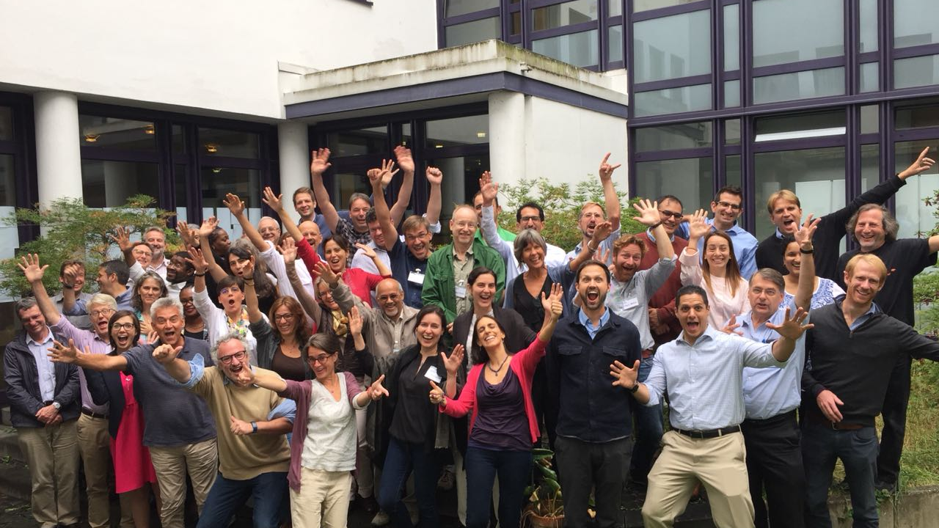
Alliance Roadmap: Strategy & Results Framework
SCOPE
Developing a joint future strategy and results framework
Positioning in the context of global challenges
Exploring new business models and partnership options.

Slide 6
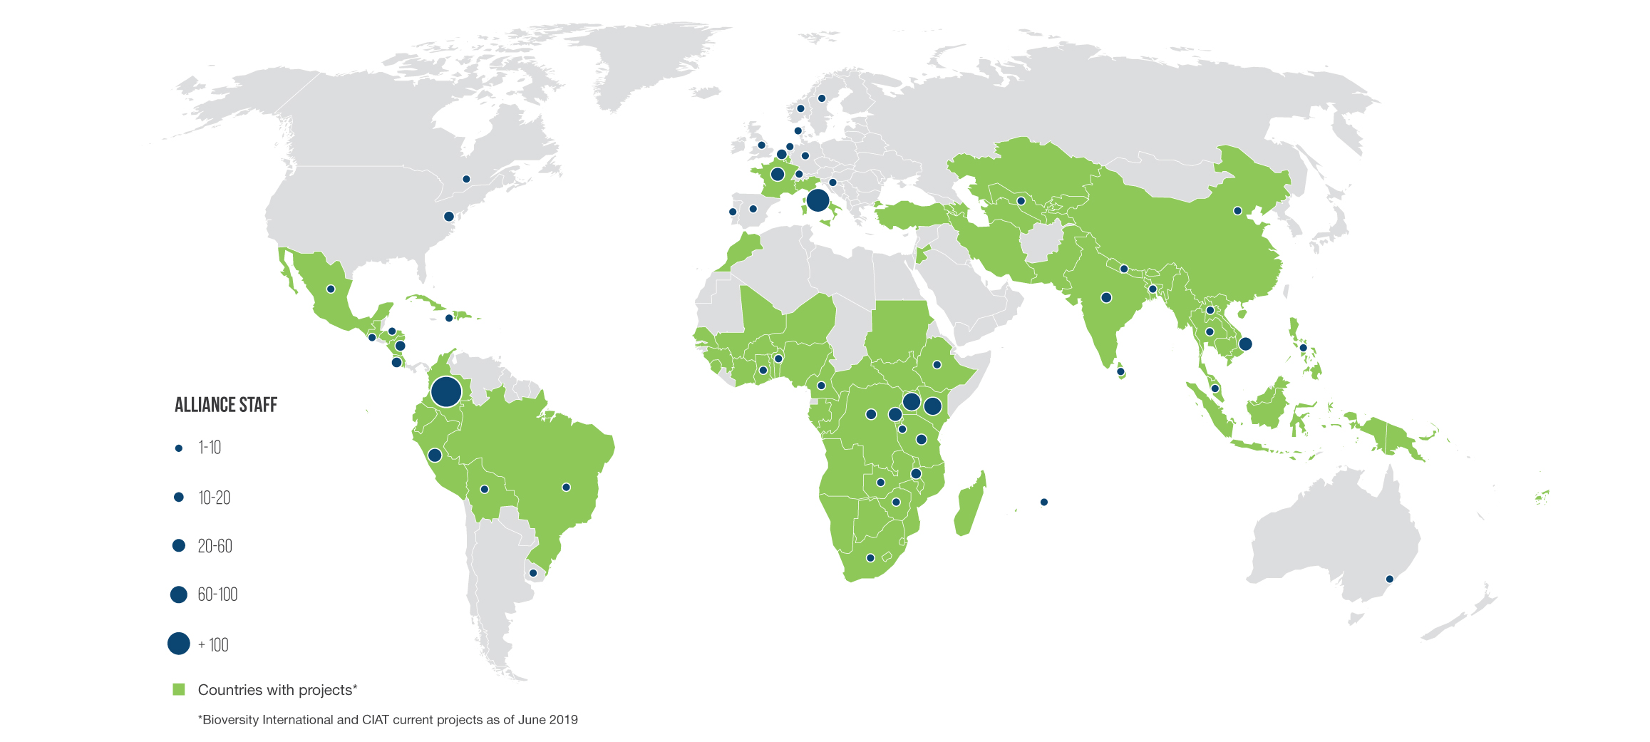
Where we work

Slide 7
Our partners
Our scientists work with global, national and local partners – UN agencies, international financial institutions, national research organizations, governments, civil society organizations and private sector – vital to delivering impact at scale
The Alliance is part of CGIAR, a global research partnership for a food-secure future.

Slide 8
Thank you!
Author
Position
Email

