Slide 1


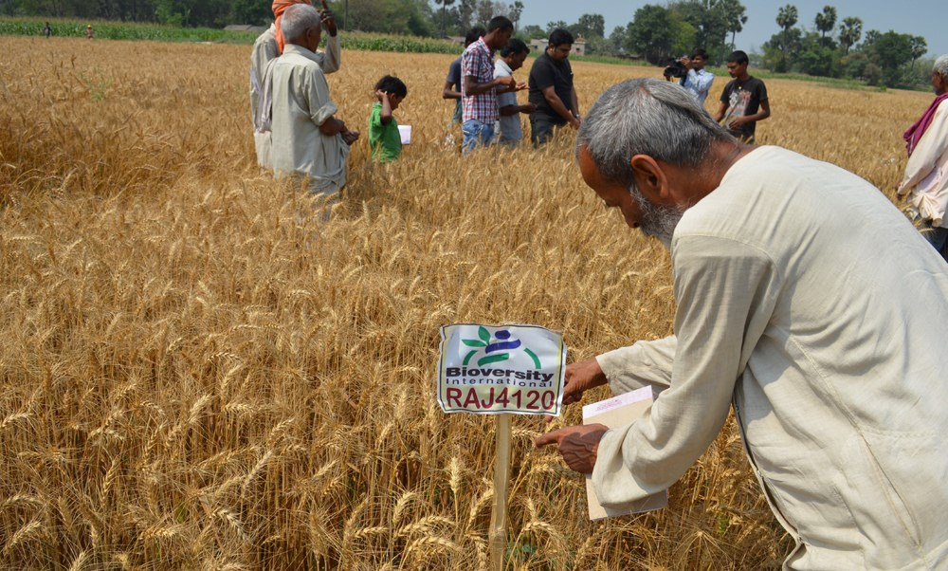
Crowdsourcing citizen-science for diversification and adaptation in agriculture: evidence from three continents
Kauê de Sousa

Slide 2
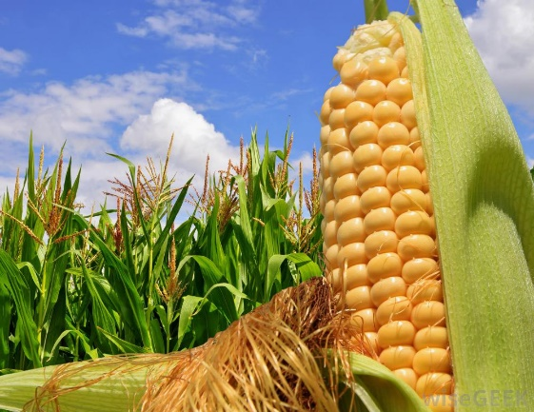
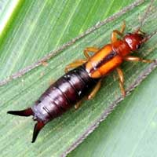

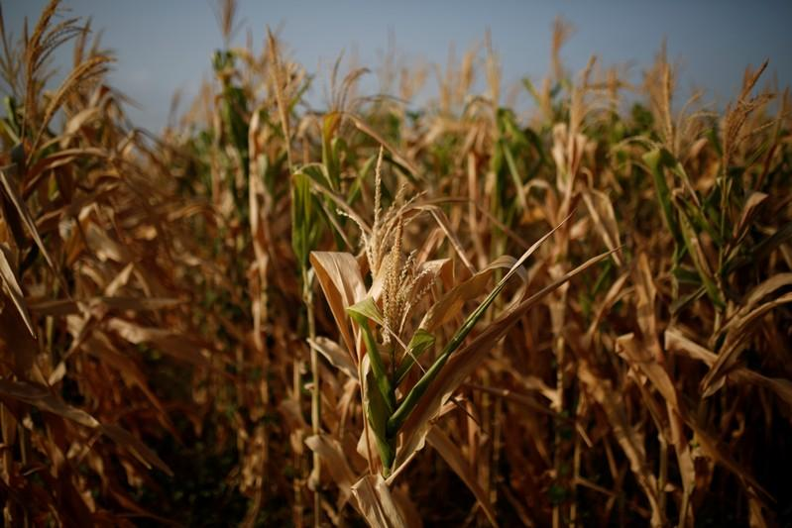
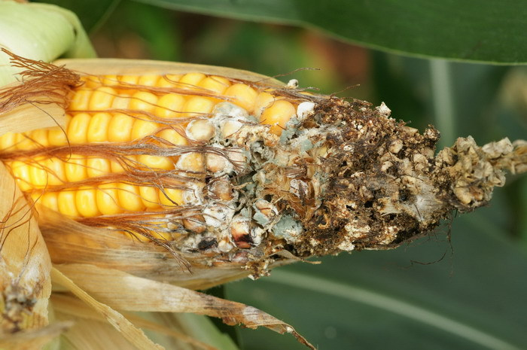
What is the problem we want to solve?
Challinor et al. (2016) Nat. Clim. Change 6:954-958
Tollenaar et al. (2017) Nat. Clim. Change 7:275-278
Deutsch et al. (2018) Science 361(6405):916-919

Slide 3
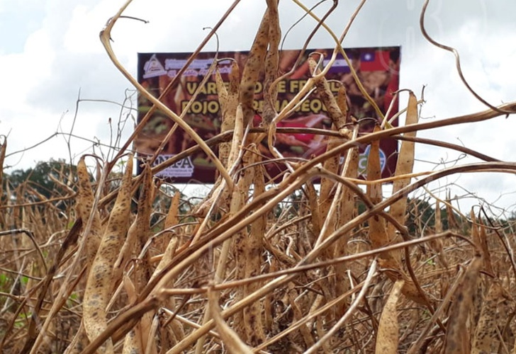
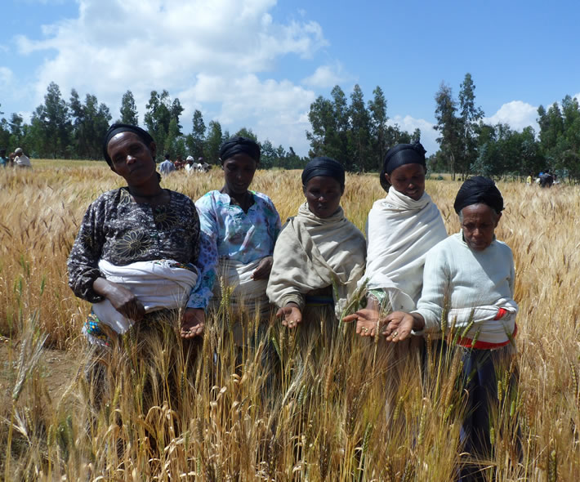
What is the problem we want to solve?

Slide 4
What is the problem we want to solve?
We need diverse, location-specific and scalable solutions for a climate adapted agriculture
But current methods cannot address these solutions…
Lipper et al. (2014) Nat. Clim. Change 4:1068–1072

Slide 5
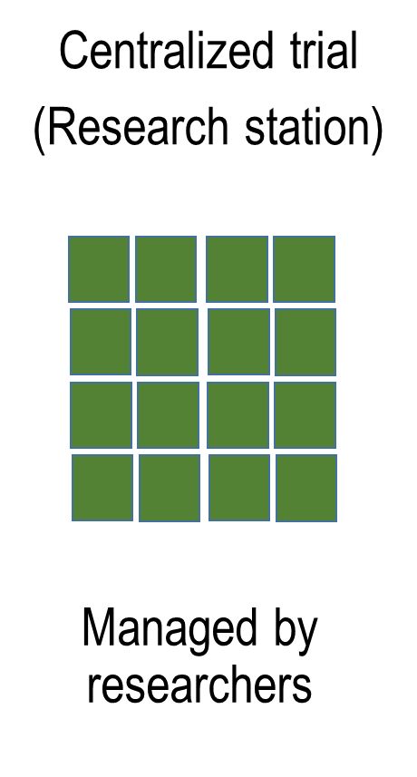
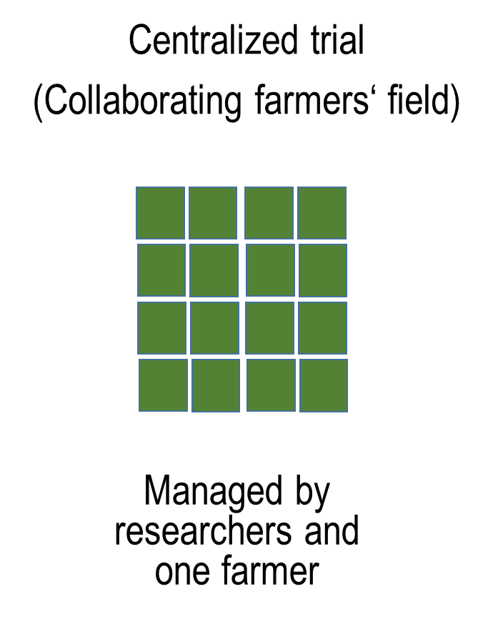
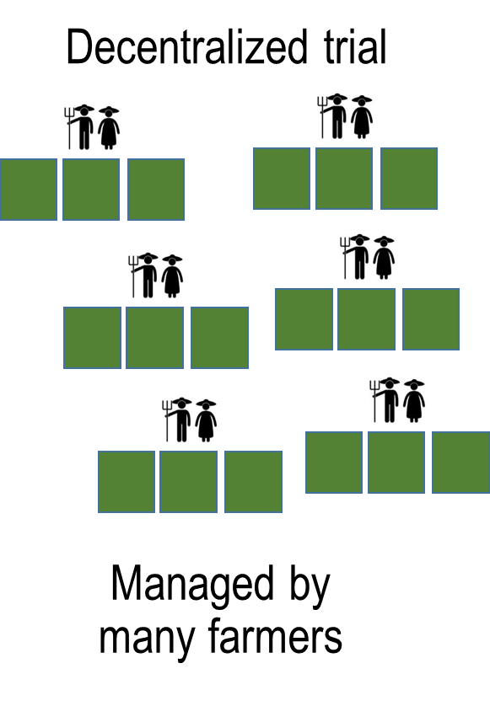
A new agricultural research paradigm

Slide 6
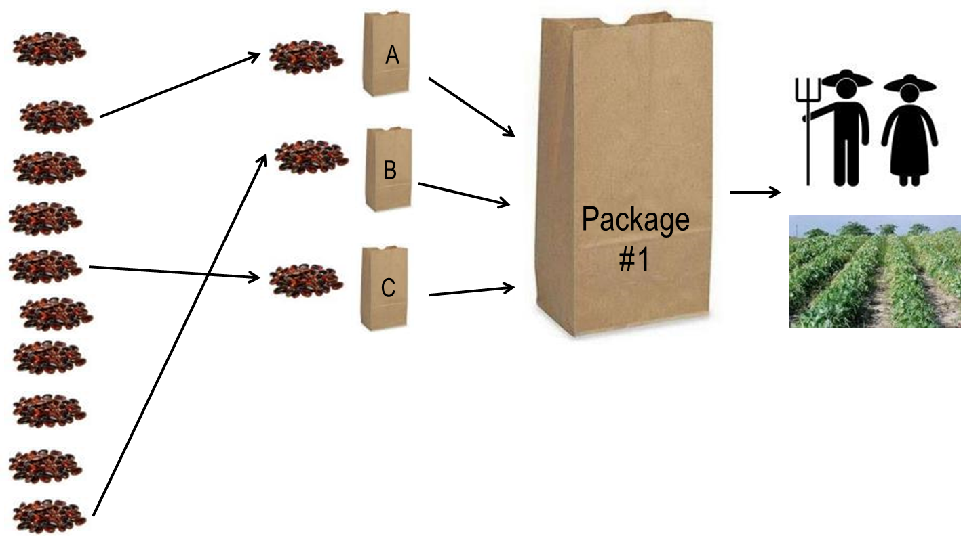
Crowdsourcing for climate adaptation
A blind set of 3 varieties
A randomization scheme
Real farm conditions
Farmers rank the varieties
van Etten et al. (2019) Expl. Agric.
Beza et al. (2017) PloS ONE 12(5):e0175700

Slide 7


Combining many partial rankings for the full picture
+ -
A > C > D
C > D > G
A > D > G
A>C>D>G
Turner et al. (2019) CRAN. PlackettLuce

Slide 8
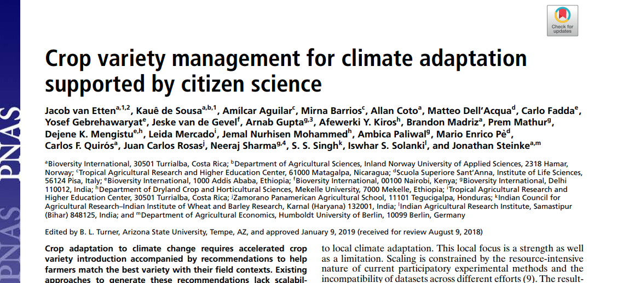
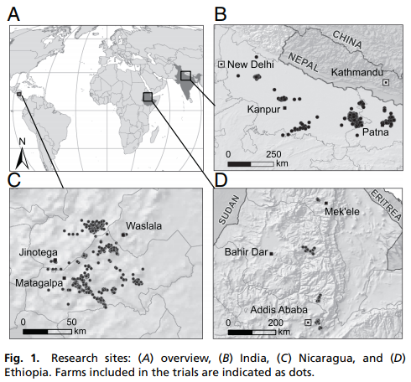
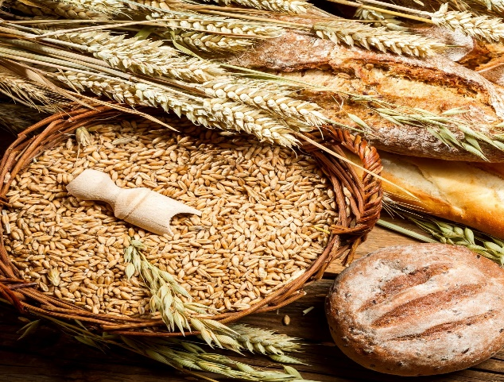
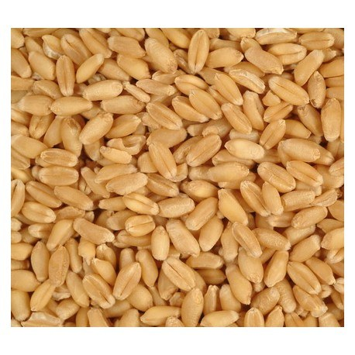
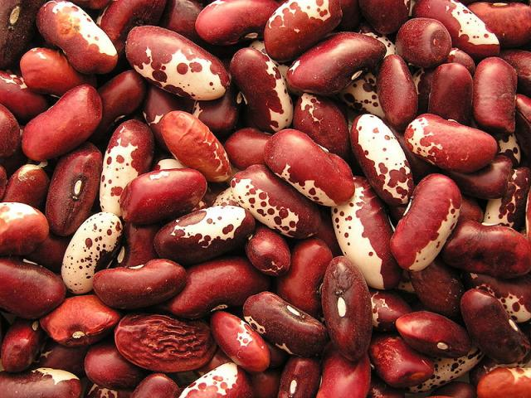
Crowdsourcing for climate adaptation
12,409 trial plots
van Etten, de Sousa, et al. (2019) PNAS 116(10):4194-4199

Slide 9
What we found...
This approach can improve variety recommendations in four aspects:
Reduction of climate bias
Incorporation of seasonal climate forecasts
Risk analysis
Geographic extrapolation

Slide 10
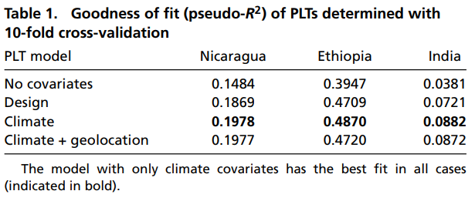
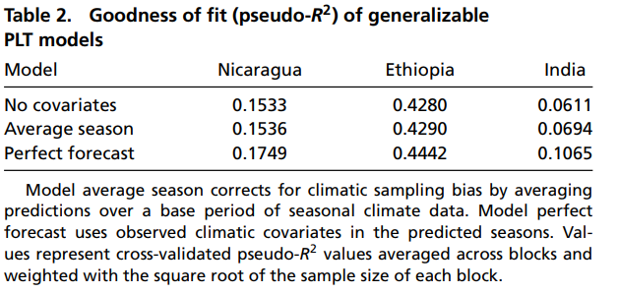
Reduction of climate bias

Slide 11
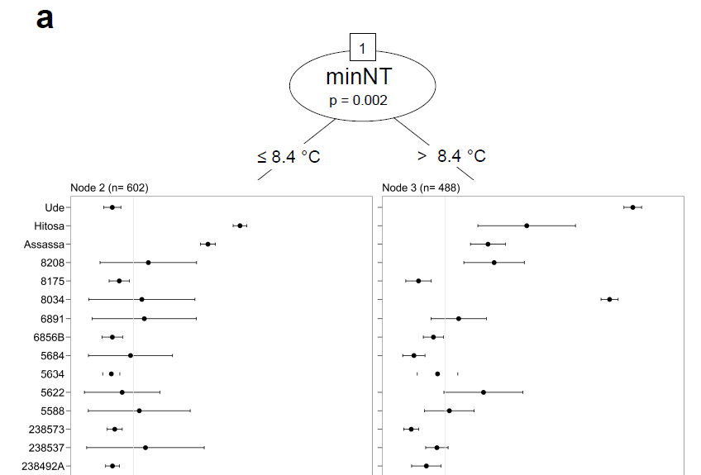
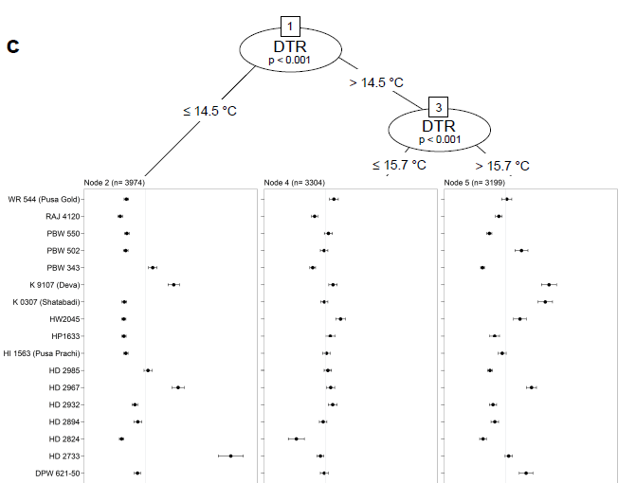
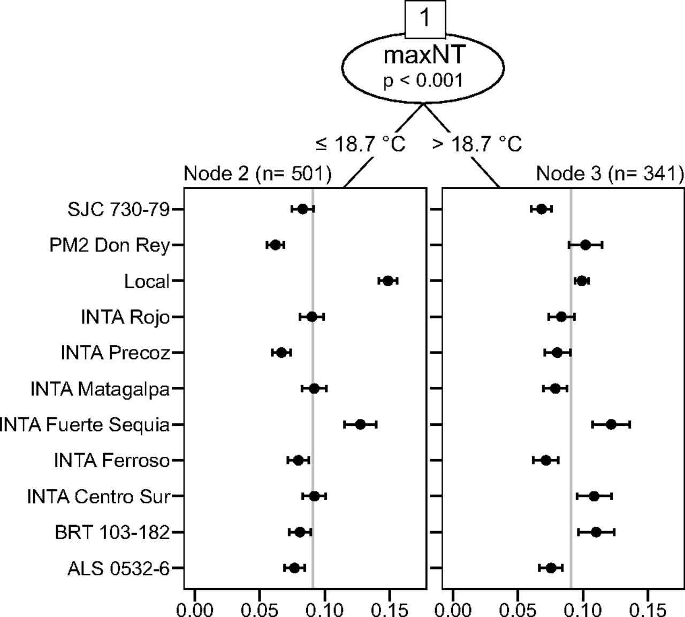

Incorporation of seasonal climate forecasts

Slide 12
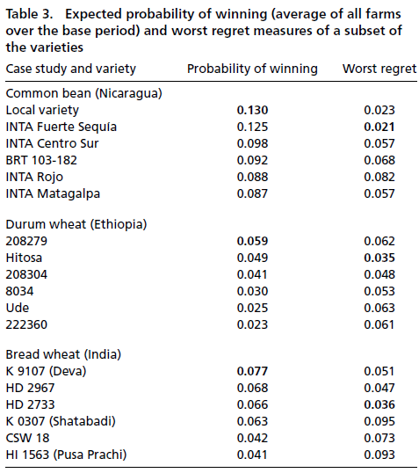
Risk analysis

Slide 13
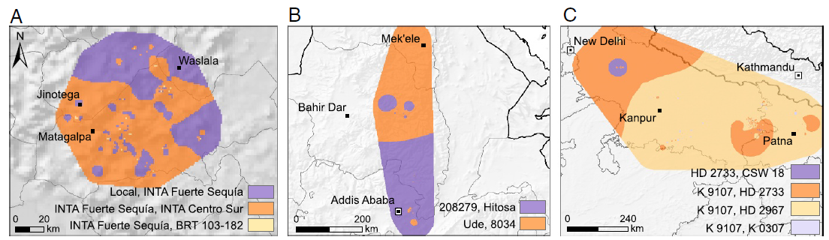
Geographic extrapolation

Slide 14
Recap…
Citizen science data revealed generalizable relations between seasonal climate variables and crop variety performance
Climatic analyses of these data were shown to improve variety recommendations
The approach can track climate trends as they manifest themselves on farms
The findings can serve to create variety portfolios that diminish climate risk

Slide 15


Thank you!
kaue.desousa@inn.no
k.desousa@cgiar.org

