Slide 1


Slide 2


Table Of Contents
Overview
AIDXR concept
Power of AIDXR in training
The process
Architecture Diagram
A glimpse inside AIDXR

Slide 3


150,000
DEATHS PER YEAR
People dying per year due to lack of proper first Aid skills
Isn’t it a big number??

Slide 4




Say goodbye to those pages of instructions
INTRODUCING
AIDXR
AIDXR

Slide 5

Emergency First Aid &
Basic Life Support training using:
Augmented Reality
Overview
AidXR aims at training people with basic first aid. It uses Augmented Reality intertwined with adaptive learning, thus providing training in an immersive, controlled and a safe environment.

Slide 6


1. The users need to choose a scenario. The app would then train them with step by step instructions along with 3D models augmented in the real world around them!
AIDXR CONCEPT
2. Their activities would be constantly monitored. After the training is over, they’d be able to see their results.
3. This would give them a clear understanding on how to respond to such situations, if they happen in the real world.

Slide 7





POWER OF AIDXR IN TRAINING
90%
Of information transmitted to the brain is VISUALLY
VISUALS are processed
Of the people respond better to VISUAL information then TEXT
60,000
40%
times faster then TEXT

Slide 8








THE PROCESS
STEP 1
STEP 2
STEP 3
OPEN THE APP
CHOOSE SCENARIO
LEARN FIRST AID
Skin Burns
Snake Bites
AIDXR
And Much More!!

Slide 9
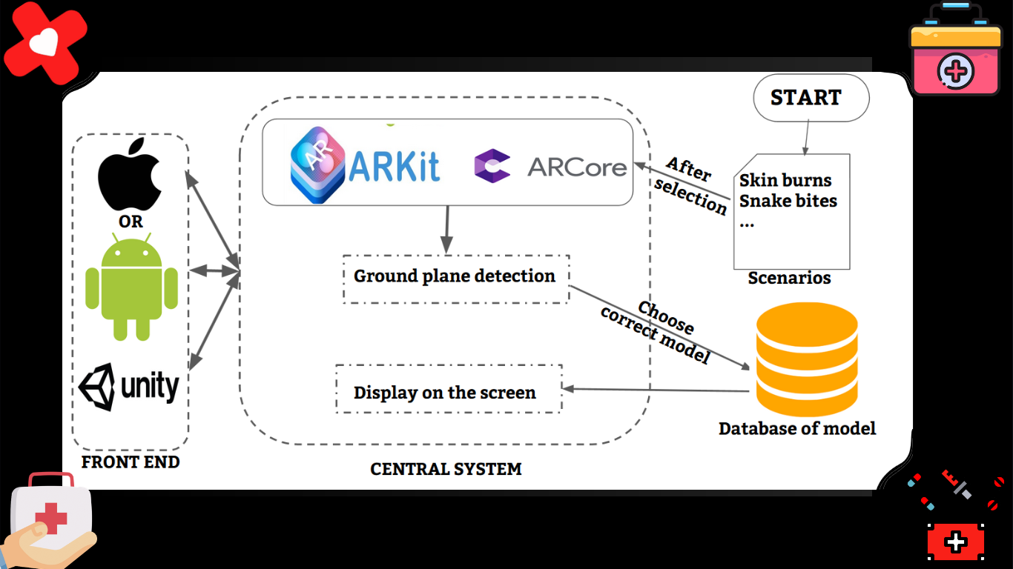
Architecture Diagram

Slide 10
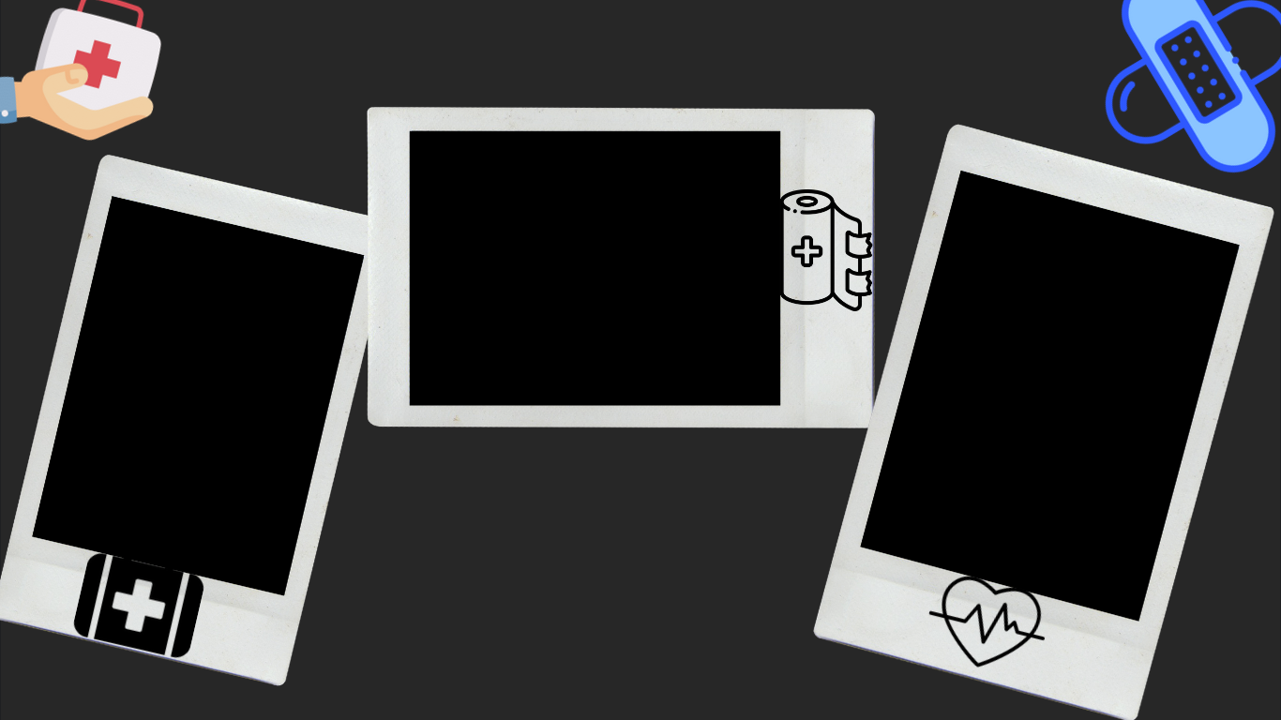
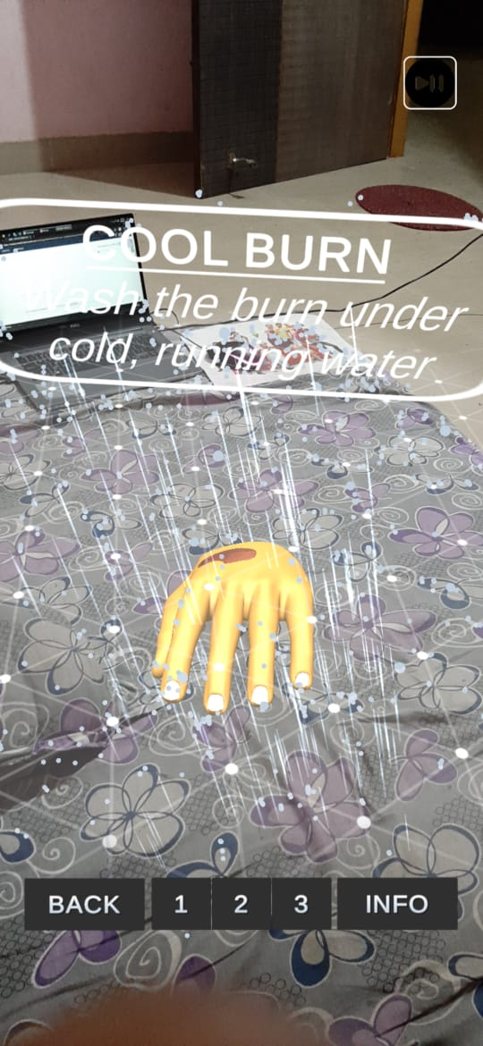
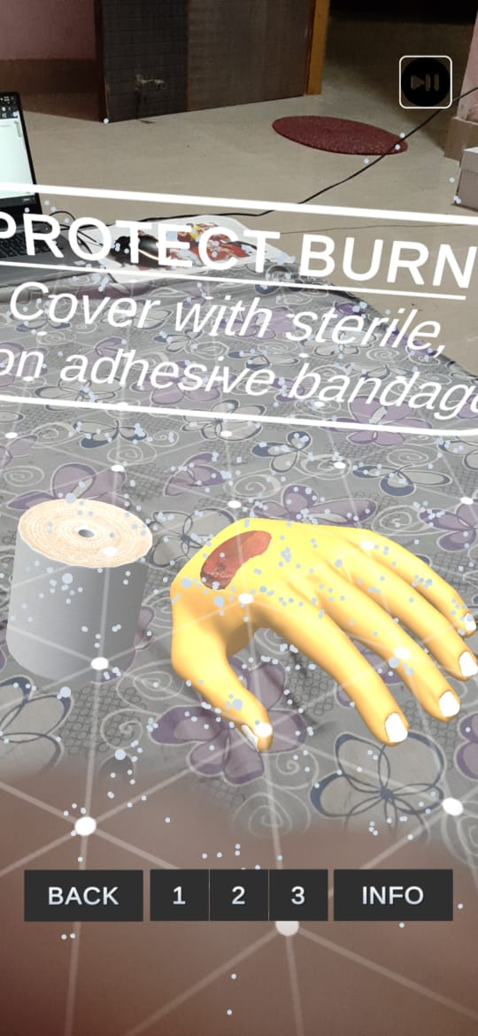
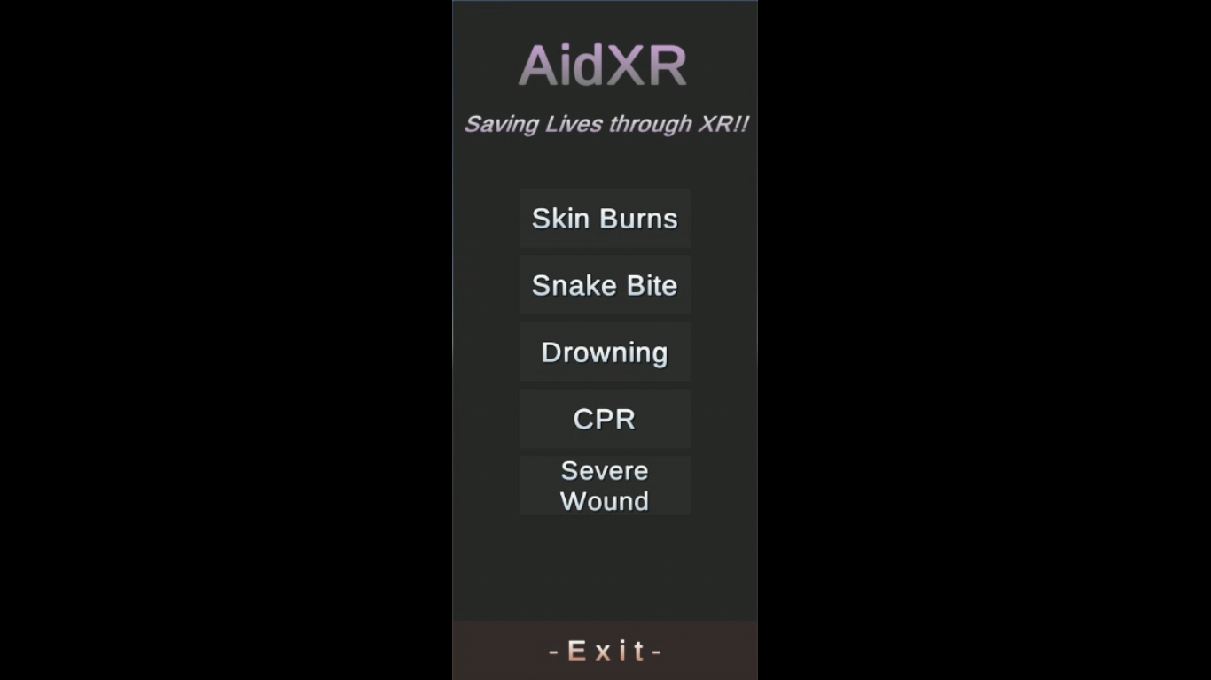
A glimpse inside AIDXR

Slide 11





