Slide 1
AUTOMATED GARAGE DOOR OPENER SYSTEM
PREPARED BY :
2021 / E / 009 – PERERA A.Y.I.D.
2021 /E / 053 - SEWWANDI I.G.P.T.
2021 / E / 121 – AGRAPALA P.W.S.H.D.
2021 / E / 138 – LOKUVITHANA S.M.
GROUP 04

Slide 2
Contents
Introduction
Aim, scope and objective
Design
Sensor And Logic Setup
Cost
Future Enhancements

Slide 3
Introduction
.Leveraging smart technology to simplify daily tasks.
Focus on automating garage door operations for better convenience and security.
Uses microcontrollers, wireless communication, ultrasonic sensors, and motor drivers.
Enhances safety by allowing only authorized vehicles to enter. Demonstrates the real-world application of embedded systems to improve daily life.

Slide 4
Aim, Scope and Objective
AIM:
To design and implement an automated garage door system for smart and
secure access.
OBJECTIVE:
Automate garage door opening and closing for authorized vehicles.
Enhance security by blocking unknown vehicles.
Improve user convenience with wireless access.
Demonstrate the power of embedded systems in daily life.
SCOPE:
Wireless authentication using Wi-Fi/Bluetooth.
Real-time vehicle detection with ultrasonic sensors.
Secure door control using a motor driver module.

Slide 5
DESIGN…

Slide 6
Server Board (Vehicle Unit)
Listens and accepts incoming TCP connections.
Rejects connection if the MAC address does not match.
Client Board (Garage Unit)
Tries to connect with the server board.
Ignores connection if the MAC address does not match.
Uses an ultrasonic sensor to measure vehicle distance.
Displays distance using four LEDs (representing four threshold levels).
Door Opens Only If:
Measured distance is below the smallest threshold value.
Client board successfully connects to the server board.

Slide 7
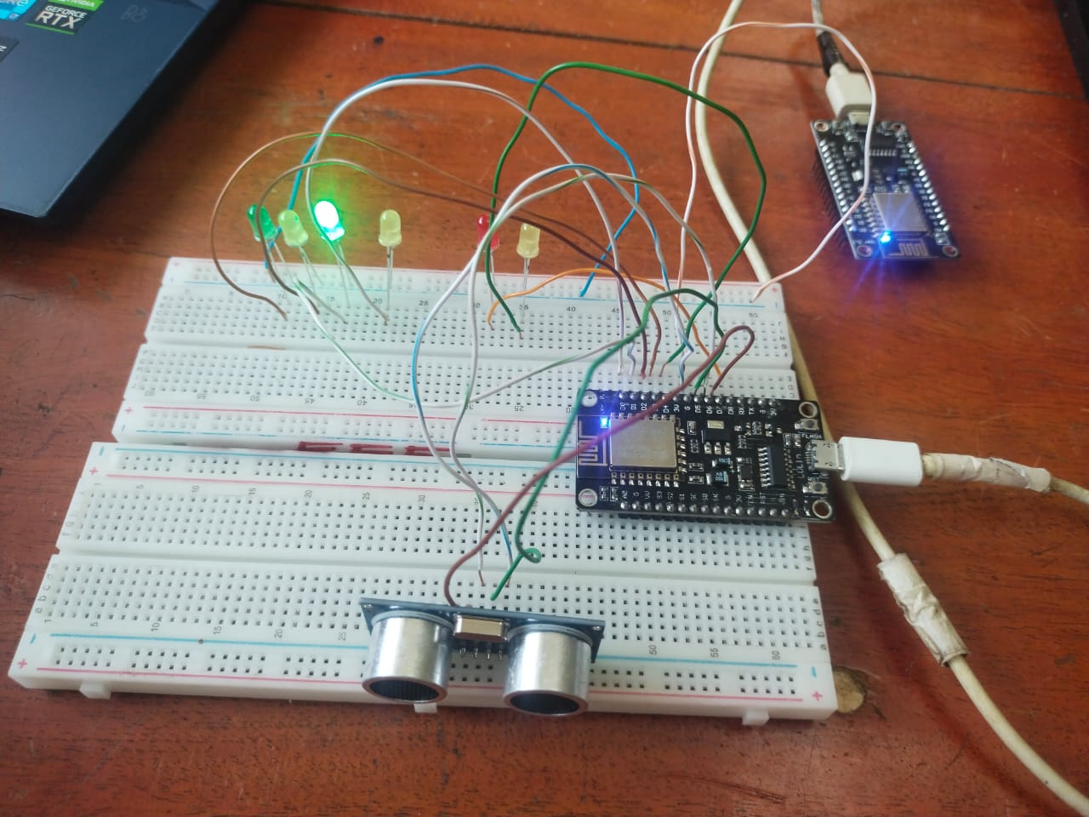
Circuit Diagram

Slide 8
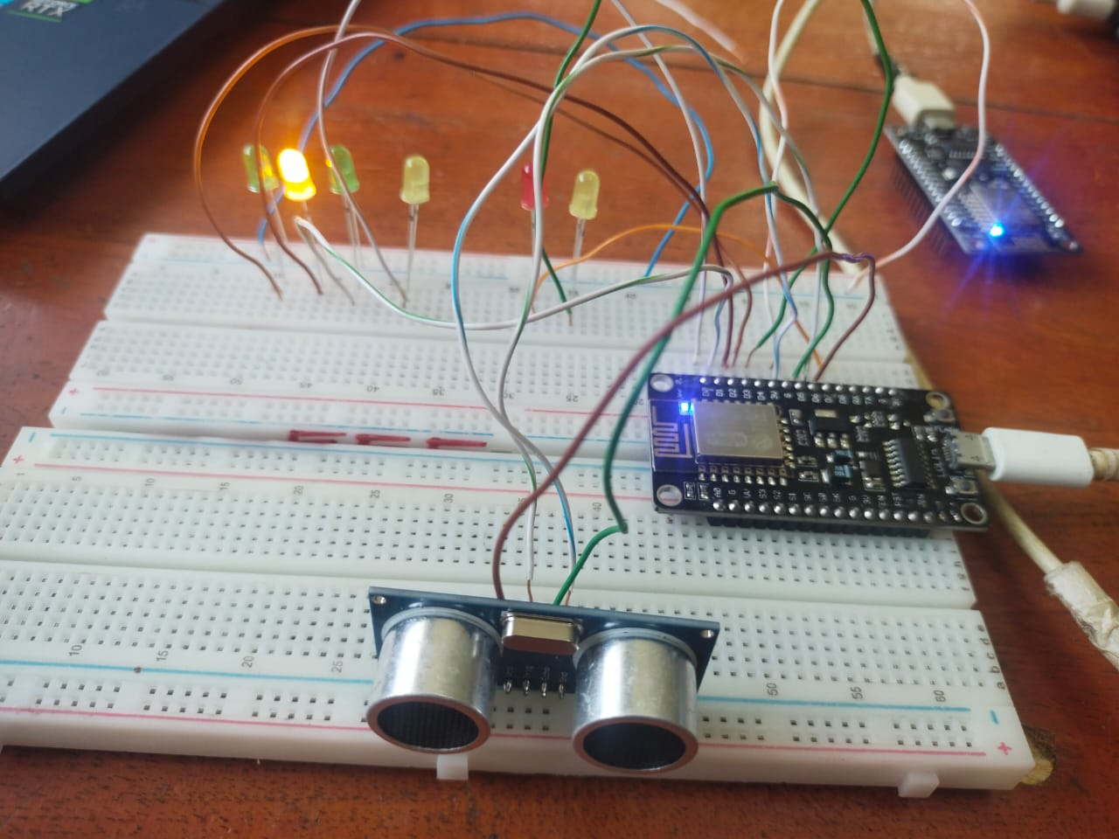

Slide 9
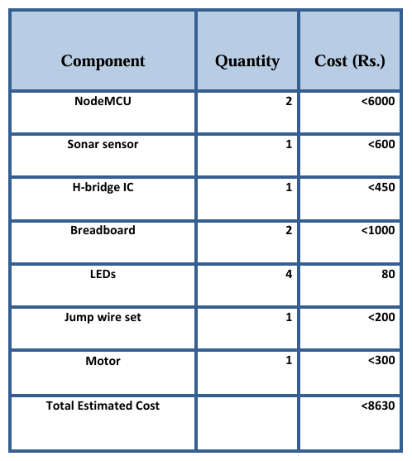
COST

Slide 10
Future Enhancements
Mobile App Integration
Control and monitor the garage door remotely via a smartphone app.
Battery Backup & Solar Power
Ensure system functionality during power failures with a backup battery or solar-powered unit.
Security Alerts & Logging
Send real-time notifications to homeowners if an unauthorized vehicle attempts access.
Maintain logs of vehicle entries for security tracking.

Slide 11
Thank you!

