Slide 1
Kafka: a Distributed Messaging System for Log Processing
(Group 12)
Group Members
Anadi Sharma (B21CS008)
Drishti Agrawal(B21CS027)
Yatharth Shukla(B21CS080)

Slide 2
Introduction
This project involves implementing Kafka, a scalable and distributed messaging system optimized for efficient log processing. Kafka excels at handling high volumes of data with low latency, combining features from both log aggregation and messaging systems to support real-time data consumption.
By utilizing Kafka's pull-based model, consumers can retrieve data at their own pace, making it a flexible solution for processing large streams of log data efficiently.
The goal is to leverage Kafka's capabilities to build a robust, scalable system that meets the demands of modern data-driven applications.

Slide 3
Architecture
Producer
(Topic 1)
Producer
(Topic 2)
Producer
(Topic 3)
Broker 1
Broker 2
Broker 3
Broker 4
Topic 1
Topic 3
Topic 2
Topic 2
Topic 1
Topic 3
Topic 2
Topic 1
Topic 3
Replication factor = 3
Consumer
(Topic 2)
Consumer
(Topic 1 & 3)

Slide 4
Components
1.
3
2
Producer
Sends data to the Kafka cluster. Produces and publishes messages to specific Kafka topics.
Consumer
Consumes data from kafka topics.Process messages based on application requirements.
Kafka Cluster
Core system managing data replication and partition
4..
Broker
Stores partitions, handles data requests, and manages fault tolerance
6.
Config Server
Configures Kafka topics and settings for optimal performance.
Zookeeper
Coordinates brokers, manages metadata, facilitates leader election.
5.

Slide 5
Features
Original Kafka Features
Scalability: Scaled horizontally by adding brokers to the cluster.
High Throughput: Handling thousands of messages per second.
Durability: Messages are stored on disk to prevent loss.
Additional Implemented Features
Fault Tolerance:
We are replicating data across multiple brokers using a leader-follower strategy. In this setup, one broker acts as the leader for a partition, handling reads and writes, while other brokers (followers) maintain copies. If the leader fails, a follower takes over, ensuring continuous availability and data integrity.

Slide 6
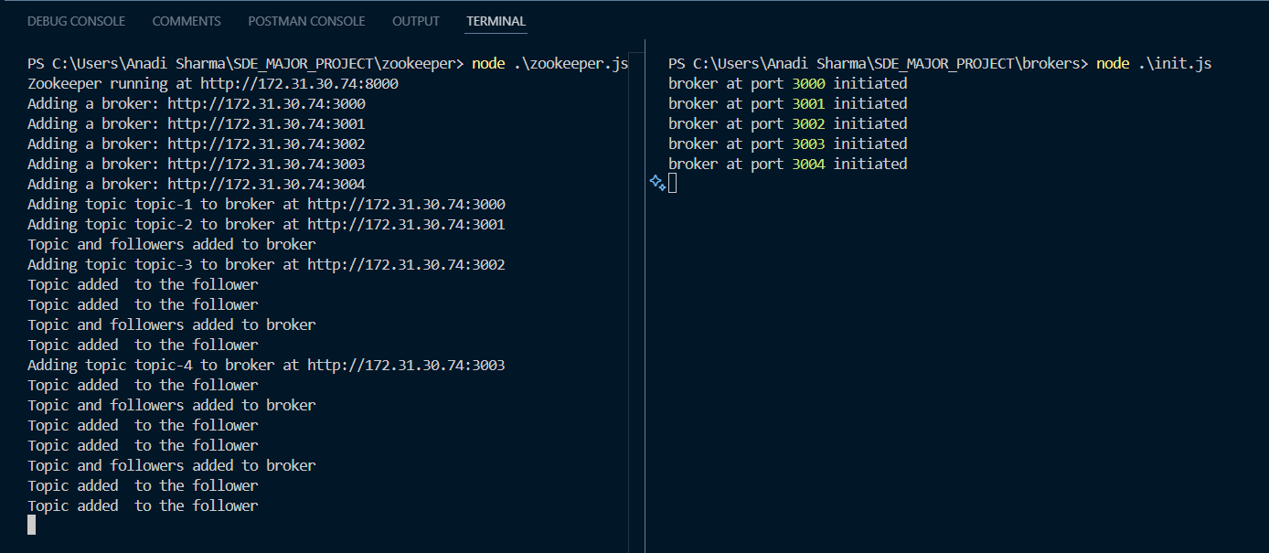
Init of Zookeeper and Brokers

Slide 7
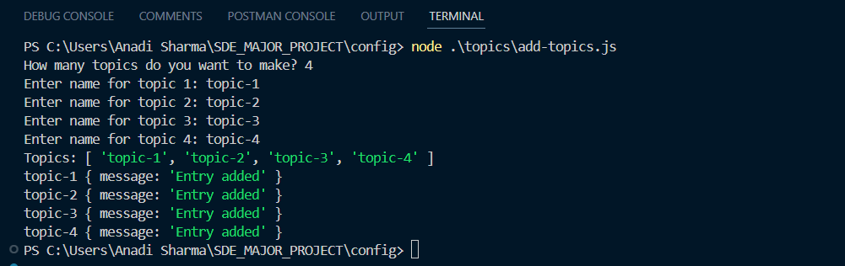
Adding topics

Slide 8
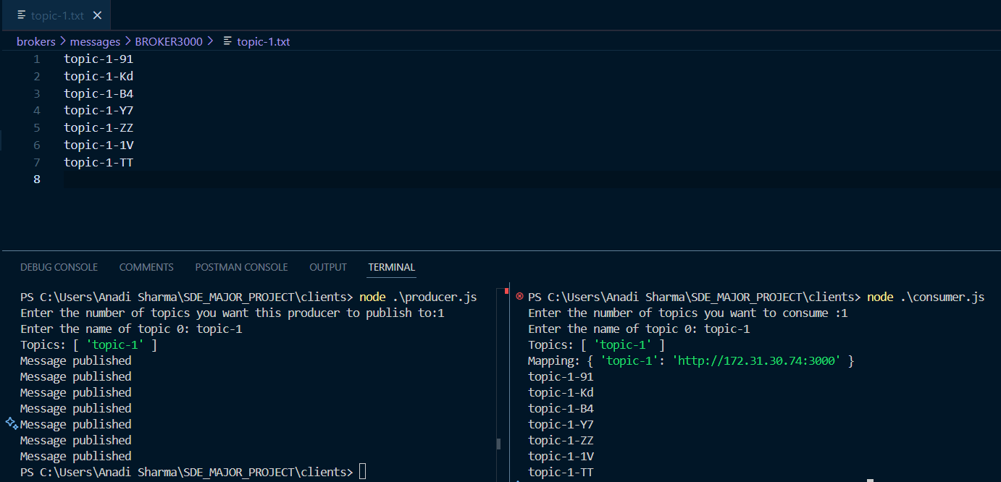
Clients: Producer & Consumer

Slide 9
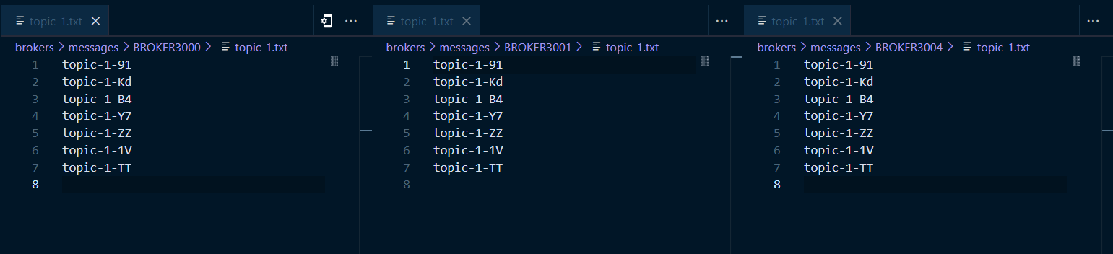
Data Replication: Leader-Follower
Leader: (R/W Access)
Follower
Follower

Slide 10
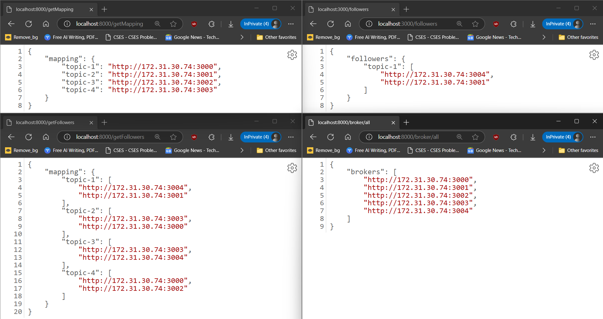
End Points

Slide 11
Benefits
Pull-Based Model
Consumers control their data consumption rate, allowing better resource management and tailored data processing based on specific application needs.
Decoupled Architecture
Producers and consumers are independent, allowing flexibility in scaling and modifying components without disrupting the system.
Configurable Topics
Flexibility in configuring topics (partitions, replication factor) to optimize performance and resource utilization.
Fault Tolerance
Continuous availability and data integrity by replicating data across multiple brokers using a leader-follower strategy. If the leader broker for a partition fails, a follower takes over, maintaining system reliability.

Slide 12
Future Scope
Integration with Data Processing Pipelines: for providing data to consumers after processing
Authentication and Authorization Integration: allowing restricted access to few topics
Integration with Hadoop: instead of removing data, it can be dumped to Hadoop after a specific time like 3-4 days after processing
Custom Replication factor: for different topics different amount of Data Replication can be provided

