Slide 1
INFORMS GM Motors
Akhil-Meetali-Stanley

Slide 2
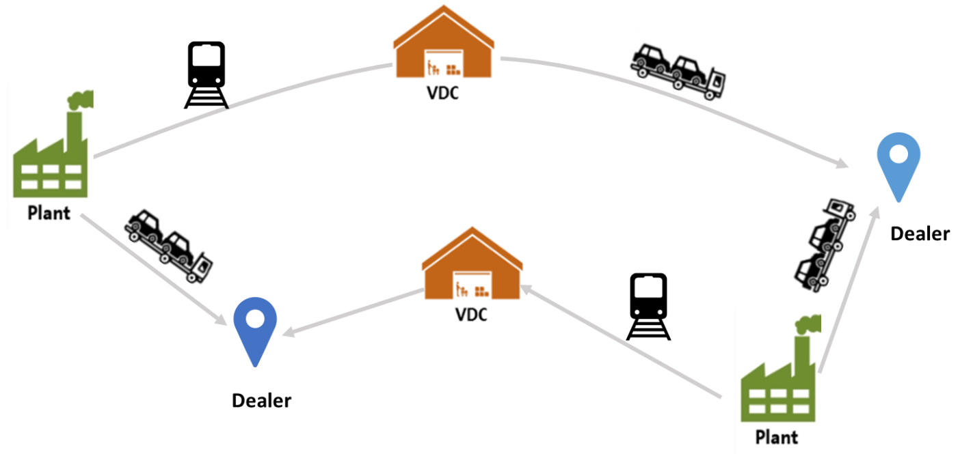
Background
Production of an average of 29,000 vehicles, shipping out from approximately 70 assembly plants to approximately 20,000 dealers by truck, rail and ship everyday.
Uses traditional approach for logistics network which ships vehicles from manufacturing plants to distribution centers, which are then supplied to dealers.
Objective is to introduce an optimization model which minimizes the total shipping and operating cost.

Slide 3
Introducing AV
Autonomous vehicle as a shipment source
Can drive itself and load itself on the trailer, which reduces handling cost.
If VDC runs out of space, AV parks itself in nearby parking area.
Could drive itself to dealer, reducing delivery costs.
This can lead to static and dynamic routing.

Slide 4
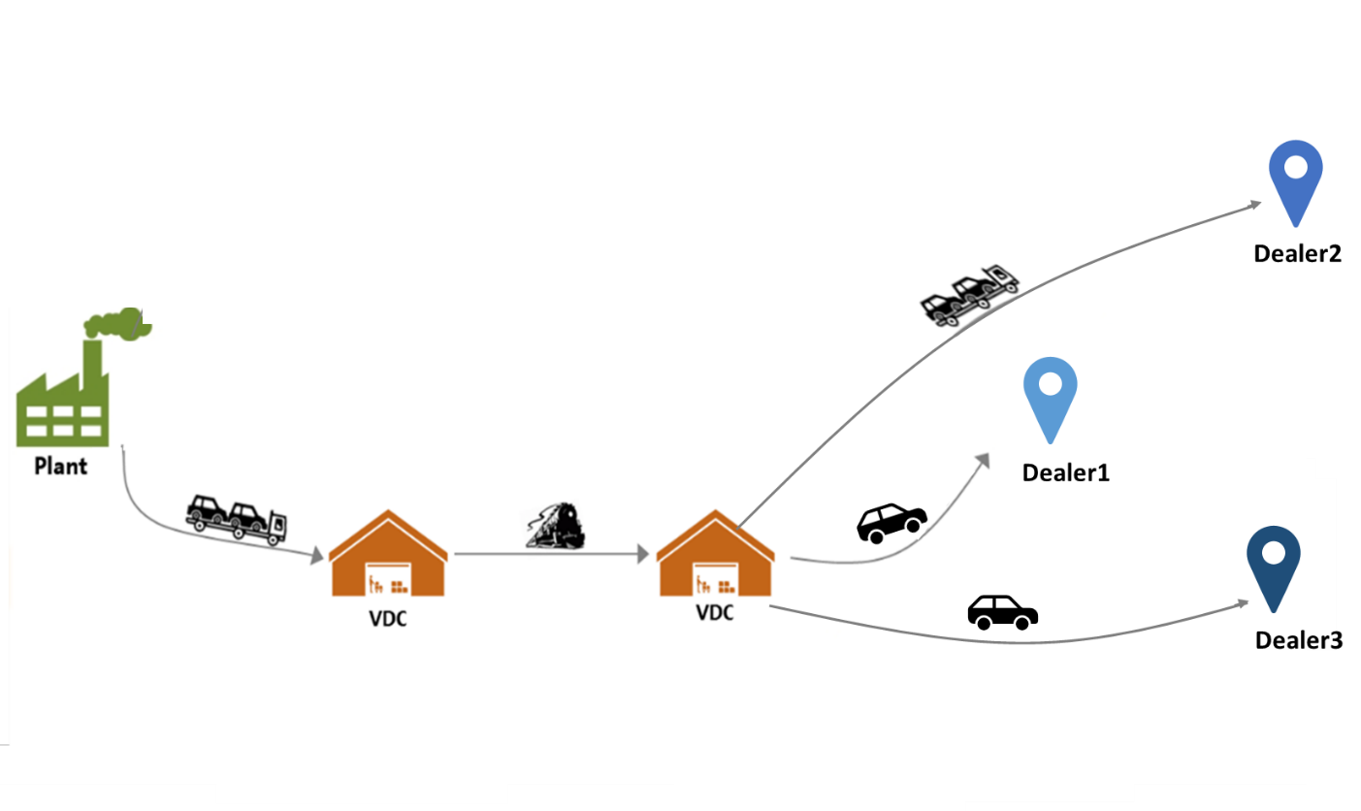
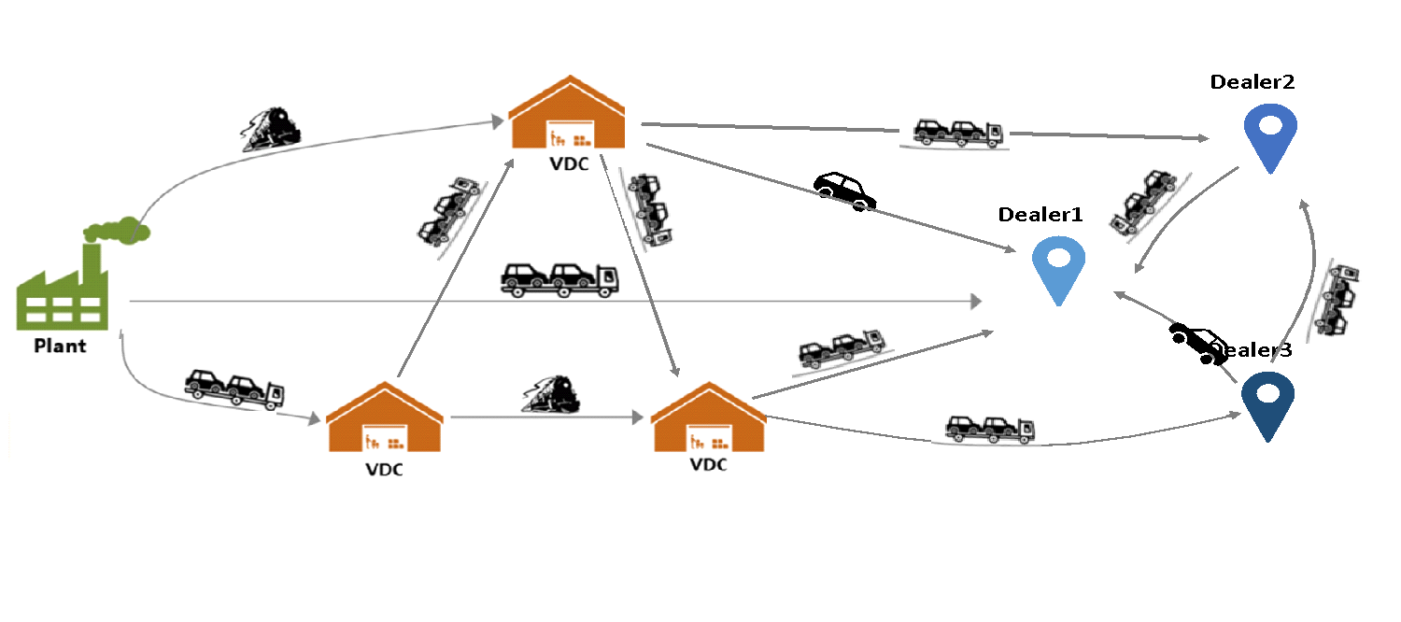
Static and Dynamic Routing
Static routing
Follows fixed path and fixed transportation modes, from a plant to VDC,
Second part from VDC to dealer is optimized everyday based on available inventory.
Dynamic routing
No longer fixed plant-dealer pair.More useful with AVs.
AV can deliver itself, and park itself from an overflow parking lot.

Slide 5
Our problem statement
Using transportation problem formulation, creating an optimized model to minimize the total cost of shipping the vehicles and other involved costs.
Static routing, identifying plants, VDC’s and dealers, and location for each of them and the demand of every plant-dealer pair..
Total Plants: 4
VDC’s: 44
Dealers: 1 lakh approx

Slide 6
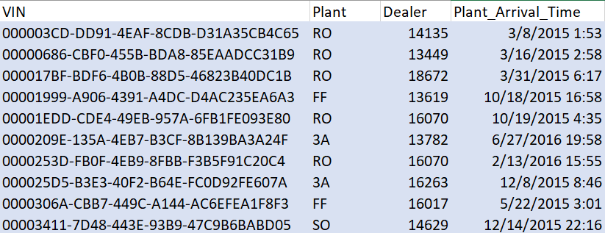
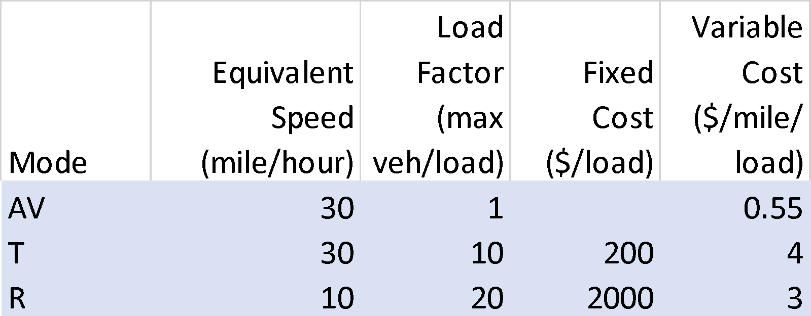
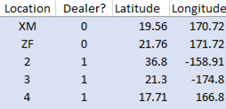
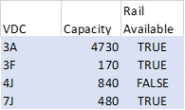
Given datasets

Slide 7
Assumptions for our model
We are using 2 plants : RO, 3A
5 VDC’s : BE, DO, GU, OX, QT
2 Dealers : 15534, 16070
2 modes of transport: AV, Truck
Number of VIN’s gives the demand for each plant-dealer pair

Slide 8
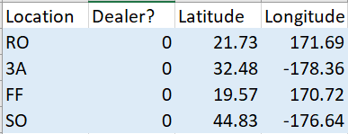
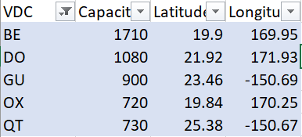

Filtering the datasets

Slide 9
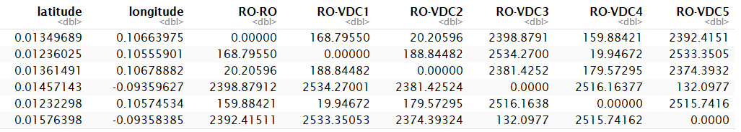
Calculating the distance between Plants and Dealers
We calculate the distance of plant to dealer by converting latitude and longitude locations of each of them.
The distance between Plant 1 (RO) and VDC 1-5, BE DO GU OX QT are 169 20 2399 160 2392 miles.
The distance between Dealer 1 (15534) and VDC 1-5, BE DO GU OX QT are 583 722 3104 602 3095 miles.
The distance between Plant 2 (3A) and VDC BE DO GU OX QT are 1128 940 1795 1119 1741 miles.
The distance between Dealer 2 (16070) and VDC BE DO GU OX QT are 188 134 2348 169 2348 miles.

Slide 10
Calculating the cost coefficients
For Autonomous Vehicles:
$0.55 - cost/mile per car
$40 - hadling cost per car
Formula for calculating cost of AV's =
[((Distance from Plant1 to VDC1 + Distance from VDC1 to Dealer1)*cost/mile) + handling cost]*Q111
For Trucks:
Each load can carry max 10 trucks (0.1)
$4 - cost/mile per load
$50 - hadling cost per truck
$200 - fixed cost
Formula for calculating cost of Trucks =
[((Distance from Plant1 to VDC1 + Distance from VDC1 to Dealer1)*cost/mile*0.1) + (fixed cost*0.1) + handling cost]*T111

Slide 11
Decision Variables
We have 2 variables, since we are using 2 modes of shipment.
Qijk, where the vehicle are shipped from plant i to VDC j, which goes to dealer k. This variable is used for AV.
Tijk, used for truck, which again shows the route from plant i to VDC j to dealer k.

Slide 12
Constraints
Each load has a capacity of carrying 10 trucks.
load -> 0.1 * Tijk
VIN gives the demand for each plant-dealer pair.
Plant1(RO)-Dealer1(15534) -> 144
Plant2(3A)-Dealer1(15534) -> 17
Plant1(RO)-Dealer2(16070) -> 148
Plant2(3A)-Dealer2(16070) -> 17

Slide 13
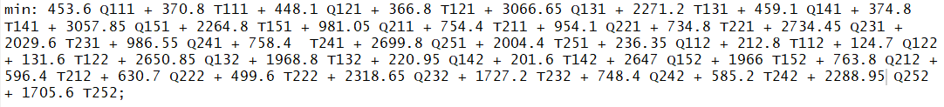
Objective function
Calculating the cost for AV’s and Trucks, we get the objective function as:

Slide 14
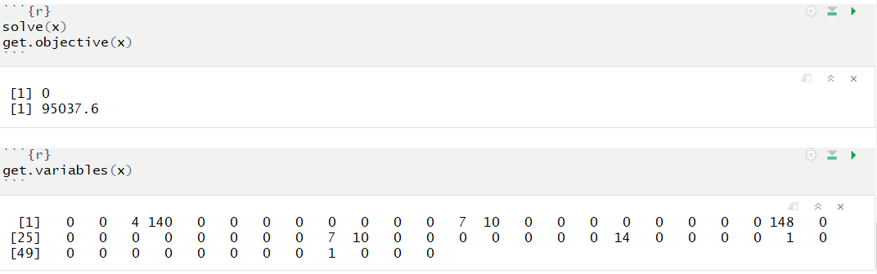
Comprehending the Results
According to the demand of each plant-dealer pair, the smallest cost of shipping and operating will be $95038.
Q121=4, T121=144, Q221=7, T221=10, Q122=148, Q222=7 and T222=10.

