Slide 1
NUWARE AI . INTERNSHIP PROGRAM
S&P 500 Zero-Shot Forecasting
Moirai vs. Chronos vs. TimesFM
Nine checkpoints, zero fine-tuning -- a rolling backtest comparison
AUTHOR
MENTOR
TOPIC
DATE
Agrim Gupta
Sushant Khuntegave Shivanshu Garg
Moirai . Chronos . TimesFM
12th August 2026
yfinance . Salesforce/uni2ts . amazon-science/chronos-forecasting . google-research/timesfm

Slide 2
9 Zero-Shot Checkpoints, 3 Foundation-Model Families
Moirai
Chronos
TimesFM
Moirai-1.0
Chronos
TimesFM-1.0
moirai-1.0-R-large
chronos-t5-large
timesfm-1.0-200m
Moirai-MoE
Chronos-Bolt
TimesFM-2.0
moirai-moe-1.0-R-base
chronos-bolt-base
timesfm-2.0-500m
Moirai-2.0
Chronos-2
TimesFM-2.5
moirai-2.0-R-small
chronos-2
timesfm-2.5-200m
One checkpoint per model version -- the largest available for that version.

Slide 3
One Family, Many Sizes
Illustrated with the original Chronos lineup
Large
Base
Small
Mini
Tiny
8M
20M
46M
200M
710M
Used in this project
Chronos-Bolt ships tiny -> base (4 sizes). Chronos-2 is Amazon's newest release -- a single unified checkpoint, not size-tiered.
This project always uses the largest checkpoint available for each model version.

Slide 4
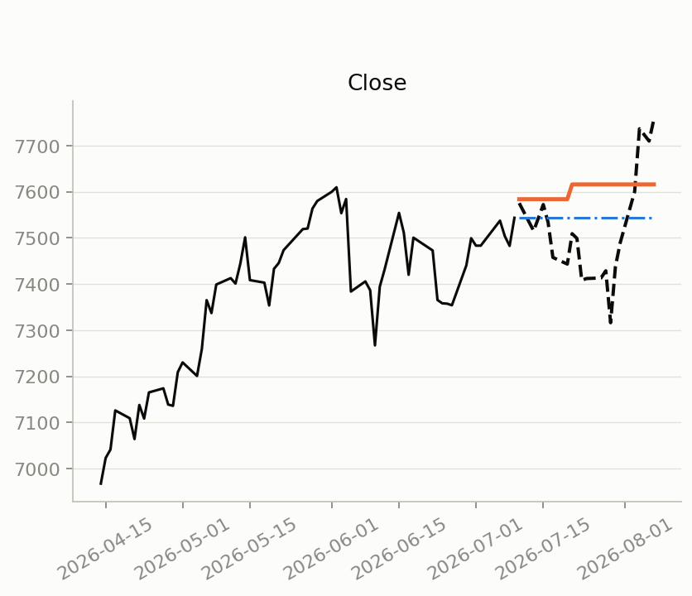
The Data
^GSPC
S&P 500 Close -- the forecast target
Yahoo Finance (yfinance) . 2005-01-01 -> present, refetched live
One rolling window, end to end
Context -- 512 trading days (~2 years)
Forecast -- 5 or 21 days
Forecast origin
Repeated at 60 rolling origins spanning 2005 -> present
Predicted for every window
Close price
Simple return
Log return
Real example -- history (solid) into naive / zero-shot forecast

Slide 5
Backtest Design
512 days
5 & 21 days
60
Context window (~2 trading years)
Forecast horizons
Rolling-origin windows, 2005 -> present
3
9
3
Targets: price, simple return, log return
Quantile levels (0.1 - 0.9)
Metrics: MASE, sMAPE, WQL

Slide 6
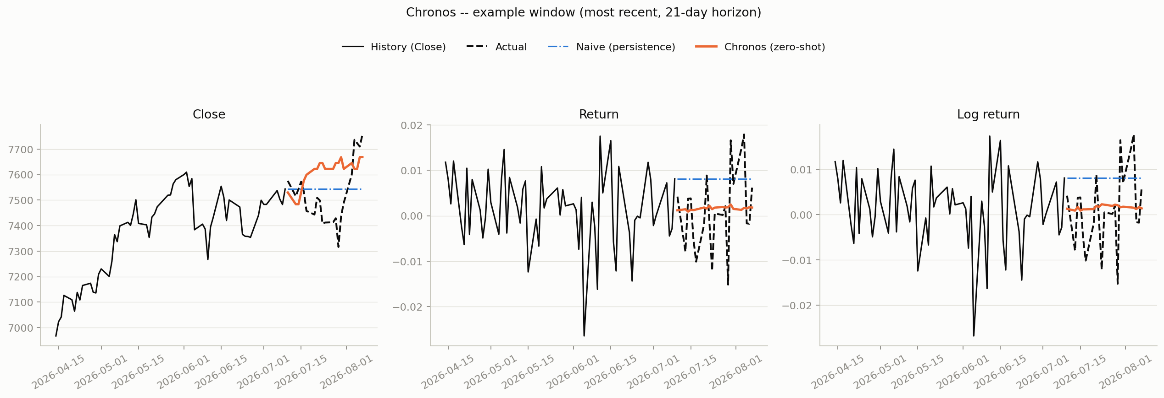
Example Forecast -- Chronos
History, actual, naive baseline (blue, dotted), and zero-shot forecast (orange) for Close / Return / Log return -- most recent window, 21-day horizon.

Slide 7
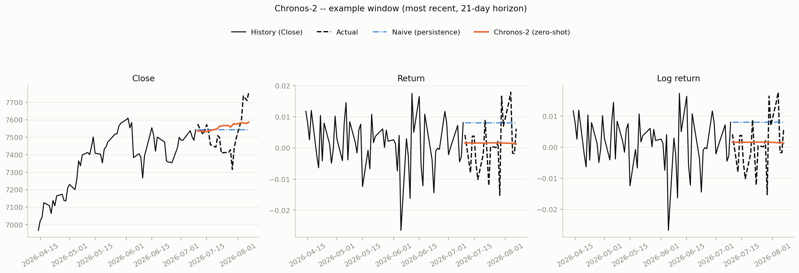
Example Forecast -- Chronos-2
History, actual, naive baseline (blue, dotted), and zero-shot forecast (orange) for Close / Return / Log return -- most recent window, 21-day horizon.

Slide 8
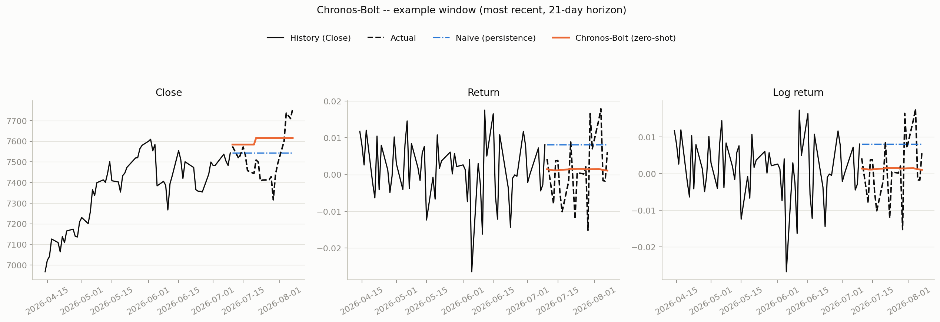
Example Forecast -- Chronos-Bolt
History, actual, naive baseline (blue, dotted), and zero-shot forecast (orange) for Close / Return / Log return -- most recent window, 21-day horizon.

Slide 9
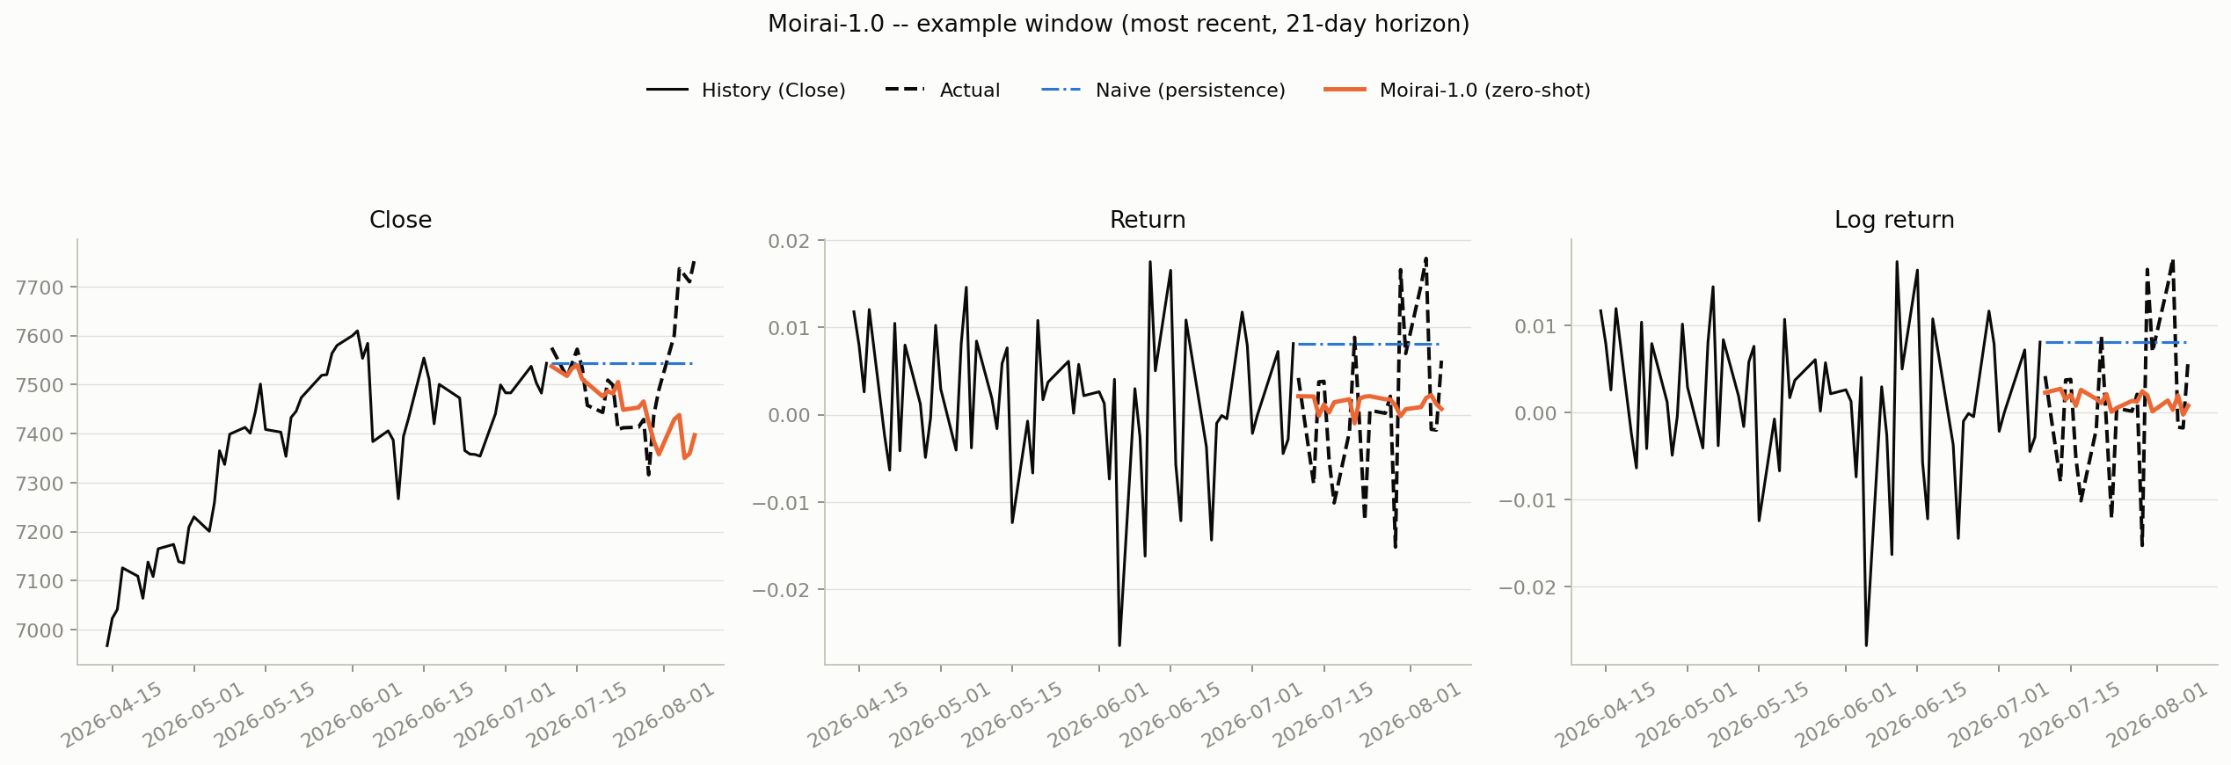
Example Forecast -- Moirai-1.0
History, actual, naive baseline (blue, dotted), and zero-shot forecast (orange) for Close / Return / Log return -- most recent window, 21-day horizon.

Slide 10
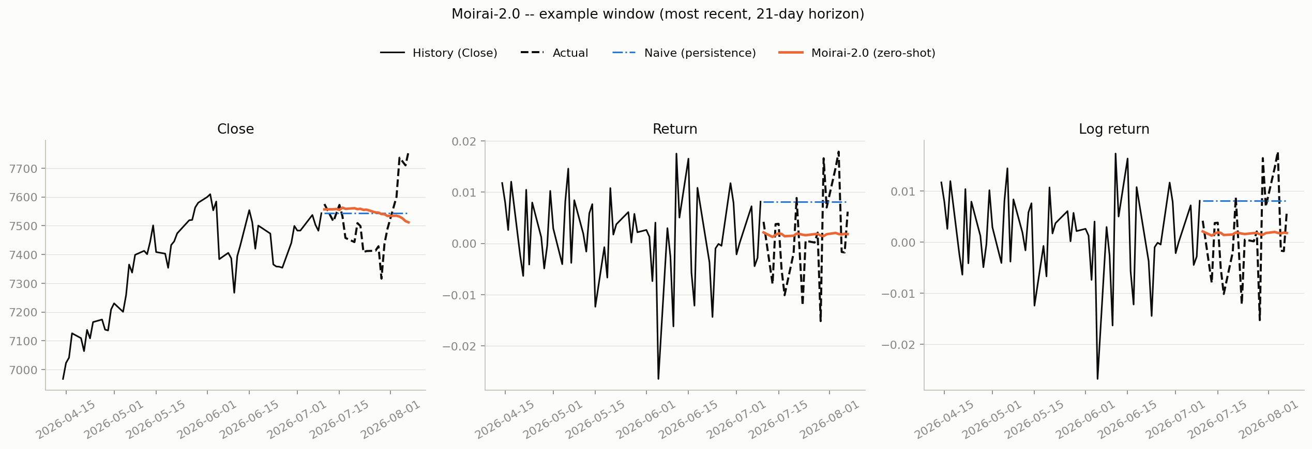
Example Forecast -- Moirai-2.0
History, actual, naive baseline (blue, dotted), and zero-shot forecast (orange) for Close / Return / Log return -- most recent window, 21-day horizon.

Slide 11
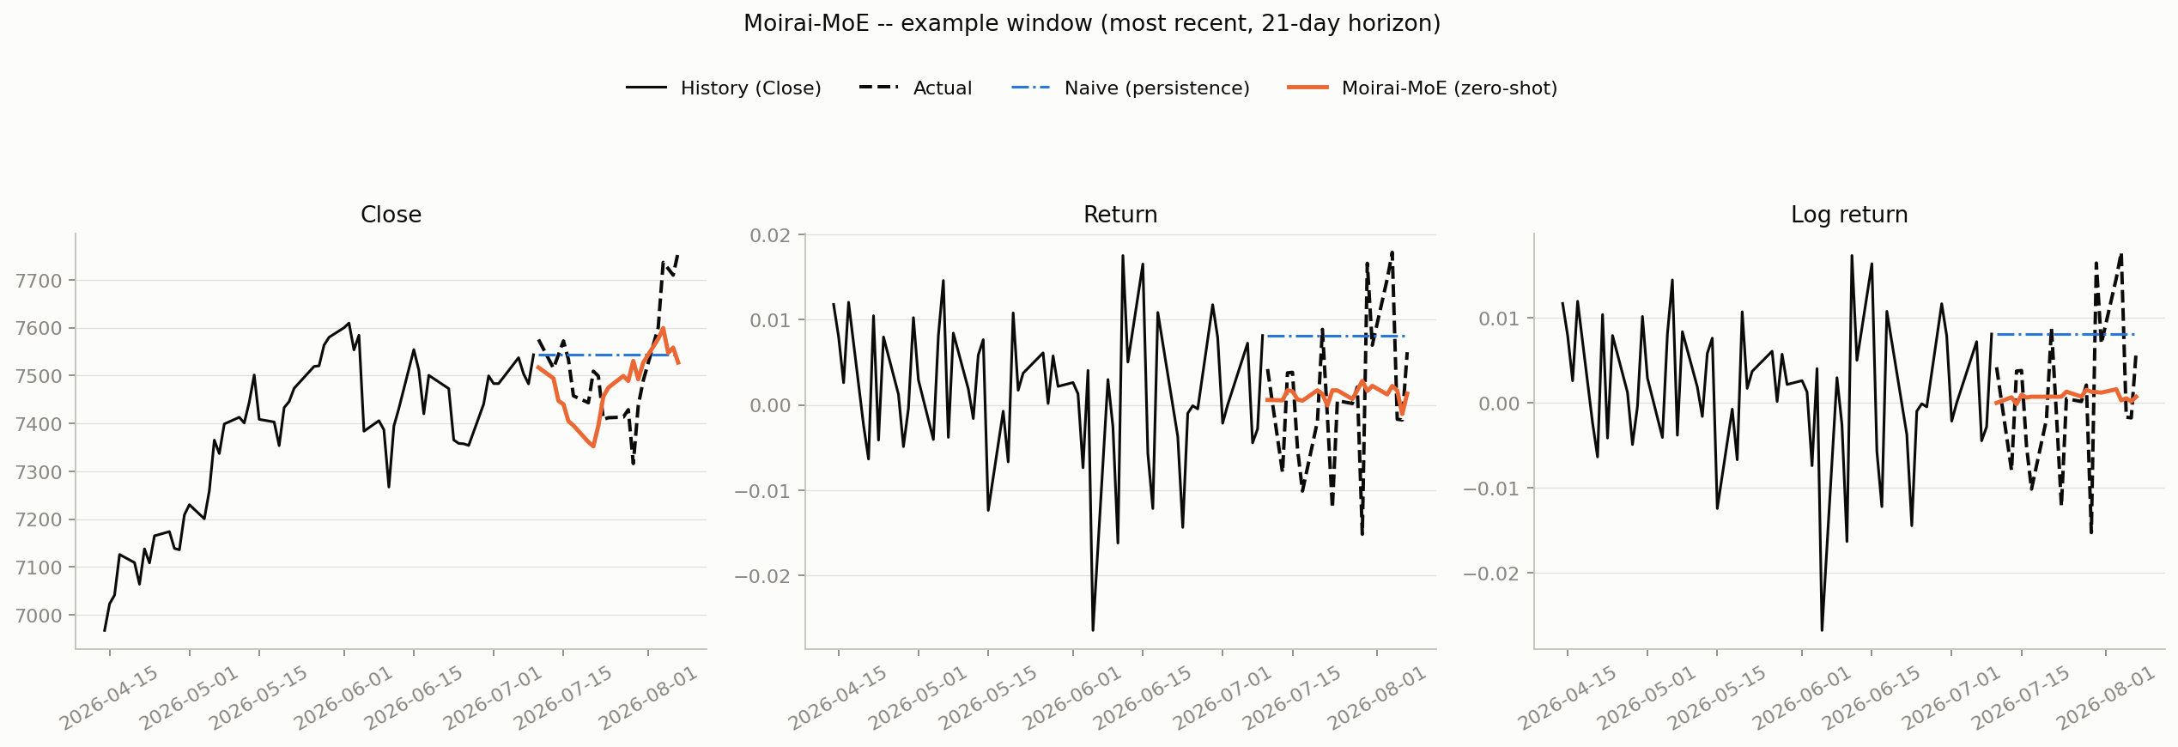
Example Forecast -- Moirai-MoE
History, actual, naive baseline (blue, dotted), and zero-shot forecast (orange) for Close / Return / Log return -- most recent window, 21-day horizon.

Slide 12
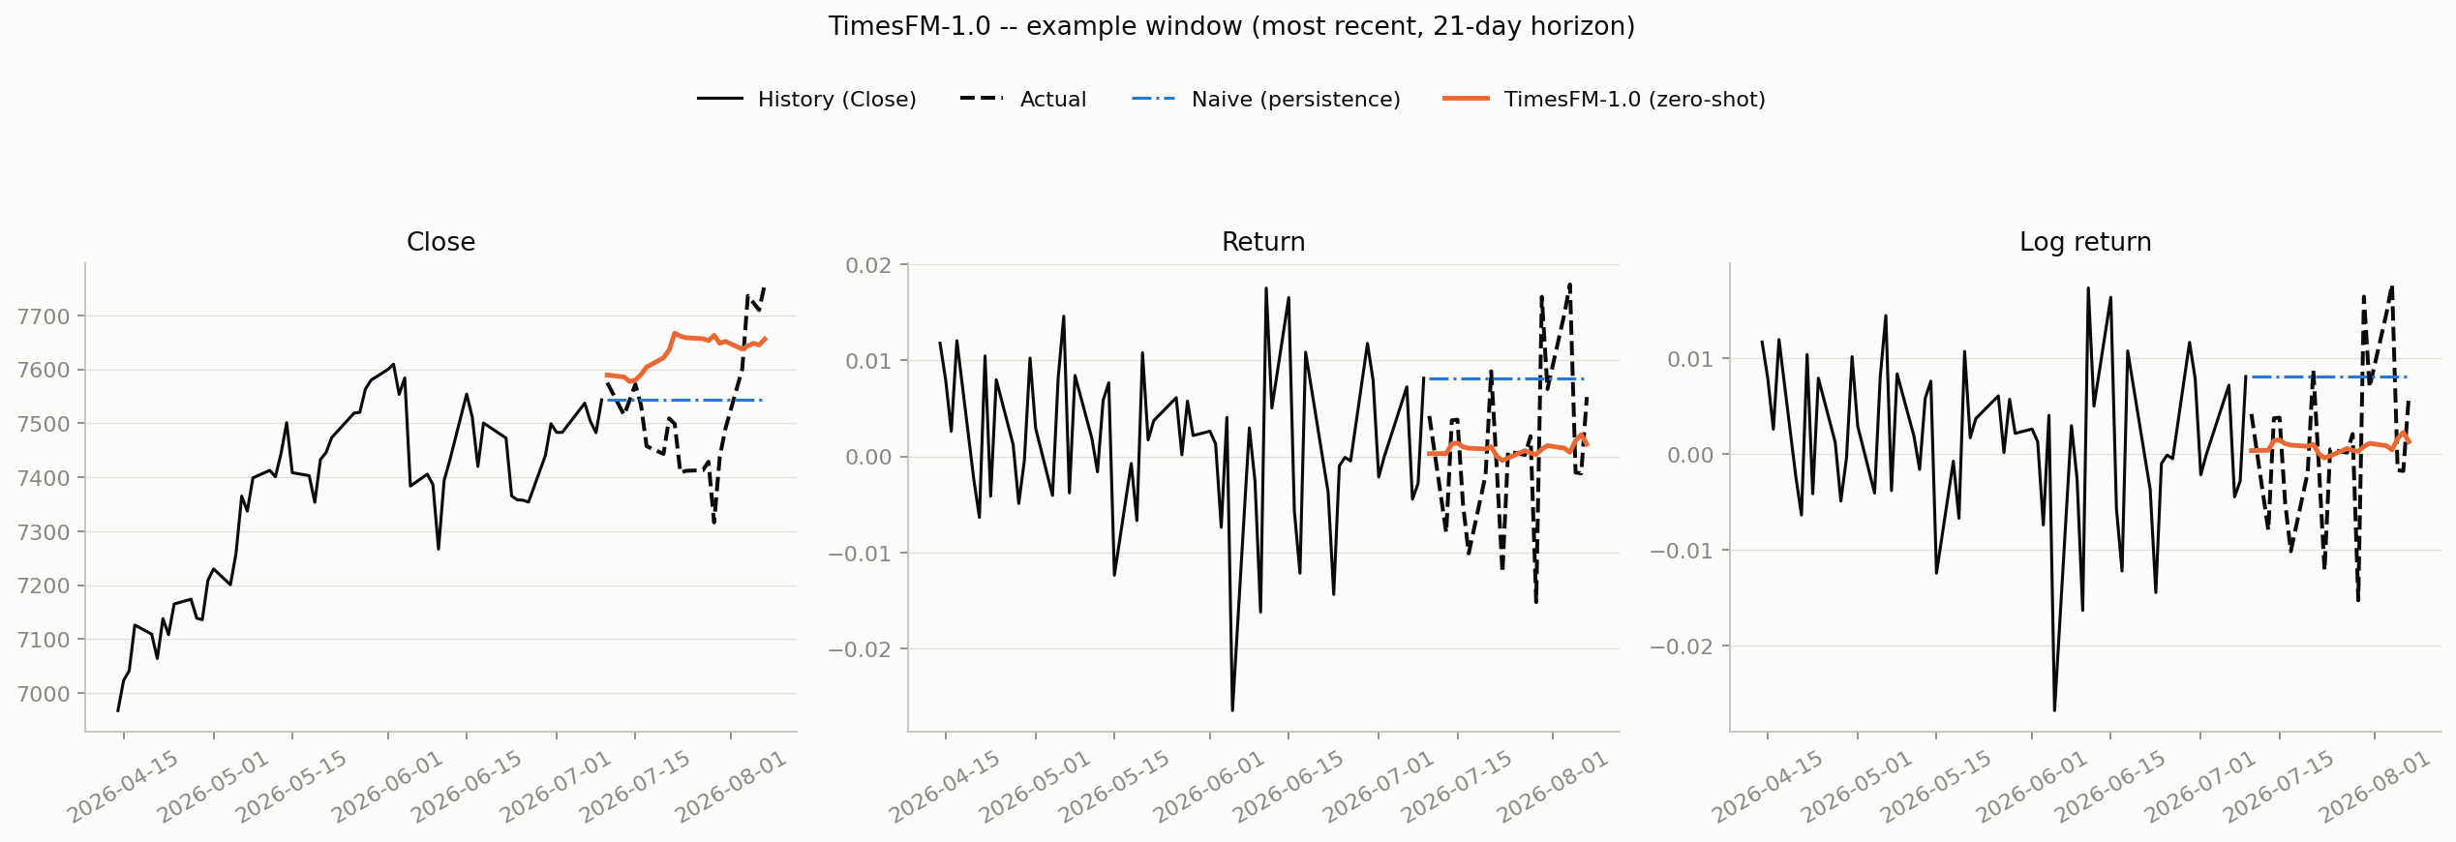
Example Forecast -- TimesFM-1.0
History, actual, naive baseline (blue, dotted), and zero-shot forecast (orange) for Close / Return / Log return -- most recent window, 21-day horizon.

Slide 13
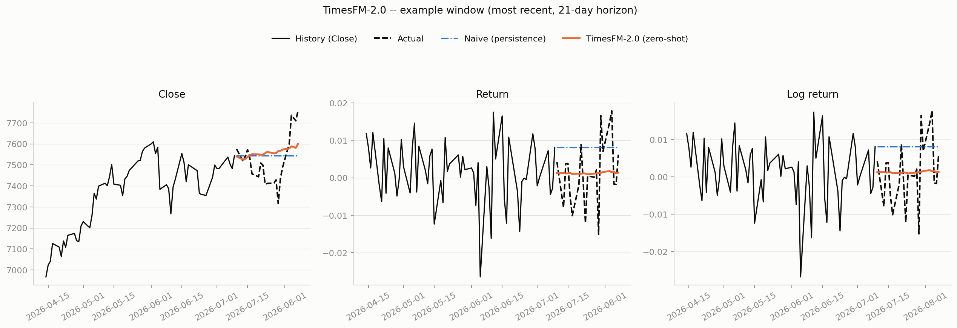
Example Forecast -- TimesFM-2.0
History, actual, naive baseline (blue, dotted), and zero-shot forecast (orange) for Close / Return / Log return -- most recent window, 21-day horizon.

Slide 14
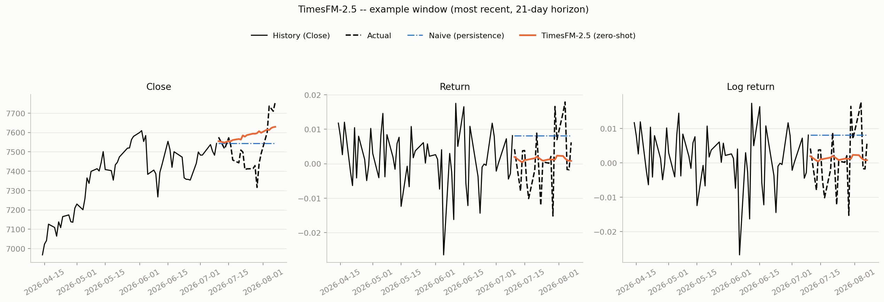
Example Forecast -- TimesFM-2.5
History, actual, naive baseline (blue, dotted), and zero-shot forecast (orange) for Close / Return / Log return -- most recent window, 21-day horizon.

Slide 15
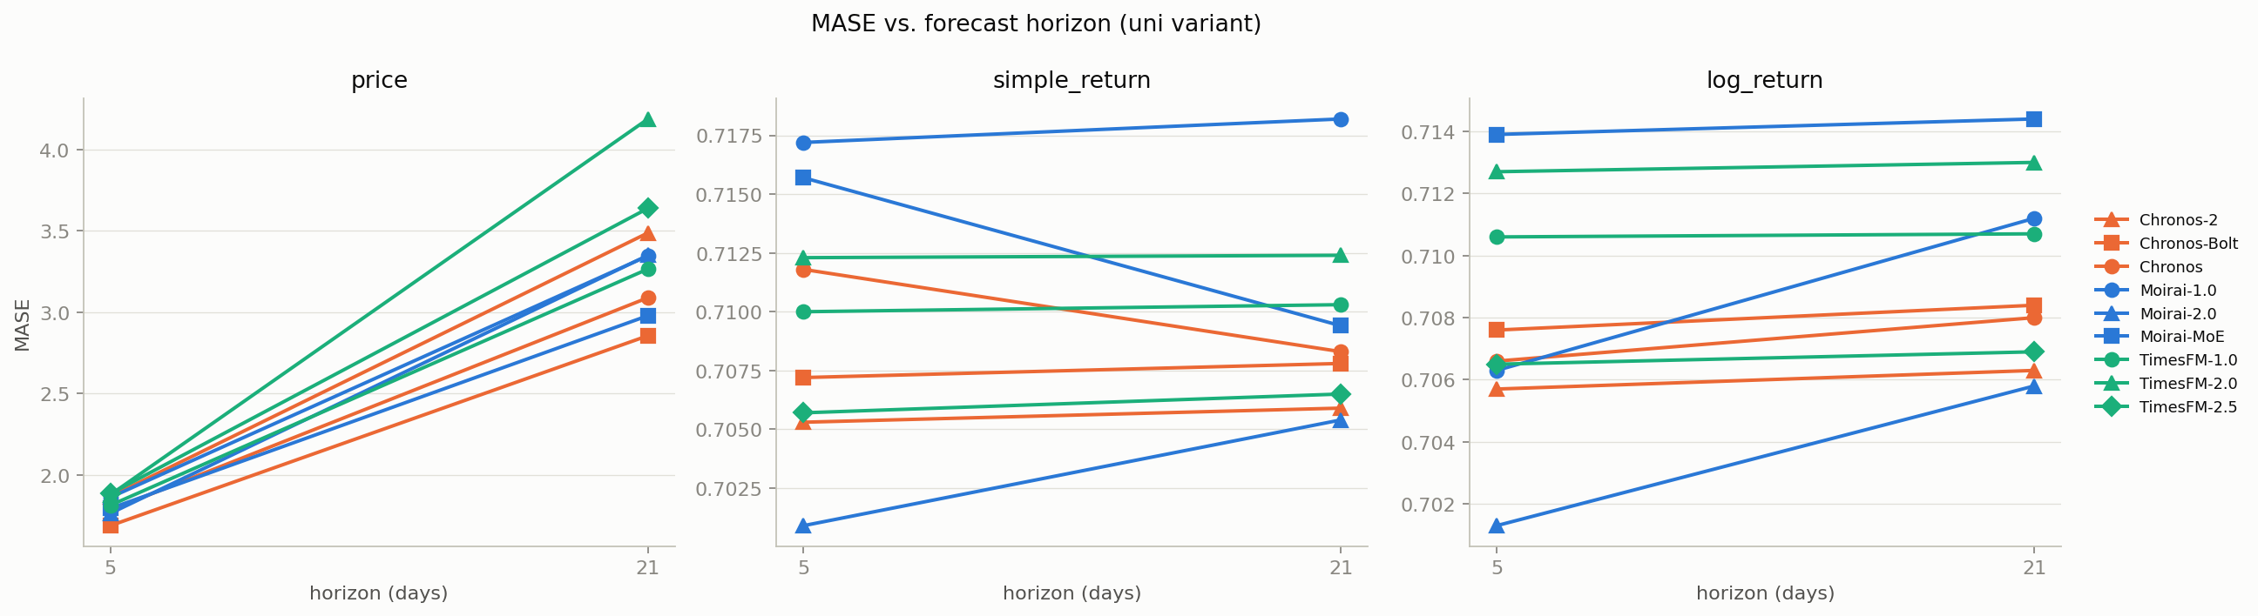
Accuracy vs. Forecast Horizon (MASE)
Does accuracy fall off from 5-day to 21-day? Faceted by target; color = family, marker = version within family.

Slide 16
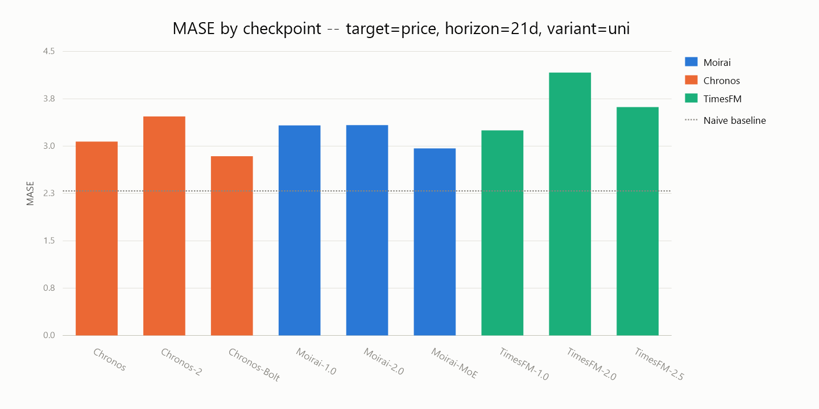
Headline Comparison -- MASE
Price target, 21-day horizon, univariate variant. Dotted line marks the naive (repeat-yesterday) baseline.

Slide 17
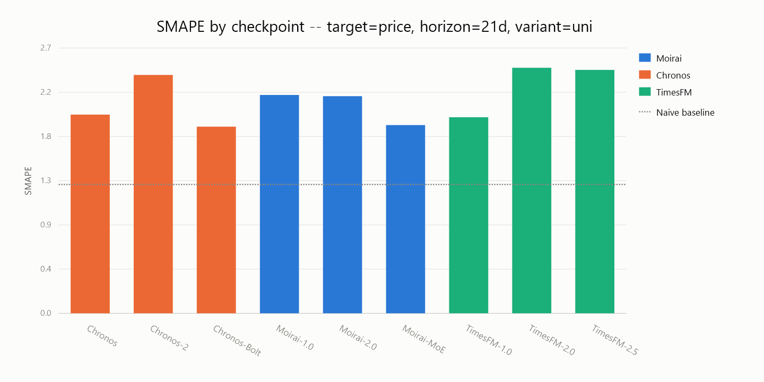
Headline Comparison -- sMAPE
Price target, 21-day horizon, univariate variant. Dotted line marks the naive (repeat-yesterday) baseline.

Slide 18
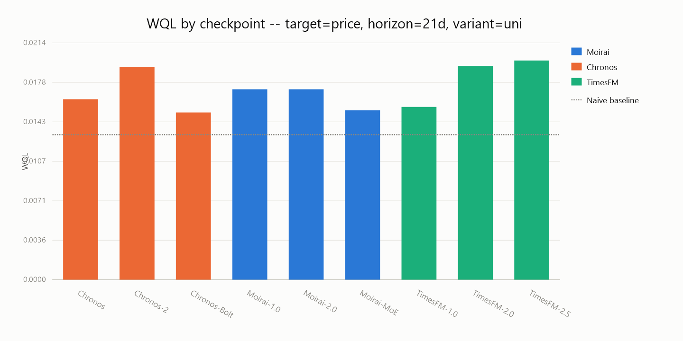
Headline Comparison -- WQL
Price target, 21-day horizon, univariate variant. Dotted line marks the naive (repeat-yesterday) baseline.

