Slide 1
FREQUENCY HOPPING SPREAD SPECTRUM
HARSHVARDHAN TIBREWAL AGRIM GUPTA

Slide 2
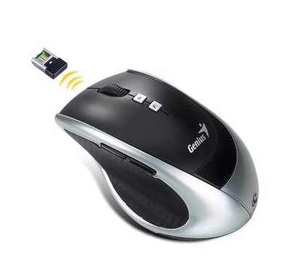
INSPIRATION
Previously used by us while implementing XBee network for a personal project. The Xbee module hopped over various frequencies in the start to select the frequency with the lowest SNR.
Has wide usage in Bluetooth and Wi-Fi technologies, like in wireless mouse. Bluetooth utilizes frequency-hopping spread spectrum technology to avoid interference problems. The signal switches carrier channels rapidly, at a rate of 1600 hops per second, over a determined pattern of channels

Slide 3
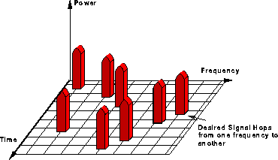
INTRODUCTION
Different parts of the message are sent out at different carrier frequencies
A good algorithm to generate carrier frequencies in a random manner is by using Pseudo Random Sequences
PN sequences have a property that autocorrelation is very low unless they overlap. (We will exploit this property in acquisition)
Retrieval will be in two stages:
Acquisition: Our block will identify which frequency is being transmitted using the autocorrelation property
Tracking: Once we know the frequency, using our PN sequence we can track next frequencies and retrieve message signal without data loss

Slide 4
Modulation
We are using Phase modulation
The message is spread in time and parts are placed in the carrier, its carrier frequency hopping periodically
Phase modulation has more resistance for additive noise than DSB-SC

Slide 5
Pseudo Random Sequences
We are implementing Random sequences using Linear Feedback Shift registers
The bit sequence in the system at any state decides which carrier frequency is going to be used for transmission
These sequences repeat at regular intervals hence periodically hopping in frequencies
Although the PN sequence is completely deterministic given the initial seed, it shows many properties of random sequences, thus it’s name
PN sequences are unique to the receiver and transmitter and hence cannot be tracked easily

Slide 6
Transmitter
At the Trasmitter end, we have the PM modulation block, but with a twist. The carrier frequency is being hopped continuously, through the hopping block.
We have made a complete block “Mod_64” for the same (PM modulation and Hopping)

Slide 7
At the receiver’s end
Our block has:
The acquisition and tracking system used for detection of carrier of frequencies
The demodulation scheme for phase modulation
Input to the Block is the transmitted signal and output is the demodulated message signal

Slide 8
Serial Acquisition Technique
We evaluate autocorrelation of the incoming samples with each frequency and take the highest one (above a threshold), which gives us the “Locked On Frequency”
Procedure: <multiply conjugate, square, integrate >
Timing issues: how many samples does each frequency require to give a successful autocorrelation? …..calculation
Integral saves the day…check.py
The Tracking stage has a periodic down counter of 10 cycles of hop (i.e. after 10 full cycles of hopping, the code goes to acquisition part again, for periodic updates)

Slide 9
Limitations to Serial Acquisition
Since we need at a minimum of 30 samples to detect a frequency, number of frequencies we can check before the signal is over is…
X=n*S/f; where n is number of 2pi cycles, S –Sampling rate, f- max frequency, X is # of samples (X<8192, GNURadio Constraint)
This gives us at best 64 hops, since for 128 hops number of 2pi cycles reduce to 16, which hinders the autocorrelation (eg Bluetooth)
Hence an attacker is limited to checking only a certain number of frequencies in a limited period of time (order of 200msec)
Without the knowledge of PN sequence it is almost impossible to tract FHSS

Slide 10
Tracking
Once frequency acquired, we use that frequency as input to the PN sequence and start generating next frequencies
Our acquisition runs periodically (self.counter) during this stage because if there are changes ( due to noise or wrong transmissions) it will adapt automatically

Slide 11
Demodulation
We demodulate the PM wave in house and output the message
Procedure:
Convert float to complex of the transmitted signal - in the polar form Ae^{j(2*pi*fc*t + Kp*m(t))}
Now remove the carrier frequency (by multiplication with conjugate)
What’s remaining - our Message!

Slide 12
Resistance to Multipath Interference

Slide 13
Resistance to Jamming

Slide 14
PROBLEMS FACED IN GNURADIO CODING
BUFFER:
Gnuradio randomly changes buffer transmission rate , and as our signal is crucial in variations of frequencies and time we cannot acquire them easily
DELAY IN BLOCKS:
Blocks in series create a significant delay, which hinders synchronization within the flowgraph

Slide 15
The Buffer Problem
One very big challenge faced by us is the buffer rate of the block giving the transmitted frequency to the receiver
Since buffer rate keeps on changing randomly (varying from any number between 0 and 8192), we cannot be sure that what we have received in the current set of samples contains just 1 frequency or 2 frequencies (ex : half set of f1 and second half set of of f2)
If we directly demodulate there is a high chance that we lose data if we cannot identify which frequency its is on (especially in the case with 2 frequencies in one set)
Hence Acquisition is difficult as synchronization is the major task!

Slide 16
We have a solution!
We have an internal buffer we save previous samples.
Once the internal buffer overflows, it gives the set of samples to the acquisition
We now know that only one frequency can be contained in the set of samples and proceed to acquisition and tracking

