Slide 1
BookVerse
Search the catalog: “algorithms”
Every library visit, in one simple app
A library management web app where students, librarians and admins share one catalog, one set of loans and one inbox.
Introduction to Algorithms
Thomas H. Cormen
Shelf A-03
PRESENTED BY
Anveer Singh Sandhu
Ayush Sharma
Agrim Joshi
2510992756
2510992832
2510992925
Issued at desk
Due in 14 days
Notes:
Good morning. We are presenting BookVerse, a library management web app we built as our project. The idea in one line: everything that happens at a library, from searching for a book to returning it, happens in one app. The shelf on the right shows that journey: a student searches, finds the book and its shelf, and takes it home from the desk.

Slide 2
Paper registers and Excel sheets make every loan error-prone
Today
Paper register
Excel sheet
Every issue and return is handwritten
Anyone with the file can change any row
Overdue days and fines are counted by hand
No rules: limits and due dates are not enforced
Finding who has a book means flipping pages
Copies on different PCs drift out of sync
With BookVerse
Each loan is recorded instantly, with the rules checked
Due dates, overdue days and fines are calculated for you
One shared library, with a login and permissions for every role
Notes:
Most college libraries run on one of two things. A paper register: every loan is a handwritten line, fines are counted by hand, and finding who has a book means flipping pages. Or an Excel sheet: faster to type, but anyone can change any row, nothing stops a fifth book or a missed due date, and copies on different computers go out of sync. BookVerse fixes both: loans are recorded with the rules checked, fines are calculated for you, and everyone works on one shared library with their own login.

Slide 3
BookVerse is one web app with a desk for every role
Visitor
Student
Reads about the library, sends a message, asks to join.
Browses, reserves, renews, tracks due dates and fines.
Shared library data
Books, members, loans, holds, fines and messages
Librarian
Admin
Issues and returns books and follows up overdue loans.
Runs the catalog, members, staff, fines, reports and settings.
Notes:
BookVerse is a single web app with four kinds of visitor. Each role sees its own pages, but all of them read and write the same library data in the middle. That is what removes the paper: when a librarian issues a book, the student and the admin see it straight away.

Slide 4
A student goes from sign-up to a book in hand in four stops
0 min
Same day
+2 min
14 days
Register
Approved
Reserve
Return or renew
Fills the form and solves the captcha; the account waits for approval.
An admin approves the request on the Members page.
Searches the catalog, opens the book page and reserves a copy.
Collects at the desk; one renewal adds another 14 days.
RULES THE APP ENFORCES
Up to 3 books at once
Holds kept for 3 days
₹10 per late day
Admin can change all
Notes:
Here is the student journey. A student registers, solving a captcha, and an admin approves the account. They search, open a book page and reserve it, collect it at the desk, and have 14 days to return it, with one renewal allowed. The rules in the grey panel are not just text; the app enforces them, and the admin can change them in Settings.

Slide 5
Each role gets its own pages and its own permissions
ROLE
PAGES
ONLY THIS ROLE CAN
Student
Dashboard · Browse Books · Book details · My Books · Reservations · Fines · Profile
Reserve and renew their own books, pay their fines
Librarian
Dashboard · Students · Books · Book details · Issue Book · Return Book · Transactions · Profile
Issue and return books, send due-date reminders
Admin
Dashboard · Books · Members · Staff · Transactions · Fines · Inbox · Reports · Settings · Profile
Approve students, create staff, reset passwords, change rules
Staff accounts are created only by an admin, with a temporary password the person must replace on first login.
Notes:
The three signed-in roles each get their own area of the site. Students handle their own borrowing, librarians run the desk, and the admin runs the library: the catalog, people, rules and inbox. Staff cannot register themselves; an admin creates them with a temporary password that must be changed at first login.

Slide 6
Every page talks to a small promise-based server in the browser
React pages
LibraryContext
Fake server
localStorage
src/pages · 37 components
src/context
src/api
the database
One component per page, lazy-loaded by React Router and guarded by role.
Gives pages the data and turns every button press into an API call.
index.js checks who is asking · engine.js holds the rules · captcha.js · db.js
One key per table: bookverse:books, :loans, :students, :messages …
BUILT WITH
React 19
React Router 7
Vite 8
bcryptjs
Hand-written CSS
There is no real server, so src/api plays one: every call waits about 300 ms like a network trip, checks the role, applies the rules and saves the tables, then resolves or rejects.
Notes:
This is how the code is organised. Pages never touch storage directly; they call the context, which calls our small API layer. That layer behaves like a server: it checks who is signed in, validates input, applies the library rules from engine.js and writes the tables to localStorage. Because every call returns a Promise, the pages can later be pointed at a real server with almost no changes.

Slide 7
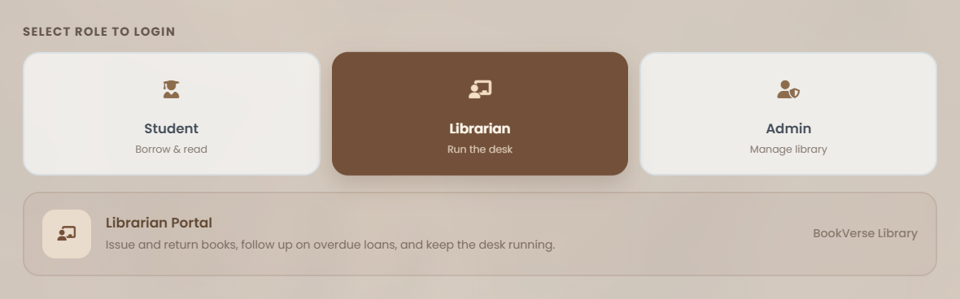
A role is checked twice: in the router and in the API
src/components/RequireRole.jsx · src/api/index.js
export default function RequireRole({ role, children }) {
const { ready, session, me } = useLibrary();
…
if (!session || session.role !== role ||
!me || me.status !== 'active') {
return <Navigate to="/login" replace state={{ from: … }} />;
}
if (me.mustChangePassword)
return <Navigate to="/set-password" replace />;
return children;
}
function requireRole(state, ...roles) {
const user = signedIn(state);
const role = user.role ?? 'student';
if (user.status !== 'active' || !roles.includes(role)) {
throw new ApiError('You are not allowed to do that.');
}
…
1
2
1
Wrong role? Back to login
A student opening /admin is redirected before the page loads.
2
Temporary password
3
A reset account must set a new password first.
3
The API checks again
Even a forged request is refused by the server layer.
Notes:
This is the role cards on the login page and the code behind them. In the router, RequireRole sends anyone with the wrong role back to login, and sends a reset account to set a new password. The API checks the role a second time, so even a hand-crafted request cannot do something the role is not allowed to.

Slide 8
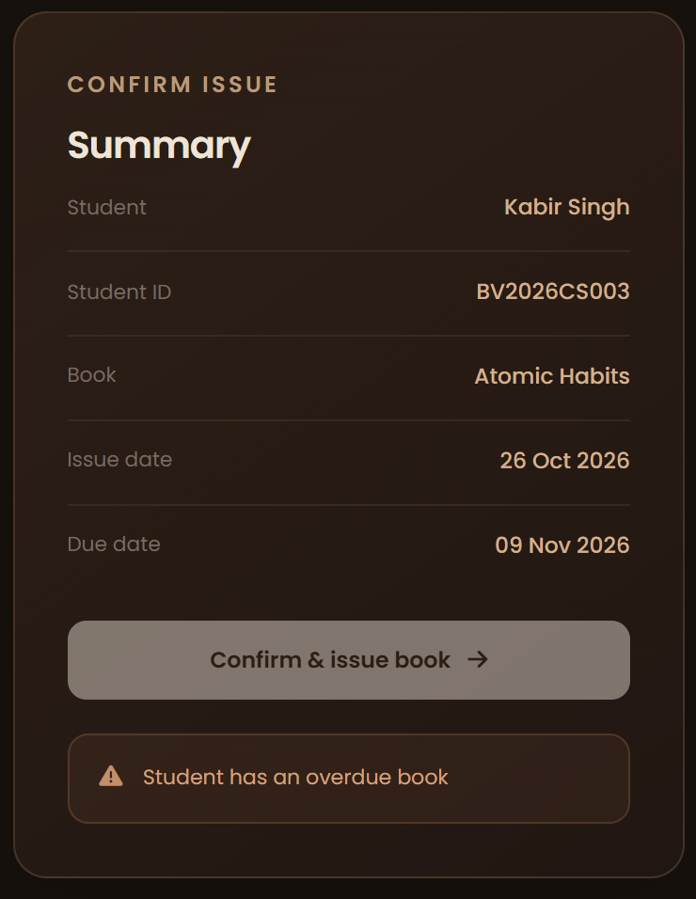
The issue desk refuses a loan that breaks a rule
src/api/engine.js · canIssue()
export function canIssue(state, studentId, bookId) {
const member = state.students.find((s) => s.id === studentId);
if (member && member.status !== 'active') {
return { ok: false, reason: `Member is ${member.status}` };
}
…
if (state.loans.some((l) => l.studentId === studentId &&
daysUntil(l.dueOn) < 0)) {
return { ok: false, reason: 'Student has an overdue book' };
}
const { maxBooks } = state.settings;
if (state.loans.filter((l) => l.studentId === studentId)
.length >= maxBooks) {
return { ok: false,
reason: `Student has reached the limit of ${plural(maxBooks, 'book')}` };
}
…
if (availableCopies(state, bookId) < 1)
return { ok: false, reason: 'No copies available' };
return { ok: true, reason: '' };
}
1
2
1
Overdue blocks new loans
Kabir is 6 days late, so the button stays disabled.
3
2
Limit of 3 books
Read from Settings, not hard-coded.
3
No free copy, no loan
Copies out or held for pickup are not on the shelf.
Notes:
canIssue is one pure function that every issue screen uses. It returns ok or a reason. On the right, the librarian picked Kabir, who has an overdue book, so the summary shows the reason and the Confirm button stays disabled. The same function checks the borrowing limit from Settings and whether a copy is free.

Slide 9

Reservations form a fair queue: first asked, first served
src/api/engine.js
export function waitingFor(state, bookId) {
return state.reservations
.map((reservation, index) => ({ reservation, index }))
.filter(({ reservation }) => reservation.bookId === bookId
&& reservation.status === 'waiting')
.sort((a, b) =>
a.reservation.placedOn.localeCompare(b.reservation.placedOn)
|| a.index - b.index,
)
.map(({ reservation }) => reservation);
}
function promoteWaiting(state) {
…
for (const next of waitingFor({ ...state, reservations }, book.id)) {
if (free < 1) break;
free -= 1;
reservations = reservations.map((r) =>
r.id === next.id ? { ...r, status: 'ready',
expiresOn: addDays(today(), state.settings.holdDays) } : r,
);
}
…
1
2
1
Queue order
2
Next in line gets the copy
Only waiting holds, oldest first; ties keep the order they were made.
Arjun is first; when Riya returns it, his hold is ready for 3 days.
Notes:
This slide shows the librarian view of a book with one copy. Riya has it, and Arjun and Kabir are waiting in order. waitingFor sorts the waiting reservations by date. When Riya returns the book, promoteWaiting gives it to Arjun and holds it for three days. Note: the code is slightly shortened for the slide, shown by the ellipses.

Slide 10
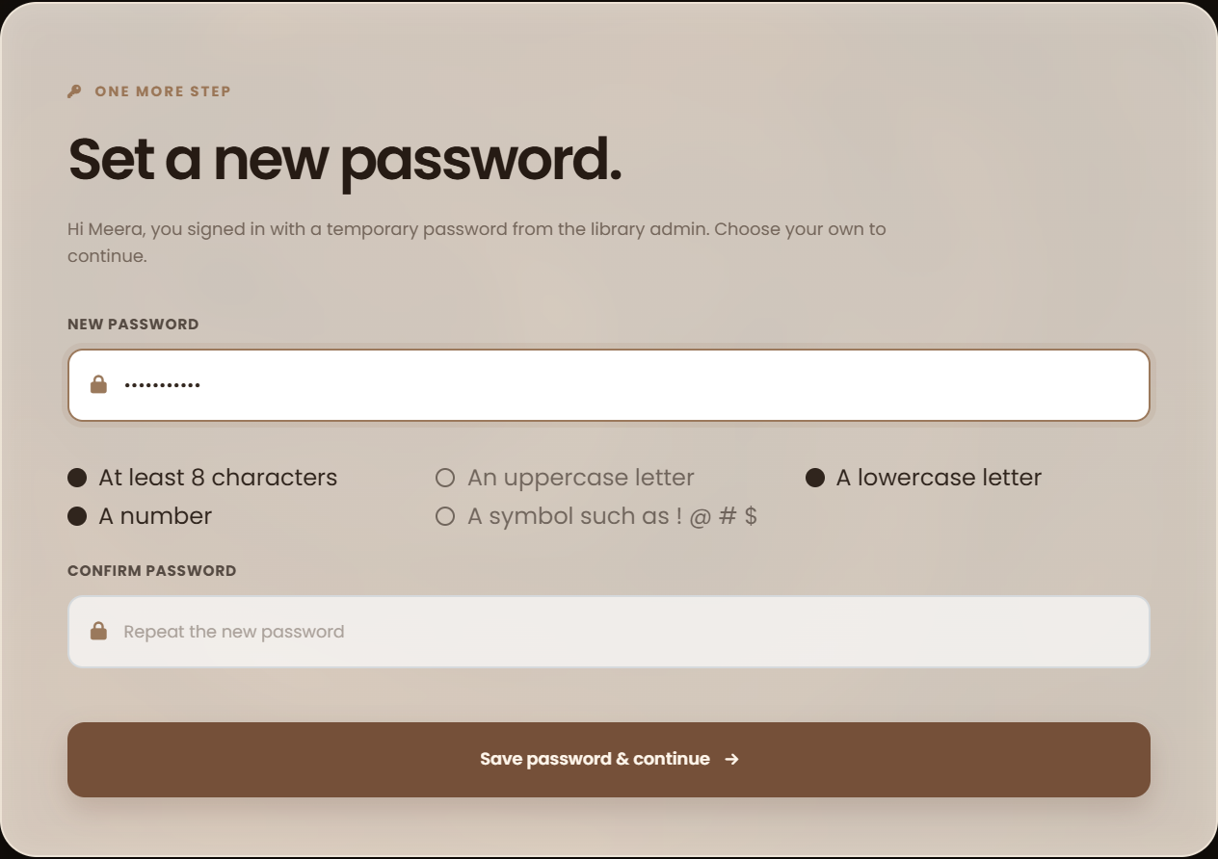
Passwords are checked as you type and stored only as hashes
src/api/engine.js · src/api/index.js
1
export const PASSWORD_RULES = [
{ label: 'At least 8 characters', test: (pw) => pw.length >= 8 },
{ label: 'An uppercase letter', test: (pw) => /[A-Z]/.test(pw) },
{ label: 'A lowercase letter', test: (pw) => /[a-z]/.test(pw) },
{ label: 'A number', test: (pw) => /\d/.test(pw) },
{ label: 'A symbol such as ! @ # $',
test: (pw) => /[^A-Za-z0-9\s]/.test(pw) },
];
export const resetPassword = (id, temp) =>
request(async () => {
const state = db.load();
const actor = requireRole(state, 'admin');
…
db.credentials.set(id, await bcrypt.hash(temp, HASH_ROUNDS));
apply(state, { type: 'resetPassword', id }, actor);
});
2
1
One rule list, two jobs
2
Never stored as text
Draws the live checklist and blocks weak passwords in the API.
Only the bcrypt hash is saved; reset users must pick their own.
Notes:
Security in three parts. One list of rules drives both the live checklist you see on the right and the server-side check, so they can never disagree. Passwords are hashed with bcrypt and only the hash is stored. When an admin resets a password, the account is flagged, and the person lands on this Set password page before anything else.

Slide 11

Promises keep the app responsive; a captcha keeps bots out
JavaScript Promises
CAPTCHA
A Promise is a value that arrives later. Every BookVerse API call returns one, so the page can show “Reserving…” while it waits.
A test that people pass and simple bots fail. BookVerse draws 5 distorted characters on a canvas for its four public forms.
src/api/index.js · src/pages/student/BookDetail.jsx
src/api/captcha.js
function request(work) {
return new Promise((resolve, reject) => {
setTimeout(() => {
db.init().then(work).then(resolve, reject);
}, DELAY);
});
}
async function reserve() {
setBusy(true);
…
try {
await reserveBook(book.id);
} catch (err) { … setError(err.message); }
setBusy(false);
}
export function captchaProblem(captcha) {
const found = captcha?.id ? challenges.get(captcha.id) : null;
if (captcha?.id) challenges.delete(captcha.id);
if (!found || found.expiresAt < Date.now())
return 'That captcha expired. Try the new one.';
if (String(captcha.answer ?? '').trim().toUpperCase()
!== found.answer) {
return 'The characters did not match. Try the new one.';
}
return '';
}
1
3
4
2
3 · Single use: deleted on any try
4 · Expires after 5 minutes
Click “Reserve”
Pending
Resolved / rejected
Used on Login, Register, Forgot password and Contact. It runs in the browser like the rest of this demo backend, so it stops casual bots, not a determined attacker.
1 · Promise created
button reads “Reserving…”
2 · saved, or ApiError shown
Notes:
Two topics we were asked to cover. Promises: every API call returns a Promise. request wraps the work in a 300 millisecond delay, like a network trip, and resolves or rejects. The page awaits it, shows Reserving while pending, and shows the error if it rejects. CAPTCHA: the four public forms show a picture of five characters. The answer stays in memory, each challenge can be tried only once and expires after five minutes. Since there is no real server, it stops casual spam, not a determined attacker, and we say so honestly.

Slide 12
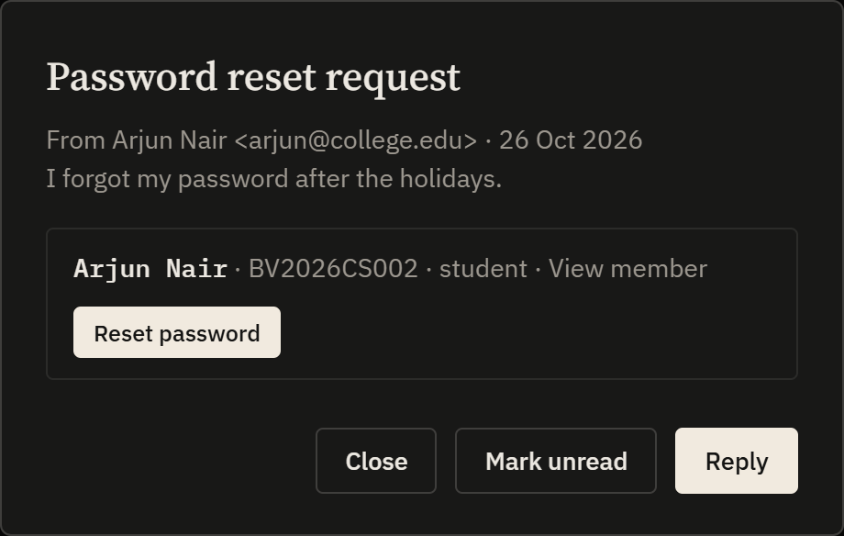
Contact messages and lost passwords land in one admin Inbox
src/api/index.js · requestPasswordReset()
export function requestPasswordReset({ role, email, note = '', captcha }) {
return request(async () => {
requireCaptcha(captcha);
const state = db.load();
problems(validateResetRequest({ role, email }));
…
const account = table.find(
(a) => a.email.toLowerCase() === wanted && …);
const accountId = account?.id ?? null;
…
const message = {
…
subject: 'Password reset request',
kind: 'reset',
accountId,
};
db.save(reducer(state, { type: 'addMessage', message }), state);
});
}
1
2
3
1
Captcha first
Bots cannot flood the inbox with requests.
2
Account attached
The page never says whether the email exists.
3
Reset from the message
The admin sets a temporary password in one click.
Notes:
Forgot password on the login page now creates a message in the admin Inbox instead of sending people to the contact page. The code checks the captcha, finds the matching account and stores a message of kind reset. In the Inbox, the admin sees the account and resets it with one button, which forces the person to choose a new password at next login.

Slide 13
BookVerse replaces both the register and the spreadsheet
WHAT YOU NEED
Paper register
Spreadsheet
BookVerse
Recording a loan
Handwritten line
Typed row, no checks
One click, rules checked
Overdue days and fines
Counted by hand
Manual formulas
Calculated automatically
Reservation queue
Not tracked
A separate sheet
First asked, first served
Who can change what
Anyone with the book
Anyone with the file
Role-based logins
Finding a book
Walk the shelves
Search one sheet
Search, filters, book page
On a phone
No
Hard to use
Works down to 400 px
Notes:
A quick comparison with the two things a library would use without us: a paper register and a shared spreadsheet. The register cannot check anything. The spreadsheet can store rows but has no rules, no roles and no queue. BookVerse does each of these for you, which is the main outcome of the project.

Slide 14
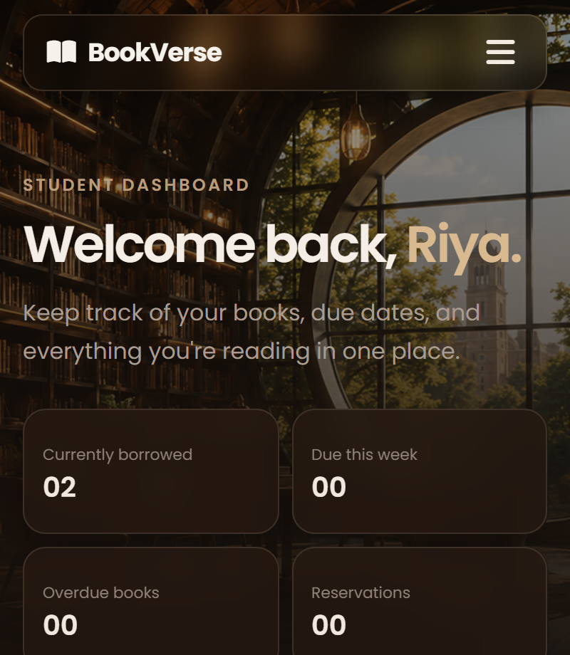
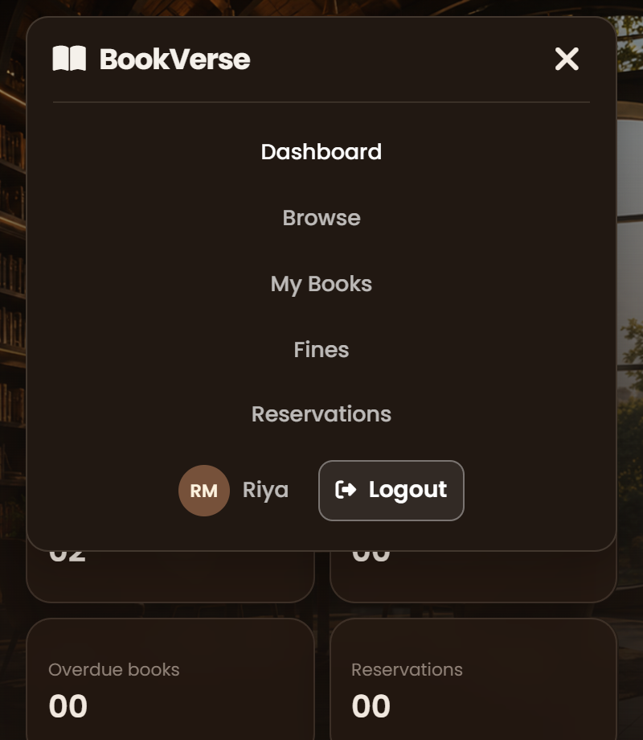
On a phone, the navbar folds into one menu button
useMobileMenu.js · RoleLayout.jsx · student-common.css
export default function useMobileMenu() {
const [open, setOpen] = useState(false);
const { pathname } = useLocation();
useEffect(() => setOpen(false), [pathname]);
return {
open,
activeClass: open ? ' active' : '',
toggle: () => setOpen((value) => !value),
};
}
<div className={`nav-links${menu.activeClass}`}>
<MenuToggle open={menu.open} onToggle={menu.toggle} />
@media (max-width: 700px) {
.nav-links, .nav-actions { display: none; }
.menu-toggle { display: block; }
.nav-links.active,
.nav-actions.active {
display: flex;
…
flex-direction: column;
}
1
2
3
1
Closes on its own
Opening another page sets the menu back to closed.
2
One class does the switch
The hook adds “active” to the links; the menu button toggles it.
3
CSS does the layout
Under 700 px the links hide; .active stacks them in a column.
Notes:
Every page is responsive, and the navbar is the clearest example. One small React hook, useMobileMenu, holds whether the menu is open and closes it whenever you move to another page. The layout adds an active class from that hook, and the CSS does the rest: under 700 pixels wide the links are hidden behind the menu button, and when active they stack in a column, as in the two phone screenshots. The same hook is reused by the public, student, librarian and admin navbars.

Slide 15
BookVerse turns the library desk into one simple app
01
One place for everything
Catalog, members, loans, holds, fines and messages share one set of data.
NEXT STEPS · PROPOSED, NOT BUILT YET
A real server and database
Replace localStorage so many devices share one library.
02
Rules, not reminders
Email or SMS due-date reminders
Limits, due dates, queues and fines are enforced by code.
Today reminders are recorded inside the app only.
Barcode scanning at the desk
03
Safe by design
Issue and return by scanning the book and the ID card.
Role checks, bcrypt passwords, forced resets and a captcha on public forms.
Thank you · Questions?
Anveer Singh Sandhu · Ayush Sharma · Agrim Joshi
Notes:
To sum up: BookVerse puts the whole library in one place, enforces the rules in code instead of relying on memory, and is secure by design. The next steps would be a real server and database, real email reminders and barcode scanning, which are proposals, not built yet. Thank you, we are happy to take questions.

