Slide 1
Hyperledger Fabric on Kubernetes
Architecture Images
Michael Edge
August 2018

Slide 2
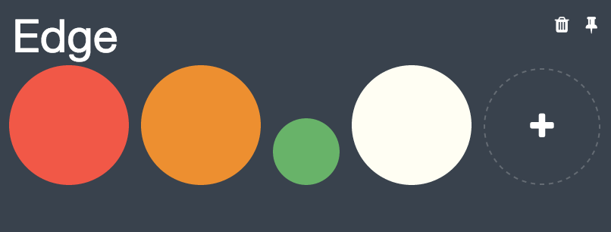

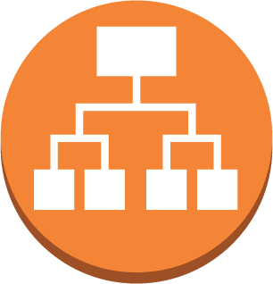
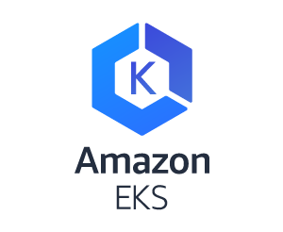




Hyperledger Fabric on Kubernetes – remote peer and Marbles app
Security Group
Security Group
Network Load Balancer
Network Load Balancer
public subnet
public subnet
POD
POD
Internet gateway
router
POD
POD
Security Group
Security Group
POD
POD
POD
POD
EC2
EC2
EC2
EC2
private subnet
private subnet
Region: us-west-2
Region: us-east-1
Orderer Organisation
Peer Organisation

Slide 3
Hyperledger Fabric on Kubernetes – remote peer
Security Group
Security Group
Network Load Balancer
Network Load Balancer
public subnet
public subnet
POD
POD
Internet gateway
router
POD
POD
Security Group
Security Group
POD
POD
POD
POD
EC2
EC2
EC2
EC2
private subnet
private subnet
Region: us-west-2
Region: us-east-1
Orderer Organisation
Peer Organisation

