Slide 1
Hyperledger Fabric on Kubernetes
Architecture Images
Michael Edge
August 2018

Slide 2
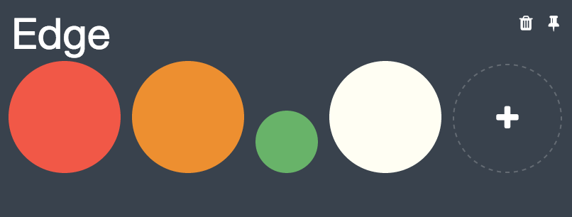
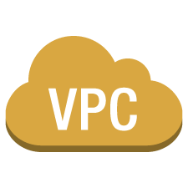
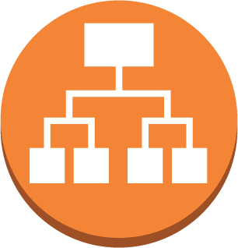
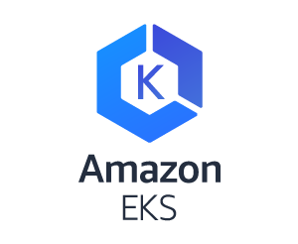




Hyperledger Fabric on Kubernetes – remote peer and Marbles app
Security Group
Security Group
Network Load Balancer
Network Load Balancer
public subnet
public subnet
POD
POD
Internet gateway
router
POD
POD
Security Group
Security Group
POD
POD
POD
POD
EC2
EC2
EC2
EC2
private subnet
private subnet
Region: us-west-2
Region: us-east-1
Orderer Organisation
Peer Organisation

Slide 3
Hyperledger Fabric on Kubernetes – remote peer
Security Group
Security Group
Network Load Balancer
Network Load Balancer
public subnet
public subnet
POD
POD
Internet gateway
router
POD
POD
Security Group
Security Group
POD
POD
POD
POD
EC2
EC2
EC2
EC2
private subnet
private subnet
Region: us-west-2
Region: us-east-1
Orderer Organisation
Peer Organisation

Slide 4
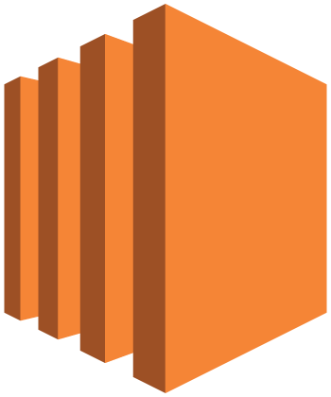
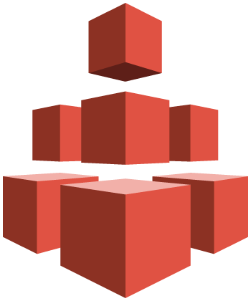
Hyperledger Fabric on Kubernetes – the Orderer Organisation
Security Group
Network Load Balancer
EC2 Bastion
public subnet
public subnet
POD
POD
Security Group
Amazon EFS
POD
POD
EC2
EC2
private subnet
private subnet
AZ: us-west-2a
AZ: us-west-2b
Orderer Organisation

Slide 5
Fabric Components – all can run on Kubernetes
Org 1
Org 2
Certificate Authority
CLI
Certificate Authority
CLI
SDK App
SDK App
Peer1, Org1
Peer2, Org1
Peer1, Org2
Peer2, Org2
Orderer Service Node
Orderer Kafka Cluster
Orderer – Org 0
Notes:
A Fabric network consists of the following components:
Peers: who store a copy of the blockchain (ledger) as well as the world state
CA: generates certificates and keys per organisation
CLI: allows operation of the network via a CLI
Orderer: usually, Kafka is used to order the TX
OSN: receives TX, validates signatures, cuts blocks and distributes blocks to peers
It’s possible to run all of these components on Kubernetes.

