Slide 1
Icarus
Mission software and a validation harness for autonomous drones
For defence and enterprise drone systems
Simulation-first product development

Slide 2
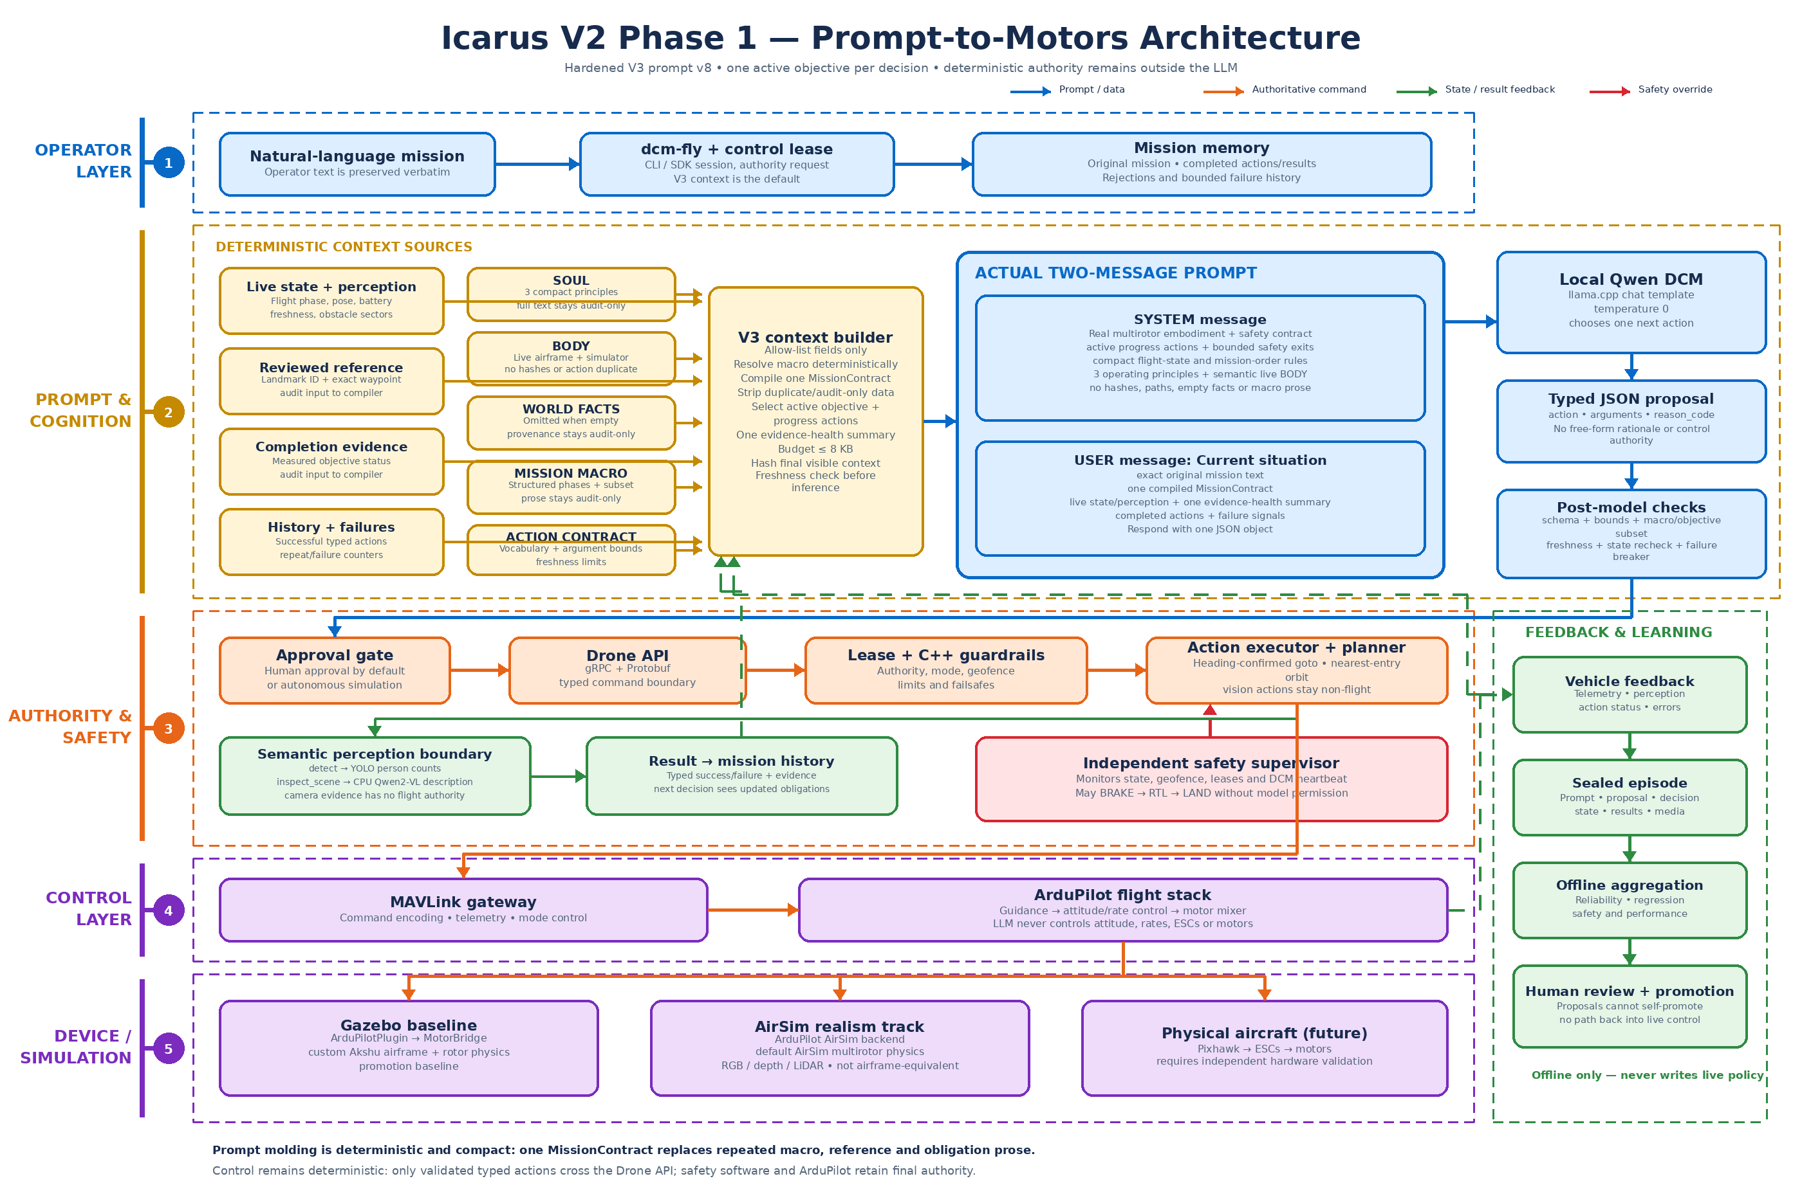
How Icarus works
The model proposes one bounded action at a time. The flight stack validates, executes and records the result.

Slide 3
Where it fits
Defence and security
Enterprise operations
• Operator-supervised perimeter observation
• Mission rehearsal before deployment
• Replayable records for review and training
• Industrial inspection and asset surveys
• Site security and operational monitoring
• Shared mission workflows across hardware
Icarus sits above existing autopilots and sensors. It does not require an operator to replace their drone fleet.

Slide 4
What the startup can sell
Mission software
Validation harness
Integration programmes
A controllable mission layer that connects operators, sensors and ArduPilot.
Scenario testing, fault injection, telemetry capture and replay before a customer deploys.
Customer-specific airframe, sensor and mission workflow integration.
Initial customers: drone OEMs, systems integrators, and security or inspection operators
Current stage: simulation-first R&D. Unattended and physical-flight approval remains a future qualification gate.

