Slide 1

Heart Disease Prediction

Slide 2

ABSTRACT
A Machine Learning-based Heart Disease Prediction System
Provides an efficient and accurate alternative to traditional
Diagnostic
Analyzes key medical factors for early heart disease risk detection
Uses a structured dataset with preprocessing and feature selection
Employs models like Logistic Regression, Random Forest, XGBoost, KNN, and AdaBoost
Evaluates model performance to identify the best predictor
Enhances decision-making for healthcare providers

Slide 3

INTRODUCTION
Traditional methods for heart disease diagnosis are subjective, slow, and costly, relying heavily on expert interpretation.
Cardiovascular diseases cause 17.9 million deaths annually (WHO)
Machine Learning (ML) offers faster, more accurate risk predictions
ML models analyze patient data to uncover hidden patterns
Achieves up to 90% accuracy compared to 70-80% in traditional methods
Enables personalized assessments and reduces healthcare costs

Slide 4
PROBLEM STATEMENT
Traditional heart disease diagnostic methods face significant challenges that hinder accuracy, efficiency, and accessibility, especially in critical care scenarios.
Subjectivity and Delays Diagnostic processes rely heavily on expert interpretation, leading to inconsistent outcomes and treatment delays.
High Costs and Limited Accessibility Expensive tests and reliance on specialists make diagnosis inaccessible for many patients. Poor Scalability for Large Populations
Inadequate Predictive Accuracy Conventional methods achieve limited accuracy (70-80%), increasing the risk of missed or late diagnoses.

Slide 5
METHODOLOGY
Start the System
Loading the Dataset
918 rows x 12 columns
Data Preprocessing
Handling Missing Values
Outlier Removal
Encoding Categorical Variables
746 rows x 12 columns
DATA SPLIT
85% Training Data
15 % Testing Data
Model Training and Evaluation
Accuracy Score
Classification Report
Confusion Matrix
Frontend Integration

Slide 6

Implementation Details
Built using Python and powerful models for accuracy and speed.
Python 3.8+ used for development
NumPy, Matplotlib, Seaborn, Scikit-Learn, XGBoost Libraries used
Logistic Regression, Random Forest, XGBoost Classifier Models used
Label encoding for categorical variables
Best Performing Model implemented with an interactive interface.

Slide 7

Models Used
Linear Regression
A baseline linear model for binary classification.
Provides a good starting point to evaluate dataset separability.
Achieved train accuracy of 84.38% and test accuracy of 83.93%.
AdaBoost Classifier
An ensemble method that combines weak learners to improve accuracy.
Uses iterative boosting to minimize errors.
Train accuracy: 84.54%, Test accuracy: 83.93%.

Slide 8
Models Used
K-Nearest Neighbours (KNN)
A simple algorithm that classifies based on the majority vote of nearest neighbors
Performed poorly on this dataset due to high dimensionality.
Train accuracy: 74.13%, Test accuracy: 61.61%.
Random Forest Classifier
A tree-based ensemble method that improves generalization using multiple decision trees.
Tuned hyperparameters to reduce overfitting.
Train accuracy: 98.89%, Test accuracy: 85.71%.

Slide 9
Best Performing Model
XGB CLASSIFIER
A highly efficient and accurate machine learning model designed for classification tasks. Popular for its speed and high performance.
Builds a series of small decision trees, where each tree improves on the mistakes of the previous ones. Includes techniques to avoid overfitting and ensures better predictions.
Train accuracy: 93.38%, Test accuracy: 91.96%.

Slide 10

Best Performing Model
Why XGB CLASSIFIER worked best ?
Handled the mix of numerical and categorical features effectively.
Identified patterns in the data better than other models.
Tuned parameters enhanced its accuracy and reliability
Outperformed all other models, making it the best fit for this project.

Slide 11
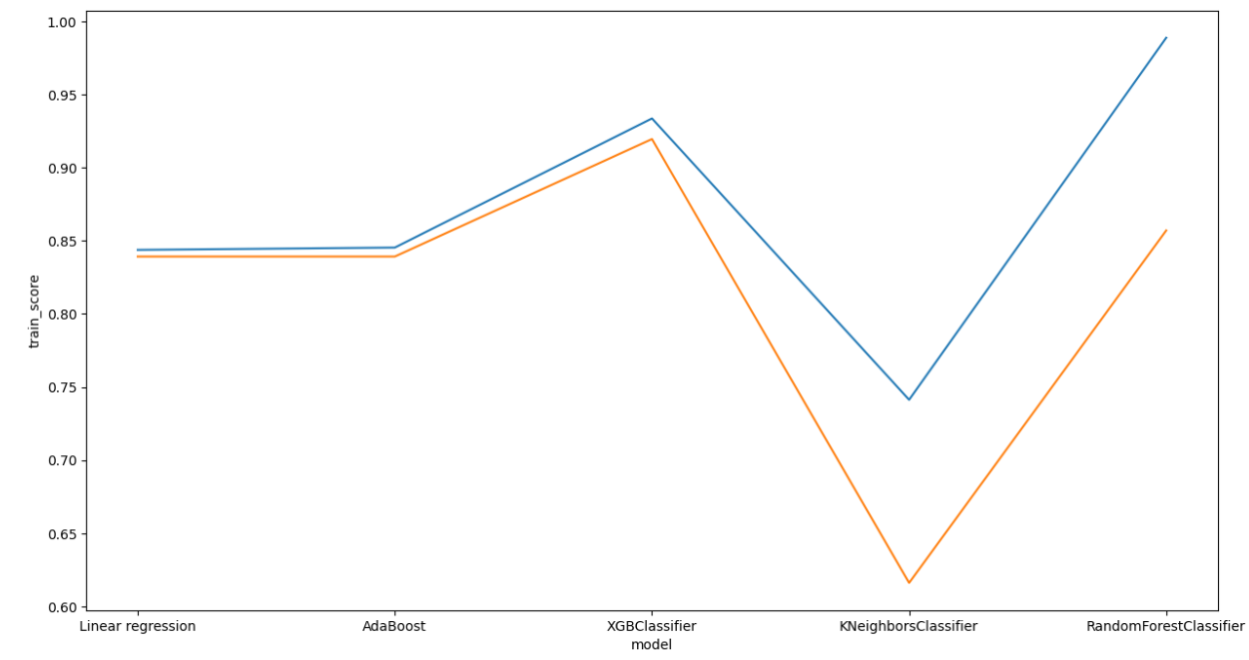
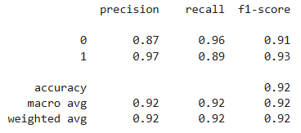
Accuracy Analysis and Results
For the XGB Model

Slide 12
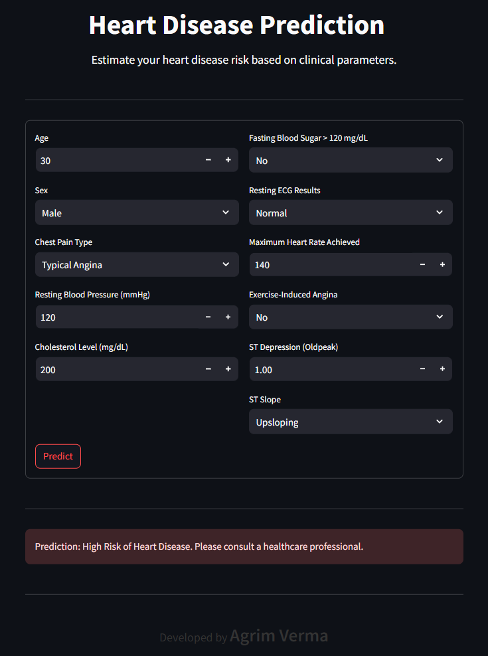
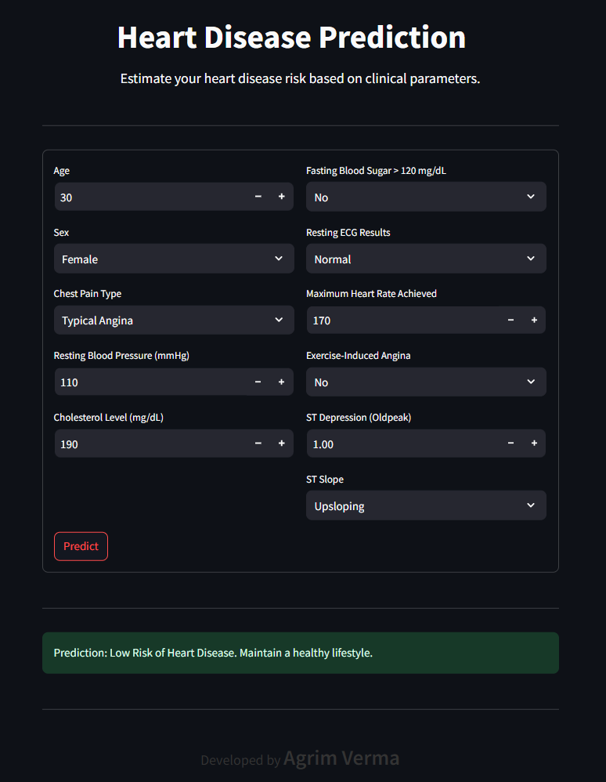
Implementation Results

Slide 13
Conclusion
The proposed Multi-Model Heart Disease Prediction System offers a reliable and intelligent approach to assist in early diagnosis, enhancing clinical decision-making and patient outcomes.
High Accuracy & Robust Performance: The system evaluates multiple classifiers, with ensemble methods like XGBoost demonstrating superior predictive accuracy and strong generalization capabilities across patient data.
Balanced Model Selection: Each model highlights a trade-off between complexity, performance, and ease of explanation — allowing selection based on specific healthcare needs and resource availability.
Scalable and Practical Design: The approach supports integration into healthcare systems, enables personalized risk assessment, and is adaptable for future enhancements with larger datasets or real-time predictions..

Slide 14
Future Scope
The project holds strong potential for real-world clinical deployment and can be significantly enhanced to meet healthcare-grade standards. Planned future improvements include:
Integration of Deep Learning Models Explore architectures like Deep Neural Networks (DNNs) or CNNs to capture complex patterns in patient data and further improve prediction accuracy.
Real Time Health Monitoring Integrate with wearable devices (e.g., smartwatches, ECG sensors) to provide continuous, real-time heart health analysis and alerts. For visual clues, OpenCV can be integrated.
Large & Diverse Medical Datsets Expand the training dataset with data from various hospitals and demographics to improve generalization across populations.
Automated Model Updating Enable scheduled retraining with new patient data to keep the model current, adaptive, and performance-optimized over time.

Slide 15
Thanks!
Do you have any questions?

