Slide 1
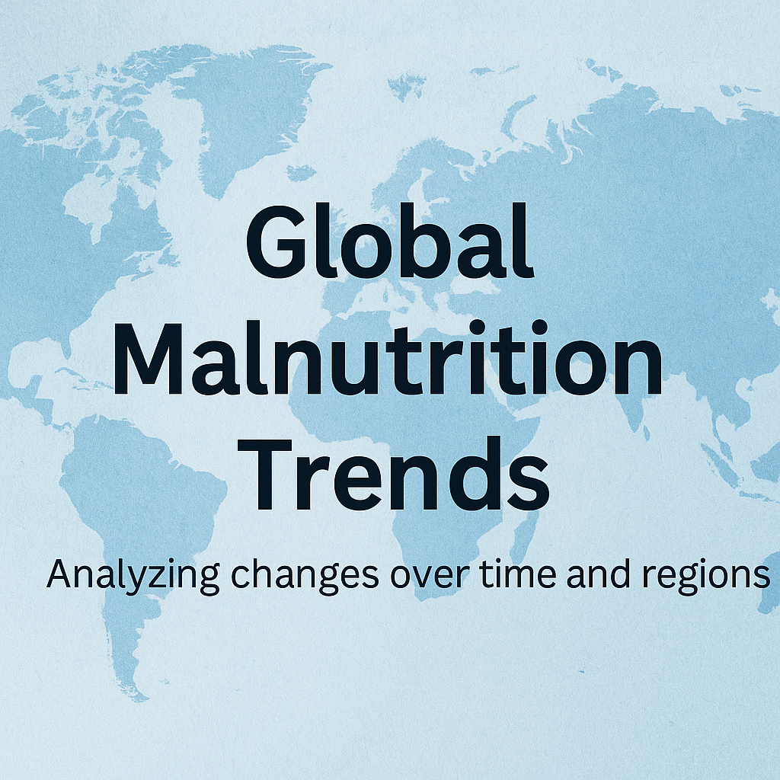

Slide 2
TOOLS USED:
.
Power BI:
Used for creating interactive visualizations, dashboards, and insights from the malnutrition dataset.
Microsoft Excel:
Used for initial data cleaning, formatting, and CSV file preparation.
GitHub:
Used for uploading and showcasing the project files, PPT, and documentation.

Slide 3
Overnutrition Trends:
The Rising Tide of Overweight & Obesity.
Rapid increase across all ages globally.
2.5B adults overweight (2022); 890M obese.
Childhood overweight/obesity a growing concern.
Visual Idea: Bar charts or world map showing prevalence.

Slide 4
Data Insights & Analysis:
Global Trends:
Malnutrition rates have gradually declined in many regions from 1983 to 2019, but progress varies across continents.
Improvements Over Time:
Countries like China, Brazil, and Indonesia have shown notable improvements in reducing undernourishment.
Data Understanding:
Explored a dataset covering 1983 to 2019 across multiple countries with yearly malnutrition indicators.
.

Slide 5
Why Data Analytics?
Data Analytics: Essential for Malnutrition Action.
Identifies trends, patterns, and hotspots.
Reveals root causes.
Enables targeted, effective interventions.
Monitors program impact.

Slide 6
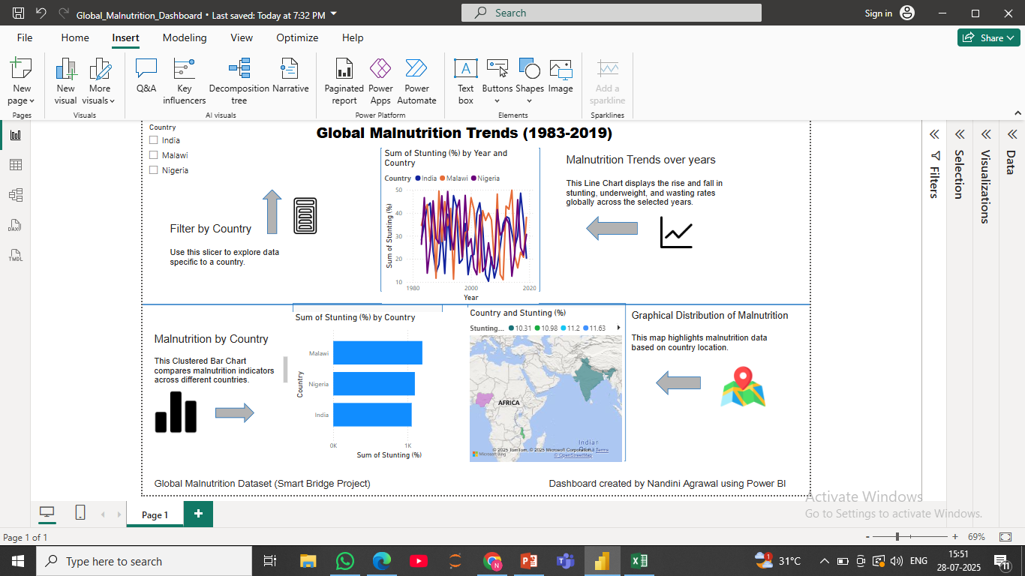
DASHBOARD SNAPSHOT

Slide 7
Challenges Faced:
Faced technical glitches with textbox formatting and data alignment, which I solved through troubleshooting and exploring Power BI tools more deeply.”

Slide 8
Conclusion:
The Power BI dashboard provides a clear and interactive view of global malnutrition trends from 1983 to 2019.
Visual tools like line charts, bar charts, maps, and slicers help identify patterns across countries and time.
This project improved my understanding of data visualization, dashboard design, and real-world problem analysis.
Despite technical and formatting challenges, the final output is professional, insightful, and ready for submission.
I am now more confident in using Power BI for data analytics and storytelling with data.

