Slide 1



Technical Report + BMC
AT PS5 - Data - Driven Crop Yield Prediction
Agro - Genesis

Slide 2
TEAM DETAILS
Team Name: Agro - Genesis
POINT OF CONTACT DETAILS
Name: K.Thirumala Narasimha Naidu
Mobile number: 8125150264
email:22pa1a0577@vishnu.edu.in

Slide 3
PS Code - AT PS5 - Data - Driven Crop Yield Prediction
Introduction:
🡪Background:
Farmers struggle with unpredictable crop yields due to variable weather, soil, and environmental conditions. Accurate predictions are crucial for better planning, reduced risks, and sustainable farming.
🡪Objectives and Key features:
Accurate Predictions: Reliable crop forecasts using data.
Better Planning: Optimize farming activities.
Risk Management: Prepare for yield changes.
Smart Farming: Integrate technology with traditional methods.
Boost Productivity: Enhance efficiency and output.
Sustainable Growth: Promote eco-friendly practices.

Slide 4
Tech Stack
🡪Technologies:
Flutter (App development for Android, IOS ),
REST API,
Node.js (environment setup for REST API),
ML Model ,
Flask ( Accessing the predictions made by ML Model to flutter application)
🡪Tools :
API :
https://rapidapi.com/weatherapi/api/weatherapi-com/playground/apiendpoint_bef542ef-a177-4633-aacc-ee9703945037
Datasets : https://drive.google.com/drive/folders/1ueCzLjRsghldCvH16CepV4M796ZrK7-U?usp=drive_link

Slide 5
Tech Stack
🡪System Architecture:
In this crop yield prediction project, the system is structured to ensure smooth interaction between various components. The Flutter mobile app serves as the user interface, where farmers and agronomists can input data such as crop type and location. This data is sent to a Node.js server, which acts as the central hub for communication. The Node.js server fetches real-time weather data from an external API and then combines it with the user’s input before sending it to a Flask server that hosts a machine learning model. The ML model processes this information to predict crop yield. The prediction is then sent back through the Node.js server to the Flutter app, where the results are displayed to the user. This architecture ensures that users receive accurate crop yield predictions by leveraging real-time data and machine learning, all while maintaining a seamless user experience on the mobile app.

Slide 6
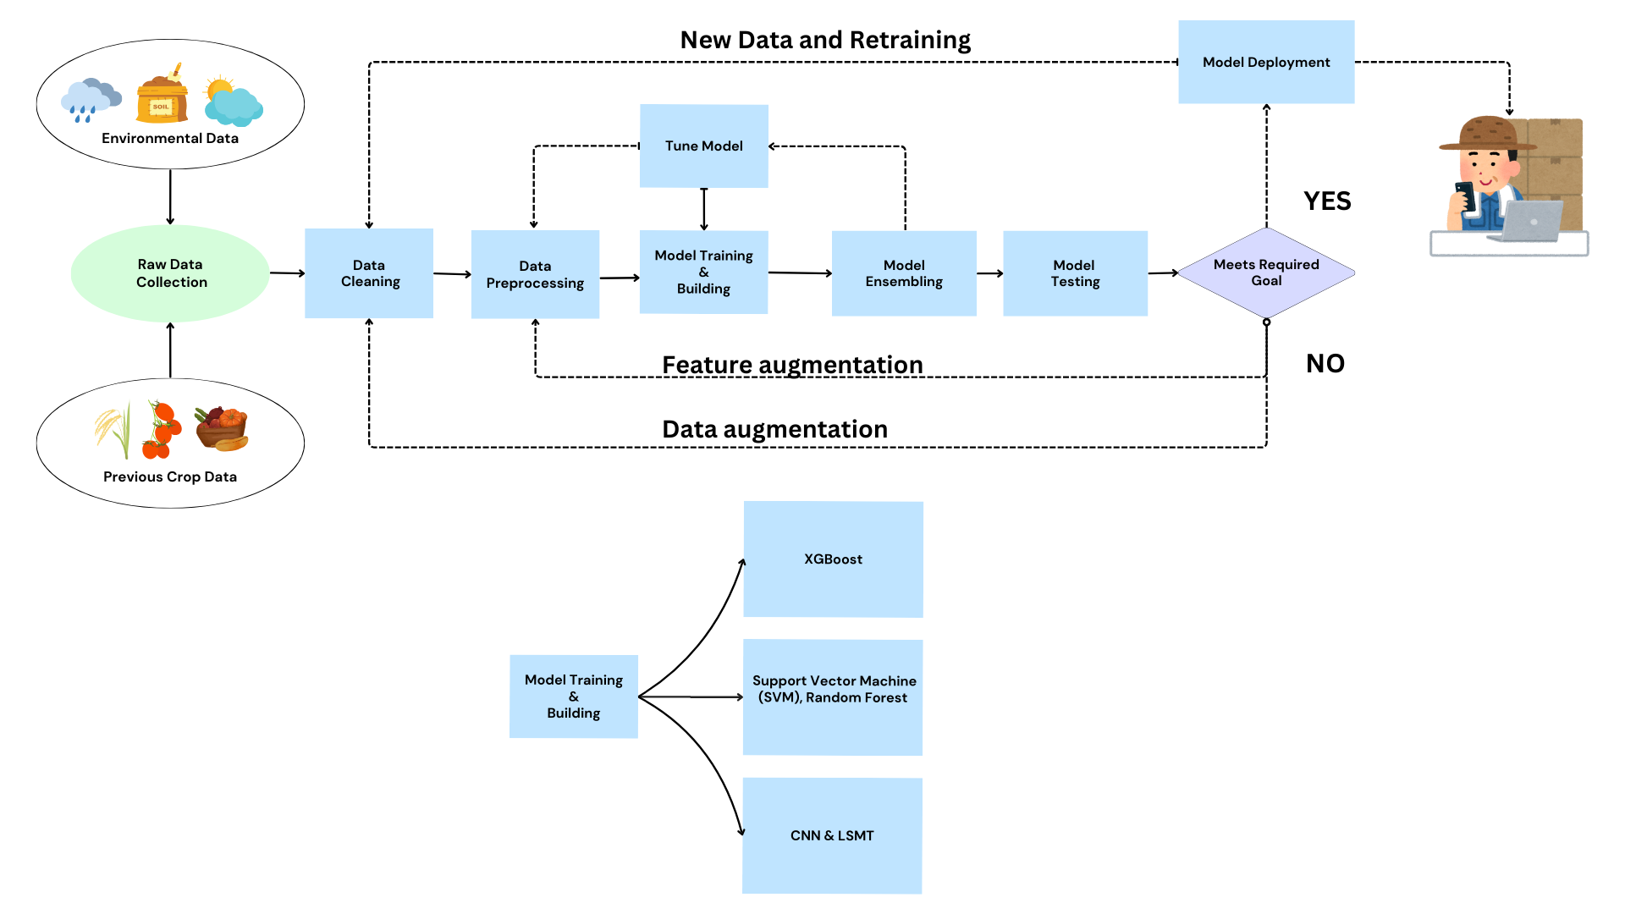
System Architecture

Slide 7
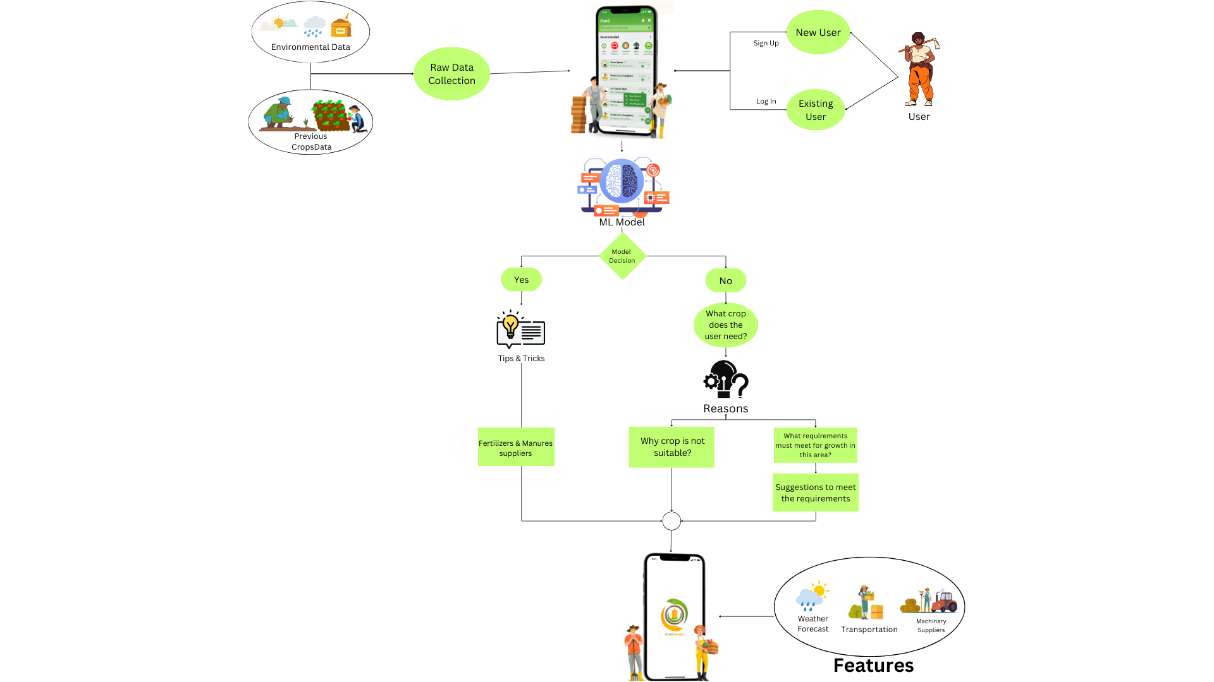
System Methodology

Slide 8
Possible Outcomes
🡪Expected Results:
Accurate predictions, better planning, and higher yields.
Reduced risks and more sustainable farming practices.
🡪Scalability:
Adaptable to different crops and regions.
Continuous updates ensure long-term use.
Potential to scale from local farms to a global level.
🡪Challenges:
Data Quality: Improve with cleaning and validation.
Scope Limitations: Update and retrain models regularly.
Data Gaps: Use IoT and farmer collaboration to fill gaps.
Adaptability: Continuously refine for changing conditions

Slide 9









Business Model Canvas ( All the content of BMC should be in this page itself )
bfbcbcb
Key partnerships
Key activities
Value proportions
Customer relationships
Customer segments
Distributers
Seed Companies
Manure Providers
Machinery Suppliers
Transport Agencies
Merchants
Data Collection
Model and Platform Developement
Weather Updates
R&D,Promotions
Online Services
Low Price
Accurate Predictions
Risk Management
Boost Productivity
Machinery Assistance
Transport Assistance
High Yields
No Brokerage
Sustainable Growth
Easy Access
Personalized Support
Regular Updates
Weather Alerts & Market updates
Feedback & Farming Tips
Small Farmers
Agri-Businesses
Cooperatives
Logistics
Distributors
Providers
Key resources
Channels
Datasets & Algorithms
Front-end & Back-end
R&D and Partners
Communities & mobile/Web App
Social Media
Digital Marketing
Campaigns & Talks
Conferences & Communications
Cost Structure
Revenue Streams
R&D Costs
Hardware & Developement Costs
Marketing & Partnership Costs
Training
Advertisements
Subscription
Premimum Services
Collaboration
Travel Expenses

Slide 10
Conclusion
🡪Impact and Future Implications:
- Empowers Farmers: Improves yields and decision-making.
- Supports Research: Advances data-driven agriculture.
- Global Impact: Promotes food security and sustainability.
🡪Final Thoughts:
The solution has strong potential. Ongoing improvements will make it even more effective for future farming needs.

