Slide 1
Hot to make Issues?

Slide 2
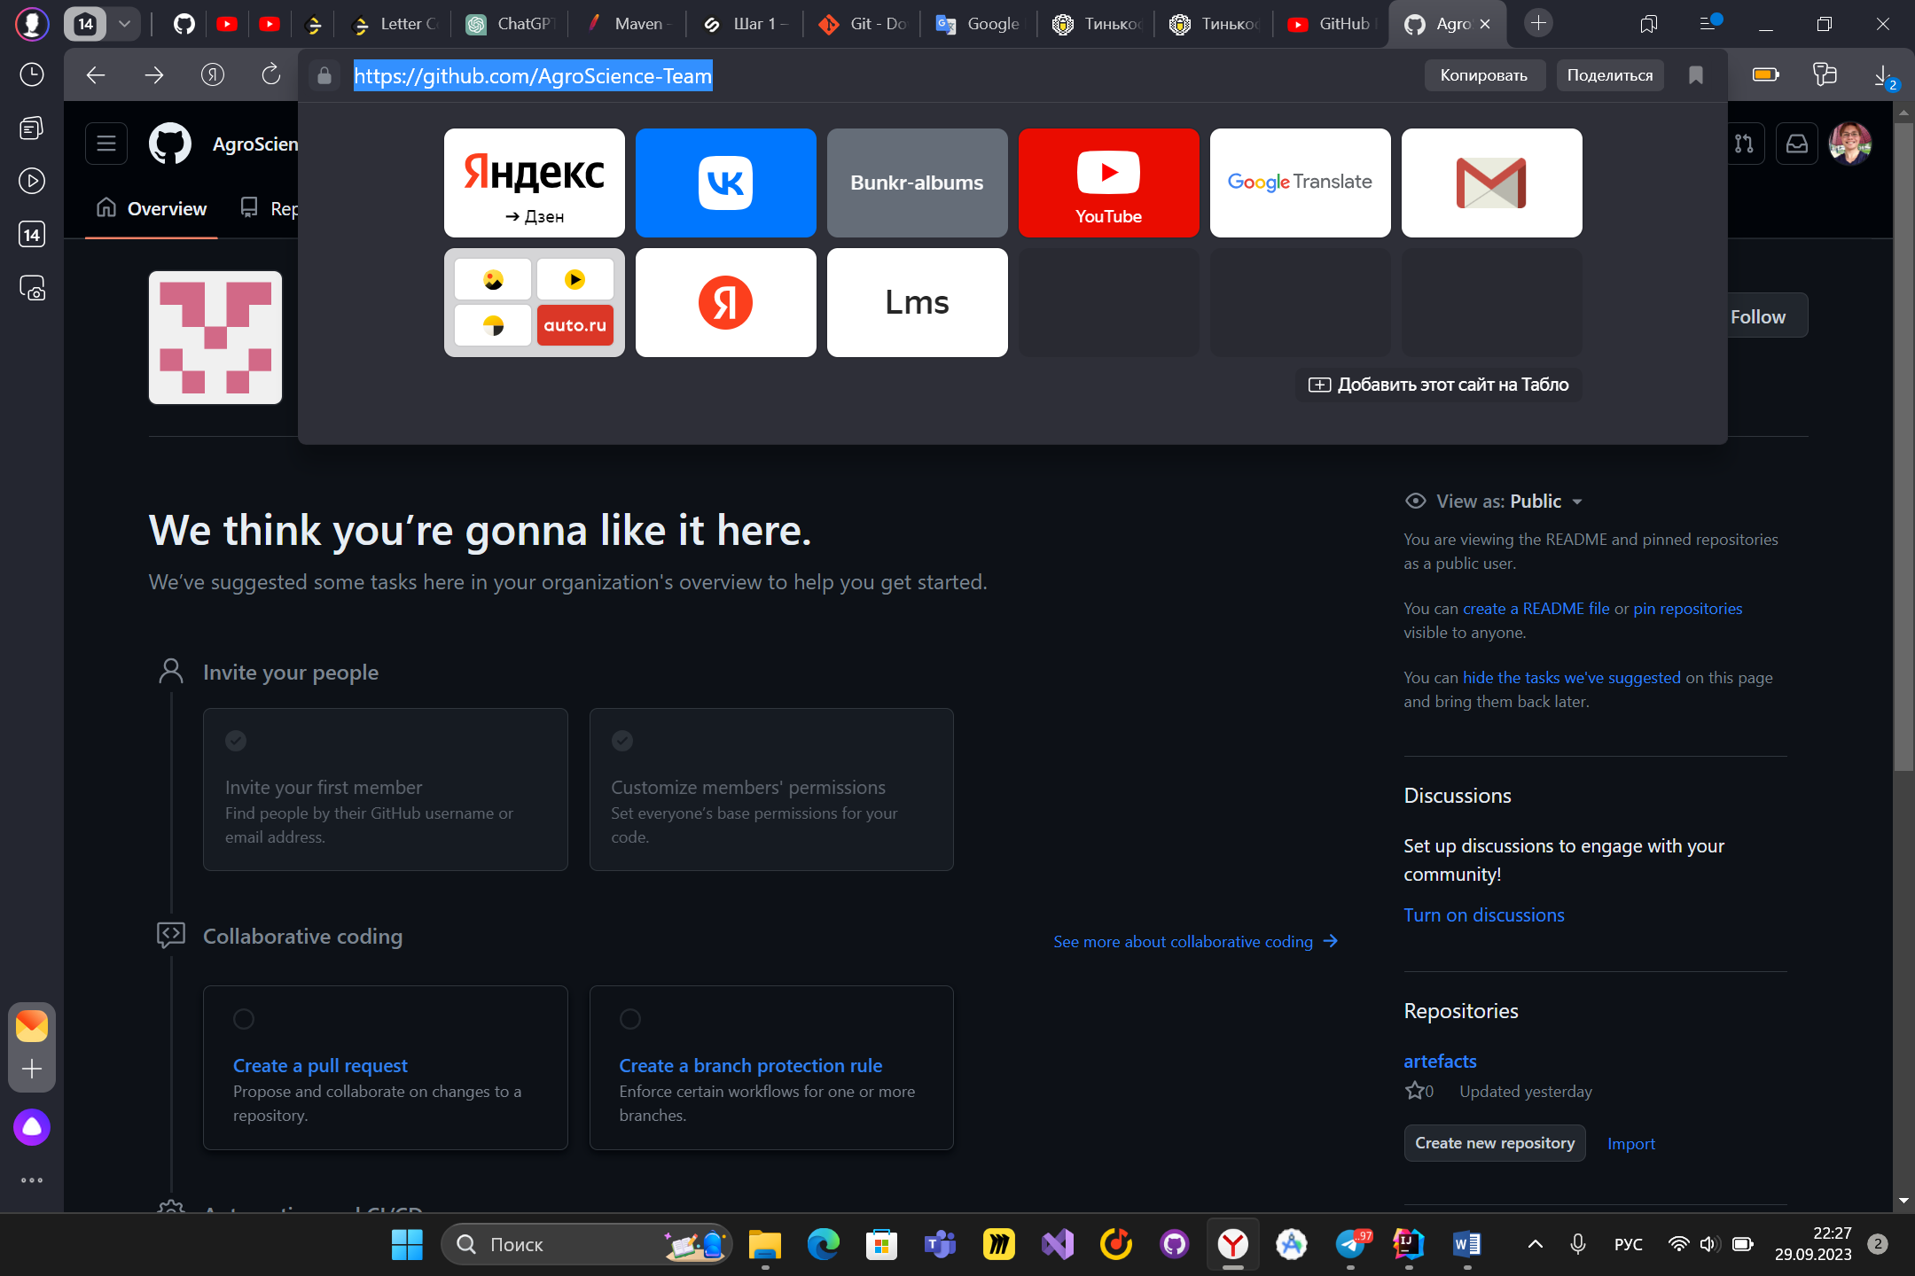
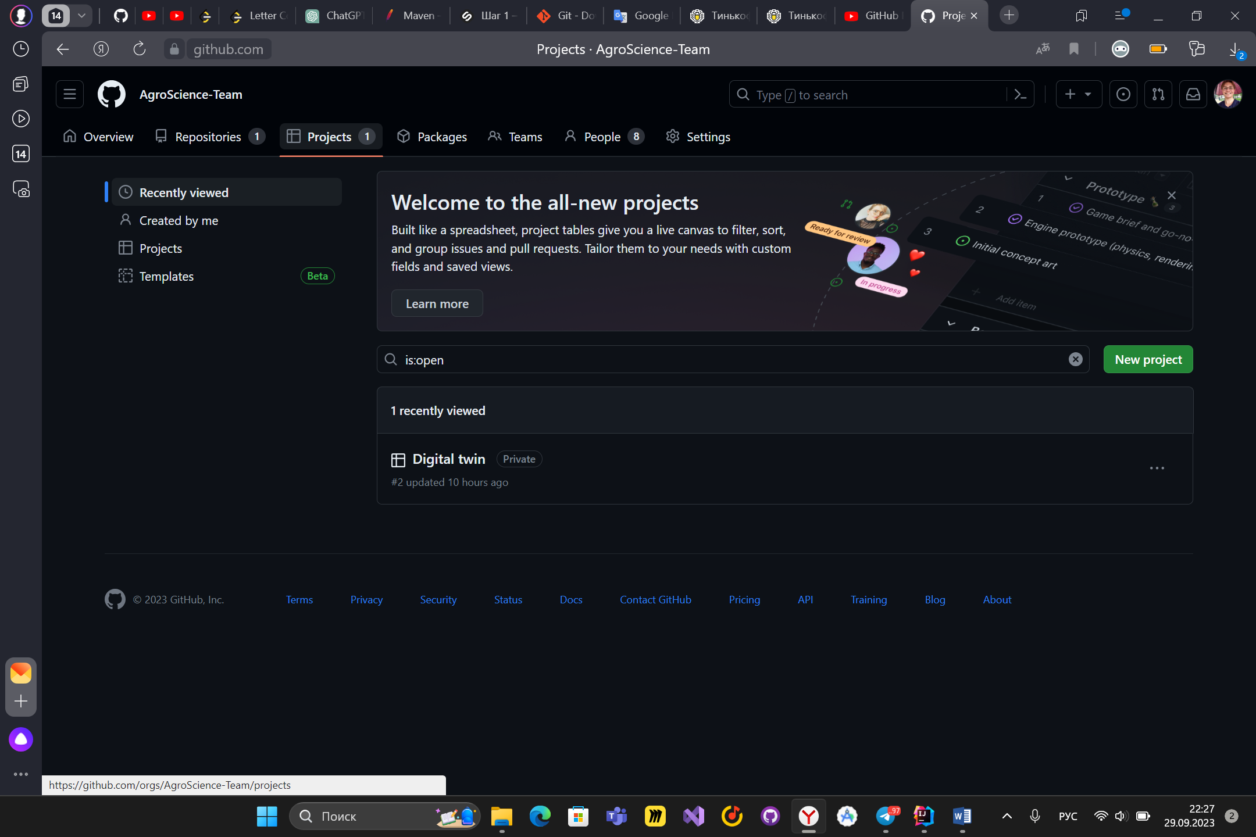
Open our organization AgriScience-Team in github. The URL should look exactly like the screenshot. Then click on projects.
There click on Digital twin. This our board for task tracking.

Slide 3
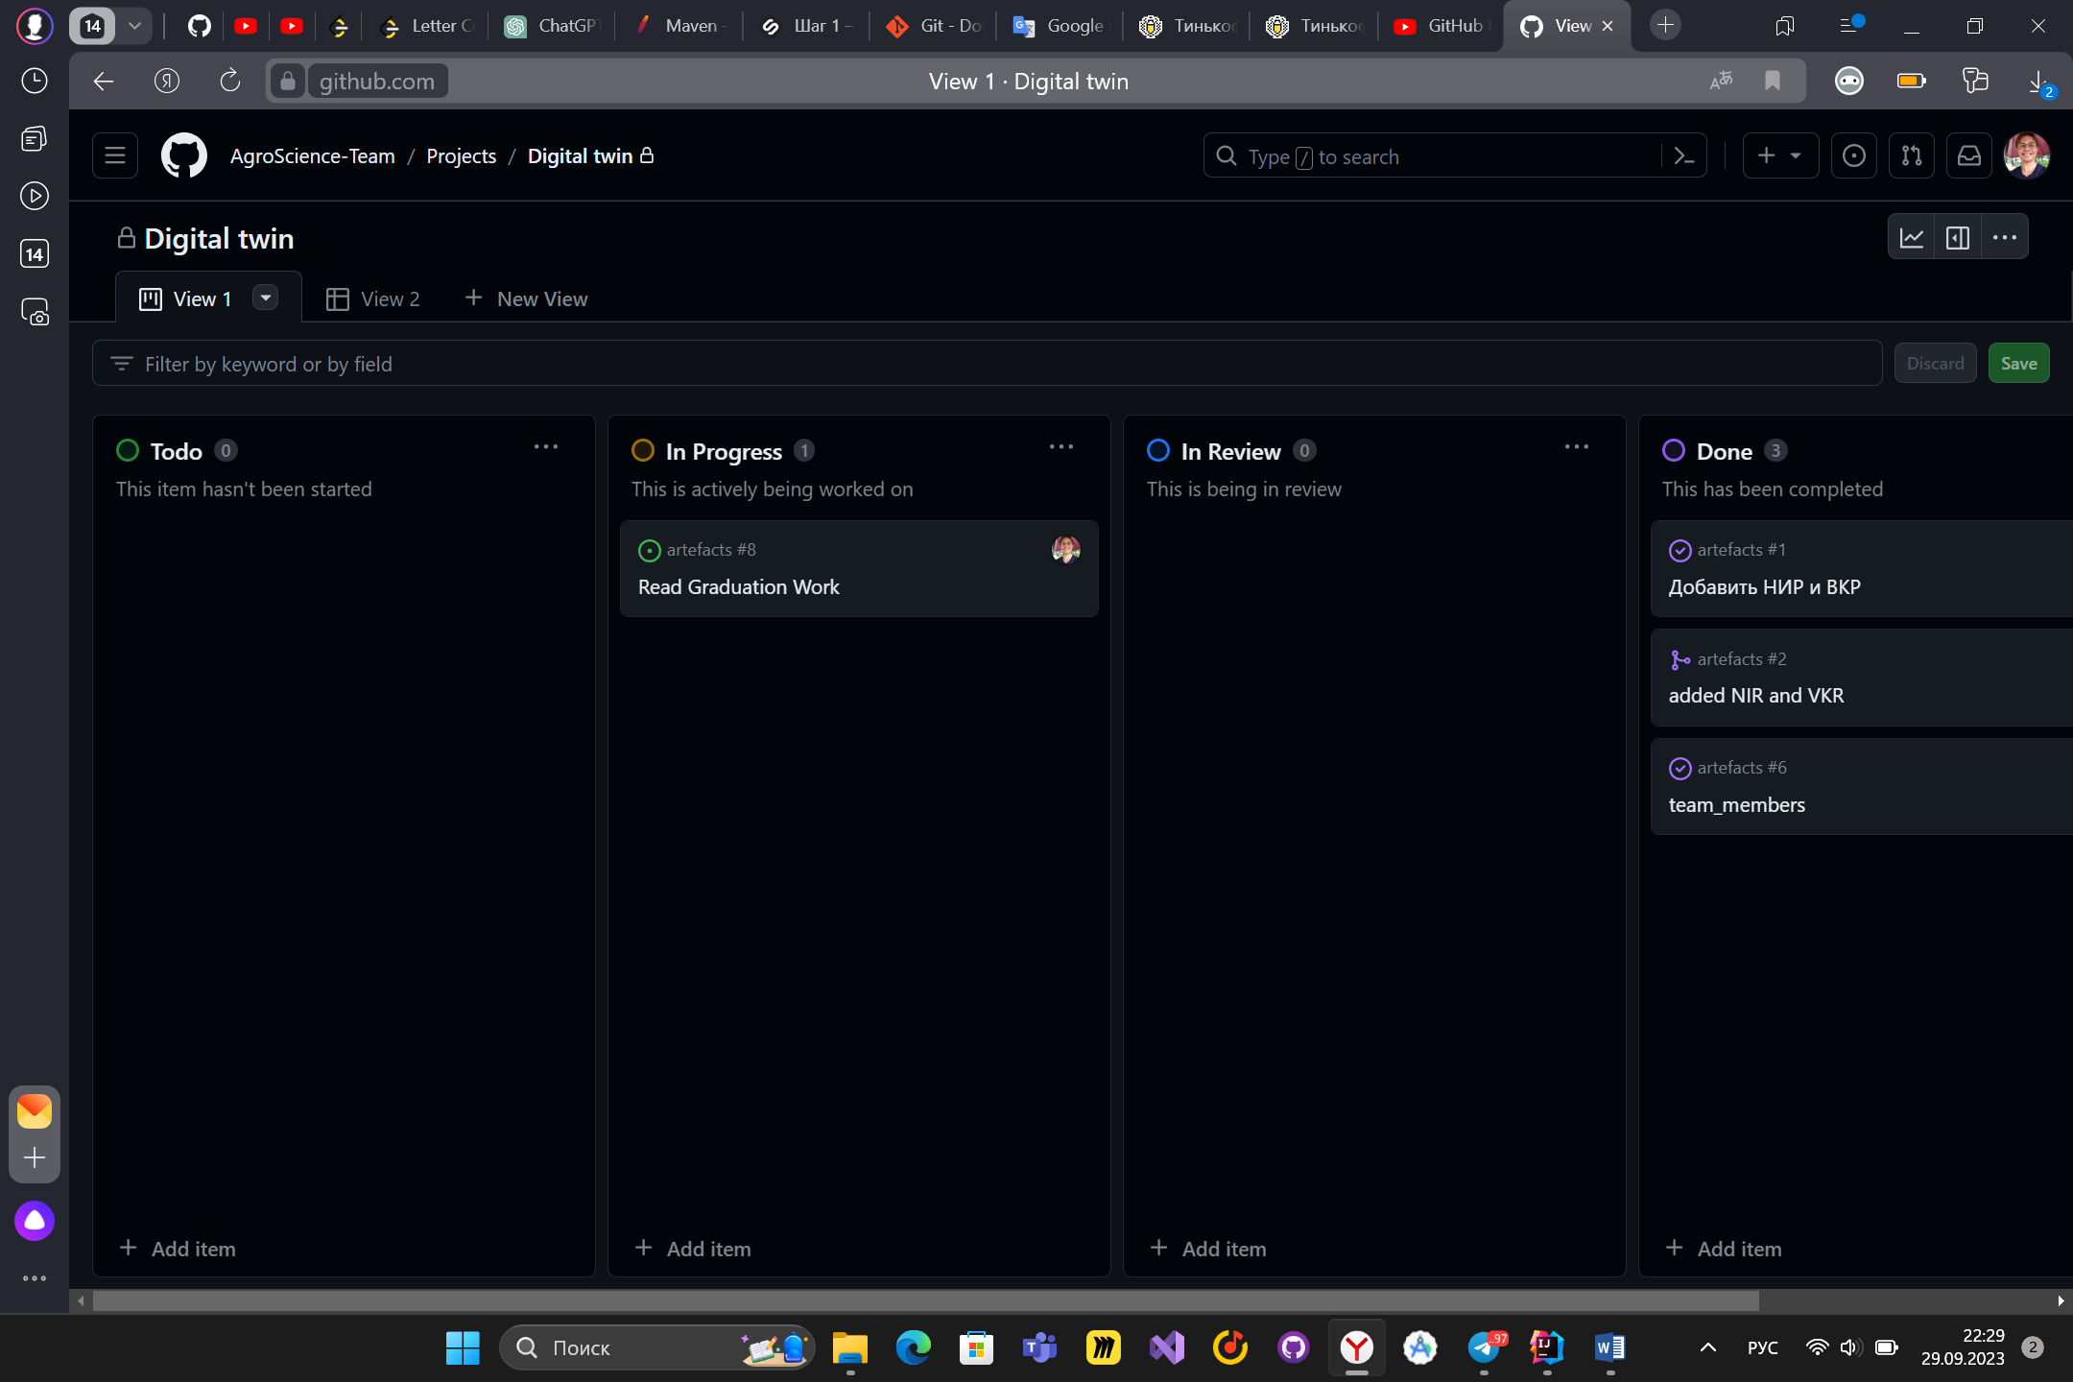
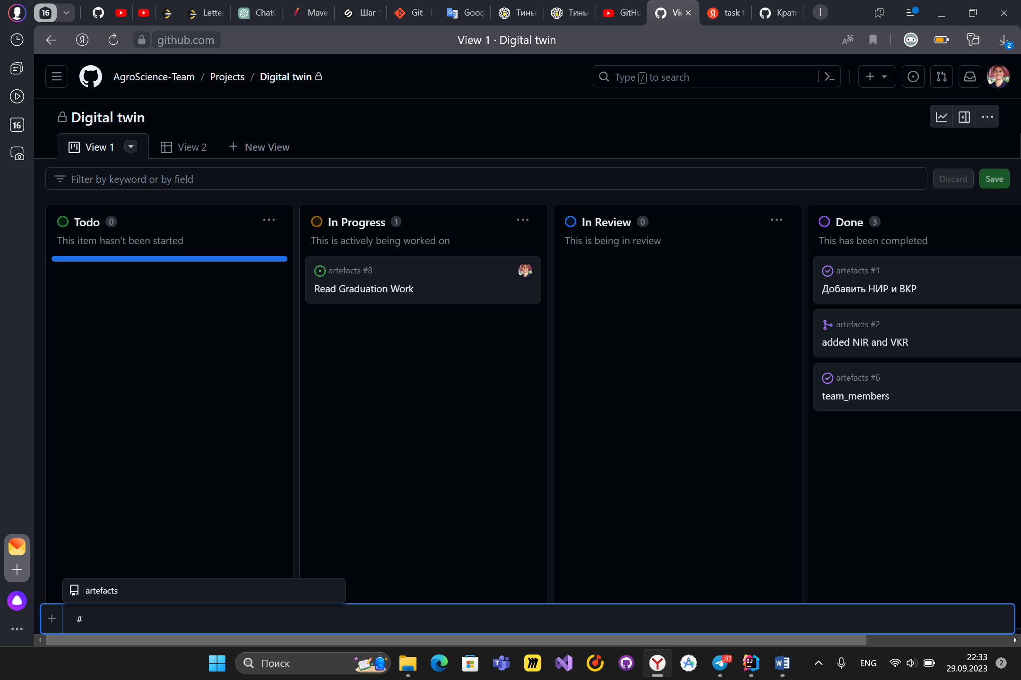
There you can see all tasks of users. here you can see all the tasks of team members. Click on “Add item” on Todo table.
First, write # and select the repository (storage) to which the task will be sent. Tasks that do not require coding (presentations, reading something, etc.) are sent to artefacts repository.

Slide 4
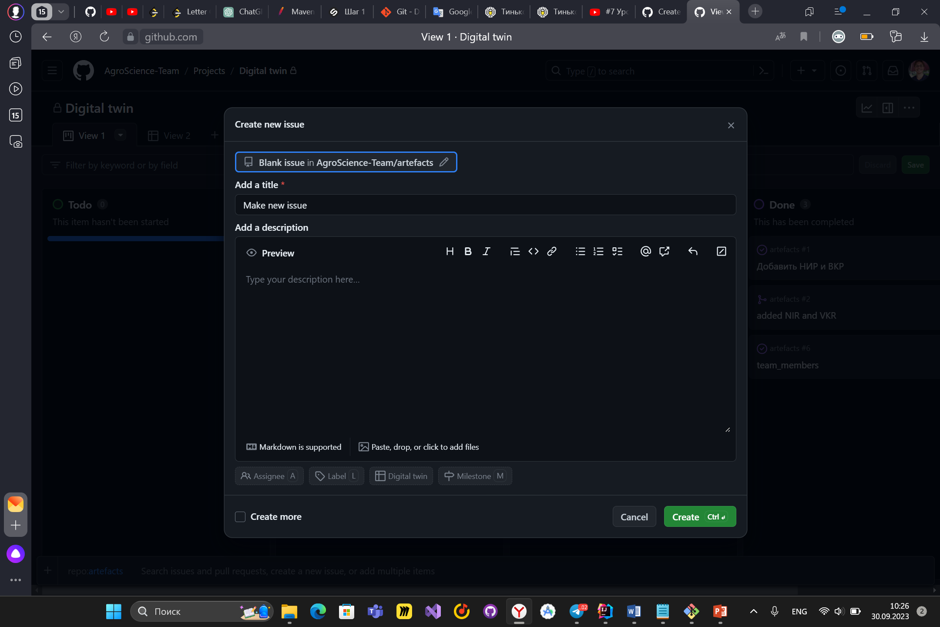
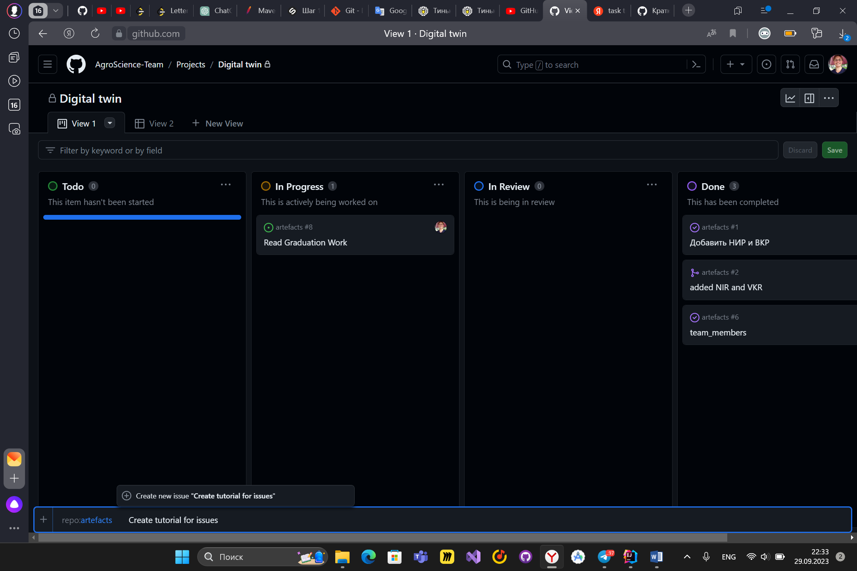
Write title of issue. Click on create new issue
Select label and Assignee in the pop-up window

Slide 5
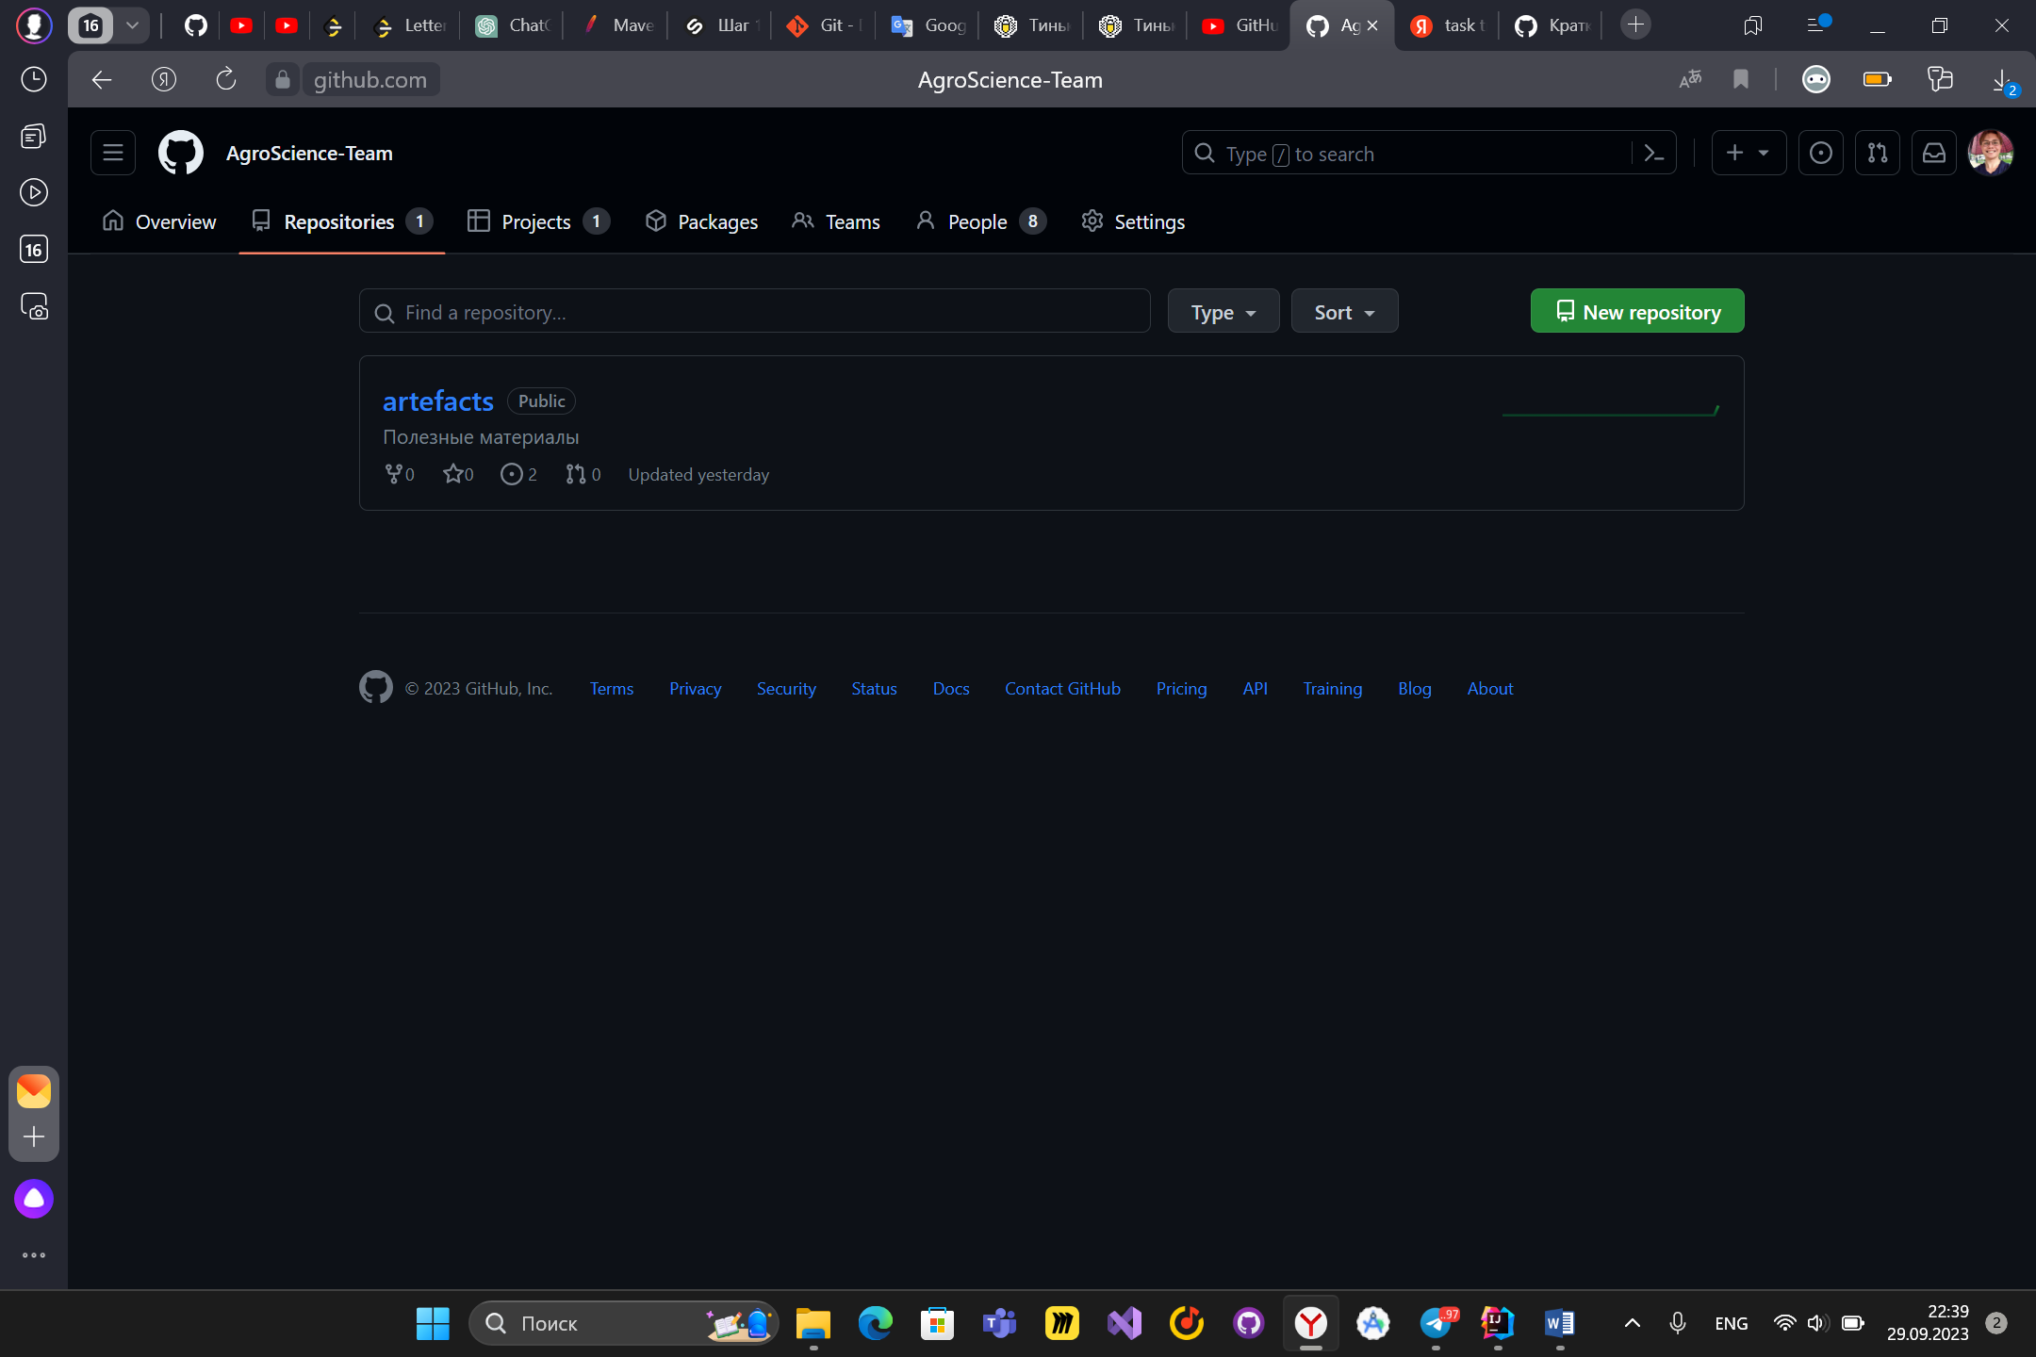
Come back to the first url: https://github.com/AgroScience-Team. Click on repositories and click on repository that you select before for issue.

Slide 6
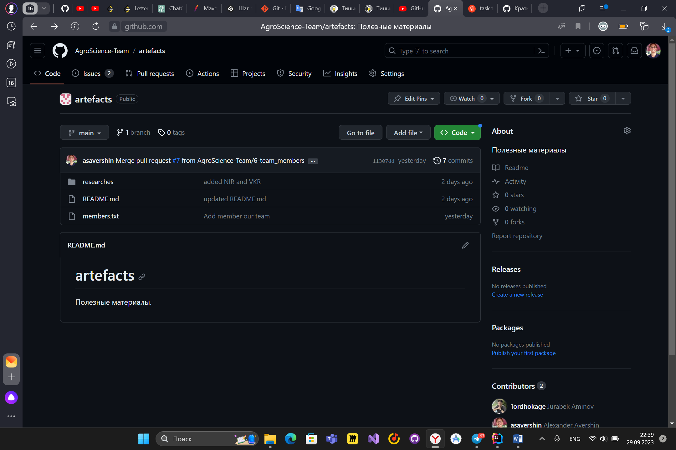
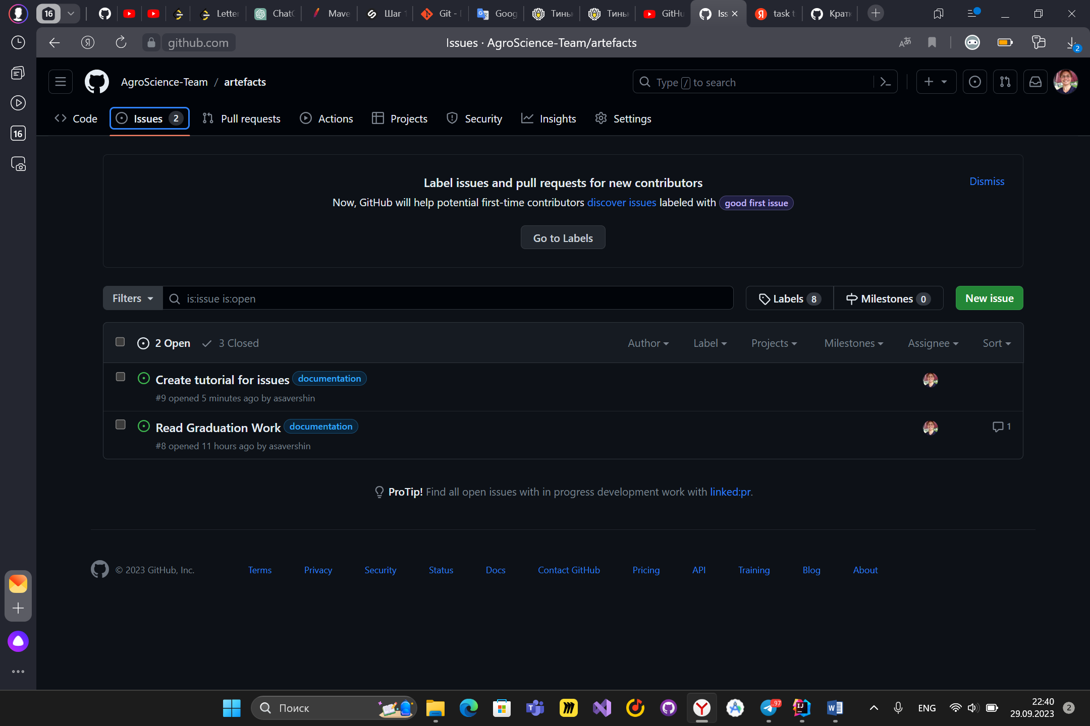
Select issue that you want to do
Click on issues

Slide 7
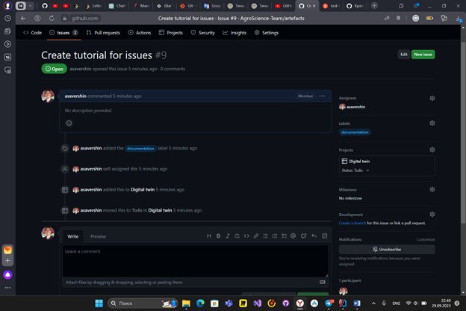
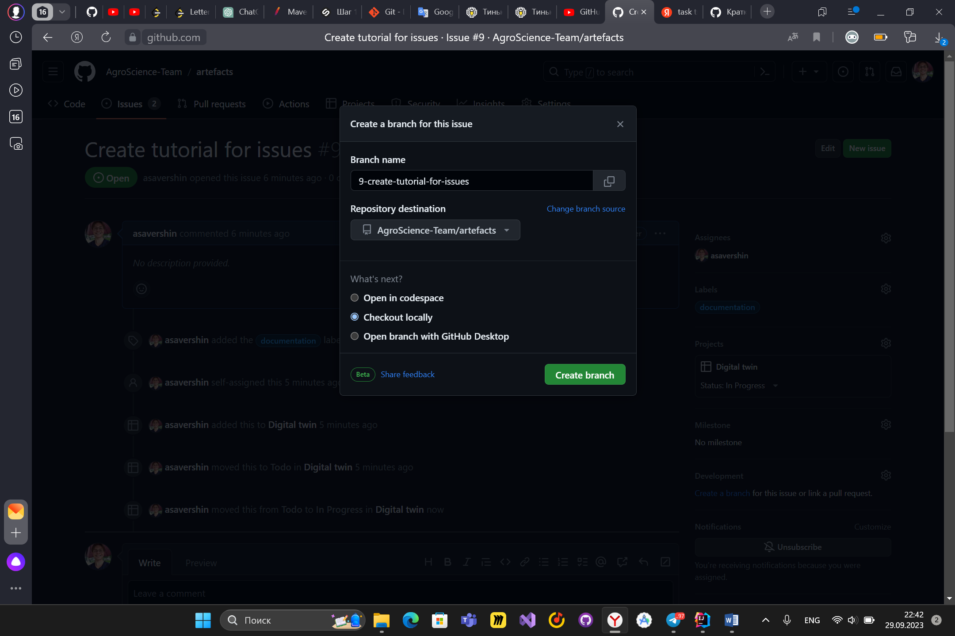
Please, do not change the default name of branch. Click on create branch. After this you must pull this repo and then checkout on this branch(localy of course) and then make pull request. Hou to do this you can see in the internet
On this page you change status of issue. From todo to inProgress for example. If your issue requires adding files or coding so click on create branch.

