Slide 1
CAEs for 3D-VarDA
9 September 2019
MSc Machine Learning
Author: Julian Mack Supervisor: Dr Arcucci

Slide 2
Project Summary
Used an Attention-based Convolutional Autoencoder (CAE)
...to reduce the space of Background Covariance Matrix in 3D Variational Data Assimilation (3D-VarDA).
...extending the work in [Arcucci et al.2019] which used TSVD for the same task.
1
2
3

Slide 3
Project Summary
In comparison with [Arcucci et al.2019] approach:
DA error reduced by 37%. Up to x30 faster
Compressed representation is O(10³) smaller.
1
2
3

Slide 4
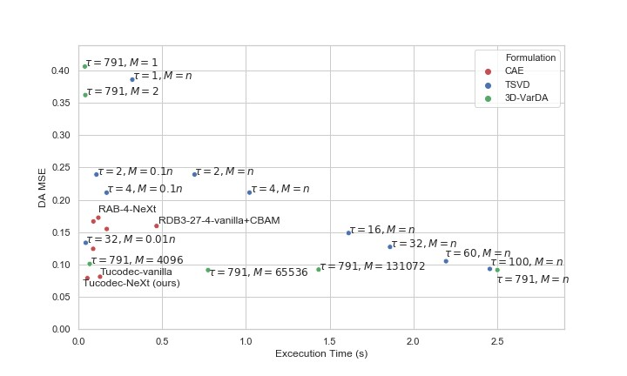
Performance-Time Tradeoff
Figure 1: Performance-speed tradeoff for a range of systems.

Slide 5
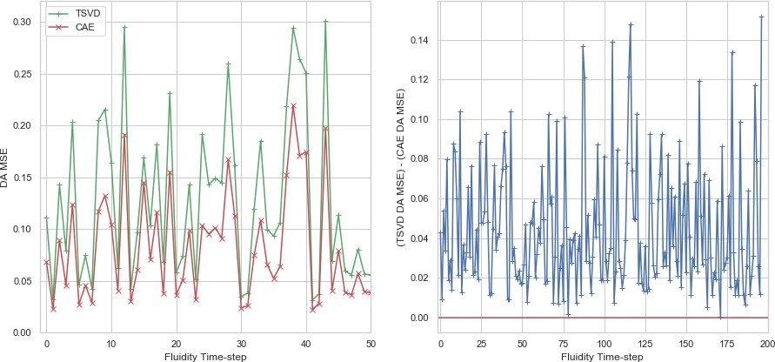
Results are consistently improved
Figure 2: Comparison of TSVD (τ = 32, M = n) and CAE data assimilation performance on sequential test-set time-steps.

Slide 6




Presentation Structure
1
Background: previous work and context
2
Proposed formulation
3
CAE architecture search
4
Experimental Evaluation
5
Future Work
6 Summary

Slide 7




Presentation Structure
1
Background: previous work and context
2
Proposed formulation
3
CAE architecture search
4
Experimental Evaluation
5
Future Work
6 Summary

Slide 8
MAGIC Project
‘Managing Air for Green Inner Cities’, or MAGIC project.
An international collaboration to produce models to monitor and control pollution in urban areas.
One of the project’s aims is to produce: “reduced order models [of inner city fluid flow] that allow rapid calculations for real time analysis and emergency response”.

Slide 9
MAGIC project (continued)
[Arcucci et al.2019] use TSVD in 3D Variational data assimilation to tackle this problem.
...on a MAGIC test-site location in South London
...with synthetic data generated by the open-source finite-element fluid dynamic software Fluidity.
We use the same domain and data
...to enable a clear comparison between the approaches

Slide 10
MAGIC project (continued)
We use the same domain and data
...to enable a clear comparison between the approaches
But the new method is non-intrusive (required no information about the underlying forecasting model) so it is more widely applicable.

Slide 11
3D-VarDA Definitions
x : state of model. Vector in ∈ R^{n}
y : observation space of model. Vector in ∈ R^{M}
x ^{b} : background state. Our prior on the model state before seeing any observations. Vector in ∈ R^{n}
H: Observation operator. H : R^{n} →− R^{M}
R: Observation error covariance matrix in ∈ R^{M×M}
B: Background error covariance matrix in ∈ R^{n×n}
1
2
3
4
5
6

Slide 12
Incremental 3D-VarDA
Consider perturbations δx := x − x ^{b} to background state. Cost function minimisation [Courtier et al.1994]:
δx ^{DA} = arg min J(δx )
δx
(1)
1 1
J(δx ) = δx
T _{B}−1
2
δx + ǁd − Hδx ǁ_{R}−1
2
2
Misfit
d = y − Hx ^{b} is the ‘misfit’ between observations y and prior expectation on observations Hx ^{b}

Slide 13
CVT
1
T _{B}−1
1
2
_{R}−1
J(δx ) = δx
δx + ǁd − Hδx ǁ
2 2
[Parrish and Derber1992] use the following Control Variable Transform(CVT):
δx = V w B = VV ^{T}

Slide 14
CVT
δx = V w B = VV ^{T}
where V is constructed from mean-centred model outputs X ^{b} : which are set aside as “background”:
b b b b n×S
X = [x , x , ..., x ] ∈ R
0 1 S
V = (X ^{b} − x¯^{b} ) ∈ R^{n×S}
S, sample size
S is number of samples used to create background prior.

Slide 15
Reduced Space
V = ∈ R^{n×S}
This introduces a reduced space of dimension S:
w ∈ R^{S}
We are implicitly representing background matrix of size O(n²) with matrix with O(nS ) parameters.

Slide 16
CVT continued
This gives cost function:
w^{DA} = arg min J(w)
w
1 1
(2)
T
2
_{R}−1
J(w) = w w + ǁd − HV wǁ
2 2
After finding w^{DA} by minimisation we can return to the full space with:
V w = δx

Slide 17
Presentation Structure
1
Background: previous work and context
2
Proposed formulation
3
CAE architecture search
4
Experimental Evaluation
5
Future Work
6 Summary

Slide 18
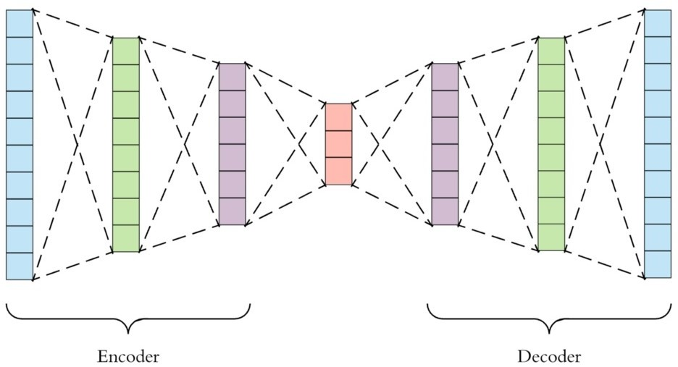
Latent space
We train an encoder f (x ) to create a latent space representation of the inputs.
This is restored to the full space with decoder g (·).
This is a lossy process so
g (f (x )) ƒ= x .
Figure 3: AE framework. An encoder compresses the input (blue) to a smaller latent representation(red).

Slide 19
Latent space V
Σ Σ
b b b
n×S
V = δx , δx , ..., δx ∈ R
0 1
S
We define latent space V_{l} such that:
V_{l} = f (V )
Σ Σ
b b b
m×S
V = f (δx ), f (δx ), ..., f (δx ) ∈ R
l 0
1
S
Size of representation
We are representing B with V_{l} which has O(mS ) parameters.
In our implementation m ∼ 0.001n so this is an O(10³) reduction in comparison with previous approach.

Slide 20
Proposed Formulation
w^{DA} = arg min J(w_{l} )
l
w_{l}
(3)
1
1
2
J(w_{l} ) = w^{T} w_{l} + ǁ
d − V w ǁ
_{R}−1
l l l l
2 2
l
where a subscript l implies the matrix or vector has been replaced by its latent-space equivalent. See report for definitions of d_{l} and R_{l} .

Slide 21
Bi-reduced Space
Note that there are two ‘reduced’ spaces in this case:
1
The reduced space of size S introduced by the CVT. The
‘reduced space’.
The reduced space of size m introduced by the encoder-decoder framework. The ‘latent space’.
2
Hence the ‘Bi-reduced space’ formulation.

Slide 22
Return to full space
w^{DA} can be restored to the full space in a two-stage
l
transformation:
1
Multiplication by V_{l} to move from the reduced space representation to the latent space.
2
Using the decoder g (·) to move from the latent space to the
full space ∈ R^{n}.

Slide 23
Return to full space (continued)
Overall this gives:
δx ^{DA} = g (V_{l} w^{DA})
l

Slide 24
Complexity
The online complexities of the [Parrish and Derber1992] reduced space approach R_{on} is:
2
R_{on} = O(I₁M + nS )
where I₁ is the number of iterations in the reduced space VarDA minimisation routine.
And the bi-reduced space approach B_{on} is:
B_{on} = O(nm) Derivation and discussion in report.

Slide 25
Approaches are [almost] equivalent
i.e. we show that:
_{w}DA _{= w}DA
l
...under three assumptions including that the compression is
lossless g (f (x )) = x .
See report for more details.

Slide 26
Comparison Summary
Reduced Space 3D-VarDA
Bi-reduced Space 3D-VarDA
2
_{R}−1
1 T
1
2
1 T 1
J(w) = w w + ǁ
d − V wǁ −1
J(w) = w w + ǁd − HV wǁ
2 2
l l
R_{l}
2 2
Return: δx ^{DA} = V w^{DA}
Return: δx ^{DA} = g (V_{l} w^{DA})
R_{on} = O(I₁M² + nS )
B_{on} = O(nm)

Slide 27
Theory: TSVD vs CAE
A good CAE should produce higher quality compression of V
since:
1
Redundancies in the training data distribution can be stored ‘for free’ by the decoder.
CAEs take location data into account – can use properties like local smoothness to compress more efficiently.
CAEs use non-linear combinations of the inputs – likely to be of greater expressive quality than those in SVD.
In Truncated SVD, some of the information is intentionally discarded. This is not true in the CAE framework.
2
3
4

Slide 28
Presentation Structure
1
Background: previous work and context
2
Proposed formulation
3
CAE architecture search
4
Experimental Evaluation
5
Future Work
6 Summary

Slide 29
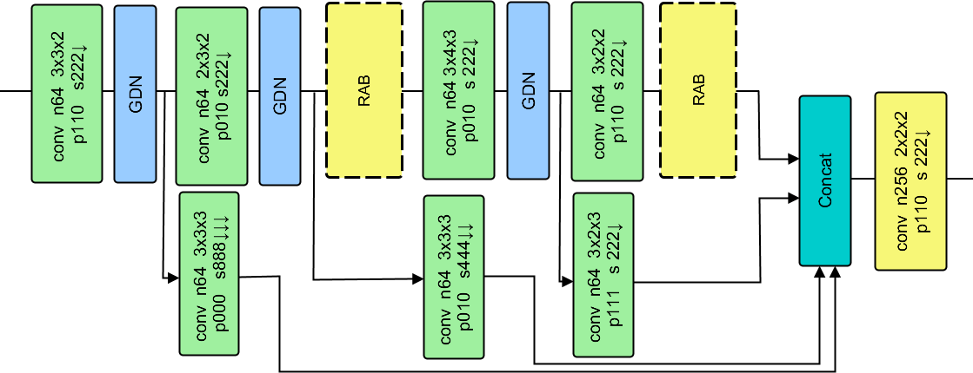
CAE Design
We only see benefits of proposed approach with a high-quality CAE.
We defined CAE specification and argue that the Image Compression literature is most relevant parallel use-case.
Figure 4: The Tucodec encoder of [Zhou et al.2019].

Slide 30
CLIC
CLIC: ‘Challenges on Learned Image Compression’. A workshop to find SOTA in lossy image compression (runs annually as part of CVPR).
CLIC-2019 was in June so we had an up-to-date comparison of available approaches.
I reviewed ∼ 65+ ML papers using CLIC as a starting point.
I implemented and evaluated every top-5 CLIC-2018 and CLIC-2019 entry
...as well as number of related architectures.

Slide 31
Implementation challenge
The MAGIC problem domain is 3D but CLIC focuses on 2D image compression.
It was non-trivial to extend many architectures to three spatial input dimensions as default channel and kernel sizes gave unreasonably large feature maps or had very high computational cost.
To mitigate this, we made a number of alterations to architectures including replacing all large convolutional kernels with 3x3 convolutions.

Slide 32
CAE Building Blocks
Most CLIC architectures had some of the following components: Parallel convolutional filters.
GDN activation functions. Multi-scale learning.
Attention.
Complex residual blocks: e.g. CBAMs or RABs.

Slide 33
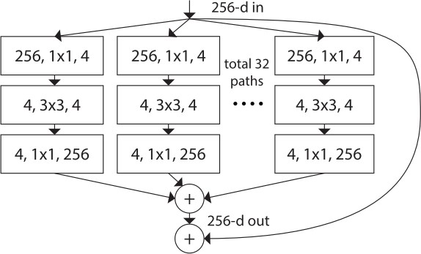
Parallel Convolutional Filters
Filter concatenation
3x3 convolutions
5x5 convolutions
1x1 convolutions
1x1 convolutions
1x1 convolutions
1x1 convolutions
3x3 max pooling
Previous layer
Figure 5: The Inception module [Szegedy et al.2015]. Three convolutional and one pooling operation are performed in parallel.
Figure 6: ResNeXt residual block in which the ‘cardinality’, or width can be increased to boost the capacity of the network
[Xie et al.2017].

Slide 34
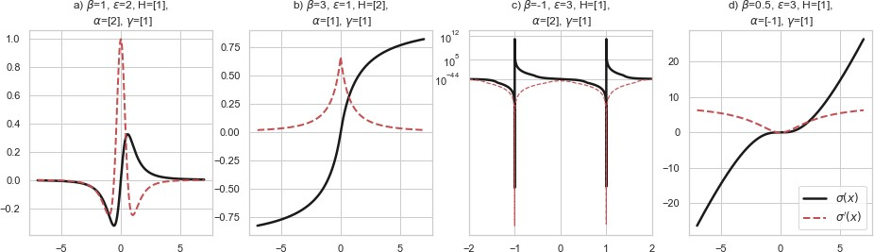
GDNs
Generalised Divisive Normalisation transformations or GDNs [Ball´e et al.2015] normalise and Gaussianize the inputs on the assumption that they are drawn from a very general probability distribution. See report for definition.
Figure 7: A range of GDN transforms.

Slide 35
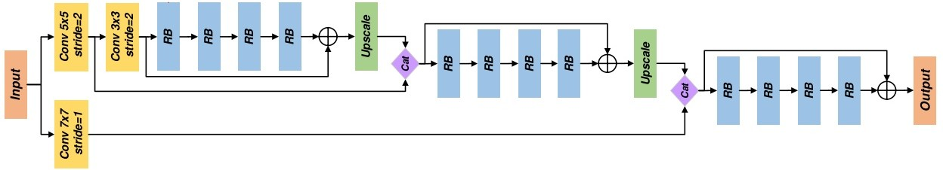
Multi-scale Learning
Figure 8: The decoder of Lu et al.’s fourth place entry to CLIC 2019 [Lu et al.2019] in which features are available at multiple resolutions simultaneous. ‘RB’ stands for residual block.

Slide 36
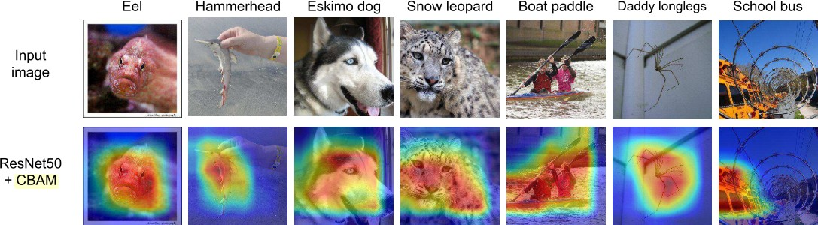
Attention
Figure 9: The effect of attention for classification on ImageNet using the Grad-CAM method for visualisation [Selvaraju et al.2017]¹. Image adapted from the CBAM paper [Woo et al.].

Slide 37
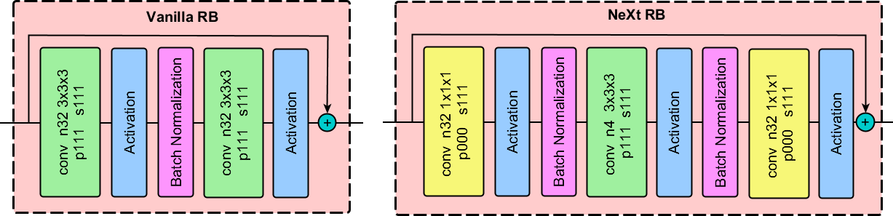
Residual Blocks
Figure 10: The two basic RBs we evaluated.
NeXt RBs use 1x1 convolutions to bottleneck the inputs
...and therefore have fewer parameters. In the example above:
NeXt: 2k params vanilla: 60k params.

Slide 38
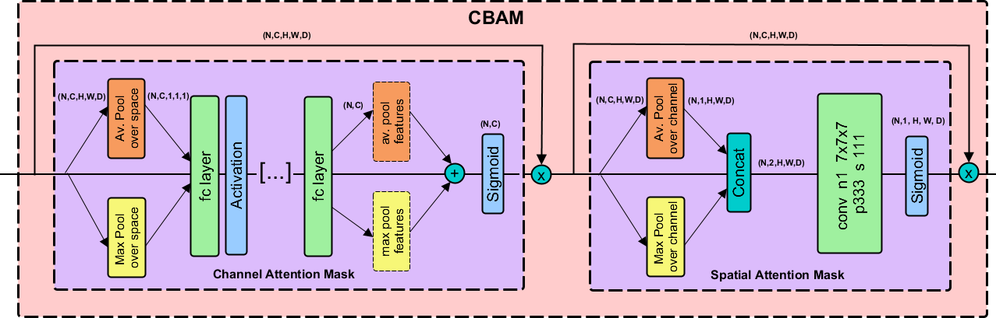
CBAMs
Figure 11: Convolutional Block Attention Modules, or CBAMs, [Woo et al.] are residual blocks that add channel-wise and spatial attention sequentially.

Slide 39
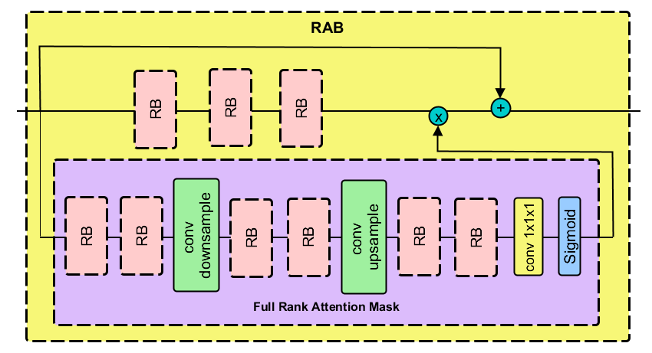
RABs
Figure 12: Residual Attention Blocks proposed by [Zhang et al.2019] and utilised by [Zhou et al.2019].

Slide 40
Architecture Search
We investigated our pool of CLIC models with two [main] changes:
1
Activation Functions (x3):
GDNs
PReLUs ReLUs
Residual Blocks (x4):
Vanilla RBs NeXt RBs Vanilla + CBAM NeXt + CBAM
2

Slide 41
Architecture Summary
Model
DA MSE
Execution Time (s)
Number of Parameters
Backbone
ResNeXt3-27-1-vanilla+CBAM RDB3-27-4-vanilla+CBAM RAB-4-NeXt
GRDN-NeXt+CBAM
0.1665
0.1548
0.1594
0.1723
0.1241
0.0897
0.1693
0.4666
0.1192
0.0983
0.3M
3.5M
25.6M
1.3M
4.7M
2.5M
10.6M
Tucodec-NeXt
0.0787
0.0537
Tucodec-vanilla 0.0809 0.1294
Table 1: A comparison of the DA MSE and inference speeds of a selection of our best models.

Slide 42
Tucodec Model
Figure 13: The Tucodec encoder of [Zhou et al.2019]. The decoder did not have the multi-scale path but was otherwise symmetric.

Slide 43
Presentation Structure
1
Background: previous work and context
2
Proposed formulation
3
CAE architecture search
4
Experimental Evaluation
5
Future Work
6 Summary

Slide 44
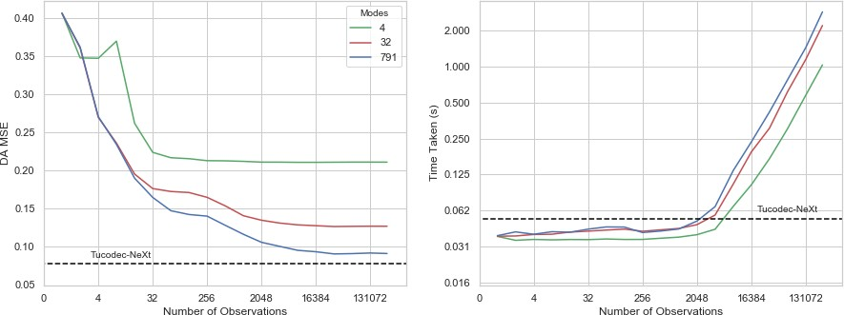
Effect of M
Figure 14: Effect of number of observations M on a) DA MSE and b) execution time. Tucodec values are marked with dashed black lines.

Slide 45
Comparison with [Arcucci et al.2019]
Model
DA MSE Excecution Time (s)
Ref MSE | 1.0001 | -
TSVD, τ = 32, M = n | 0.1270 | 1.8597
TSVD, τ = 32, M = 0.1n | 0.1270 | 0.2627
TSVD, τ = 32, M = 0.01n | 0.1334 | 0.0443
TSVD, τ = 32, M = 0.001n | 0.1680 | 0.0390
Tucodec-NeXt | 0.0787 | 0.0537
Table 2: Comparison of our best Tucodec model with the
[Arcucci et al.2019] approach which sets σ_{τ} = √σ₁ = 32. Our DA MSE is 37% lower than the best performing Arcucci et al. system.

Slide 46
Comparison with [Parrish and Derber1992]
Model
DA MSE Excecution Time (s)
Ref MSE | 1.0001 | -
TSVD, τ = 791, M = n | 0.09132 | 2.5009
TSVD, τ = 791, M = 0.1n | 0.0923 | 0.3182
TSVD, τ = 791, M = 0.01n | 0.1046 | 0.0481
TSVD, τ = 791, M = 0.001n | 0.1403 | 0.0410
Tucodec-NeXt | 0.0787 | 0.0537
Table 3: Comparison of our best Tucodec model with the
[Parrish and Derber1992] approach in which there is no truncation of V . Our DA MSE is 14% lower than the best performing system.

Slide 47
Performance-Speed Tradeoff
Figure 15: Performance-speed tradeoff for a range of systems.

Slide 48
Acceleration Methods
The quoted figures likely underestimate the relative speed of the proposed approach.
This is because the proposed method can be accelerated:
1
With hardware (V100, Graphcore IPU, FPGA implementation).
With algorithmic acceleration methods such as:
Quantization
Pruning (i.e. structured or unstructured sparsity) Thinner Decoder (suggested in [Theis et al.2017]) Factorised Convolutions [Wang et al.2018]
Pixel Shuffle [Shi et al.2016]
2

Slide 49
Importance of Architecture
The results here demonstrate the central importance of using state-of-the-art CAE architectures.
This field is moving exceptionally fast: our Backbone network, was state-of-the-art for image compression in 2017
[Theis et al.2017] but gives a DA MSE that is:
1
Double that of the Tucodec models.
2
∼ 30% worse than [Arcucci et al.2019]’s approach with τ = 32
and M = 0.01.

Slide 50
Presentation Structure
1
Background: previous work and context
2
Proposed formulation
3
CAE architecture search
4
Experimental Evaluation
5
Future Work
6 Summary

Slide 51
Future Work: DA
Apply to approach to: 4D-VarDA.
Other data-sets.
Investigate:
Integrating with a ROM that learns underlying physics.
Integrating with data assimilation Localization techniques [Montmerle et al.2018].
Alternative minimisation routines (used L-BFGS here).

Slide 52
Future Work: ML
Investigate other AE variants including: VAEs
GAN-CAEs
Or investigate acceleration techniques discussed previously: Quantization
Pruning (i.e. structured or unstructured sparsity) Thinner Decoder (suggested in [Theis et al.2017]) Factorised Convolutions [Wang et al.2018]
Pixel Shuffle [Shi et al.2016]

Slide 53
Presentation Structure
1
Background: previous work and context
2
Proposed formulation
3
CAE architecture search
4
Experimental Evaluation
5
Future Work
6 Summary

Slide 54
Contribution Summary 1/3
Proposed a new ‘Bi-reduced space’ 3D-VarDA formulation that is [approximately] equivalent to
[Parrish and Derber1992]’s approach.
New formulation has lower complexity than
[Parrish and Derber1992] or [Arcucci et al.2019] and does not penalise dense sensor networks (i.e large M).
We evaluate the success of our approach experimentally – it has lower DA MSE in all cases and is faster except for when M is small.

Slide 55
Contribution Summary 2/3
Implemented and evaluated a range of SOTA CAEs
We find that [Zhou et al.2019]’s ‘Tucodec’ attention-based model performs best.
We perform an extensive architecture search and find that we can reduce Tucodec decoder inference latency by almost x2.5 by replacing vanilla RBs [He et al.2016] with ‘NeXt’ RBs
[Xie et al.2017].
To our knowledge, we are the first to extend the image compression network of [Zhou et al.2019] and image restoration GRDN of [Kim et al.2019] to three-dimensions.

Slide 56
Contribution Summary 3/3
We release a well tested open-source Python module
VarDACAE²that enables users to:
Easily replicate our experiments,
Use our model implementations, and
Train CAEs for any variational data assimilation problem.
²The repository can be found at
https://github.com/julianmack/Data_Assimilation.

Slide 57
Any Questions?
Figure 16: Comparison of TSVD (τ = 32, M = n) and CAE data assimilation performance on sequential test-set time-steps.

Slide 58
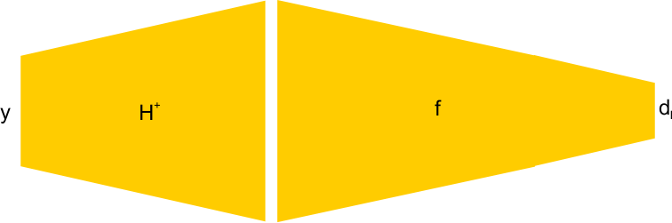
Observation encoder
If there is time – observation encoder f º :
Figure 17: Scheme to create the f º operator. It should be possible to add the H⁺ convolutional network and fine-tune the weights of f to create f º .

Slide 59
References
Arcucci, R., Mottet, L., Pain, C., and Guo, Y. K. (2019). Optimal reduced space for Variational Data Assimilation.
Journal of Computational Physics, 379:51–69.
Ball´e, J., Laparra, V., and Simoncelli, E. P. (2015).
Density Modeling of Images using a Generalized Normalization Transformation. pages 1–14.
Courtier, P., Th´epaut, J.-N., and Hollingsworth, A. (1994).
A strategy for operational implementation of 4D-Var, using an incremental approach.
Quarterly Journal of the Royal Meteorological Society, 120(519):1367–1387.
He, K., Zhang, X., Ren, S., and Sun, J. (2016).
Deep residual learning for image recognition.
Proceedings of the IEEE Computer Society Conference on Computer Vision and Pattern Recognition, 2016-Decem:770–778.
Kim, D.-W., Chung, J. R., and Jung, S.-W. (2019).
GRDN:Grouped Residual Dense Network for Real Image Denoising and GAN-based Real-world Noise Modeling.
Lu, M., Chen, T., Liu, H., and Ma, Z. (2019).
Learned Image Restoration for VVC Intra Coding. pages 2–5.
Montmerle, T., Michel, Y., Arbogast, E´., M´en´etrier, B., and Brousseau, P. (2018).
A 3D ensemble variational data assimilation scheme for the limited-area AROME model: Formulation and preliminary results.
Quarterly Journal of the Royal Meteorological Society, 144(716):2196–2215.
Parrish, D. and Derber, J. (1992).

Slide 60
The National Meteorological Center’s Spectral Statistical-Interpolation Analysis System.pdf.
Selvaraju, R. R., Cogswell, M., Das, A., Vedantam, R., Parikh, D., and Batra, D. (2017).
Grad-CAM: Visual Explanations from Deep Networks via Gradient-Based Localization.
Proceedings of the IEEE International Conference on Computer Vision, 2017-Octob:618–626.
Shi, W., Caballero, J., Huszar, F., Totz, J., Aitken, A. P., Bishop, R., Rueckert, D., and Wang, Z. (2016).
Real-Time Single Image and Video Super-Resolution Using an Efficient Sub-Pixel Convolutional Neural Network.
Proceedings of the IEEE Computer Society Conference on Computer Vision and Pattern Recognition,
2016-Decem:1874–1883.
Szegedy, C., Liu, W., Jia, Y., Sermanet, P., Reed, S., Anguelov, D., Erhan, D., Vanhoucke, V., and Rabinovich, A. (2015).
Going deeper with convolutions.
Proceedings of the IEEE Computer Society Conference on Computer Vision and Pattern Recognition, 07-12-June:1–9.
Theis, L., Shi, W., Cunningham, A., and Husz´ar, F. (2017).
Lossy Image Compression with Compressive Autoencoders. pages 1–19.
Wang, M., Liu, B., and Foroosh, H. (2018). Factorized Convolutional Neural Networks.
Proceedings - 2017 IEEE International Conference on Computer Vision Workshops, ICCVW 2017, 2018-Janua:545–553.
Woo, S., Park, J., Lee, J.-y., and Kweon, I. S. CBAM: Convolutional Block Attention Module.
Xie, S., Girshick, R., Doll´ar, P., Tu, Z., and He, K. (2017).
Aggregated residual transformations for deep neural networks.
Proceedings - 30th IEEE Conference on Computer Vision and Pattern Recognition, CVPR 2017, 2017-Janua:5987–5995.

Slide 61
Zhang, Y., Li, K., Li, K., Zhong, B., and Fu, Y. (2019).
Residual Non-local Attention Networks for Image Restoration. pages 1–18.
Zhou, L., Sun, Z., Wu, X., and Wu, J. (2019).
End-to-end Optimized Image Compression with Attention Mechanism.

