Slide 1




Campaign Summary
Online ad campaigns quick overview for last 16-week period :
Ad Spend : $450,680
Gross Profit:
$602,809
Net Profit :
$152,129
Weekly Budget :
$31,300
ROI (Avg.):
1.34
Recommendations :
Reddit: Ramp Up Campaign
Highest ROI & conversion rate amongst all channels
Repurpose budget saved in remaining 3 to scale up reddit campaign
Projected 456% increase in ROI from increased budget spend
Google: Continue Campaign
Limit Ad Spend to 9.15k/week
Optimum Net Profit achieved between Ad Spend of 9.1k- 9.4k, any further increase doesn’t amount to any increase in profit.
Facebook: Continue Campaign
Limit Ad Spend to 9.5k/week and prioritize ad spend budget towards weekends.
General trend ROI is higher on weekends vs weekdays with an overall increase across the last 5 weeks
LinkedIn: Stop Campaign
Almost 3x the Ad spend vs Reddit, but translates to < 1/7th of the Net Profit
Least ROI with consistently decreasing ROI MoM
Assumptions : 1) User base across each platform is not considered
2) Product/Products being sold is unknown, therefore it is assumed that different products are sold across different channels because Net Profit per sale varies significantly, channel to channel

Slide 2
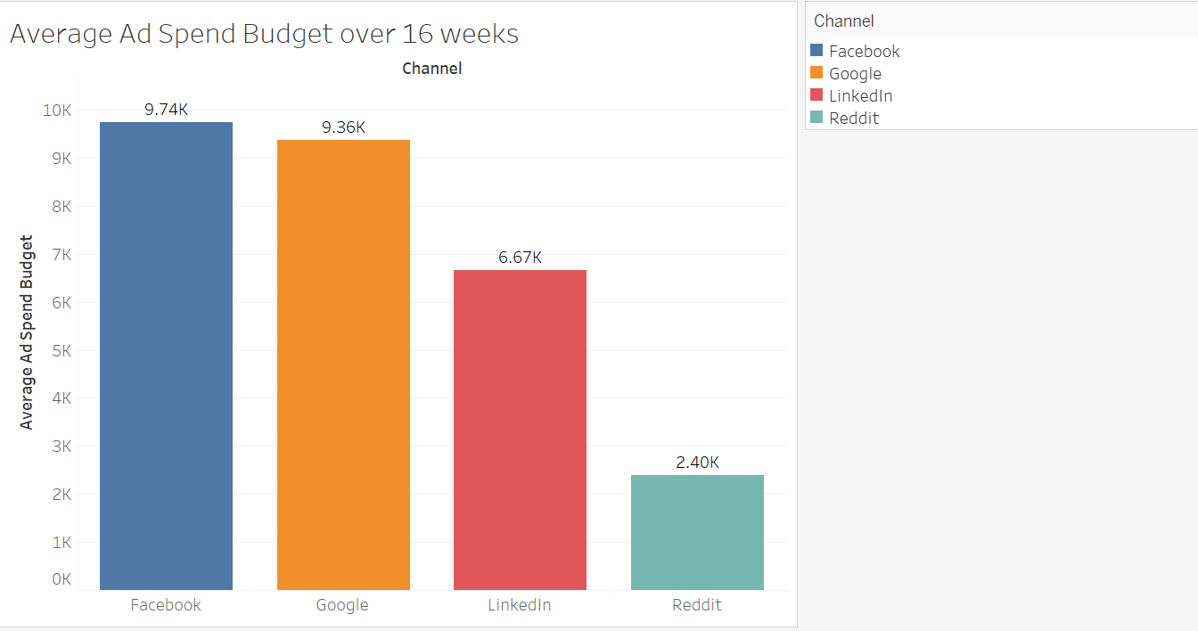
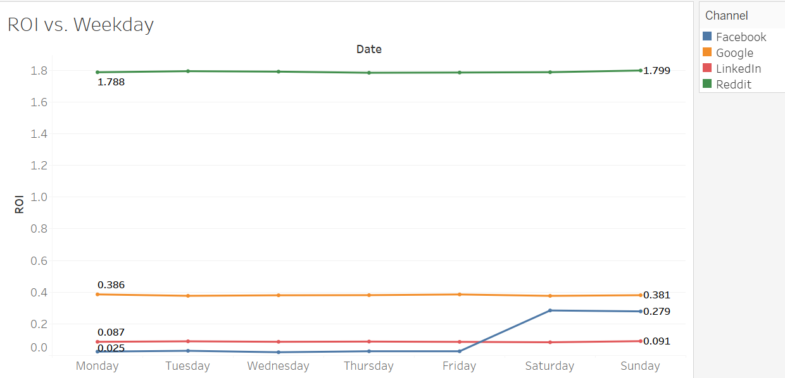
Appendix - 1
Average Ad Spend budget across 16 weeks
ROI vs Weekdays
Reddit displays significantly higher ROI in comparison to other platforms. Optimize Reddit Campaign to reap better results . With current trends, A Suggested ad budget of ~ $12 K will lead to a net profit ~ $22K ,resulting in 456% increase in ROI .
Facebook generated a higher ROI towards weekends in comparison to weekdays.

Slide 3
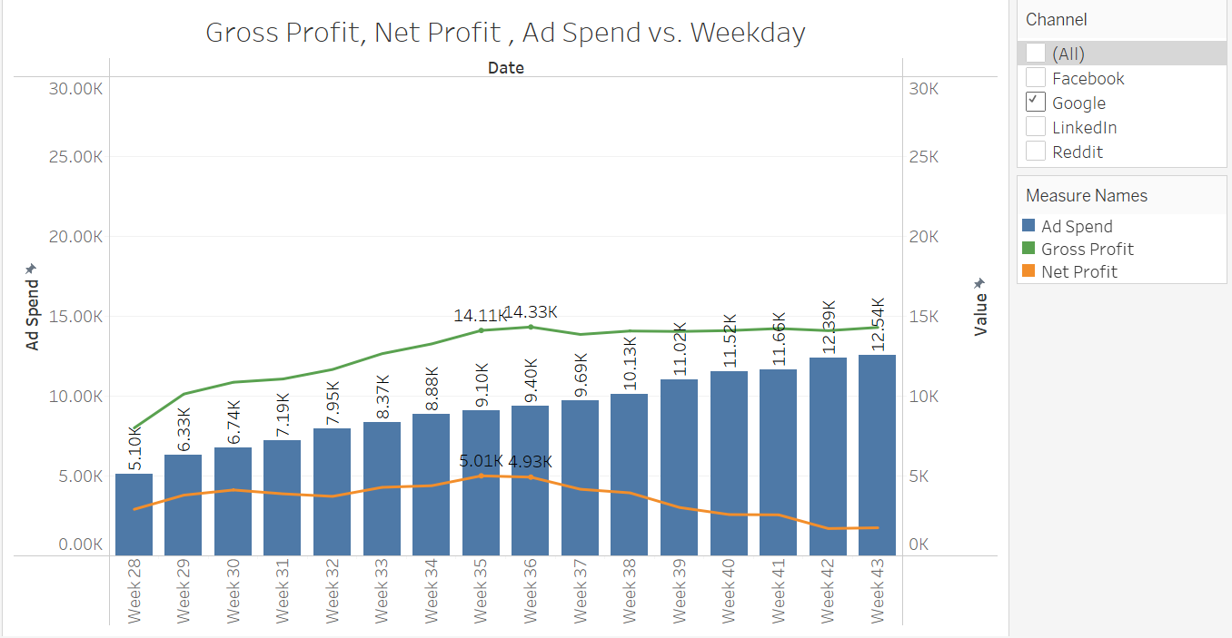
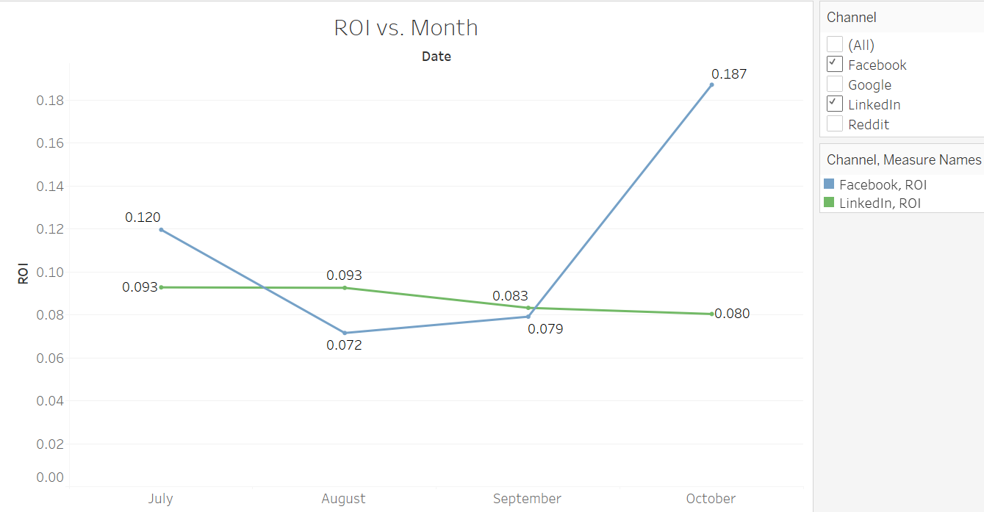
Appendix - 2
Google:
Limit Ad Spend Budget to 9.15k per week to obtain an optimum net profit between 4.9K to 5.0K . Any further increase in Ad Spend results in a significant decrease in net profit.
ROI vs Month
Stop LinkedIn Campaign due to decreasing ROI every month.
General increase in ROI observed over last 5 weeks for Facebook due to improved click rates.

