Slide 1
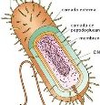
Sizes of a few particles
clay
7000 nm, 7 μm
bacteria
1000 nm, 1 μm
Nanoparticle of coagulant
90 nm, 0.09 μm
Dissolved organic matter
50 nm, 0.05 μm

