Slide 1
High Flow Chemical Dose Controller
Ellie Beaudry, Wenduo Nie and Jillian Foley
December 18th, 2019

Slide 2
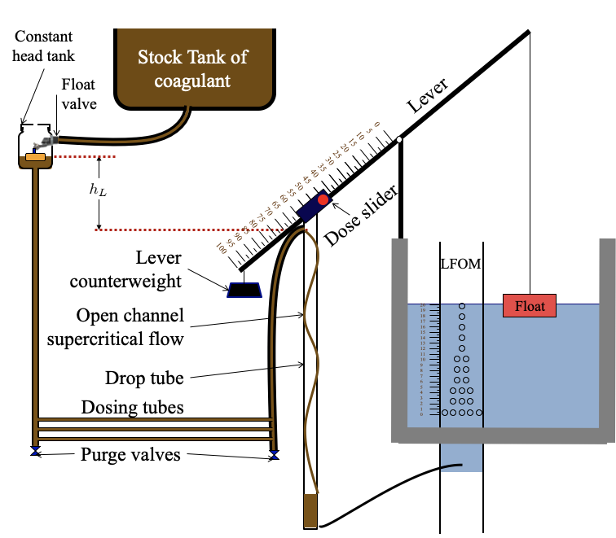
Project Goal
and Context
Goal Flow Rate = 430 L/s
At a flow rate of 430 L/s, would need 41 dosing tubes
10 in diameter would need over 15m of tubing
Larger diameter would have turbulent flows
Notes:
From the report:
The flow rate decreases with the larger pipe but the reynolds number is even higher: definitely turbulent

Slide 3
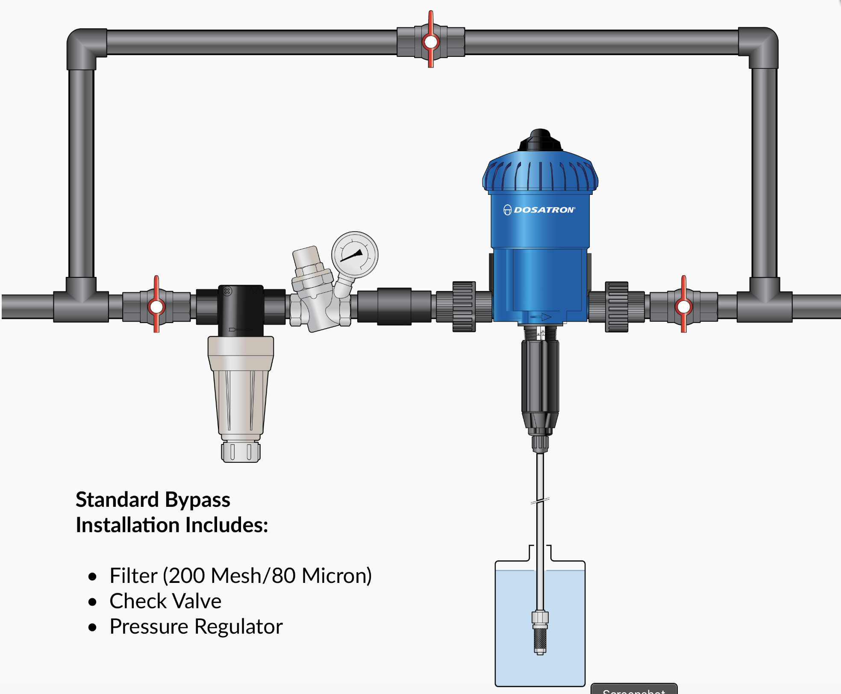
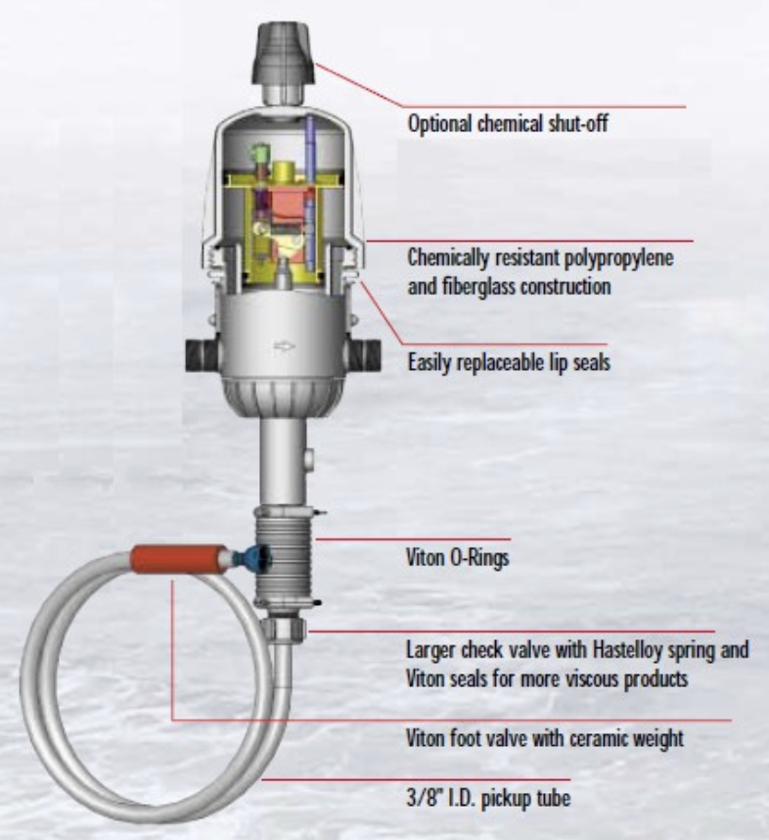
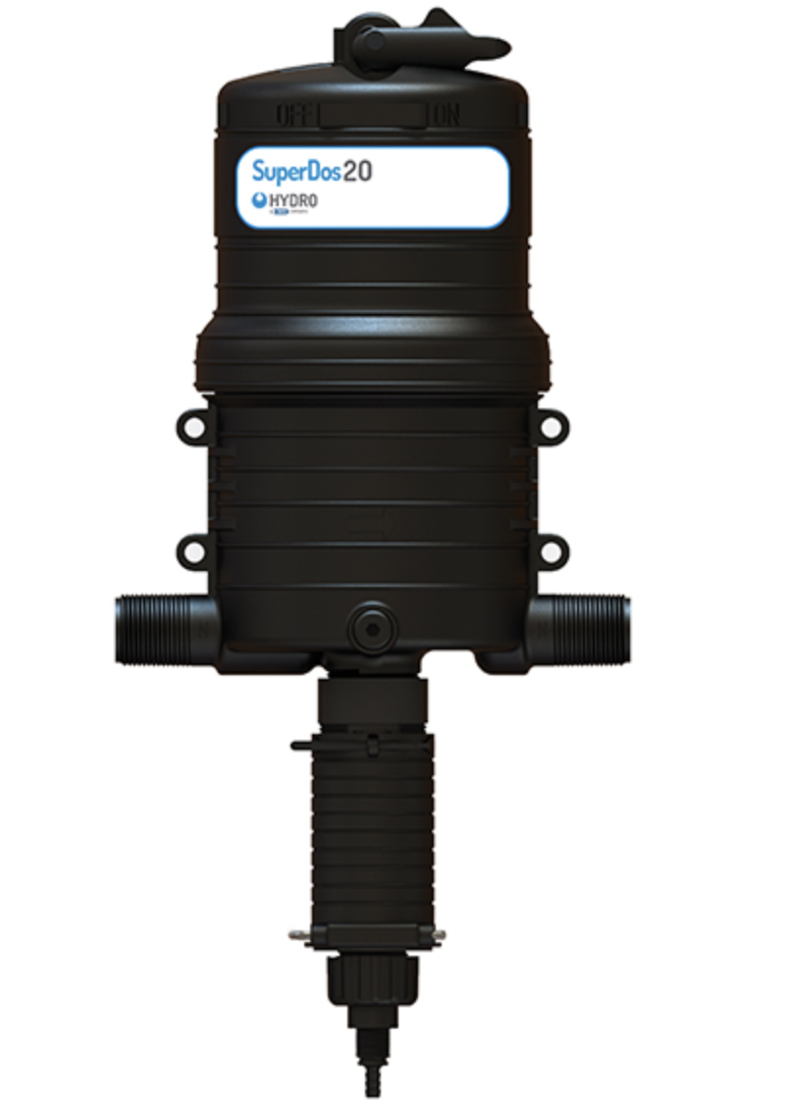
Commercially Available Substitutes
https://www.dosatronusa.com/d25re09
https://hydrosystemseurope.com/product/superdos/
System | Dilution Range | Water Flow Range (LPS) | Dimensions (cm) | Weight (kg) | Operating Pressure (kPa) | Pressure Loss (kPa) | Max Temp (deg C)
Dosatron | 0.3-0.125% | 0.138-0.252 | 67 x 21.6 | 5.44 | 15-800 | 40-140 | 40
MixRite | 3-10% | 0.0055-0.69 | 55.6 x 16 | 1.25 | 20-827 | 100 | 50
Gator XL | 0.75, 1, 1.5, 2% | 0.002-0.6 | 61 x 25 | 2.82 | 21-827 | 103
Superdos45 | 0.4-5% | 0.016-2.8 | -- | -- | 40-550 | -- | 38
Notes:
1.9kPa currently in AguaClara plants
https://www.adtec.gr/products/en/water-powered-chemical-dosing-pump/water-powered-dosing-pump-dilution-p-2064.html

Slide 4
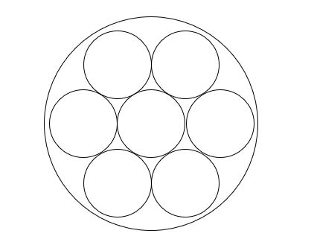
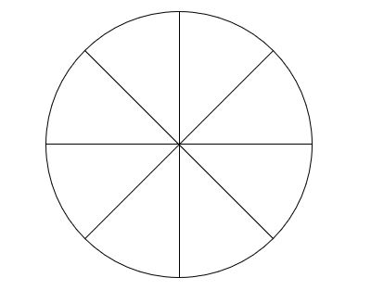
New Geometry for Dosing Tubes
Plan A
Plan B

Slide 5
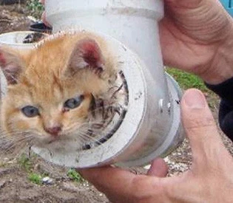


Head loss Constraints
The desired head loss is 20 cm.
With equation:
We calculate the flow rate within each small tube. We assumed the value of coefficient of minor loss to be 2.
After obtaining the flow rate within each small tube, we can calculate the fluid velocity within each small tube based on the known diameter and area.
https://www.bostonherald.com/2009/06/08/firefighters-rescue-kitten-stuck-in-pipe/
https://wadeawalker.wordpress.com/2013/02/07/fluid-dynamics-super-awesome-or-super-awesomer/

Slide 6
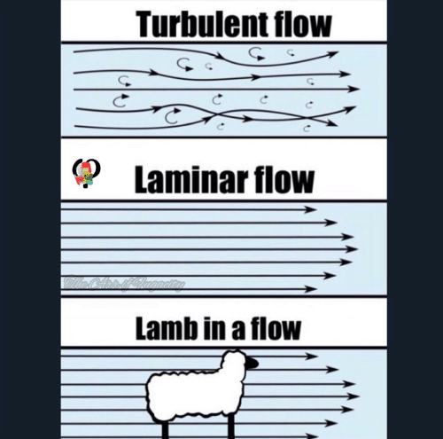
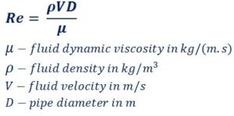
Flow Rate Constraints
We want to have laminar flow, so the calculated Reynolds number can not exceed 2100.
Reynolds number equation:
If the calculated Re is bigger than 2100, we will need to lower the velocity. With adjusted velocity, we can calculate the adjusted flow rate. We then need to calculate required length based on flow rate.
https://awwmemes.com/t/fluid-mechanics?s=new

Slide 7
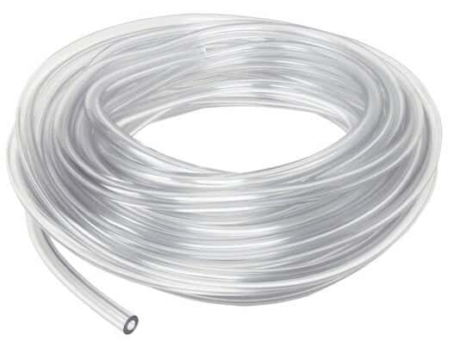
Constraints of small pipes
Plan No.1
Inner diameter of small pipe: ⅛’’
Headloss: 20 cm. Meets requirement.
Re: 1082. Meets requirement (<2100)
Minimum required length: 0.97 m. Meets requirement (<1.5 m)
Plan No.2
Inner diameter of small pipe: ¼’’
Headloss: 20 cm. Meets requirement.
Re: 2163. Doesn’t meet requirement (<2100). Need to adjust Velocity.
Minimum required length: 4 m. Doesn’t meet requirement (<1.5 m)
https://www.coleparmer.com/i/cole-parmer-pvc-tubing-1-8-x-1-4-50-ft-pk/9660501?PubID=UX&persist=true&ip=no&gclid=EAIaIQobChMI2pv7lO355QIVEz0MCh3HKQBzEAkYAiABEgJaz_D_BwE
Notes:
1.5 m is the flocculater length

Slide 8
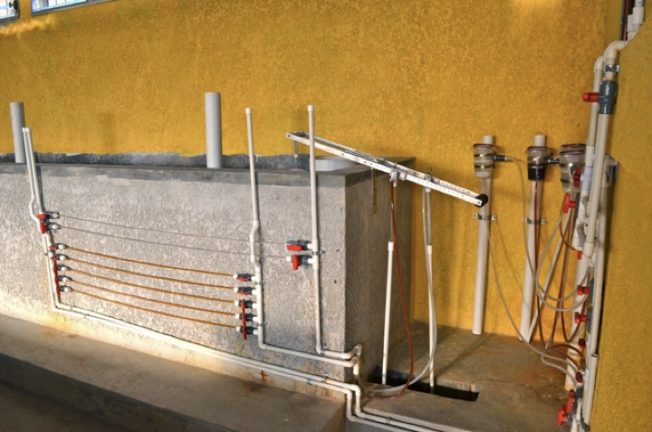
Constraints of big pipes
At least 3 big pipes. One can be taken off for cleaning while the other two still running.
Outer diameter of the big pipe cannot be bigger than that of the side tubes that come out of the tank.
Increase the number of big pipes when the flow rate of the plant increases.
No more than 15 big pipes in total.
The selected inner diameter of the big pipe based on manufactured pipes is 0.792 inches.
Notes:
Estimated max plant flow rate is 2000 L/s

Slide 9
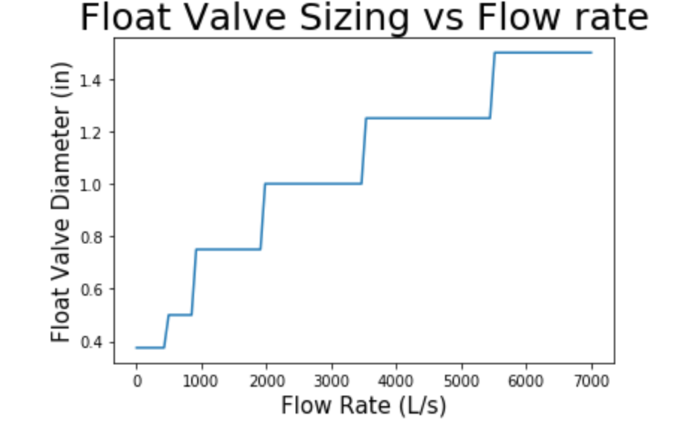

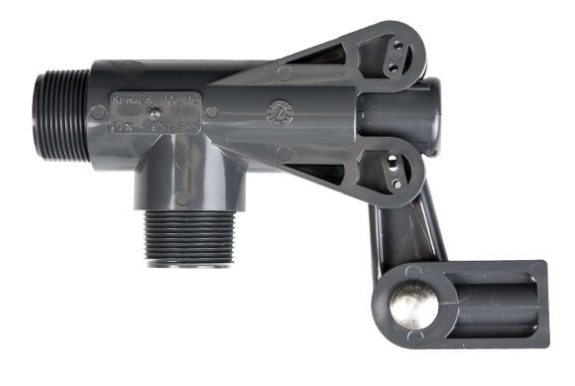
Float Valve Considerations
Constraint: produce the max dosage at a minimum head loss of 30 cm
Orifice Equation:
http://www.cdivalve.com/products/detail/kerick-125-standard-mount-float-valve

Slide 10
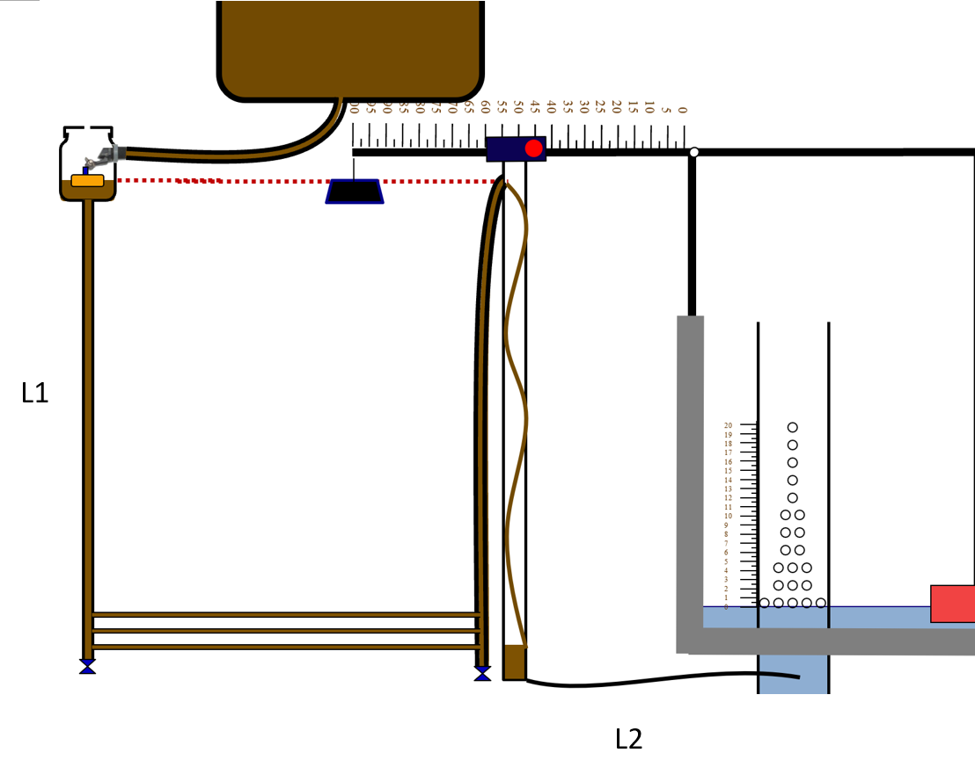
Auxiliary Piping
Constraint: Head loss through all additional tubing is less than 5% of head loss through dosing tubes
Design Considerations:
Total length: 4 m
Minor loss coefficient: 3.5

Slide 11
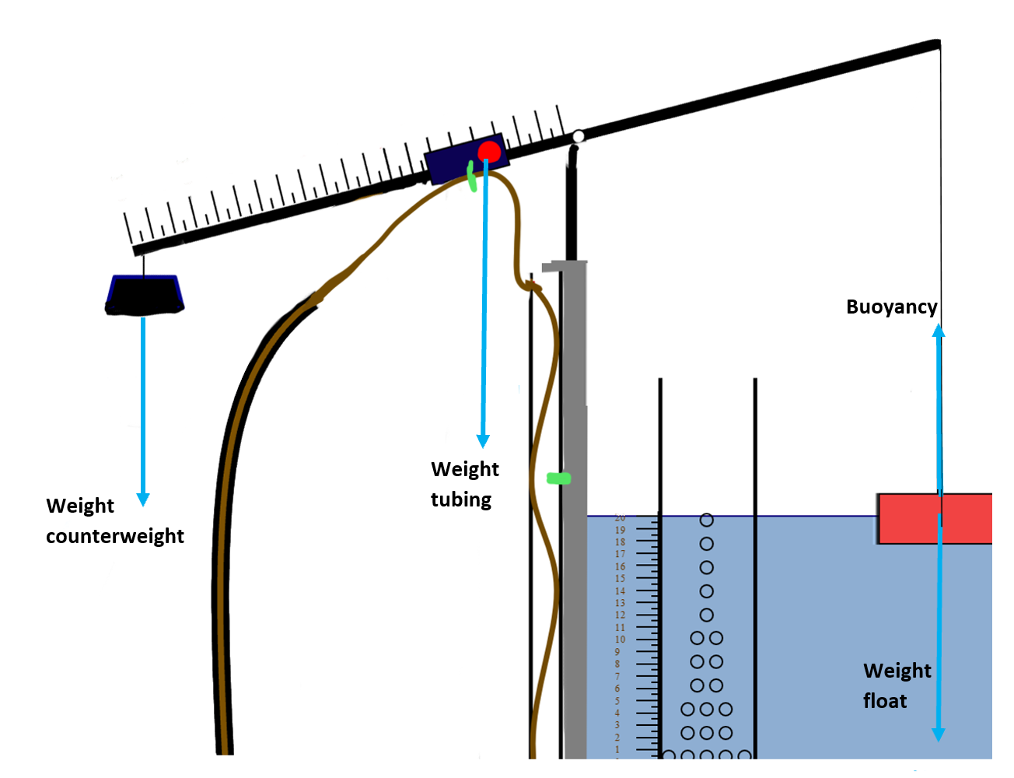

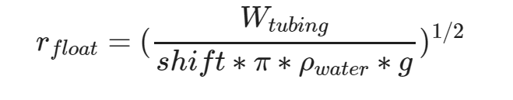
Float Sizing
Constraint: float only shifts 1 cm up or down when dosing meter changes from max to min dosage, float size must fit in entrance tank.

Slide 12
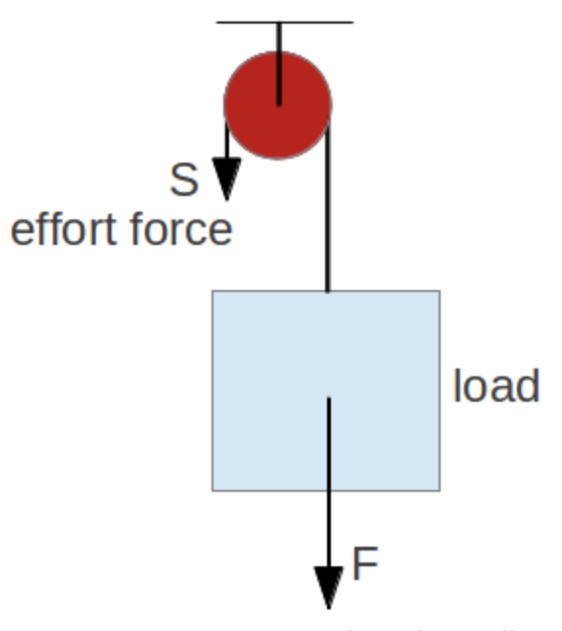
Recommendations
We proposed new code to be added to the CDC class code to check for a Reynold’s number constraint -> GitHub issue 33
Using several smaller diameter tubes inside a bigger tube is the most cost effective and practical solution for larger flow plants.
More consideration needs to go into reducing the float size either with a pulley system or a different counterweight.
All connections must be chlorine resistant.
https://www.engineeringtoolbox.com/pulleys-d_1297.html
Notes:
All of the chlorine resistant valves that we found had o-rings with EPDM rubber that is only moderately resistant which is not ideal
Have to think about alternative float options

Slide 13
References
AguaClara Textbook https://aguaclara.github.io/Textbook/index.html
Adtec-Zerowaste. (n.d.). Retrieved from https://www.adtec.gr/products/en/water-powered-chemical-dosing-pump/water-powered-dosing-pump-dilution-p-2064.html.
Cole-Parmer PVC Tubing, 1/8" x 1/4", 50 Ft/Pk. (n.d.). Retrieved from https://www.coleparmer.com/i/cole-parmer-pvc-tubing-1-8-x-1-4-50-ft-pk/9660501?PubID=UX&persist=true&ip=no&gclid=EAIaIQobChMI2pv7lO355QIVEz0MCh3HKQBzEAkYAiABEgJaz_D_BwE.
Comprehensive Guide on Polyvinyl Chloride (PVC). (n.d.). Retrieved from https://omnexus.specialchem.com/selection-guide/polyvinyl-chloride-pvc-plastic.
D25RE09. (n.d.). Retrieved from https://www.dosatronusa.com/d25re09/.
Gator-XL - Water Powered Chemical Feed Pump Injector - Specifications. (n.d.). Retrieved from http://www.gatorxl.com/Specifications.html.
Minor or Dynamic Loss Coefficients for Pipe or Tube System Components. (n.d.). Retrieved from https://www.engineeringtoolbox.com/minor-loss-coefficients-pipes-d_626.html.
Reticulated Foam Sheets - 12. (n.d.). Retrieved from https://cleverbrand.com/products/reticulated-foam-sheets-12-wide-x-4-ft-long?gclid=EAIaIQobChMI05fH-Mj55QIVgZ6zCh0mSQWMEAAYASAAEgI_rPD_BwE.
SuperDos: Proportional Fertilizer Injector: Hydro Sytems Europe. (n.d.). Retrieved from https://hydrosystemseurope.com/product/superdos/.
The AYLESBURY™ Float Valve Range. (n.d.). Retrieved from https://cms.esi.info/Media/documents/Kera_valves_ML.pdf.

