Slide 1
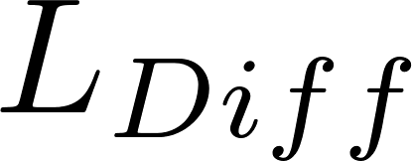
Diffusion length scale
Fluid velocity
Clay
Coagulant nanoparticle

