Slide 1
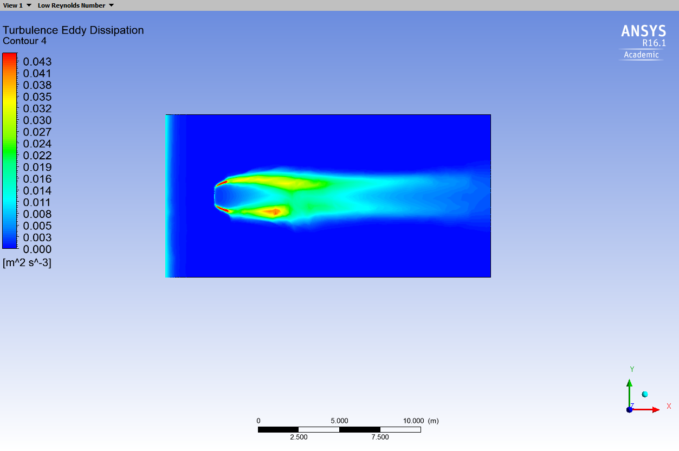
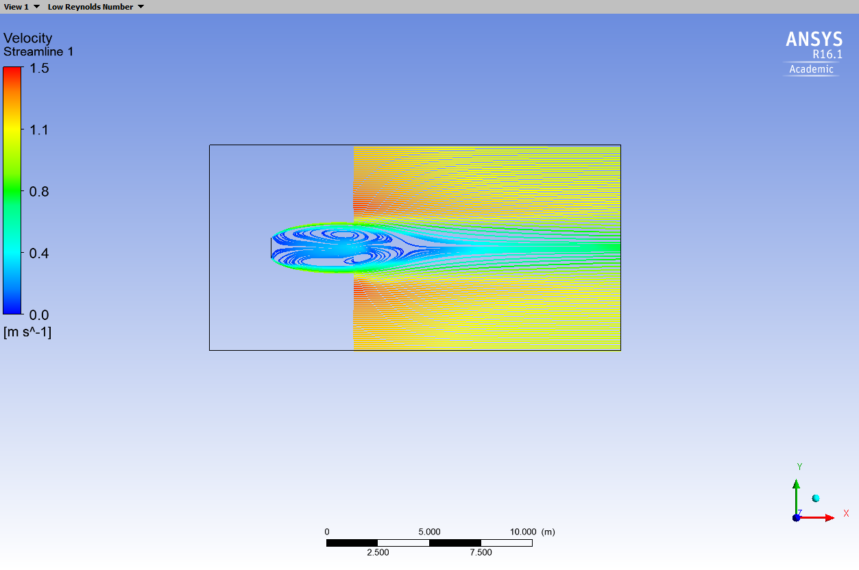
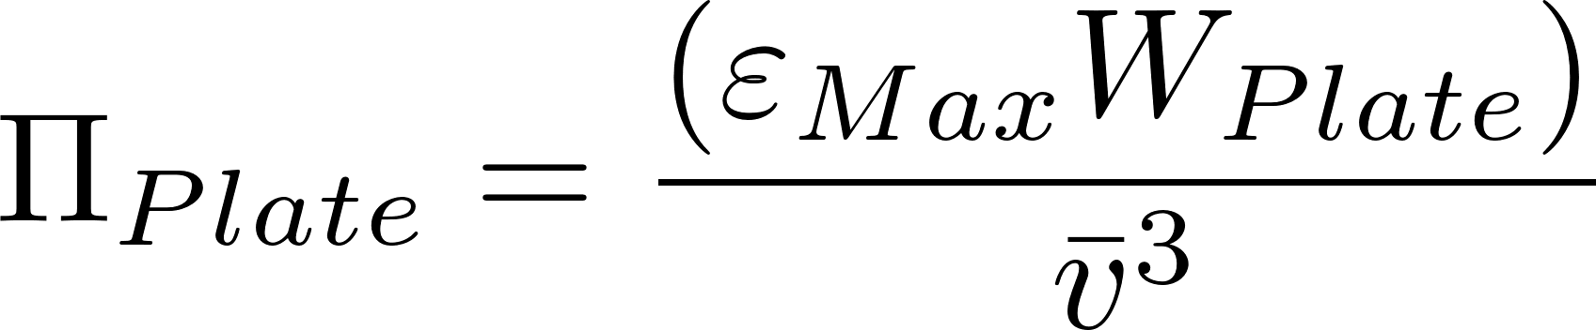

Flat Plate CFD
Flat plate normal to the flow
1 m wide
Flow was 2-D
V=1 m/s
Re = 100,000
$ε_{Max}$ = 0.04 W/kg
$Π_{Plate}$ = 0.04
Energy dissipation rate
Streamlines
Ariane Walker-Horn <avw27@cornell.edu> 2015
Notes:
Ariane Walker-Horn <avw27@cornell.edu> 2015

