Slide 1


Slide 2
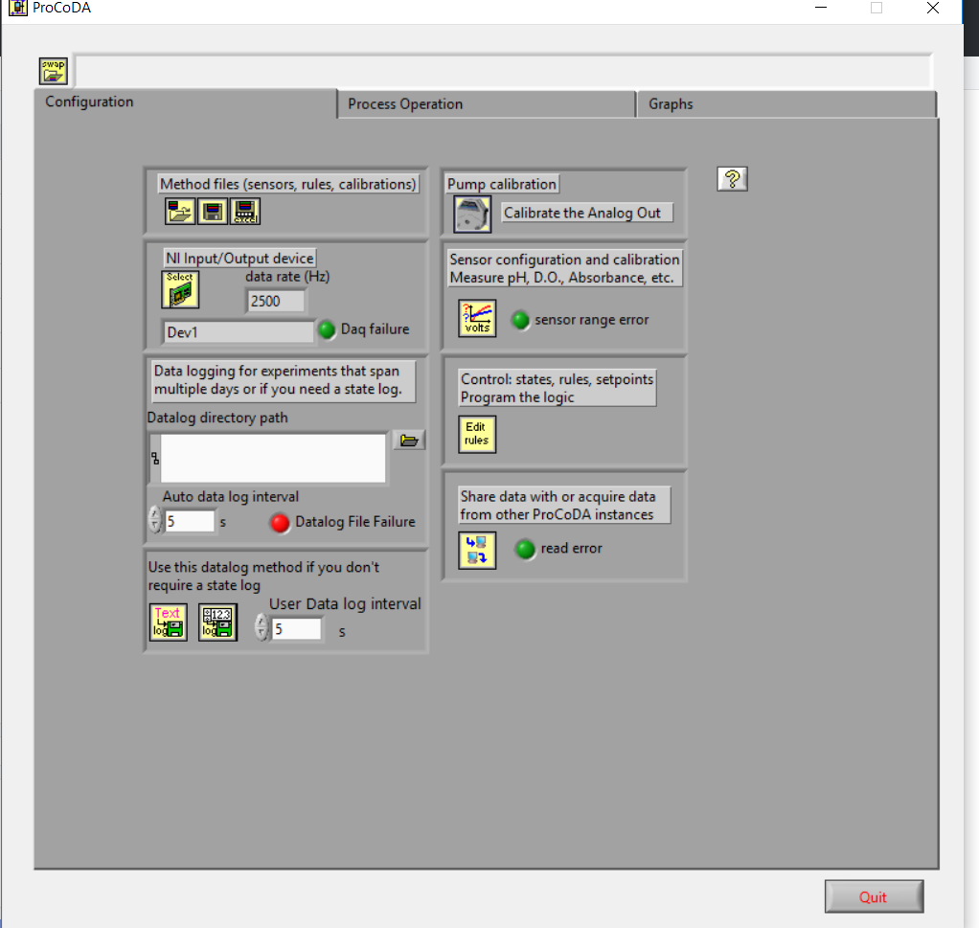

Slide 3


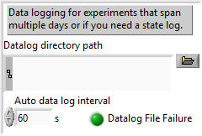






Config tab

Slide 4











sensors

Slide 5
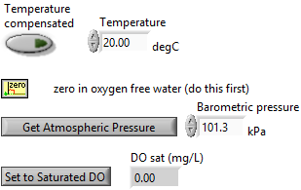

Dissolved Oxygen

Slide 6
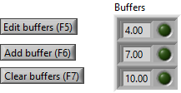



pH

Slide 7


photometer

