Slide 1
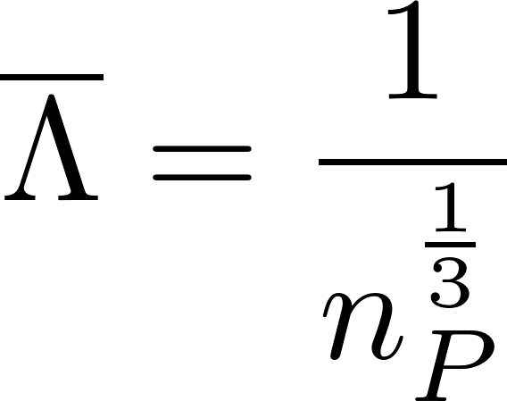
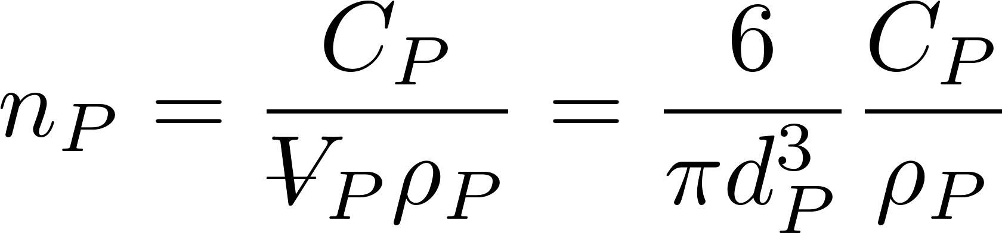
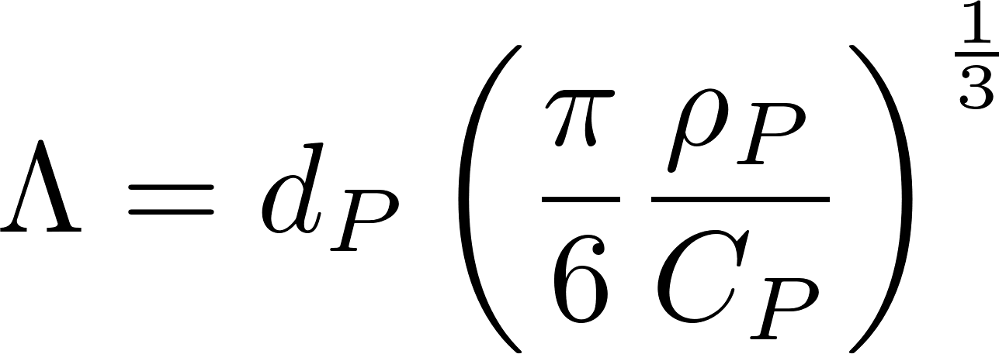
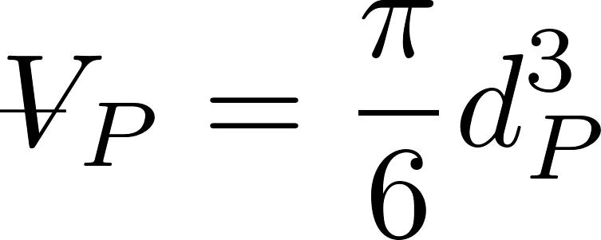
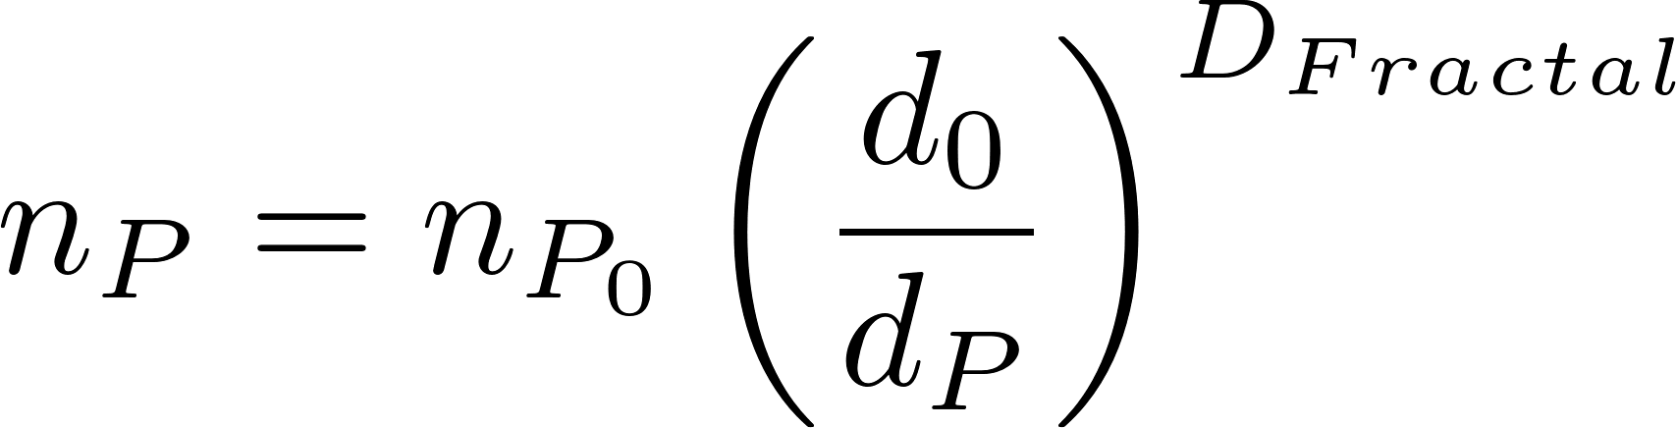
Average distance between particles is the cube root of the volume occupied (Λ)
extra
The average volume of water “occupied” by a particle!
Need to know number of particles per volume (n_{P})
The number of flocs decreases as the flocs grow in size

