Slide 1
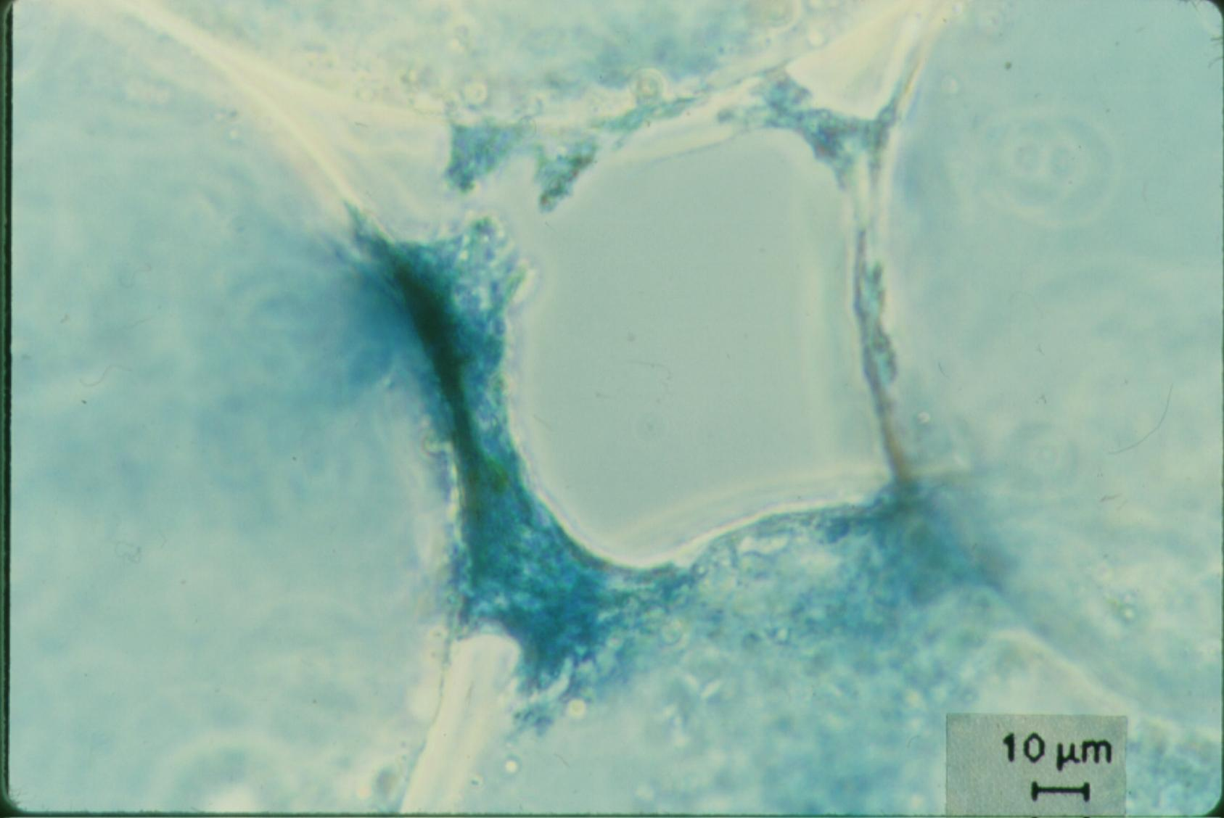
Interception occurs where streamlines converge
No removal by interception in straight tube
Particles are deposited at the constriction
The biggest part of the filter pore remains empty!
Big particles can’t attach to partially filled restrictions

